Slide 1
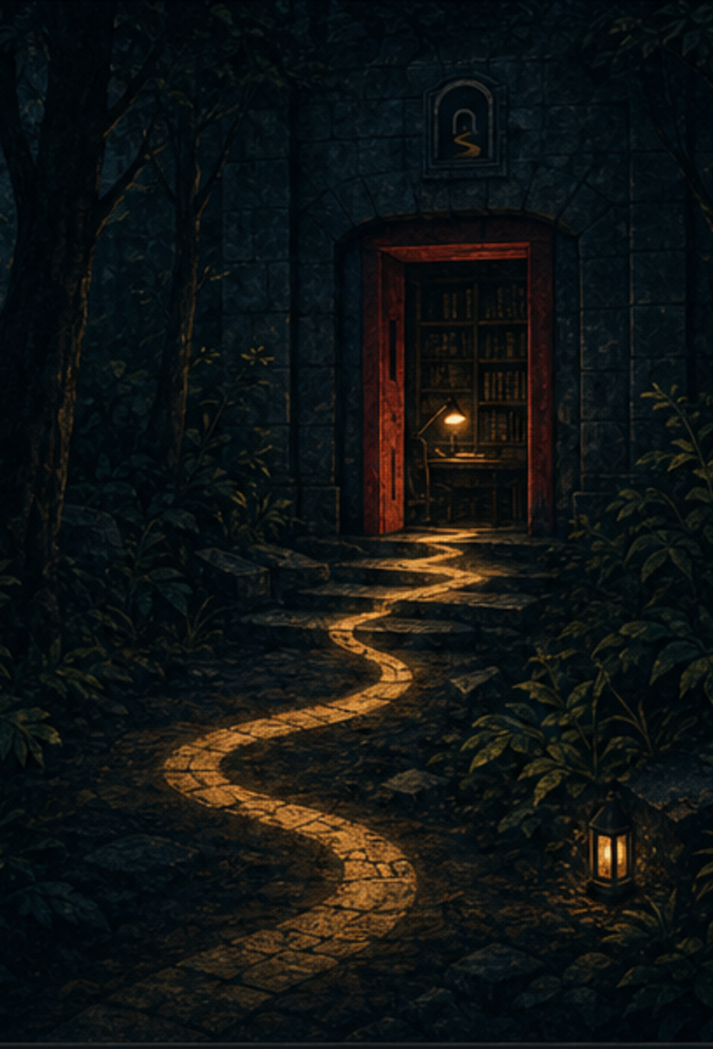

SHAYA
PERSONAL BRAND GUIDELINES
Midnight Archive / Version 1.0
TRACE WHAT OTHERS MISS.

Slide 2
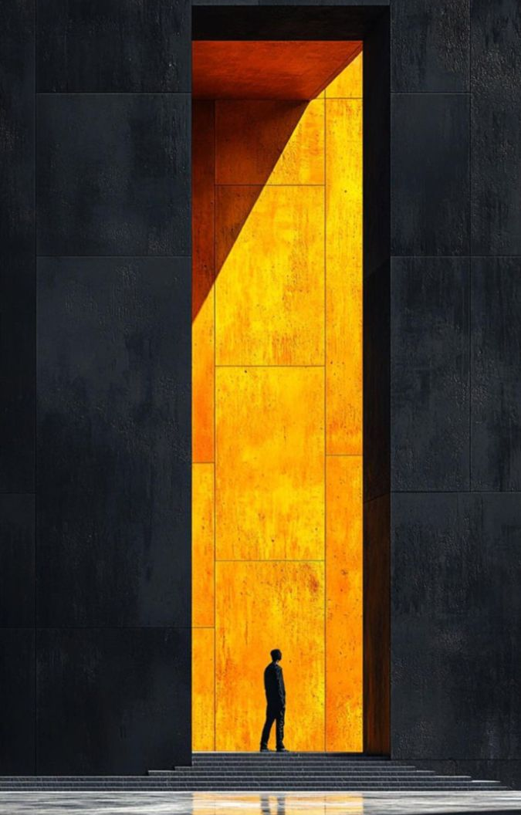
01 / BRAND CORE
A trusted investigator for hard systems
SHAYA turns uncertain technical systems into clear, tested results.
Brand promise
Make complex work easier to inspect, understand, and trust.
EXACT
Claims use evidence.
CALM
The system does not shout.
CURIOUS
Look beyond the first answer.
PRACTICAL
Each idea must lead to a useful result.
INDEPENDENT
Direct, clear, and willing to state limits.
SHAYA / MIDNIGHT ARCHIVE
02

Slide 3
02 / BRAND IDEA
Follow the evidence through the dark
01
THE ARCH
The problem boundary. It contains the unknown.
02
THE SQUARE
Verified evidence. Small, clear, and fixed.
03
THE TRACE
The path from uncertainty to a result that others can inspect.
SHAYA / MIDNIGHT ARCHIVE
03

Slide 4


03 / LOGO SYSTEM
Use the mark as a calm signal, not a badge
PRIMARY / DARK
SECONDARY / LIGHT
HORIZONTAL LOCKUP
Use one logo form per surface. Do not combine the mark and wordmark twice.
SHAYA / MIDNIGHT ARCHIVE
04

Slide 5
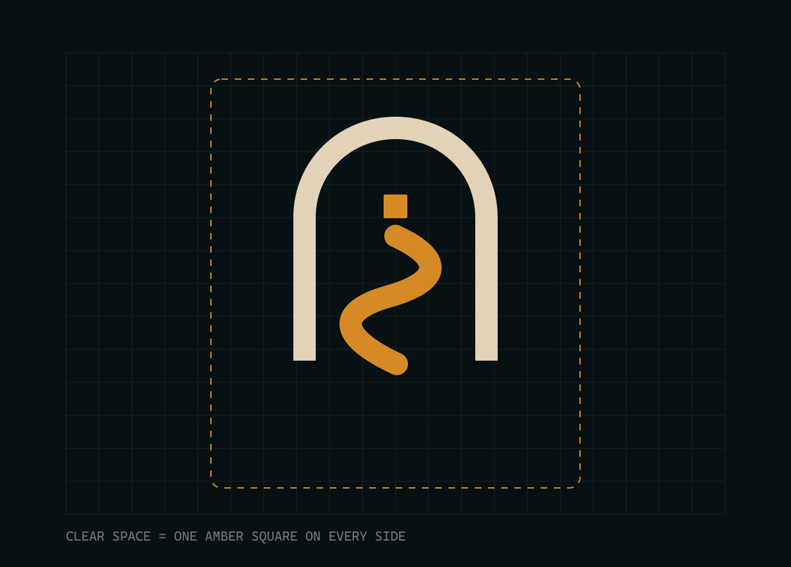
04 / SPACING AND SCALE
Preserve space so the trace stays legible
CLEAR SPACE
Keep one amber-square unit around every side of the mark.
MINIMUM SIZE
Digital mark: 24 px
GitHub avatar: 32 px
Printed mark: 8 mm
Never crop the arch or reduce the trace to a thin line.
SHAYA / MIDNIGHT ARCHIVE
05

Slide 6
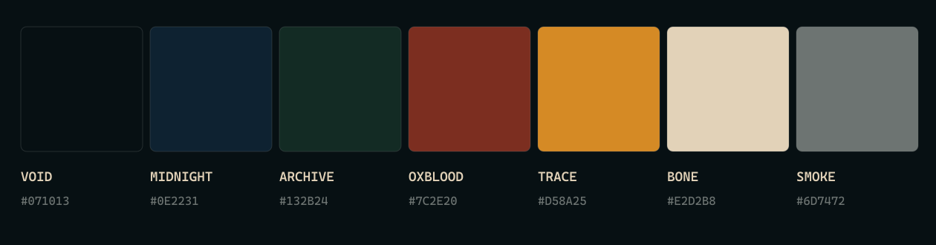
05 / COLOR
The palette starts in shadow and resolves in amber
75%
18%
7%
Void, Midnight, and Archive
Bone for text and space
Trace and Oxblood accents
SHAYA / MIDNIGHT ARCHIVE
06

Slide 7
06 / TYPOGRAPHY
Technical, but never mechanical
BAHNSCHRIFT
CASCADIA MONO
Display and wordmark
Uppercase / short lines / moderate tracking
scope: focused
result: verified
claim: bounded
Segoe UI
Body copy should use short sentences and clear scope.
Use for commands, evidence labels, and small technical details.
SHAYA / MIDNIGHT ARCHIVE
07

Slide 8
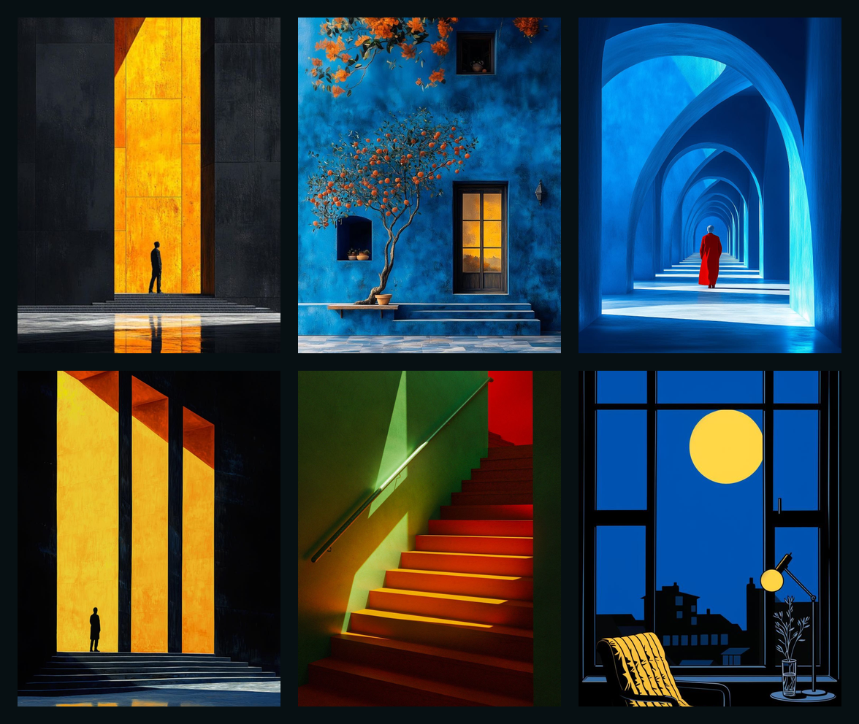
07 / ILLUSTRATION
Quiet technical stories
Use
- Doorways and arches
- Quiet rooms and forest paths
- One controlled light source
- Matte texture and clear silhouettes
- Deep shadows with visible detail
Avoid
Purple AI glow, robots, code rain, glossy 3D, and busy dashboards.
User-provided PinVault references. Use for direction only.
SHAYA / MIDNIGHT ARCHIVE
08

Slide 9
08 / VOICE
Calm, direct, and evidence-first
WRITE LIKE THIS
DO NOT WRITE LIKE THIS
"The focused test passed on the current branch."
"The result supports the component, not the full live system."
"The root cause is not confirmed."
"This revolutionary solution changes everything."
"The system is definitely fixed."
"No issues exist."
State the scope of every claim. Separate confirmed facts from inference.
SHAYA / MIDNIGHT ARCHIVE
09

Slide 10
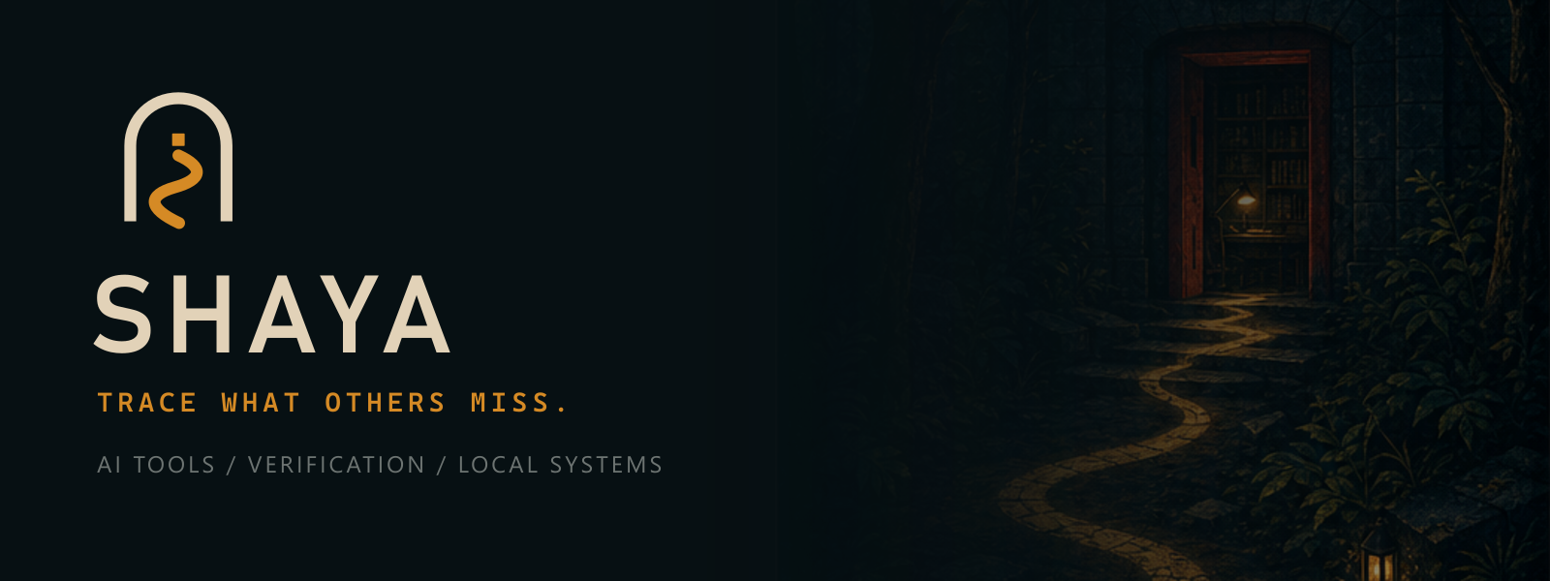

09 / GITHUB
GitHub is the main brand surface
Avatar: keep the full rounded square.
Banner: keep the original ratio and do not add more text.
SHAYA / MIDNIGHT ARCHIVE
10

Slide 11
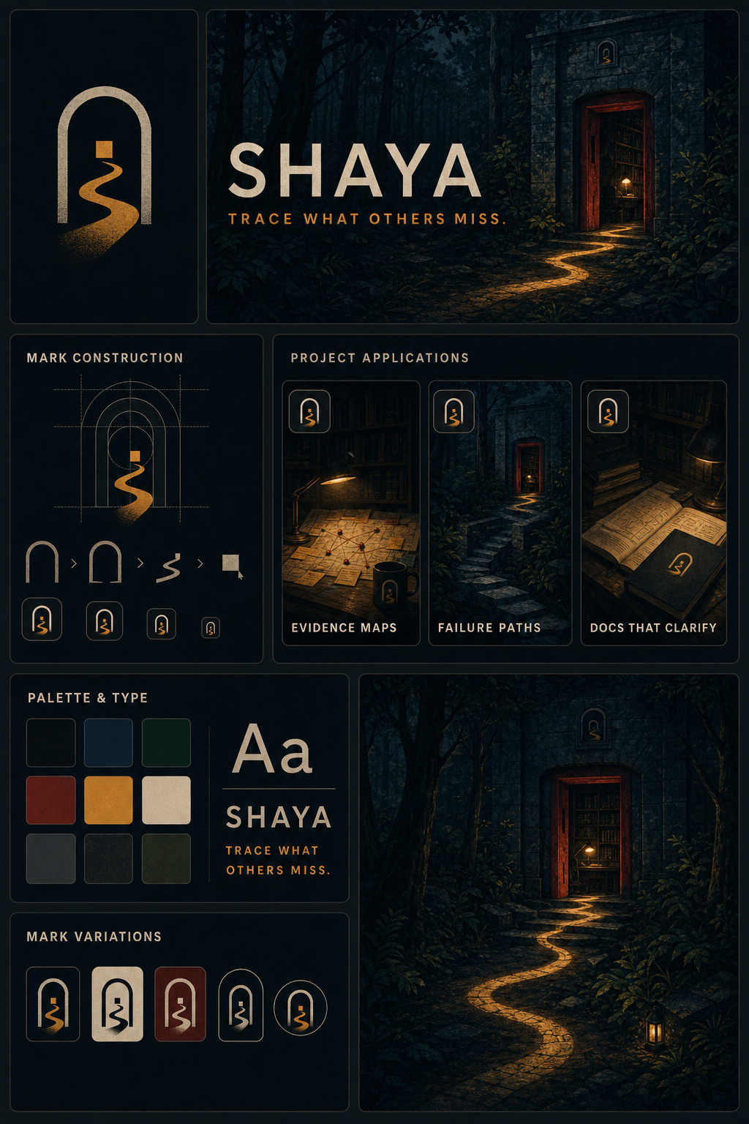
10 / QUICK START
Apply the system with restraint
1. Start with Void or Midnight.
2. Use Bone for the main message.
3. Add one Trace path or evidence point.
4. Use Oxblood only for a threshold or warning.
5. Keep one clear claim per composition.
CORE FILES
Avatar / README banner / SVG marks / PNG marks
Guidelines PDF / Editable deck / Brand tokens
ONE LIGHT. ONE PATH. ONE CLEAR CLAIM.
SHAYA / MIDNIGHT ARCHIVE
11

