Slide 1
CSCI 2400 Computer Systems
Data Lab Recitation
TA : Sepideh Goodarzy

Slide 2
Office hours Details:
Every Monday and Wednesday, 2 PM to 3 PM in Engr Cntr - Comp Sci Dept Wing - Eng Ctr Comp Sci 102
Email: sego7256@colorado.edu
About Me :
PhD student at Computer Science Department, System Lab
My field of research is computer system

Slide 3
Data Lab: Prerequisite
Prepare your working environment:
Virtual Machine with the “college version” Linux installed:
download links/instructions in https://foundation.cs.colorado.edu/vm/
Download and install a VM hypervisor
either VMware (follow https://foundation.cs.colorado.edu/vm/)
or VirtualBox (from https://www.virtualbox.org/ ) – a free software
Download “CU CS” version VM Linux image
Load the Linux image in the hypervisor
for VMware, follow the https://foundation.cs.colorado.edu/vm/
for VirtualBox, “file”-> “import”, select the “ovf” file from the unzipped image.
Notes:
How many of you have already set up the Virtual Machine ?

Slide 4
Data Lab: Prerequisite
Tips about VM/Linux
set display resolution here: -> settings -> display
if “error” in VirtualBox, try VirtualBox: view -> “Scaled mode” first, then set display resolution. (Use right “CTRL”+C to return normal windowed mode)
open terminal by: -> terminal emulator
set terminal font size by: edit -> preferences -> appearance -> Font
Linux basics:
home directory (~): /home/user/ (“user” is your account name)
basic commands (used in terminal):
cp <src> <dest> (copy file <src> to <dest>); mv <src> <dest> (move/rename file <src> to <dest>)
cd <dir> (change directory to <dir> # cd .. (is “cd” to parent directory)
man <command>, or, <command> --help (show help/manual for <command>, e.g. man cp)
Google for more commands
Notes:
Any question about virtual machine or linux?

Slide 5
Data Lab: Prerequisite
Jupyter Notebook available online:
https://coding.csel.io
You tube video for Data Lab introduction:
https://www.youtube.com/watch?time_continue=382&v=IAuYtwAblF4

Slide 6
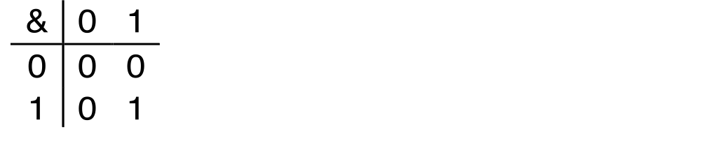
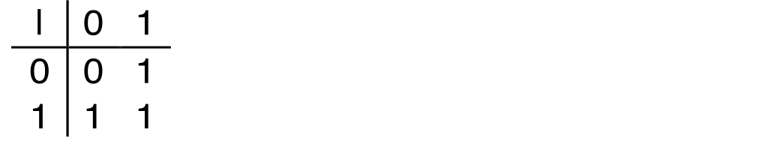
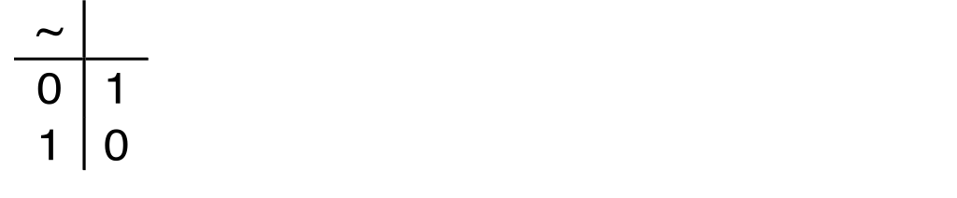
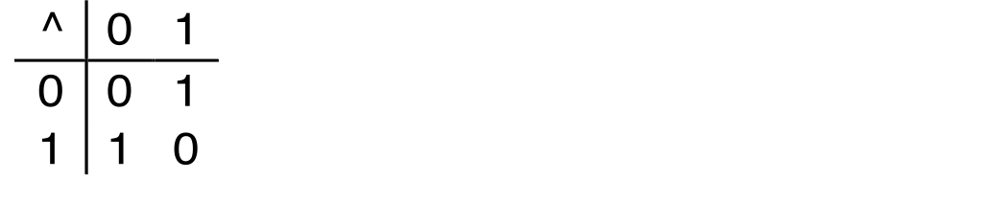
Boolean Algebra
Developed by George Boole in 19th Century Algebraic representation of logic Encode “True” as 1 and “False” as 0
And
A&B = 1 when both A=1 and B=1
Or
A|B = 1 when either A=1 or B=1
Not
~A = 1 when A=0
Exclusive-Or (Xor)
A^B = 1 when either A=1 or B=1, but not both

Slide 7
General Boolean Algebras
Operate on Bit Vectors Operations applied bitwise
All of the Properties of Boolean Algebra Apply
01101001
& 01010101
01000001
01101001
| 01010101
01111101
01101001
^ 01010101
00111100
~ 01010101
10101010
01000001
01111101
00111100
10101010

Slide 8
Bit-Level Operations in C
Decimal
Hex
Binary
Operations &, |, ~, ^ Available in C
Apply to any “integral” data type
long, int, short, char, unsigned
View arguments as bit vectors
Arguments applied bit-wise
Examples (Char data type)
~0x41 → 0xBE
~010000012 → 101111102
~0x00 → 0xFF
~000000002 → 111111112
0x69 & 0x55 → 0x41
011010012 & 010101012 → 010000012
0x69 | 0x55 → 0x7D
011010012 | 010101012 → 011111012
0
0
0000
1
1
0001
2
2
0010
3
3
0011
4
4
0100
5
5
0101
6
6
0110
7
7
0111
8
8
1000
9
9
1001
A
10
1010
B
11
1011
C
12
1100
D
13
1101
E
14
1110
F
15
1111

Slide 9
Contrast: Logic Operations in C
Contrast to Bit-Level Operators
Logic Operations: &&, ||, !
View 0 as “False”
Anything nonzero as “True”
Always return 0 or 1
Early termination
Examples (char data type)
!0x41 → 0x00
!0x00 → 0x01
!!0x41→ 0x01
0x69 && 0x55 → 0x01
0x69 || 0x55 → 0x01
p && *p (avoids null pointer access)
Watch out for && vs. & (and || vs. |)…
one of the more common oopsies in
C programming

Slide 10
Shift Operations (IMPORTANT FOR DATALAB)
Argument x
01100010
Left Shift: x << y
Shift bit-vector x left y positions
Throw away extra bits on left
Fill with 0’s on right
Right Shift: x >> y
Shift bit-vector x right y positions
Throw away extra bits on right
Logical shift
Fill with 0’s on left
Arithmetic shift
Replicate most significant bit on left
Undefined Behavior
Shift amount < 0 or ≥ word size
<< 3
00010000
00010000
00010000
Log. >> 2
00011000
00011000
00011000
Arith. >> 2
00011000
00011000
00011000
Argument x
10100010
<< 3
00010000
00010000
00010000
Log. >> 2
00101000
00101000
00101000
Arith. >> 2
11101000
11101000
11101000

Slide 11
Data Lab: WriteUp.pdf
Handout instructions:
copy “datalab-handout.tar.gz” to some directory and unpack it:
tar -xvf datalab-handout.tar.gz
inside “datalab-handout” directory:
bits.c: file to write your code, total 15 functions to implement
btest.c/btest: to test the correctness of your code
dlc: to test your code for compliance with “coding rules”
“rules” are documented in bits.c
read the “rules” in bits.c before start coding
demo
Notes:
after the slide, show demo of this directory , bits.c (no dlc, no coding here)

Slide 12
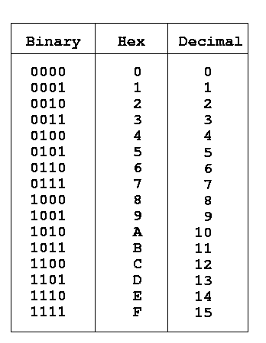
Data Lab: tips
Be careful of operator precedence
what’s the execution order of “~a+1+b*c<<3*2”?
If in confusion, use parentheses: (~a)+1+(b*(c<<3)*2)
some online tools
bitwise calculator: http://bitwisecmd.com/
hex/binary table
Notes:
any question?

Slide 13
Data Lab
I will give you guidance/hints for some of the questions
but not the solutions.
you can also try on your own, some question may have multiple solutions.
use dlc, btest to check your answer.

Slide 14
Data Lab: 1. bitOR
bitOr - x|y using only ~ and &
* Example: bitOr(6, 5) = 7
* Legal ops: ~ &
* Max ops: 8
* Rating: 1
Questions:
Implement the OR using ‘&’ and ‘~’, think of De morgan’s law.

Slide 15
Data Lab: 2. EvenBits
evenBits - return word with all even-numbered bits set to 1
* Legal ops: ! ~ & ^ | + << >>
* Max ops: 8
* Rating: 1
Questions:
What is the integer that has all even-numbered bits set to 1?
But, we can’t use large integer constant…
How can we represent this larger integer with constants in [0,0xff] and bit operations ?

Slide 16
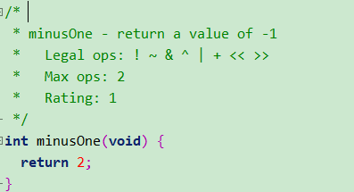
Data Lab: 3. MinusOne
Questions:
Note. We can’t use “return -1” because using negative constant is not allowed.
What’s the bit representation of -1 ?
How can we get that bit representation? (Note, max ops: 2)
* return/ assignment(=) are not accounted as “operator” (for “max ops”)

Slide 17
Data Lab: 4. allEvenBits
* allEvenBits - return 1 if all even-numbered bits in word set to 1
* Examples allEvenBits(0xFFFFFFFE) = 0, allEvenBits(0x55555555) = 1
* Legal ops: ! ~ & ^ | + << >>
* Max ops: 12
* Rating: 2
Hint:
Very similar to the 2nd function.
Use 0xAA as a mask and keep shifting the mask to get the 32bit word do an OR with x and think of how to return 1 or 0 from there based on what x is.
Notes:
Use 0xAA as a mask and keep shifting the mask to get the 32bit word do an OR with x and think of how to return 1 or 0 from there based on what x is. Count the bits from right to left.

Slide 18
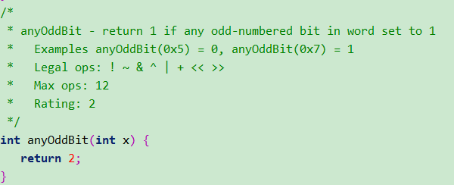
Data Lab: 5. AnyOddBit
Questions:
How to check if some specific bits are 1s?
How to convert non-zero to 1 and 0 to 0? (think of “!”)
Notes:
Similar to the previous sum catch is this for “any” OddBit.

Slide 19
Data Lab: 6.Byte Swap
* byteSwap - swaps the nth byte and the mth byte * Examples: byteSwap(0x12345678, 1, 3) = 0x56341278 * byteSwap(0xDEADBEEF, 0, 2) = 0xDEEFBEAD * You may assume that 0 <= n <= 3, 0 <= m <= 3 * Legal ops: ! ~ & ^ | + << >> * Max ops: 25 * Rating: 2
Hints: Get the n, m bytes by doing left shifts and masking with 0xff. N<<3 and m<<3 will give you corresponding bits. Once you have that get the mask bits using 0xff. Once you have masked bytes, use to get the byte required. Once you have required bytes, use it to swap the bytes.
Notes:
Firstly, get the number of bits you have to move to get the respective n and m bytes. Can be done by moving n and m left by 3, then create masks using 0xFF by shifting 0xFF by the same amount as n and m to get those bytes and do operations to get the respective bytes. Using logic and think about how to swap those bytes now.

Slide 20
Data Lab: 7. addOk
* addOK - Determine if can compute x+y without overflow * Example: addOK(0x80000000,0x80000000) = 0, * addOK(0x80000000,0x70000000) = 1, * Legal ops: ! ~ & ^ | + << >> * Max ops: 20 * Rating: 3 */
Hints: Overflow when x and y have same sign, but s is different Compute sum. Get the sign of x,y and sum and use it to return whether overflow occurred or not.

Slide 21
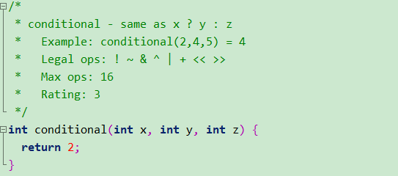
Data Lab: 8. conditional
Hints:
Form a mask, mask=!x+~0x00
((~mask) & z) | ((mask) & y) should help you to get answer
Notes:
Think of a mask which gives you a true or false when you perform some operations over y, mask and z, mask, the hint lets you think of creating the mask. Take an example and run it through.

Slide 22
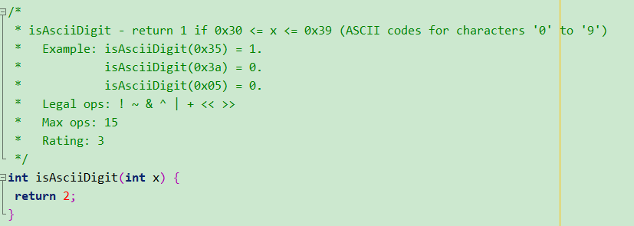
Data Lab: 9. isAsciiDigit
Hints:
X should be less than 0x39. i.e 0x39-x>=0 and it should be greater than 0x30. i.e x-0x30 should be >=0.
Use 2’s complement to compute the difference of two operations and check the sign bits.
Notes:
in this case you need to test if x is in some range

Slide 23
Data Lab: 10. replace Byte
* replaceByte(x,n,c) - Replace byte n in x with c * Bytes numbered from 0 (LSB) to 3 (MSB) * Examples: replaceByte(0x12345678,1,0xab) = 0x1234ab78 * You can assume 0 <= n <= 3 and 0 <= c <= 255 * Legal ops: ! ~ & ^ | + << >> * Max ops: 10 * Rating: 3 */
Hints:
Very similar to swap bytes. Get the byte using mask and replace the same byte with given constant c
Notes:
in this case you need to test if x is in some range

Slide 24
Data Lab: 11. reverseBits
reverseBits - reverse the bits in a 32-bit integer, i.e. b0 swaps with b31, b1 with b30, etc * Examples: reverseBits(0x11111111) = 0x88888888 * reverseBits(0xdeadbeef) = 0xf77db57b * reverseBits(0x88888888) = 0x11111111 * reverseBits(0) = 0 * reverseBits(-1) = -1 * reverseBits(0x9) = 0x90000000 * Legal ops: ! ~ & ^ | + << >> and unsigned int type * Max ops: 90 * Rating: 4 */
Hints: Swap the even and odd bits using 0x55 as mask. Swap the consecutive pair using 0x33 as mask. Swap nibble using 0x0f as mask and swap 2-byte long pair. Ex: c = 0x55; c2 = c << 8 | c; c3 = c2 << 16 | c2; v = ((v >> 1) & c3) | ((v & c3) << 1);
Notes:
in this case you need to test if x is in some range, hard question (I have no idea how to do this).

Slide 25
Data Lab: 12.satAdd
satAdd - adds two numbers but when positive overflow occurs, returns * maximum possible value, and when negative overflow occurs, * it returns minimum positive value. * Examples: satAdd(0x40000000,0x40000000) = 0x7fffffff * satAdd(0x80000000,0xffffffff) = 0x80000000 * Legal ops: ! ~ & ^ | + << >> * Max ops: 30 * Rating: 4 */
Questions:
When you add two positive numbers and get a negative number as result it is called positive overflow. You now know
How to check sign and add. Use same logic to complete the function
Notes:
Similar to checking the overflow problem but with some added twist to check for a particular case.

Slide 26
Last three functions are extra credits functions.
Solve on your own.

Slide 27
Some final tips
if you get stuck:
read the hints I give you
try some examples
try some operators if you don’t know which one to use
submit on or before due date!
I will release individual interview grading time slots on Moodle.

