Slide 1
CSCI 2400 Recitation: Bomb Lab
Recitation 2: 06-Feb-2018
Prashanth Thipparthi

Slide 2

Agenda
Introduction to GDB
Bomb Lab Overview
Assembly Refresher
Unix Refresher
Bomb Lab Demo

Slide 3
Introduction to GDB
To learn GDB we will download the tutorial files from https://moodle.cs.colorado.edu/mod/resource/view.php?id=28798
Open in https://hub.csel.io and un-tar the files and compile it .
We will demo following functions with the given c file
break, next,info breakpoints,
run, del ,tui enable/disable(ctr+l)
continue, list and where
finish,step

Slide 4
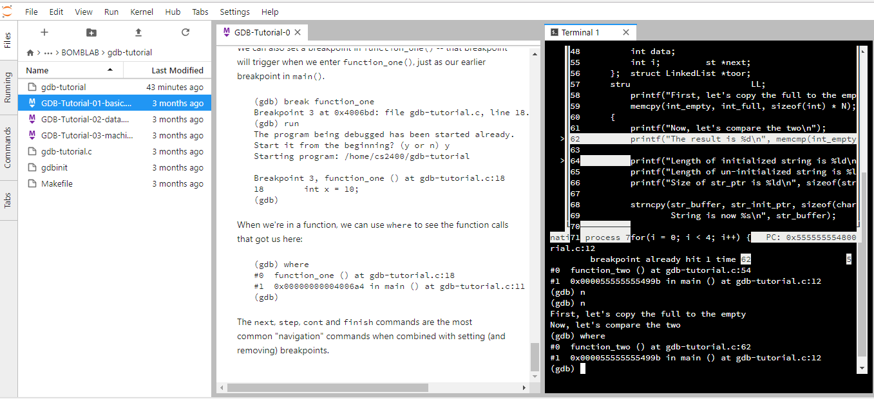
Demo:
https://moodle.cs.colorado.edu/mod/hvp/view.php?id=28799 is the video to be watched to show how to give demo.

Slide 5
Print and examine command in GDB
We will examine the following commands:
Print/p : p “x/o/t/s/c/f” variables/constants
Examine/x “x 4b memory”
Display variables
Set variable=“”

Slide 6
Print and examine Demo:
Watch Video here: https://moodle.cs.colorado.edu/mod/hvp/view.php?id=28816

Slide 7
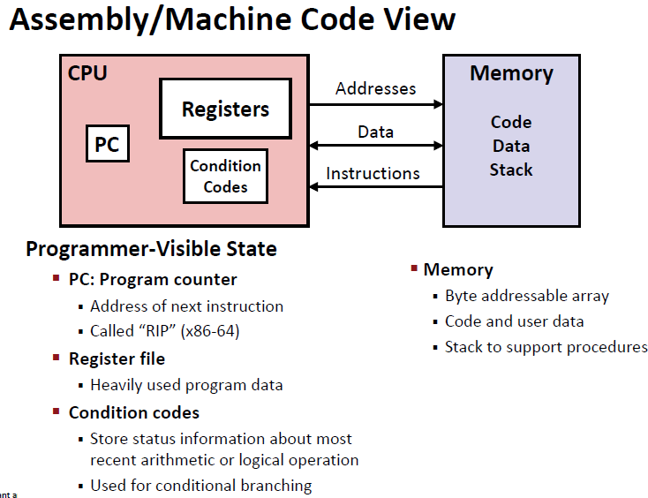

Slide 8
x86-64 Integer Registers
%rax
%r8
%al
%r8b
%rbx
%r9
%bl
%r9b
%rcx
%r10
%cl
%r10b
%rdx
%r11
%dl
%r11b
%rsi
%r12
%sil
%r12b
%rdi
%r13
%dil
%r13b
%rsp
%r14
%spl
%r14b
%rbp
%r15
%bpl
%r15b
Can reference low-order byte

Slide 9
Procedure Data Flow
Registers
Stack
First 6 arguments
Return value
• • •
%rdi
%rsi
Arg n
%rdx
• • •
%rcx
%r8
Arg 8
%r9
Arg 7
%rax
Only allocate stack space when needed

Slide 10
Machine State
Commands to examine:
Info registers: p $rip/p $pc/p $rax and x/i $pc/display/i $pc,ni,si
Disassemble
How to check instructions and program counters using p/i or x/I
Compile code without optimization –O 0/-O g
Demo:
Check out the video in https://moodle.cs.colorado.edu/mod/hvp/view.php?id=28817

Slide 11
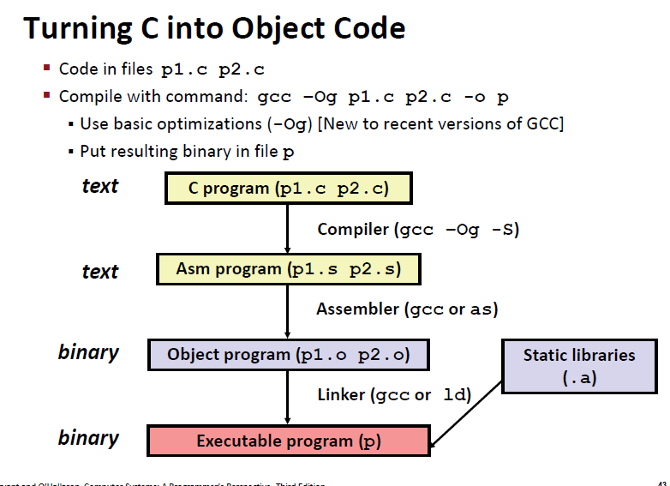

Slide 12
Online disassembler
Check out online disassembler from https://onlinedisassembler.com/static/home/index.html

Slide 13
Downloading Your Bomb
Get Bomb from http://cs2400-applied.cs.colorado.edu:15213/ using your id key and email
Your bomb is unique to you. Dr. Evil has created one million billion bombs, and can distribute as many new ones as he pleases.
Bombs have six phases which get progressively harder more fun to use.
Dead Line: 26th September

Slide 14
Exploding Your Bomb
Blowing up your bomb notifies Autolab.
Dr. Evil takes 0.5 of your points each time.
Inputting the right string moves you to the next phase.
Jumping between phases detonates the bomb

Slide 15
Examining Your Bomb
You get:
An executable
A readme
A heavily redacted source file
Source file just makes fun of you.
Outsmart Dr. Evil by examining the executable

Slide 16
Diffusing Your Bomb
objdump -t bomb examines the symbol table
objdump -d bomb disassembles all bomb code
strings bomb prints all printable strings
gdb bomb will open up the GNU Debugger
Examine while stepping through your program
registers
the stack
contents of program memory
instruction stream

Slide 17
Using gdb
break <location>
Stop execution at function name or address
Reset breakpoints when restarting gdb
run <args>
Run program with args <args>
Convenient for specifying text file with answers
disas <fun>, but not dis
stepi / nexti
Steps / does not step through function calls

Slide 18
Using gdb
info registers
Print hex values in every register
print (/x or /d) $eax - Yes, use $
Print hex or decimal contents of %eax
x $register, x 0xaddress
Prints what’s in the register / at the given address
By default, prints one word (4 bytes)
Specify format: /s, /[num][size][format]
x/8a 0x15213
x/4wd 0xdeadbeef

Slide 19
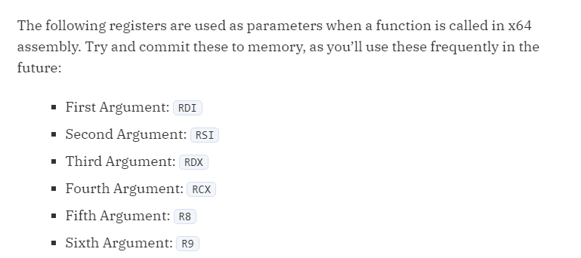

Slide 20
sscanf
Bomb uses sscanf for reading strings
Figure out what phase expects for input
Check out man sscanf for formatting string details

Slide 21
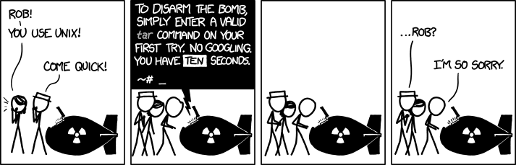
Unix Refresher – This Saturday - 9/19/2015
You should know cd, ls, scp, ssh, tar, and chmod by now. Use man <command> for help.
<Control-C> exits your current program.

Slide 22
Demo:
Lets see how to solve phase 1 and phase 2
Phase 1: string comparison
Phase 2: read six numbers
Rest of the phases students need to solve themselves.

