Slide 1
CSCI 2400 Recitation: Attack Lab
TA: Sepideh Goodarzy

Slide 2
Today
Buffer Overflow
Vulnerability
Protection

Slide 3
Recall: Memory Referencing Bug Example
typedef struct {
int a[2];
double d;
} struct_t;
double fun(int i) {
volatile struct_t s;
s.d = 3.14;
s.a[i] = 1073741824; /* Possibly out of bounds */
return s.d;
}
fun(0) -> 3.1400000000
fun(1) -> 3.1400000000
fun(2) -> 3.1399998665
fun(3) -> 2.0000006104
fun(4) -> Segmentation fault
fun(8) -> 3.1400000000
Result is system specific

Slide 4
Memory Referencing Bug Example
typedef struct {
int a[2];
double d;
} struct_t;
fun(0) -> 3.1400000000
fun(1) -> 3.1400000000
fun(2) -> 3.1399998665
fun(3) -> 2.0000006104
fun(4) -> Segmentation fault
fun(8) -> 3.1400000000
??? | 8
Critical State | 7
Critical State | 6
Critical State | 5
Critical State | 4
d7 ... d4 | 3
d3 ... d0 | 2
a[1] | 1
a[0] | 0
Explanation:
Location accessed by fun(i)
struct_t

Slide 5
Such problems are a BIG deal
Generally called a “buffer overflow”
when exceeding the memory size allocated for an array
Why a big deal?
It’s the #1 technical cause of security vulnerabilities
#1 overall cause is social engineering / user ignorance
Most common form
Unchecked lengths on string inputs
Particularly for bounded character arrays on the stack
sometimes referred to as stack smashing

Slide 6
String Library Code
Implementation of Unix function gets()
No way to specify limit on number of characters to read
Similar problems with other library functions
strcpy, strcat: Copy strings of arbitrary length
scanf, fscanf, sscanf, when given %s conversion specification
/* Get string from stdin */
char *gets(char *dest) { int c = getchar();
char *p = dest;
while (c != EOF && c != '\n') {
*p++ = c;
c = getchar();
}
*p = '\0';
return dest;
}

Slide 7
Vulnerable Buffer Code
/* Echo Line */ void echo() { char buf[4]; /* Way too small! */ gets(buf); puts(buf); }
btw, how big
is big enough?
void call_echo() {
echo();
}

Slide 8
Buffer Overflow Disassembly
echo:
00000000004006cf <echo>:
4006cf: 48 83 ec 18 sub $0x18,%rsp
4006d3: 48 89 e7 mov %rsp,%rdi
4006d6: e8 a5 ff ff ff callq 400680 <gets>
4006db: 48 89 e7 mov %rsp,%rdi
4006de: e8 3d fe ff ff callq 400520 <puts@plt>
4006e3: 48 83 c4 18 add $0x18,%rsp
4006e7: c3 retq
call_echo:
4006e8: 48 83 ec 08 sub $0x8,%rsp
4006ec: b8 00 00 00 00 mov $0x0,%eax
4006f1: e8 d9 ff ff ff callq 4006cf <echo>
4006f6: 48 83 c4 08 add $0x8,%rsp
4006fa: c3 retq

Slide 9
Buffer Overflow Stack
Before call to gets
Stack Frame
for call_echo
/* Echo Line */ void echo() { char buf[4]; /* Way too small! */ gets(buf); puts(buf); }
Return Address
(8 bytes)
20 bytes unused
[3]
[2]
[1]
[0]
buf
%rsp
echo:
subq $0x18, %rsp
movq %rsp, %rdi
call gets
. . .

Slide 10
Buffer Overflow Stack Example
Before call to gets
void echo() { char buf[4];
gets(buf); . . . }
echo:
subq $24, %rsp
movq %rsp, %rdi
call gets
. . .
Stack Frame
for call_echo
00
00
00
00
Return Address
(8 bytes)
00
40
06
f6
20 bytes unused
call_echo:
. . .
4006f1: callq 4006cf <echo>
4006f6: add $0x8,%rsp
. . .
[3]
[2]
[1]
[0]
buf
%rsp

Slide 11
Buffer Overflow Stack Example #1
After call to gets
void echo() { char buf[4];
gets(buf); . . . }
echo:
subq $24, %rsp
movq %rsp, %rdi
call gets
. . .
Stack Frame
for call_echo
00
00
00
00
Return Address
(8 bytes)
00
40
06
f6
00
32
31
30
call_echo:
20 bytes unused
39
38
37
36
. . .
4006f1: callq 4006cf <echo>
4006f6: add $0x8,%rsp
. . .
35
34
33
32
31
30
39
38
37
36
35
34
33
32
31
30
buf
%rsp
“01234567890123456789012\0”
Overflowed buffer, but did not corrupt state

Slide 12
Buffer Overflow Stack Example #2
After call to gets
void echo() { char buf[4];
gets(buf); . . . }
echo:
subq $24, %rsp
movq %rsp, %rdi
call gets
. . .
Stack Frame
for call_echo
Return Address
(8 bytes)
00
00
00
00
00
40
06
00
33
32
31
30
call_echo:
20 bytes unused
39
38
37
36
. . .
4006f1: callq 4006cf <echo>
4006f6: add $0x8,%rsp
. . .
35
34
33
32
31
30
39
38
37
36
35
34
33
32
31
30
buf
%rsp
Program “returned” to 0x0400600, and then crashed.

Slide 13
Stack Smashing Attacks
void P(){
Q();
...
}
Stack after call to gets()
return
address
A
P stack frame
int Q() {
char buf[64];
gets(buf);
...
return ...;
}
A
A → S
A B
pad
data written
by gets()
Q stack frame
void S(){
/* Something
unexpected */
...
}
Overwrite normal return address A with address of some other code S
When Q executes ret, will jump to other code
Notes:
Jump from text to stack
Show string and code on stack

Slide 14
Crafting Smashing String
int echo() {
char buf[4];
gets(buf);
...
return ...;
}
Stack Frame
for call_echo
00
00
00
00
Return Address
(8 bytes)
00
48
83
80
Return Address
(8 bytes)
00
00
07
FF
00
00
00
00
00
40
06
fb
FF
FF
AB
80
%rsp
Target Code
33
32
31
30
20 bytes unused
void smash() {
printf("I've been smashed!\n");
exit(0);
}
39
38
37
36
35
34
33
32
24 bytes
31
30
39
38
37
36
35
34
33
32
31
30
00000000004006fb <smash>:
4006fb: 48 83 ec 08
Attack String (Hex)
30 31 32 33 34 35 36 37 38 39 30 31 32 33 34 35 36 37 38 39 30 31 32 33 fb 06 40 00 00 00 00 00

Slide 15
Smashing String Effect
Stack Frame
for call_echo
00
00
00
00
Return Address
(8 bytes)
00
48
83
80
Return Address
(8 bytes)
00
00
07
FF
00
00
00
00
00
40
06
fb
FF
FF
AB
80
%rsp
Target Code
33
32
31
30
20 bytes unused
void smash() {
printf("I've been smashed!\n");
exit(0);
}
39
38
37
36
35
34
33
32
31
30
39
38
37
36
35
34
33
32
31
30
00000000004006fb <smash>:
4006fb: 48 83 ec 08
Attack String (Hex)
30 31 32 33 34 35 36 37 38 39 30 31 32 33 34 35 36 37 38 39 30 31 32 33 fb 06 40 00 00 00 00 00

Slide 16
Code Injection Attacks
Stack after call to gets()
void P(){
Q();
...
}
P stack frame
return
address
A
A
B
A B
pad
int Q() {
char buf[64];
gets(buf);
...
return ...;
}
data written
by gets()
exploit
code
Q stack frame
B
Input string contains byte representation of executable code
Overwrite return address A with address of buffer B
When Q executes ret, will jump to exploit code
Notes:
Jump from text to stack
Show string and code on stack

Slide 17
What To Do About Buffer Overflow Attacks
Avoid overflow vulnerabilities
Employ system-level protections
Have compiler use “stack canaries”
Lets talk about each…

Slide 18
1. Avoid Overflow Vulnerabilities in Code (!)
/* Echo Line */ void echo() { char buf[4]; /* Way too small! */ fgets(buf, 4, stdin); puts(buf); }
For example, use library routines that limit string lengths
fgets instead of gets
strncpy instead of strcpy
Don’t use scanf with %s conversion specification
Use fgets to read the string
Or use %ns where n is a suitable integer

Slide 19
Return-Oriented Programming Attacks
Challenge (for hackers)
Stack randomization makes it hard to predict buffer location
Marking stack nonexecutable makes it hard to insert binary code
Alternative Strategy
Use existing code
E.g., library code from stdlib
String together fragments to achieve overall desired outcome
Does not overcome stack canaries
Construct program from gadgets
Sequence of instructions ending in ret
Encoded by single byte 0xc3
Code positions fixed from run to run
Code is executable

Slide 20
Gadget Example #1
long ab_plus_c
(long a, long b, long c) {
return a*b + c;
}
00000000004004d0 <ab_plus_c>:
4004d0: 48 0f af fe imul %rsi,%rdi
4004d4: 48 8d 04 17 lea (%rdi,%rdx,1),%rax
4004d8: c3 retq
rax ← rdi + rdx
Gadget address = 0x4004d4
Use tail end of existing functions

Slide 21
Gadget Example #2
void setval(unsigned *p) {
*p = 3347663060u;
}
Encodes movq %rax, %rdi
<setval>:
4004d9: c7 07 d4 48 89 c7 movl $0xc78948d4,(%rdi)
4004df: c3 retq
rdi ← rax
Gadget address = 0x4004dc
Repurpose byte codes

Slide 22
ROP Execution
Stack
Gadget n code
c3
•
•
•
Gadget 2 code
c3
%rsp
Gadget 1 code
c3
Trigger with ret instruction
Will start executing Gadget 1
Final ret in each gadget will start next one

Slide 23
Attack Lab
To hijack target executable by running buffer overflow attacks
To understand more of the “stack” and x86-64 assembly-code
To understand better how to write a “safe” program
To understand better how OS defense works

Slide 24
Buffer Overflow Attack
Code-injection is not so powerful today due to OS countermeasures
randomize stack offset
make “stack memory” non-executable
ROP (Return-Oriented Programing) Attack can overcome these
make use of existing code gadgets (instructions ending with “ret”)
Stack
Gadget n code
c3
Attack Lab Phase 4/5 asks to use ROP
to attack the program – It will gives you a “farm” to find useful gadgets.
•
•
•
Gadget 2 code
c3
%rsp
Gadget 1 code
c3

Slide 25
Agenda
A quick refresher for “Buffer Overflow Attacks”
Attack Lab Overview
Notes:
any question in the first part

Slide 26
Attack Lab Overview
get writeup (attack.pdf) and target*.tar
“attack.pdf” is very helpful. Read it completely!
unpack your target (tar -xvf target*.tar)
ctarget: used for “Code-Injection” Attack (Phase 1/2/3)
rtarget: used for “Return-Oriented Programming” Attack (Phase 4/5)
cookie.txt: a signature for your target, should not change
hex2raw: a tool to convert hex numbers to a string (char array)
farm.c: maybe / maybe not used for Phase4/5
README
What to submit:
check Moodle page

Slide 27
Attack Lab Overview
Tools:
objdump –d ctarget > ctarget_d.txt
get assembly code. check “getbuf” function code
hex2raw
convert hex sequences into string (char array)
./hex2raw < input.txt > output.txt
run ctarget with output.txt, ./ctarget < output.txt
gdb
gdb ctarget; break getbuf
get register/memory value; get address; check step-by-step
more in “attacklab.pdf”
Demo
Notes:
after demo, any question here?

Slide 28
Attack Lab Overview, Advices
Read “attacklab.pdf” ! You’ll get:
plenty of advices for each phase
tutorial about how to make use of hex2raw (Appendix A)
tutorial about how to convert assembly-code into machine code (Appendix B)
-- you might need insert your own instructions into stack
assembly-code → machine code (hex) → string
-- demo

Slide 29
Attack Lab Overview, Advices
Byte ordering:
your VM is Little Endian
example, to store 0x01234567 (4bytes) in stack.
another example – instruction code
Big Endian
0x100
0x101
0x102
0x103
01
23
45
67
Note. String (Char Array) order
is not affected by Little-Endian.
Be careful for int (4bytes), address (8bytes)
01
23
45
67
Little Endian
0x100
0x101
0x102
0x103
67
45
23
01
67
45
23
01
Address Instruction Code Assembly Rendition
8048365: 5b pop %ebx
8048366: 81 c3 ab 12 00 00 add $0x12ab,%ebx
804836c: 83 bb 28 00 00 00 00 cmpl $0x0,0x28(%ebx)

Slide 30
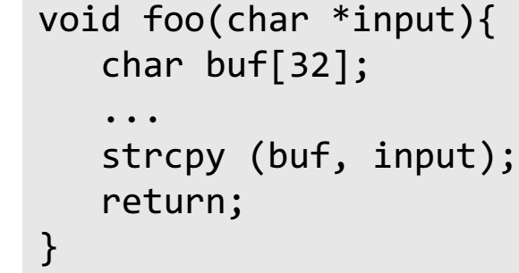
Attack Lab Overview, Advices
An Example of ROP attack -- for phase 4/5
Idea:
if
“0xBBBBBBBB” saved in stack, and
%rsp points to it,
then:
pop %rbx #%rbx == 0xBBBBBBBB
mov %rbx, %rax #%rax == 0xBBBBBBBB
Like gets(), strcpy() will not check string size, so Buffer Overflow Attack is possible
We want to set %rax to 0xBBBBBBBB when “return”
We find gadgets:
Address1: mov %rbx, %rax; ret
Address2: pop %rbx; ret

Slide 31
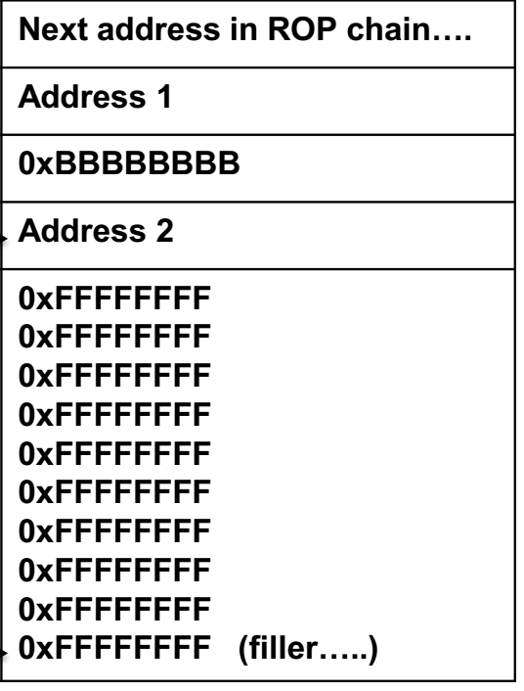
Attack Lab Overview, Advices
An Example of ROP attack -- for phase 4/5
%rsp →
%rsp →
%rsp →
should be 8 bytes
when “retq”
%rsp →
overwrite “return addr”
Like gets(), strcpy() will not check string size, so Buffer Overflow Attack is possible
We want to set %rax to 0xBBBBBBBB when “return”
We find gadgets:
Address1: mov %rbx, %rax; ret
Address2: pop %rbx; ret
local vars
%rax=0xBBBBBBBB
%rbx=0xBBBBBBBB

Slide 32
Attack Lab Overview, Advices
To find useful gadgets, for phase4/5
in phase 4, gadgets can be found between “start_farm” and “mid_farm”
in phase 5, gadgets can be found between “start_farm” and “end_farm”
2 ways to get assembly code/machine code in between:
gcc -Og –c farm.c # get farm.o
objdump –d farm.o > farm_d.txt # get assembly code/machine code
objdump –d rtarget > rtarget_d.txt # to get assembly/machine codes of rtarget
copy codes between <start_farm>, <mid_farm>/<end_farm> out into farm_d.txt
search certain machine code in farm_d.txt
“attacklab.pdf” gives reference for assembly code/machine codes
note: gadget must followed by “c3” (retq); you can have “90” (nop) between instructions
Demo

