Slide 1
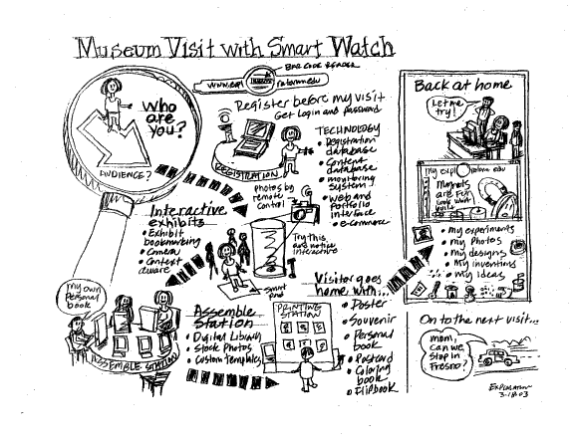
Sketching User Interfaces
CSCI 3002 – Fall 2019
Notes:
http://what-the-fail.com/computer-user-fail/

Slide 2
But first
Moving from open questions to closed questions
Next steps for the project

Slide 3
Sketching

Slide 4
Sketching
Why sketch
Tips on sketching
Storyboarding

Slide 5
What is sketching?
Representing early ideas outside of your brain
Many forms: block diagrams, drawings, storyboards, text
Early ideas at a level of detail that is easy to work with

Slide 6
Why sketch
Capture ideas before you forget them
Feed the creative part of your brain
Try out ideas quickly (and discard bad ones)
Prevent yourself from getting distracted by details

Slide 7
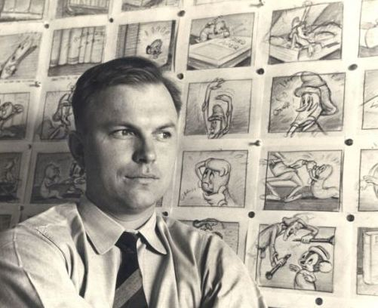
“The whole essence of good drawing – and of good thinking, perhaps – is to work a subject down to the simplest form possible and still have it believable for what it is meant to be.”
–Chuck Jones

Slide 8
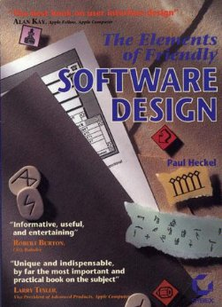
“If Ernest Hemingway, James Mitchener, Neil Simon, Frank Lloyd Wright, and Pablo Picasso could not get it right the first time, what makes you think that you will?“
— Paul Heckel

Slide 9
Myths about sketching
I can’t sketch!
I need to be an artist to sketch
I’ll save time by going straight to my dev environment

Slide 11
Sketching tools
Skitch: http://evernote.com/skitch/
Balsamiq: http://balsamiq.com/
Many apps, e.g. Paper http://www.fiftythree.com/paper

Slide 12
Sketching tools
Skitch: http://evernote.com/skitch/
Balsamiq: http://balsamiq.com/
Many apps, e.g. Paper http://www.fiftythree.com/paper
But really, start with paper
  (get fancy notebooks/pens if it helps)

Slide 13
Sketching vs. dragging stuff around
It’s important to be able to start from a blank sheet of paper
  Shows that you have an understanding of what you’re working with
  Demands attention to detail
  Ability to break rules to try new things
Notes:
If you feel like you know how to do this,

Slide 14
Sketching process
Divergent sketching
  Explore possible ideas
Convergent sketching
  Get the details right
Iterative process

Slide 15
Divergent sketching
Force yourself to represent the same thing multiple ways
  Break away from your first idea / the default way of doing things
  Consider what different aspects of the UI are actually doing
    “Why are we sorting by alpha?”

Slide 16
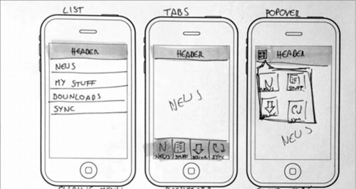
Divergent sketching
Notes:
No one should ever say, at this stage, whoa, that idea is TOO different

Slide 17
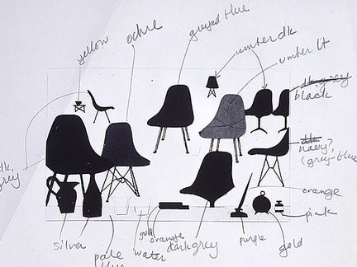
Convergent sketching
Charles Eames (dwr.com)

Slide 18

Sketching physical objects
Jeff Hawkins’ (Palm) block of wood
Notes:
Physical prototyping
http://idintern.wordpress.com/2011/02/03/business-realities/s

Slide 19
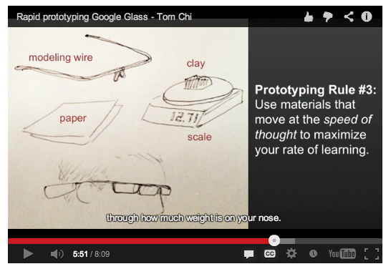
Google Glass in chopsticks
http://glass-apps.org/google-glass-prototype

Slide 20
Sketching for user interfaces
Different foci
  “On screen” only
  Hand holding device
  Person interacting with device
Next time we’ll practice storyboarding
  Sequential interactions

Slide 21
Sketching warm up
Take out a mobile device
Load up a web page
Sketch the device and the screen

Slide 22
Sketching for user interfaces
Goals
  Lay out the user interface
  Figure out what fits or doesn’t fit
  Set high level “structure” of the interaction

Slide 23
Divergent sketching
It’s often difficult to come up with multiple perspectives on a single idea
Easy to get “locked in” on a single perspective
Really need to force yourself to consider other perspectives

Slide 24
Example
Let’s sketch out an app for adopting pets
Divergent sketching, 5 ideas

Slide 25
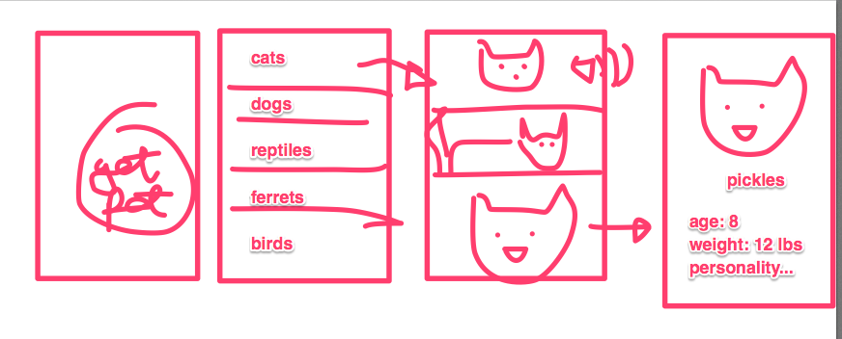
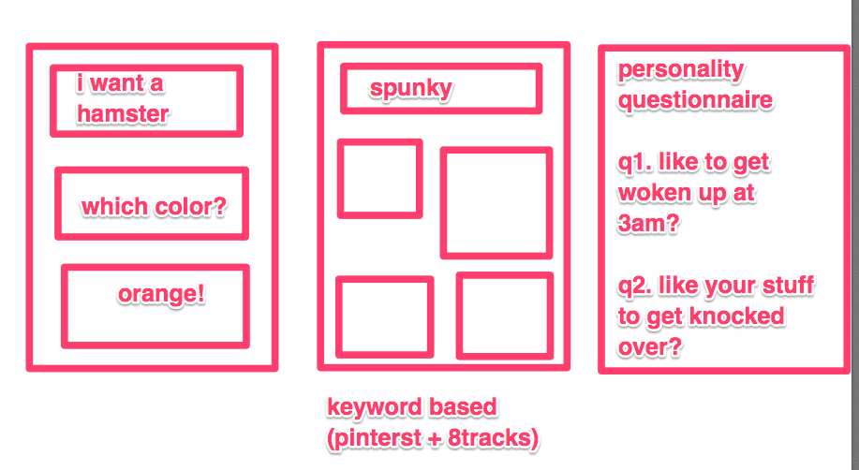

Slide 26
You try it
Design a mobile phone app for buying textbooks
Come up with at least 3 designs
  Show major interactions
Sketch them large (we’ll show them off)

Slide 27
Other factors
Speed – how can we accomplish the task as quickly as possible?
  Don’t ask things you don’t need to know
  Guess when you can
  Ask the most discriminating questions first
Make it fun – how can we make interaction itself fun or enjoyable

Slide 28
Convergent sketching
Now, refine your design
  Clean up sketch
  Clarify relationship between elements
May combine elements from different divergent sketches

Slide 29
Tips for sketching
Make LOTS of sketches
Hang them on the wall
Sketch neatly, so you can go back to your sketches later (and share them)
OK to take shortcuts (trace images, reuse elements across sketches)

Slide 30

Sketching hacks
Practice drawing common elements (devices, hands, etc)
Trace things where it will help
Star people vs. stick figures
Notes:
http://brylie.gnumedia.org/storyboarding/
Why are star people better than stick people?

