Slide 1
Clicker Q 1
Who is required to run a heuristic evaluation?
A: tester + test user
B: tester + test user + note taker
C: tester only
D: test user only

Slide 2
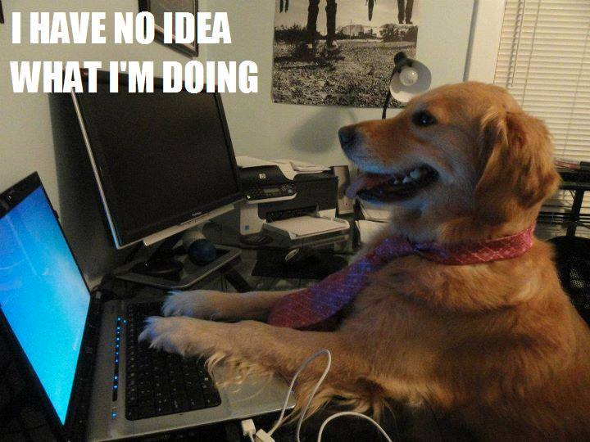
Heuristic evaluation
CSCI 3002 Fall 2019
Notes:
http://media-cache-ec0.pinimg.com/236x/c2/a5/86/c2a58664f589a2447dcb6ca6111e5226.jpg

Slide 3
How we evaluate our designs
Design review: Get people to look at our work and provide feedback
User testing: Get users to test a real prototype, watch what they do
Heuristic evaluation: Apply known best practices in a consistent way

Slide 4
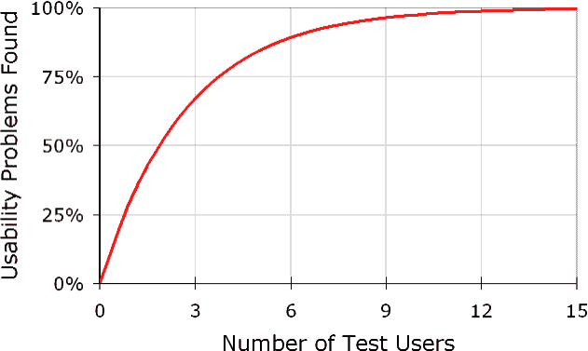
“Discount” user testing
Nielsen found that the majority of
usability problems can be found
by a few testers (~5)
Caveats:
  Depends on what’s being tested (how complex? how familiar?)
  How careful our testing is (are we making mistakes? is experience consistent across participants?)
  Not all users will have the same problems (or will benefit from the same solutions)
  Must consider atypical users as well (accessibility)
  Must iterate on / test fixes
Notes:
If you haven’t tested something, it’s not actually done.
https://www.nngroup.com/articles/why-you-only-need-to-test-with-5-users/

Slide 5
Heuristic evaluation
Testing our prototypes based on known usability principles
  But doing so in a systematic way
A trained tester walks through the interface and evaluates where it meets or violates the rules
Automated-ish. Rules are pre-defined, but require a human tester

Slide 6
What’s a heuristic?
Give an example

Slide 7
What’s a heuristic?
“experience-based techniques for problem solving, learning, and discovery that find a solution which is not guaranteed to be optimal, but good enough for a given set of goals.” (Wikipedia)
  Examples: (http://c2.com/cgi/wiki?HeuristicRule)
  Deciding to eat at restaurant B rather than restaurant A only because B has more cars in its parking lot
  When the level in the fuel tank drops to 1/2 tank or less, always filling up the fuel tank at the very next re-filling station.

Slide 8
Heuristics
How do you identify a good roommate?

Slide 9
Heuristics
How do you identify a good roommate?
  Pays rent on time
  Neat
  Respects privacy
  Cleans
  Doesn’t make you look bad
  Honest

Slide 10
How to conduct a heuristic evaluation
Choose your heuristics (including custom heuristics)
Create a testing path to move through the interface
(set of tasks or sequence of screens/buttons)
For each screen:
  Check for each heuristic
  Log each problem (can leave details for later)
Notes:
I prefer to test one heuristic at a time – I have found that it works better
Important to test in context. If you just look at a screen, might not
Solution – don’t get distracted by this

Slide 11
HE Demo

Slide 12
After the evaluation
Complete documentation for each problem
—detailed description, screen shot, which heuristic is being violated?, severity (high, medium, low), suggested solution (maybe)
  Log in bug tracker or as UAR
Prioritize issues and fix them (or pass them on to someone who will)

Slide 13
HEs: When & Who
When to do an HE?
  After any major change to the interaction
Who should do the test?
  A trained usability professional
  Or a domain expert
  It can be the person who created it,
  but they may have blind spots

Slide 14
HE vs. user testing
Benefits of HE
Can do it quickly
Doesn’t require recruiting externals
Can test repeatedly to test for regression errors
Can test more thoroughly (which may be tedious in a user test)
Can explain why problems exist
Benefits of User Testing
If a user finds a problem, we know it’s real
Discover problems that we might miss
Reflects realistic use scenarios
(vs. a systematic test)

Slide 15
Which heuristics to use?
Many possible heuristic sets
Some standard sets (e.g. Nielsen’s usability heuristics)
You might create your own heuristics, e.g. for specific applications
We’ll focus on Nielsen’s, which cover a range of general usability issues

Slide 16
Visibility of system status
The system should always keep users informed about what is going on, through appropriate feedback within reasonable time.
Match between system and the real world
The system should speak the users' language, with words, phrases and concepts familiar to the user, rather than system-oriented terms. Follow real-world conventions, making information appear in a natural and logical order.
User control and freedom
Users often choose system functions by mistake and will need a clearly marked "emergency exit" to leave the unwanted state without having to go through an extended dialogue. Support undo and redo.
Consistency and standards
Users should not have to wonder whether different words, situations, or actions mean the same thing. Follow platform conventions.
Error prevention
Even better than good error messages is a careful design which prevents a problem from occurring in the first place. Either eliminate error-prone conditions or check for them and present users with a confirmation option before they commit to the action.
Recognition rather than recall
Minimize the user's memory load by making objects, actions, and options visible. The user should not have to remember information from one part of the dialogue to another. Instructions for use of the system should be visible or easily retrievable whenever appropriate.
Flexibility and efficiency of use
Accelerators -- unseen by the novice user -- may often speed up the interaction for the expert user such that the system can cater to both inexperienced and experienced users. Allow users to tailor frequent actions.
Aesthetic and minimalist design
Dialogues should not contain information which is irrelevant or rarely needed. Every extra unit of information in a dialogue competes with the relevant units of information and diminishes their relative visibility.
Help users recognize, diagnose, and recover from errors
Error messages should be expressed in plain language (no codes), precisely indicate the problem, and constructively suggest a solution.
Help and documentation
Even though it is better if the system can be used without documentation, it may be necessary to provide help and documentation. Any such information should be easy to search, focused on the user's task, list concrete steps to be carried out, and not be too large.
Notes:
https://www.nngroup.com/articles/ten-usability-heuristics/

Slide 17
Record the problem
No standard format (but can use Usability Aspect Reports or UARs)
Each usability problem (or feature) should be documented, and include
  Descriptive title
  Evaluator name
  Location (or steps to reproduce)
  A picture
  Description of problem
  Relevant heuristic
  Severity (e.g., low, medium, high, critical)
  Proposed solution
Notes:
How should we determine severity? (frequency, impact)

Slide 18
Nielsen’s Severity Ratings
Usability Blemish. Mild annoyance or cosmetic problem. Easily avoidable.
Minor usability problem. Annoying ,misleading, unclear, confusing. Can be avoided or easily learned. May occur only once.
Major usability problem. Prevents users from completing tasks. Highly confusing or unclear.
Difficult to avoid. Likely to occur more than once.
Critical usability problem. Users won’t be able to accomplish their goals, and may quit using system.

Slide 19
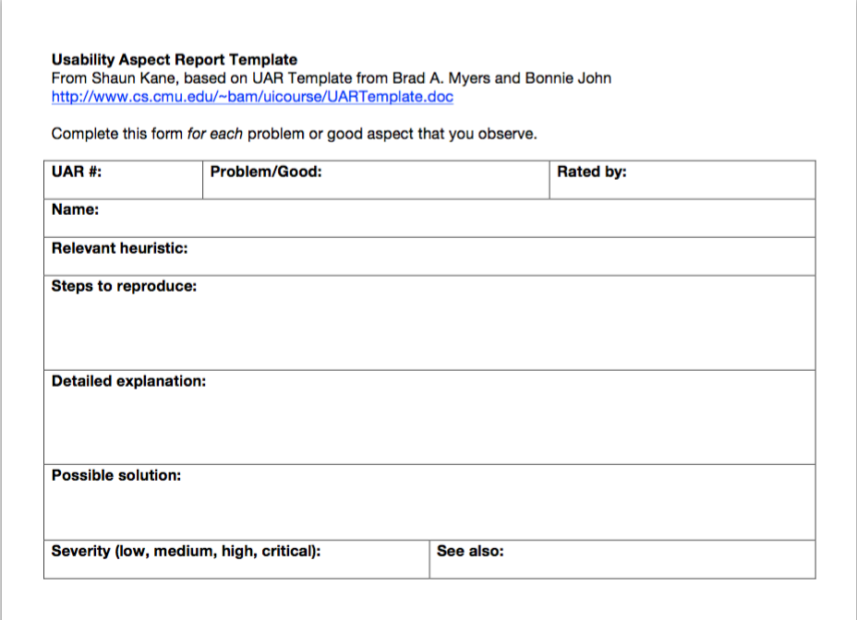

Slide 20
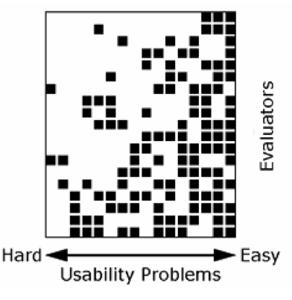
Keep looking for problems!
Usually takes a few hours
A shorter time may not find important problems
For very large interfaces, it is good to break heuristic evaluation into several sessions
Notes:
Note in the chart that not all evaluators will find the hard problems, but they will tend to find the easy ones

Slide 21
Custom heuristics
Nielsen’s heuristics are general
What is most important about our project?
We can make new heuristics for our particular use

Slide 22
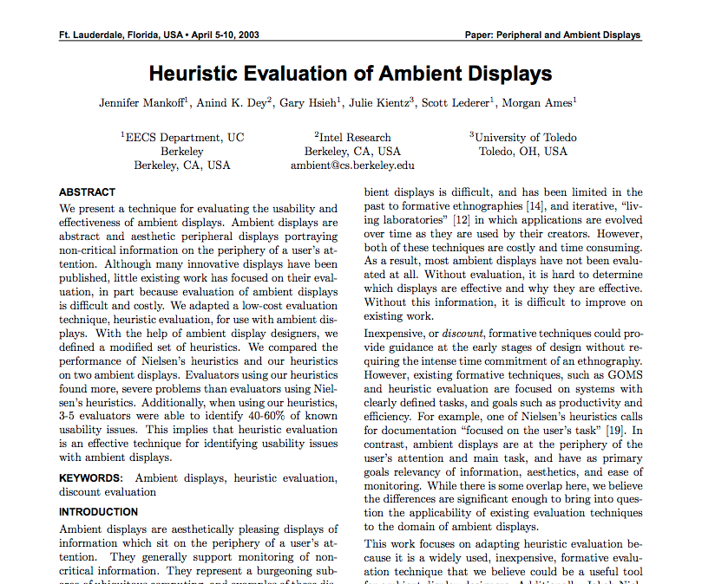
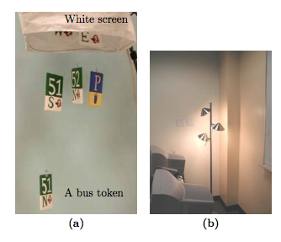
Example of custom heuristics
Notes:
https://dl.acm.org/citation.cfm?id=642642

Slide 23
New heuristics for ambient displays
Aesthetic and Pleasing Design. The display should be pleasing when it is placed in the intended setting.
Visibility of State. An ambient display should make the states of the system noticeable. The transition from one state to another should be easily perceptible.
Notes:
Version 1 on left, v2 on right

Slide 24
What makes a good X?
To get the most of this method, we may want to consider our own heuristics
Can be based on study observations, end user comments, prior studies
Notes:
shopping site?

Slide 25
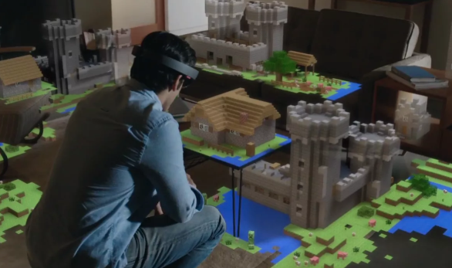
Brainstorming heuristics
Let’s spend a few minutes brainstorming heuristics for AR apps
How might we rate whether an email inbox is well designed for use?
Come up with at least 2 on your own (2N per group)
Notes:
Screenshots
Gmail: https://media.gcflearnfree.org/content/55e073847dd48174331f5193_01_17_2014/intro_labeled_graphic.jpg
Google inbox: http://ericgreer.info/assets/images/googleinboxweb.png
Apple Mail: https://support.apple.com/library/content/dam/edam/applecare/images/en_US/osx/yos_mail_conversations.png

Slide 26
Our AR app heuristics
Responsiveness to head movement
Field of view
  Maximizing it
  Making good use of it
Movement required is reasonable for where it’s being used
Minimum space requirements

Slide 27
Heuristics are not just for evaluation
If you’re working on Project X,
What makes a good X?
Activity: Take 3 minutes to answer this question for your project

Slide 28
Using heuristic evaluations
Good way to find usability bugs, especially with changes over time
Likely to miss some errors that a “real” user would catch
Best used in combination with other testing techniques

Slide 29
Similar method: Cognitive walkthrough
Usability method conducted by designers and usability experts
Tester takes the role of a typical user and completes tasks (similar to a user test)
At each step, write down:
  What is my goal at this step?
  What decisions might the user make?
  How will my goals change?
Notes:
http://sonify.psych.gatech.edu/~ben/references/polson_cognitive_walkthroughs_a_method_for_theory-based_evaluation_of_user_interfaces.pdf

Slide 30
Next time
More on the “rules” of usability
Understanding usability as a cognitive process

Slide 31
Bonus: Emotions in design

Slide 32
Emotional Design (Norman, 2004)
Three levels of design
  Visceral – raw emotional/physical experience
  Behavioral – does it work the way I expect?
  Reflective – how does using this affect my perception of myself, life, the universe, everything?

Slide 33
Emotional Design (Norman, 2004)
Three levels of design
  Visceral – raw emotional/physical experience
  Behavioral – does it work the way I expect?
  Reflective – how does using this affect my perception of myself, life, the universe, everything?

Slide 34
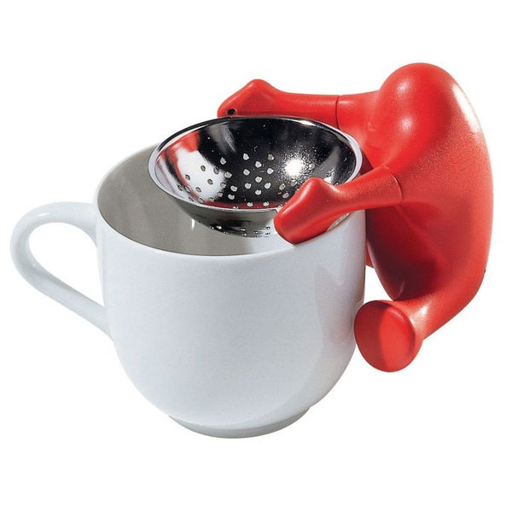
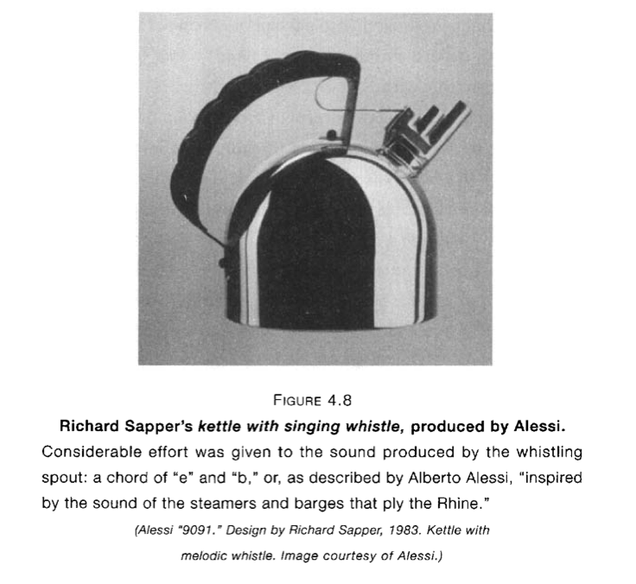
Playfulness and fun
Alessi tea strainer

Slide 35
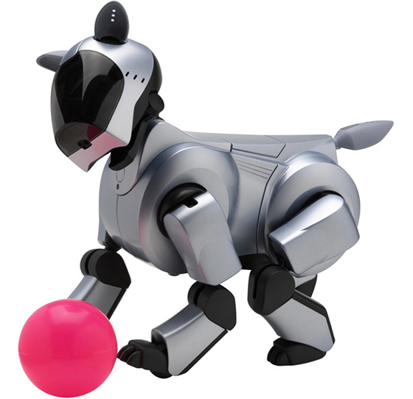
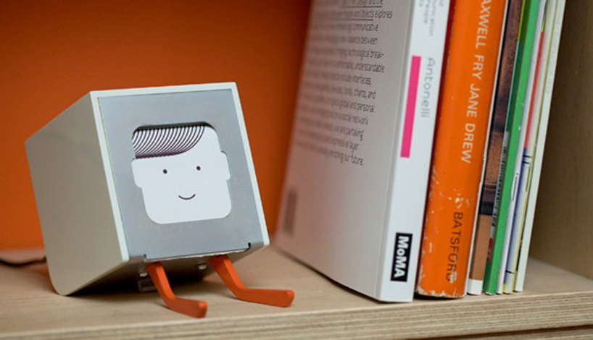
Technology with personality
BJ Fogg, “computers as social actors”
Physical: Face, eyes, body, movement
Psychological: Preferences, humor, personality, feelings, empathy, "I'm sorry"
Language: Interactive language use, spoken language, language recognition
Social Dynamics: Turn taking, cooperation, praise for good work, answering questions, reciprocity
Social Roles: Doctor, teammate, opponent, teacher, pet, guide

Slide 36
Other aspects of design
Ergonomics / human factors
Accessibility / universal design

Slide 37
What else do we need to know?
Guidelines/heuristics on good design
  Next week (usability heuristics and heuristic evaluation)
Standards
  “When should buttons be on the top or the bottom of the screen?”
  Example: Apple Human Interface Guidelines
User interface controls/toolkits
  Example: Twitter Bootstrap, iOS controls

Slide 38
Activity 2
Pair up with 1-2 partners
Goal: we are designing a set of gesture-controlled wireless headphones
  What functions should it support? (try to come up with some interesting ones)
  Design a set of interactions for controlling them – you can add gestures, add buttons, etc.
  How can mappings, affordances and constraints help?
  How can you give feedback?
You’ll act out a scenario where the user interacts with the device (and describe it, or sketch)

Slide 39
Activity 3
Pair up with 1-2 people
Consider Alexa
Evaluate with respect to:
  Affordances
  Constraints
  Feedback
  Mapping
  Gulf of execution
  Gulf of evaluation

