Slide 1




SMART INDIA HACKATHON 2026
Problem Statement ID – SIH26156
Problem Statement Title- Universal Log Pre-processing Framework
Theme- Blockchain & Cybersecurity
PS Category- Software
Team ID-
Team Name- EleventhHour

Slide 2
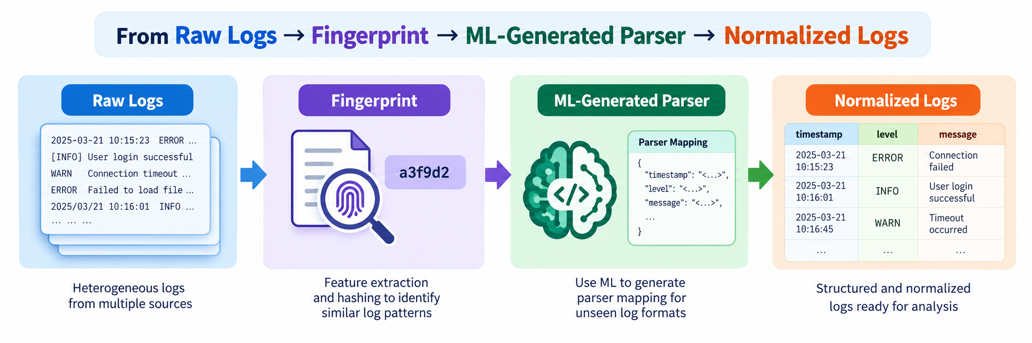
EleventhHour
Intelligent Log Normalization & Parser Generation System
Zero-Manual-Regex Ingestion Engine
2
Notes:
2

Slide 3
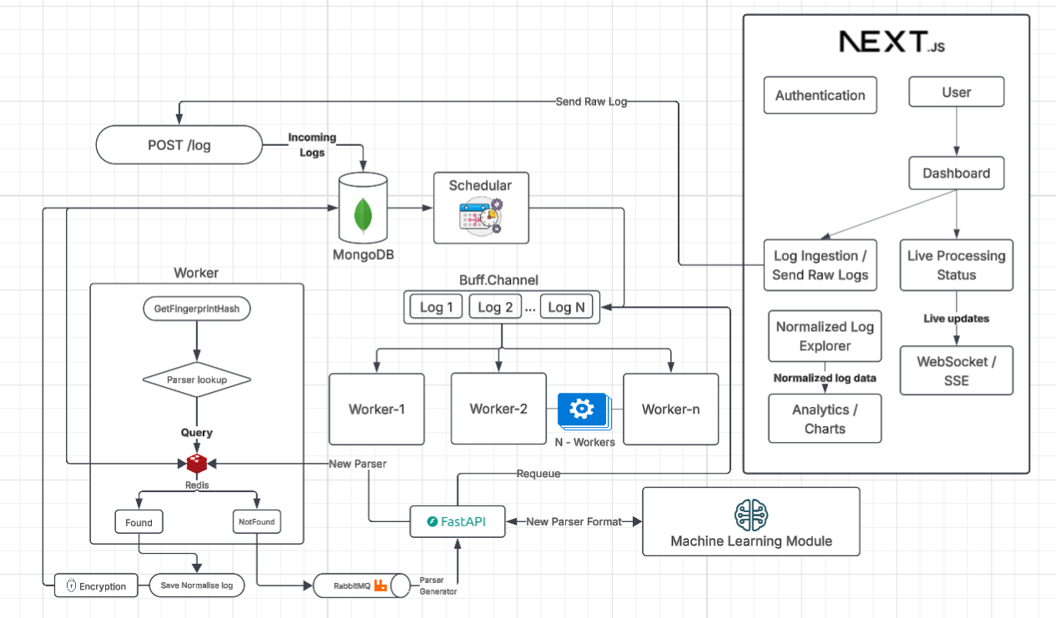









TECHNICAL APPROACH
EleventhHour
Your Team Name
Technology Used
Backend Engine: Go
Message Broker: RabbitMQ
High-Speed Cache: Redis
ML / Parser Synthesizer:
Python + FastAPI +
Pydantic + Groq API
Database & Persistence:
MongoDB
(Event store & audit log)
Frontend UI:
Next.js Tailwind
3
Notes:
3

Slide 4





FEASIBILITY AND VIABILITY
EleventhHour
Your Team Name
Technical Feasibility
Scalibility
Viability
Uses proven technologies: Database, Redis, RabbitMQ and ML services
120+ parallel workers enable concurrent log processing.
Fingerprinting reduces repeated parser-generation requests.
Redis caching provides fast parser retrieval.
RabbitMQ provides reliable asynchronous processing.
Workers can be scaled horizontally as log volume increases.
Queue-based architecture prevents processing bottlenecks.
Parser mappings are reusable across similar logs.
Asynchronous ML requests prevent the main pipeline from blocking.
Existing parsers are reused instead of regenerated.
ML is invoked only for previously unseen fingerprints.
Reduces manual parser creation and maintenance.
Architecture can support increasing log sources and formats.
Fine Tuning
Automatic Logs Collection
Future Scope
Fine-tune the LLM to generate
more accurate and reliable
parsers for previously
unseen log formats.
Automatically collect logs from the user’s system through an installed agent, eliminating the need for manual log uploads.
4
Notes:
4

Slide 5
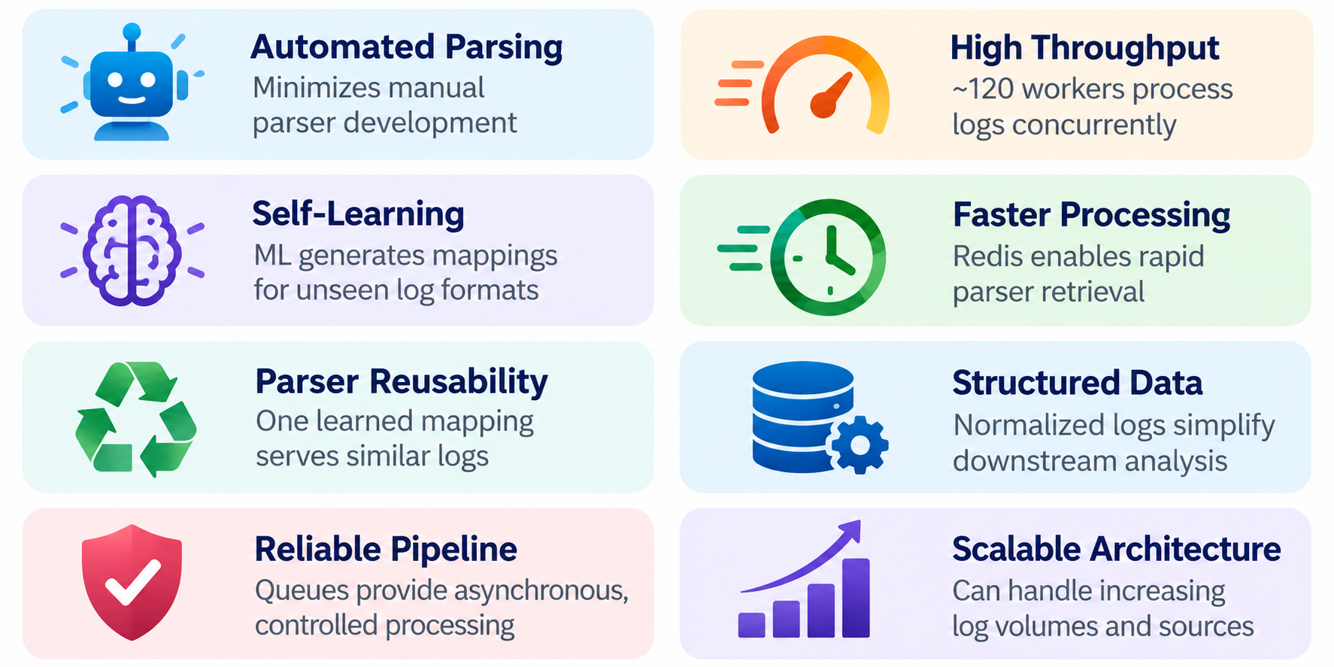
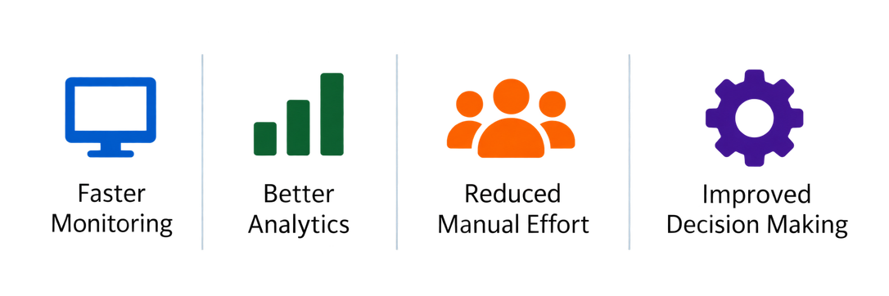
IMPACT AND BENEFITS
EleventhHour
Your Team Name
Transforming Raw Logs into Actionable Data
5
Notes:
5

Slide 6
RESEARCH AND REFERENCES
EleventhHour
Your Team Name
1. https://jiemingzhu.github.io/pub/pjhe_icws2017.pdf
2. https://go.dev/blog/pipelines
3. https://www.gofaq.org/en/how-to-implement-the-worker-pool-pattern-in-go
4. https://redis.io/docs/latest/develop/use-cases/cache-aside/
*Click to Interact
6
Notes:
6

