Slide 1

Shooting Friends and Missing Enemies
Decomposing Polarized Policy Preferences as Signal Detection Problems
Eleveny (Shiyi) Chen, UC Davis
Harry Yan, Texas A&M University
Daniel (D.J.) Flynn, IE University Madrid
Seth Frey, UC Davis
AAPOR 2026

Slide 2
The Puzzle
Americans appear deeply divided on policy.
Yet when policies are stripped of partisan labels, many command broad support. (Fiorina et al., 2005; Mason, 2018)
Is the measured depth of disagreement partly a measurement artifact?

Slide 3
Policy as Classification
Every policy that distinguishes cases is a classifier. Every classifier makes two kinds of errors.
Domain | False Positive | False Negative
Criminal Justice | Convicting the innocent | Acquitting the guilty
Immigration | Denying an admissible applicant | Admitting an inadmissible applicant
Voting | Blocking an eligible voter | Allowing an ineligible ballot
"Shooting friends and missing enemies."
Notes:
Blackstone's ratio — "better that ten guilty persons escape than that one innocent suffer"

Slide 4
Signal Detection Theory (SDT)
SDT separates two parameters:
Sensitivity (d′): How well the system separates signal from noise
Criterion (c): Where you set the threshold — which error is worse?
A policy preference conflates at least three inputs (Bullock & Lenz, 2019; Zaller, 1992):
Base-rate beliefs — "How common is the problem?"
Error thresholds — "Which mistakes are acceptable?"
Identity signaling — Partisan team expression
SDT separates #1 and #2. Whatever remains is #3.
Notes:
The goal is not to say that identity is irrelevant. The goal is to ask whether the partisan preference gap is actually coming from different perceived facts, different error trade-offs, or something else entirely.

Slide 5
Study Design Overview
N = 649 attentive U.S. adults (Prolific)
9 domains — 7 political (immigration, criminal justice, voting, firearms, welfare, airport security, armed conflict) + 2 neutral controls (disease testing, autonomous driving)
7 of 9 randomly assigned per participant
Three question types per domain:
B — Base-rate beliefs → d′, c
T — Error threshold → log₁₀(FP:FN)
P — Standard policy preference (ANES-style)

Slide 6
"What do you believe is happening?"
Criminal Justice (False Positive): "Imagine 1,000 defendants who are innocent. How many are incorrectly convicted?" [Participant enters: 0–1,000]
Immigration (False Negative): "Imagine 1,000 people who are inadmissible applicants. How many are incorrectly admitted?" [Participant enters: 0–1,000]
From these answers → FPR, TPR → d′ (sensitivity) and c (criterion)
Each participant gets 3 of 4 question types (FP, TN, FN, TP) per domain — enables both consistency checks and SDT computation.

Slide 7
"Which error is more acceptable, and by how much?"
Stage 1: Binary choice "Which error is more acceptable to you? — A guilty person is incorrectly acquitted — An innocent person is incorrectly convicted"
Stage 2: Ratio slider If "guilty acquitted" chosen: "It is acceptable for ___ guilty person(s) to be incorrectly acquitted so that 1 innocent person is not incorrectly convicted." [Slider: 1 · 10 · 100 · 1,000 · 10,000 · 100,000 · 1,000,000]
Direction (which error is worse) + magnitude (how much worse) → log₁₀(FP:FN) ratio — this is the threshold measure.

Slide 8
"How the experimental manipulation works"
B — Base-rate beliefs → d′, c
T — Error threshold → log₁₀(FP:FN)
P — Standard policy preference (ANES-style)
P block always first or last — never between B and T
H2 test: B before T → does base-rate priming increase threshold polarization? H4 test: T before P → does threshold articulation reduce preference polarization?
Controls: Age, education, income, sex, ideology Models: Mixed-effects with (1|respondent), within-theme z-scoring

Slide 9
Hypothesis Summary
H1A: Base-rate beliefs predict preferences
Beta = -0.19, p < .001 ← SUPPORTED
H1B: Error thresholds predict preferences (above d’/c)
Beta = 0.04, p = .010 ← SUPPORTED
H3: Preferences more polarized than thresholds
Beta(Rep x is_preference) = 0.55, p < .0001 ← SUPPORTED (headline finding)
H2: Base-rate priming increases threshold polarization
Beta = 0.02, p = .783 ← Not supported
H4: Threshold articulation reduces preference polarization
Beta = -0.10, p = .145 ← Not supported (pilot effect did not replicate)

Slide 10
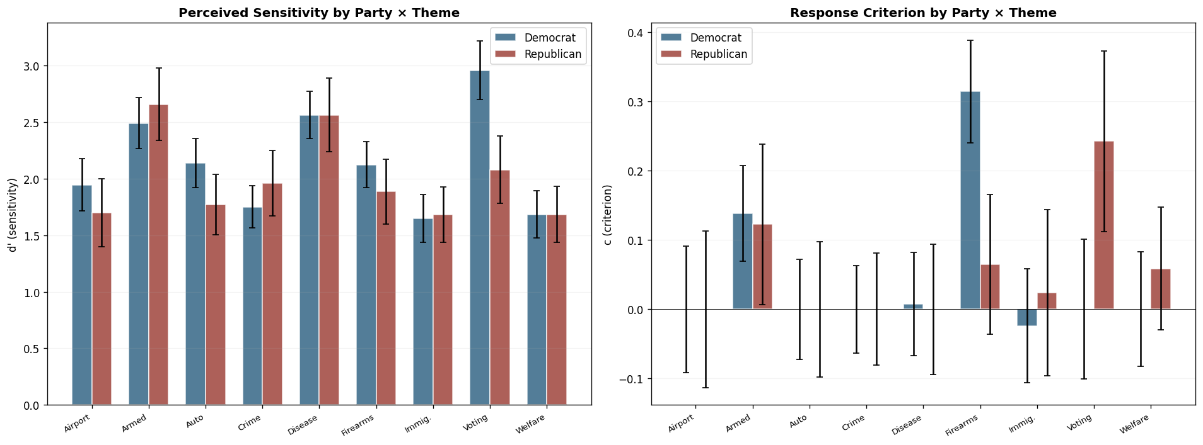
Where Partisan Differences Are: d’ and c by Domain
d′: Only voting shows a significant party difference
c: 5 of 9 domains significant, but direction varies
The mechanism of partisan divergence differs across domains

Slide 11
Per-Theme SDT Differences: Not One Story
Domain Delta-d’ (R-D) p(d’) Delta-c (R-D) p(c)
Disease Testing 0.00 .695 -0.01* .034
Armed Conflict +0.17 .507 -0.02 .578
Criminal Justice +0.21 .209 0.00 .245
Welfare 0.00 .612 +0.06** .007
Immigration +0.04 .650 +0.05** .001
Voter ID -0.88** .001 +0.24*** <.001
Airport Security -0.25 .578 0.00 .287
Firearms -0.24 .979 -0.25*** <.001
Auto Driving -0.37 .293 0.00 .818
Voting: sensitivity + criterion. Immigration: criterion only. Firearms: criterion, opposite direction. Different mechanisms, same label.

Slide 12
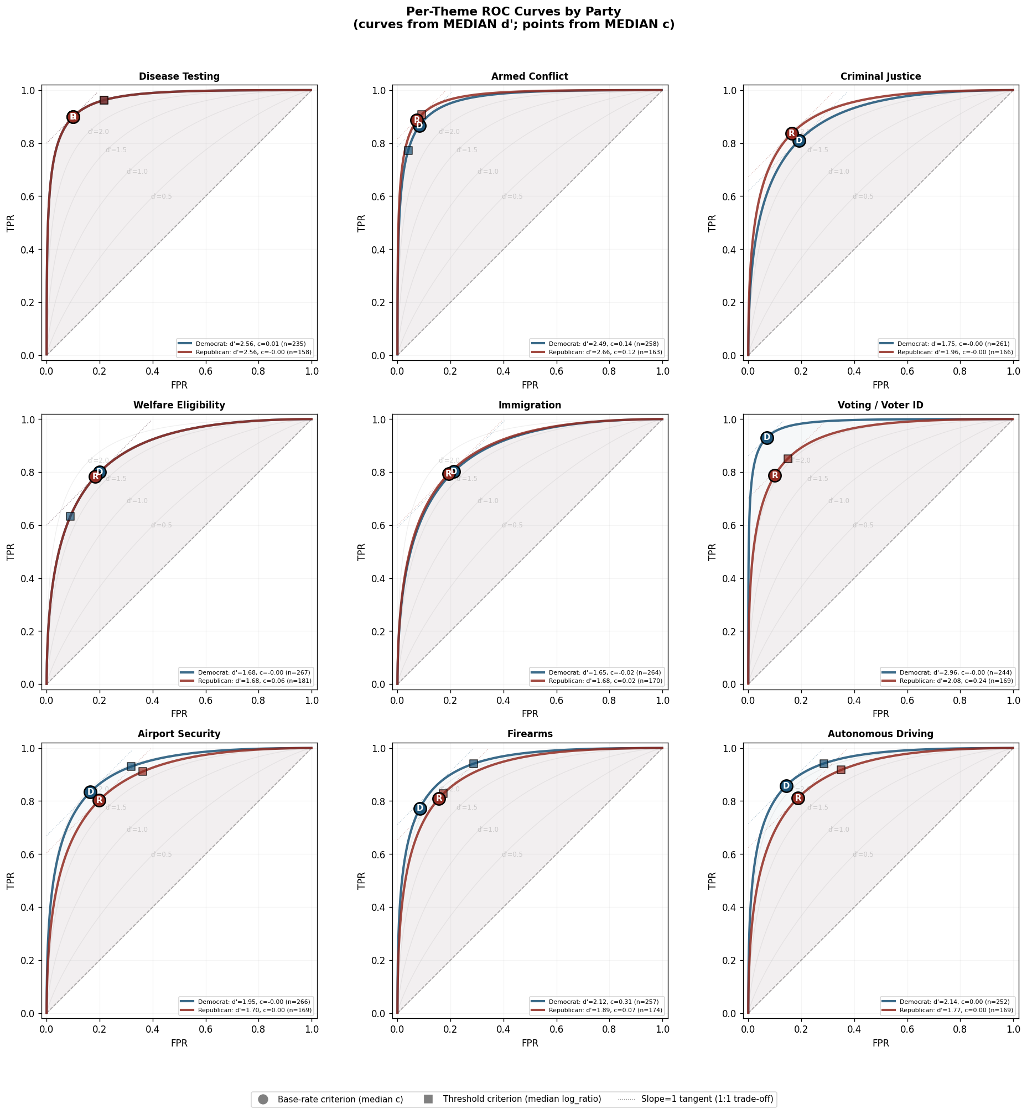
Immigration & Voting: Uniquely Divergent Domains
Only two domains where base-rate and threshold criteria cross over between parties
Consistent with genuinely divergent information environments — not just different values
The two most politically contested domains right now

Slide 13
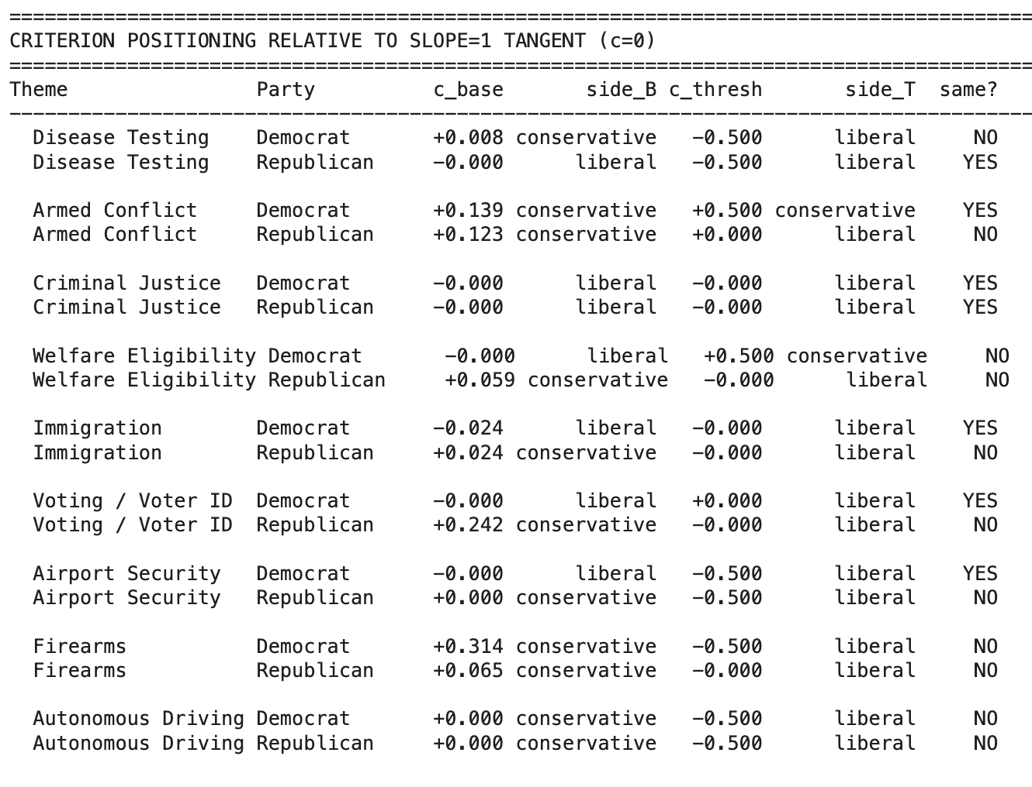
Criterion Positioning: Base-Rate vs. Threshold
General pattern: Explicit error reasoning pushes criteria liberal (away from 1:1 tangent), tolerating more false positives with fewer misses
Base-rate criteria sit closer to the "rational" 1:1 point
Threshold criteria sit systematically to the liberal side
Exceptions = immigration and voting — parties pushed in opposite directions
Notes:
Per-theme ROC curves showing D and R operating points + slope-1 tangents

Slide 14
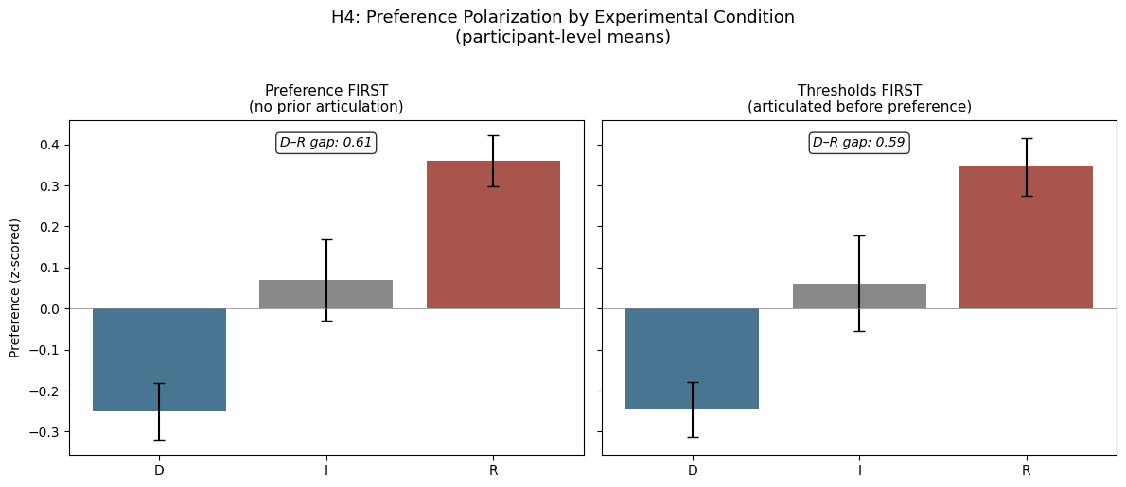
The Intervention Null: H4 Visualized
D–R gap: 0.61 (preference first) vs 0.59 (thresholds first)
β = −0.121, p = .095 — directionally right, not significant
The decomposition reveals hidden agreement. Experiencing it does not transfer to preferences.
Notes:
The decomposition reveals hidden agreement, but experiencing it doesn’t transfer.

Slide 15
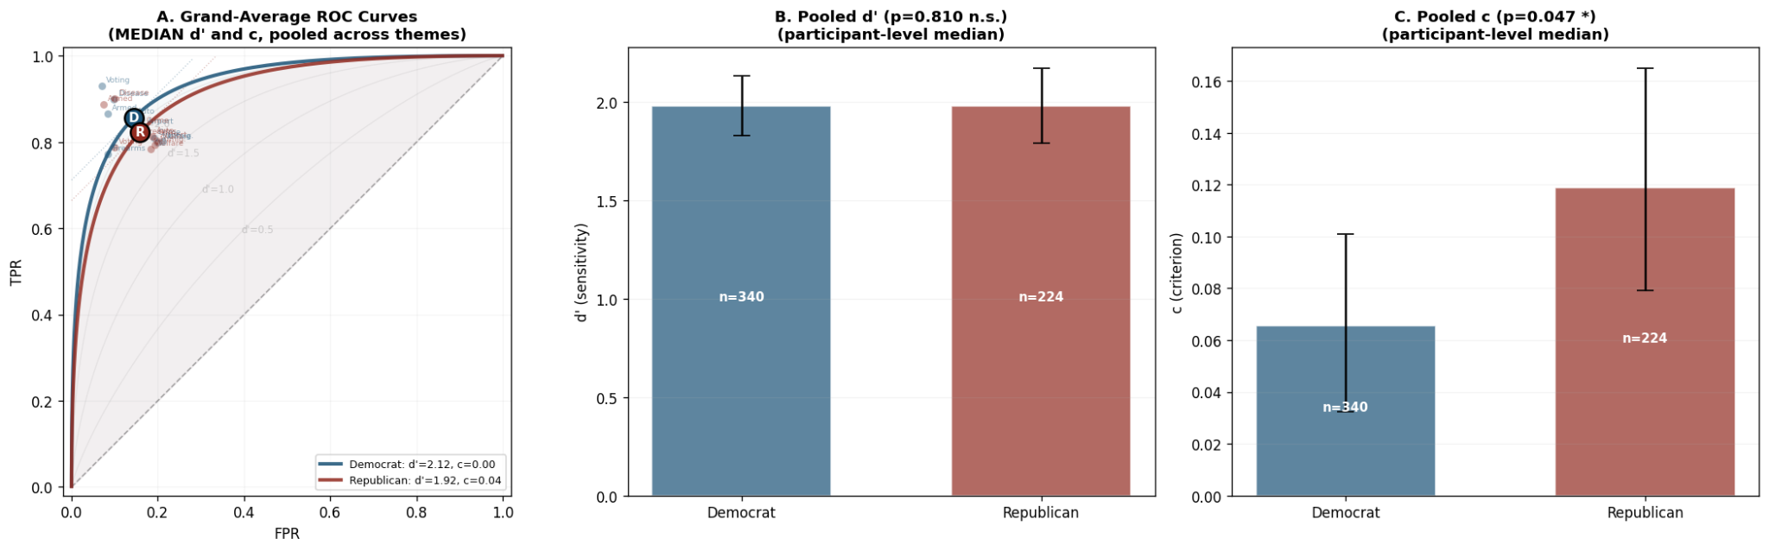
Pooled ROC: Convergence Is Predicted, Not a Null
Pooled d′: D = 2.12, R = 1.92 (p = .81) Pooled c: D = 0.00, R = 0.04 (p = .047)
If domain-specific differences vary in direction, pooling washes them out.
The convergence is a predicted consequence of domain-specific heterogeneity.

Slide 16
Implications
Measurement: Preference surveys measure a compound variable. The threshold gap is 0.55 SD smaller.
Theory: "Polarization" is not monolithic. Different domains, different mechanisms, different intervention targets.
Methodology: SDT generates its own diagnostics — below-diagonal points, logical consistency, criterion patterns.
The apparent unity of polarization may itself be a measurement artifact.

