Slide 1
Shooting Friends and Missing Enemies
What Americans actually disagree about when they disagree about policy
Eleveny (Shiyi) Chen, UC Davis · Harry Yan, Texas A&M · Daniel (D.J.) Flynn, IE University Madrid · Seth Frey, UC Davis
IC2S2 · Vermont
Notes:
Hi everyone, I'm Eleveny Chen from UC Davis.
When we say Americans are polarized on policy, what exactly are they disagreeing about? The facts? Their values? Or are they just wearing team jerseys? Today I want to show you a way to take policy disagreement apart into pieces — and tell you what we found when we did.

Slide 2
The Puzzle
Americans look deeply divided on policy.
Yet when the same policies are described without party labels, many command broad support (Fiorina et al. 2005; Mason 2018).
How much of the division we measure
is produced by the measuring stick?
Notes:
Here's the puzzle we started from. By every standard poll, Americans look deeply divided. But there's a long-standing wrinkle in that picture: when you describe the same policies without party labels, a lot of them get broad support from both sides.
A standard poll question — "do you support policy X?" — packs everything into one number: what you believe is happening in the world, which mistakes you're willing to accept, and which party you're on. So our question is the one on the screen: how much of the division we measure is produced by the measuring stick itself?

Slide 3
Every Policy Makes Two Kinds of Mistakes
Policy | Mistake 1: acting on the wrong person | Mistake 2: missing the right person
Criminal justice | Convicting an innocent person | Letting a guilty person go free
Immigration | Turning away someone who qualifies | Admitting someone who doesn't
Voting rules | Blocking an eligible voter | Counting an ineligible ballot
You cannot eliminate both. Tighten the rules and mistake 2 shrinks while mistake 1 grows. Every policy position is — implicitly — a choice about which mistake you'd rather live with.
Notes:
.....Our approach starts from one simple observation: every policy that has to sort people makes two kinds of mistakes.
A court can convict an innocent person — or let a guilty one walk free. An immigration system can turn away someone who qualifies — or admit someone who doesn't. Voting rules can block an eligible voter — or count a ballot that shouldn't count. The first kind of mistakes are called Type 1 error, the second ones are called type 2.
And here's the key: you cannot get rid of both. Tighten the rules, and one mistake shrinks while the other grows. So every policy position — whether the person knows it or not — is a choice about which mistake they'd rather live with. That's our title: shooting friends, and missing enemies.

Slide 4
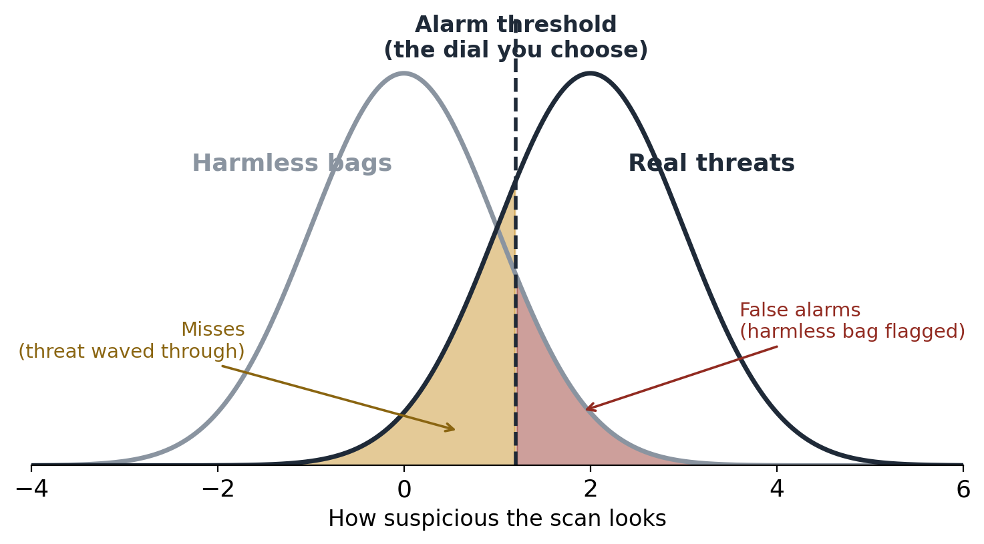
A Worked Example: The Airport Scanner
Dial 1 — Skill
d′ (sensitivity)
How well the scanner separates threats from harmless bags
Dial 2 — Judgment
c (criterion)
Where you set the alarm: strict or lenient. This one is a value choice.
Two machines can be equally good and still be set completely differently.
Notes:
Let me make that concrete with an airport scanner.
Every bag that goes through produces a suspicion score. Harmless bags — the gray curve — mostly score low. Real threats — the dark curve — mostly score high. But the curves overlap. Some harmless bags look suspicious; some threats look ordinary. That overlap is why mistakes are unavoidable.
The dashed line is the alarm threshold. Everything to the right gets flagged. Slide the line right and you get fewer false alarms — but more threats slip through. Slide it left and you catch everything — but you're pulling grandma aside for her shampoo.
So the scanner has two separate dials. Dial one is skill: how far apart those two curves are — how well it separates threats from harmless bags. Dial two is judgment: where you put the line. And notice — dial two isn't a technical question. It's a question about which mistake is worse. Two machines can be equally good and still be set completely differently.

Slide 5
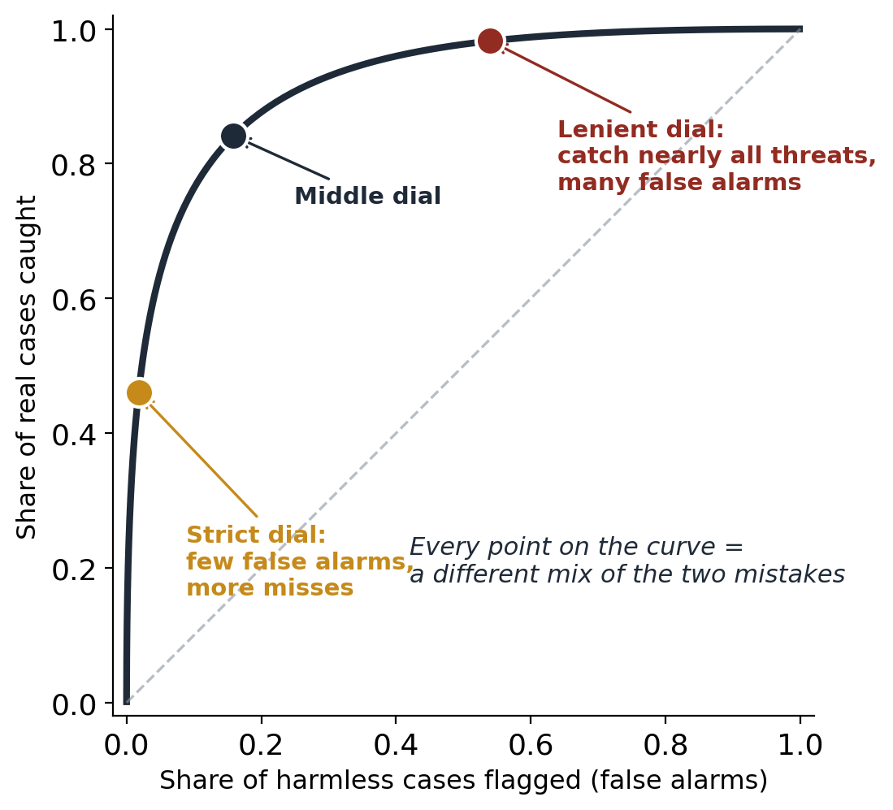
Turning the Dial Traces a Curve
One scanner, one skill level — a whole menu of settings.
Better skill pushes the whole curve up and left: fewer of both mistakes.
Where you sit on the curve is not a technical question. It is a statement about which mistake costs more.
“Better that ten guilty escape than one innocent suffer” — Blackstone was choosing a point on this curve in 1769.
Notes:
If you take one scanner — one fixed skill level — and slide the alarm line all the way from strict to lenient, you trace out this curve. Every point on it is a different mix of the two mistakes. Strict setting: bottom left — few false alarms, lots of misses. Lenient: top right — you catch nearly everything, at the cost of many false alarms.
Better skill lifts the whole curve — fewer of both mistakes. But where you sit on the curve is pure values.
And people have been stating positions on this curve for centuries. "Better that ten guilty escape than one innocent suffer" — that's Blackstone, 1769, choosing a point on this curve. He just didn't draw it.

Slide 6
One More Piece: Nobody Knows the True Error Rates
How many convictions are wrongful? How many admitted applicants shouldn't have been? Nobody knows these numbers — including us.
People act on their beliefs about them. And beliefs can differ by party.
We are not measuring ground truth.
We are measuring perceptions of ground truth —
and that is one distinct place partisans can divide.
Example from our data: the median Democrat believes 230 of 1,000 qualified immigration applicants are wrongly turned away; the median Republican believes 160.
Notes:
One more piece before the study. How many convictions are actually wrongful? How many admitted applicants shouldn't have been? Nobody knows those numbers. Not the government, not us.
People act on their beliefs about them. And beliefs can differ by party. So — this matters for everything that follows — we are not measuring ground truth. We are measuring perceptions of ground truth. And those perceptions are one distinct place partisans can divide, separate from their values.
Just one example from our data: the median Democrat believes 230 out of 1,000 qualified immigration applicants get wrongly turned away. The median Republican believes 160. Same system — different pictures of it.

Slide 7
What We Did
649 attentive U.S. adults
recruited via Prolific (343 D / 227 R / 79 I)
9 policy topics
6 political (immigration, criminal justice, voter ID, welfare, firearms, armed conflict) + 3 comparison topics (disease testing, airport security, self-driving cars)
Question order randomized
so we can test whether the exercise itself changes answers
1 · What do you believe is happening?
“Of 1,000 innocent defendants, how many get wrongly convicted?” → recovers both dials: perceived skill + perceived setting
2 · Which mistake is worse — and by how much?
“It is acceptable for ___ guilty people to go free so that 1 innocent person is not convicted.” → their preferred trade-off
3 · Standard survey question
Ordinary agree–disagree policy items, the kind every poll uses → the compound measure
Notes:
So here's the study. 649 attentive U.S. adults, recruited on Prolific. Nine policy topics — six political ones like immigration, voter ID, and firearms, plus three comparison topics like disease testing and self-driving cars, where we'd expect less partisan heat.
For every topic, three kinds of questions.
One: what do you believe is happening? "Of 1,000 innocent defendants, how many get wrongly convicted?" From answers like these we recover both dials people believe the system has — its perceived skill, and its perceived setting.
Two: which mistake is worse — and by how much? "It's acceptable for how many guilty people to go free so that one innocent person is not convicted?" That's their preferred trade-off. Their own Blackstone ratio.
Three: the standard survey question. Ordinary agree–disagree items — the kind every poll uses. The compound measure.
And we randomized the order, so we can test whether going through the exercise changes people's answers.

Slide 8
Finding 1 — Preferences Track Both Beliefs and Values
Beliefs matter
People who believe error rates are higher hold measurably different policy positions.
β = −0.19, p < .001
Values matter too
People's stated mistake trade-offs predict their positions — even after accounting for their beliefs.
β = 0.04, p = .010
Policy preferences are not team jerseys all the way down. They contain real cognitive ingredients that can be measured separately.
Notes:
First finding — really a sanity check. Do these separated ingredients actually matter?
Yes, both. People who believe error rates are higher hold measurably different policy positions. And people's stated trade-offs predict their positions on top of their beliefs — each ingredient carries its own weight.
So policy preferences are not team jerseys all the way down. There are real cognitive ingredients inside them, and they can be measured separately.

Slide 9
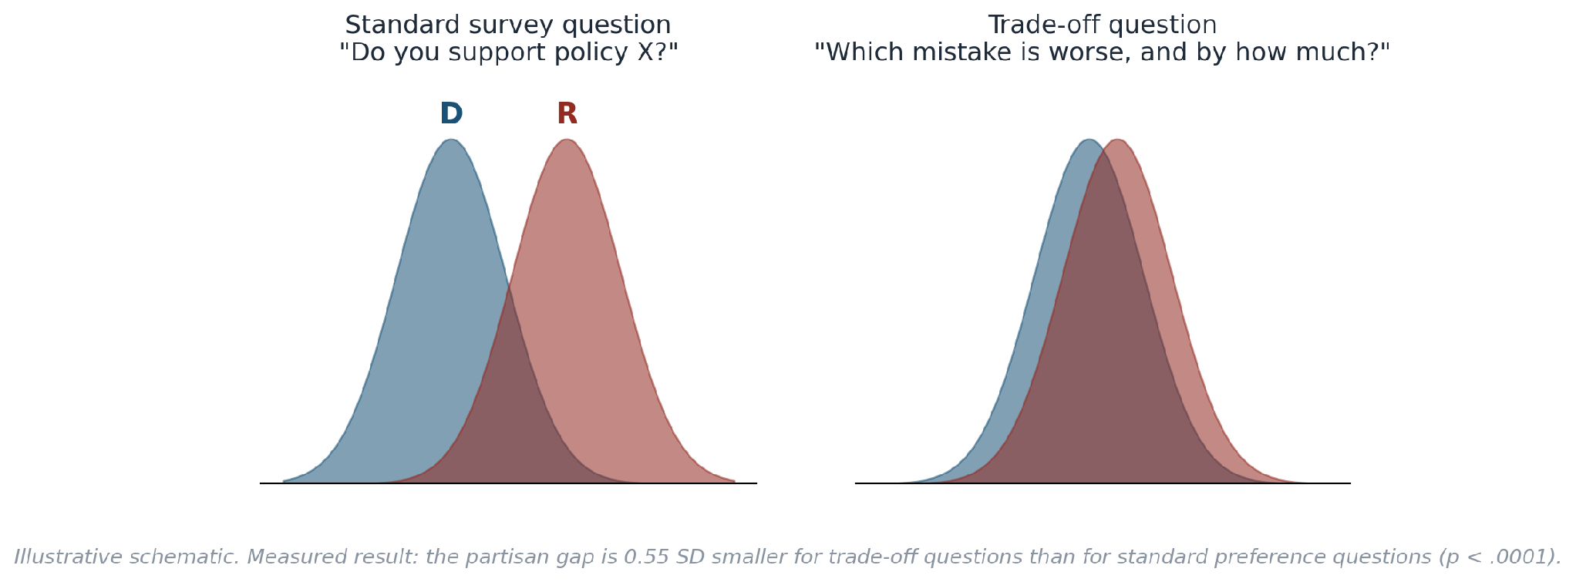
Finding 2 — Ask About Trade-offs, and Disagreement Shrinks
The partisan gap in trade-off answers is 0.55 standard deviations smaller than the gap in standard survey answers (p < .0001).
Notes:
Now the headline. Same people. Same topics. Same week.
Ask the standard survey question, and the parties sit far apart — the left panel. Ask instead "which mistake is worse, and by how much?" — and the parties move much closer together. The right panel.
Measured precisely: the partisan gap on trade-off questions is 0.55 standard deviations smaller than the gap on standard questions. That's not a rounding error. More than half a standard deviation of what we call polarization does not survive a change in question format.
Part of the divide, it turns out, lives in the instrument.

Slide 10
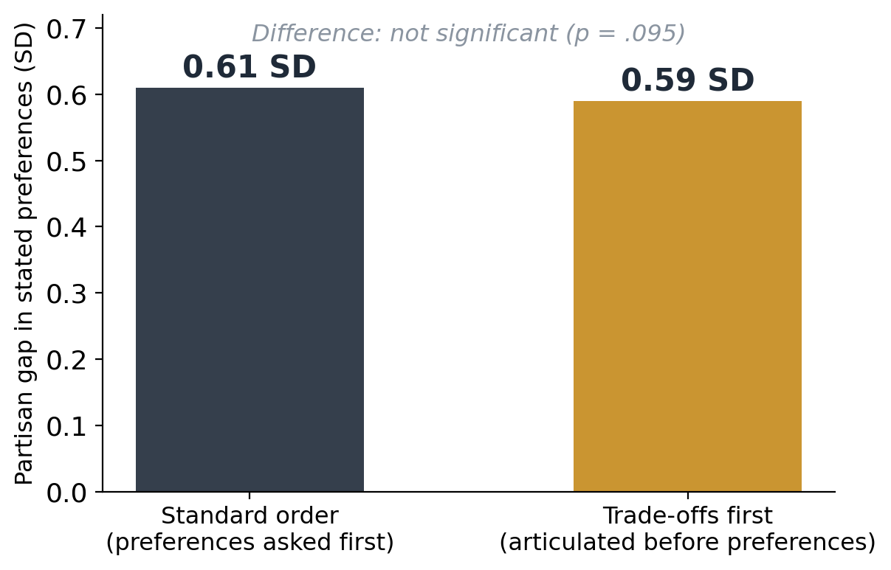
Finding 3 — But the Exercise Doesn't Change Minds
We randomized question order.
If articulating trade-offs de-polarized people, those who did it first should show smaller gaps on the standard questions.
They don't. (A promising pilot effect did not replicate.)
The hidden agreement is real — but experiencing it once does not transfer to how people answer the familiar question.
Notes:
So — natural next thought: if people articulate their trade-offs first, do they then answer the standard questions less politically? Does the exercise de-polarize them?
No. We randomized the order precisely to test this. The partisan gap is 0.61 with the standard order, 0.59 with trade-offs first. Not a significant difference. A promising effect from our pilot did not replicate.
So the hidden agreement is real — but experiencing it once doesn't transfer. The standard question seems to summon its own way of answering — the symbolic, team-flavored one. Which is a finding about the question, not a failed treatment.

Slide 11
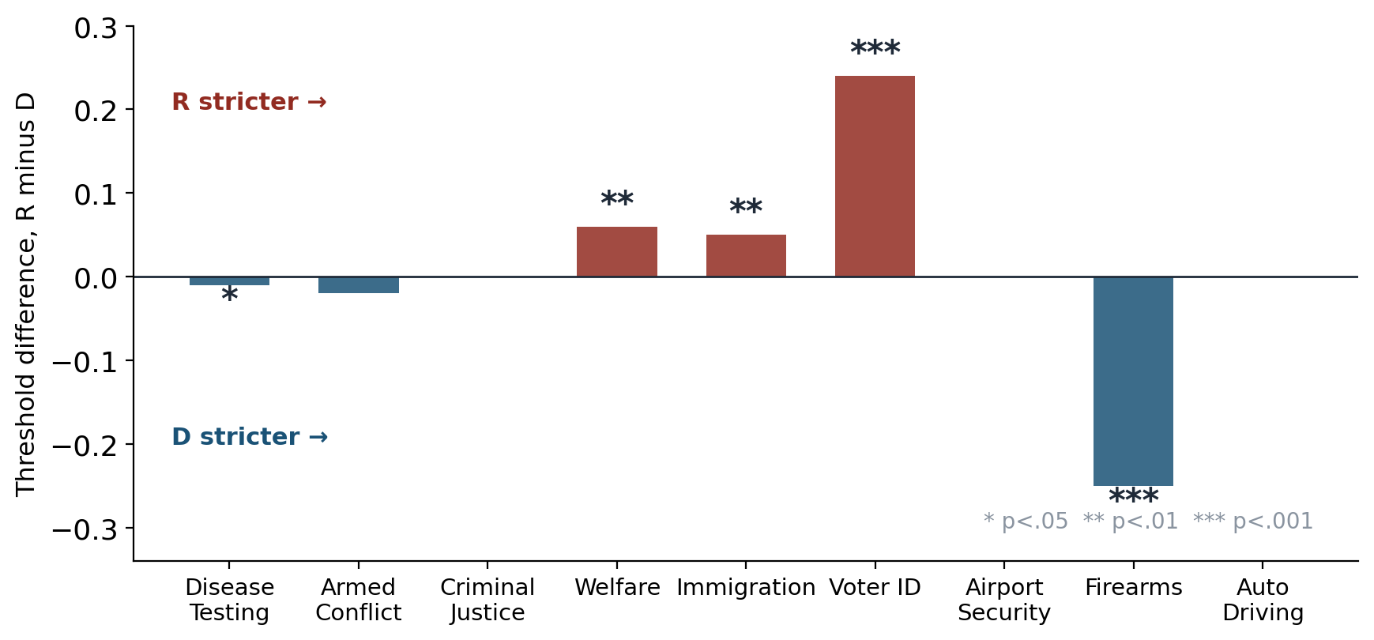
Finding 4 — “Polarization” Is Not One Thing
Voter ID:
parties differ in perceived skill AND setting
Immigration:
different beliefs about what's happening
Firearms:
thresholds differ in the opposite direction — Democrats set the stricter bar
Same word, three different disagreements — each pointing to a different kind of fix.
Notes:
And here's where the decomposition really pays off. "Polarization" is not one thing.
This chart shows, topic by topic, how the parties' preferred trade-offs differ. Look at three cases.
Voter ID — the biggest divide in the study, and it's in both dials: the parties disagree about how well the system can even tell eligible from ineligible, and about where the bar should sit.
Immigration — the parties' trade-offs barely differ. What differs is their beliefs about what's happening. That's a facts fight, not a values fight.
Firearms — the opposite: beliefs align, values split. And notice the direction — it's Democrats who set the stricter bar. The stereotype flips.
Same word — polarization — three different disagreements. And averaging across topics hides all of it: pooled together, the parties look nearly identical, exactly because these differences point in opposite directions.

Slide 12
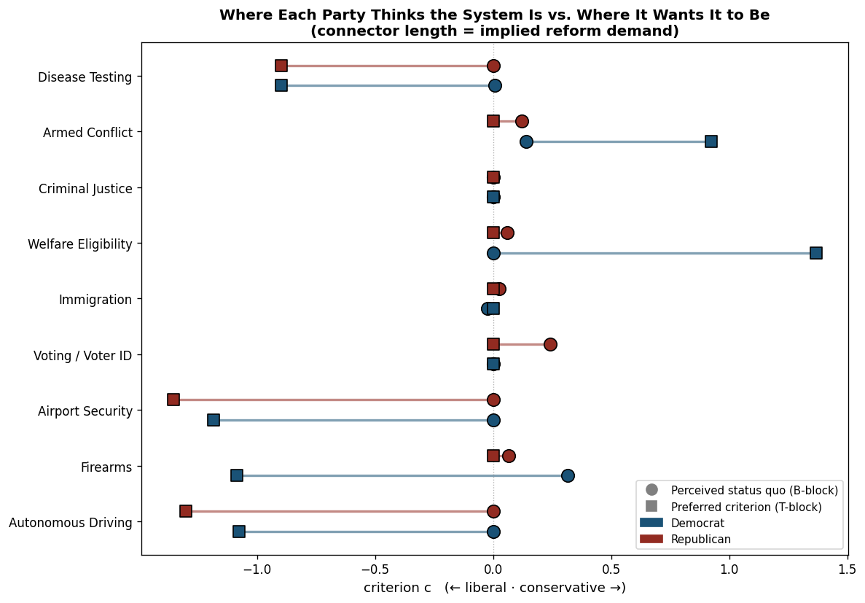
A New Lens: Where People Think We Are vs. Where They Want to Be
The belief questions tell us where people think the system currently operates.
The trade-off questions tell us where they want it to operate.
The gap between the two is each side's implied reform demand — its direction and its size.
Notes:
One more thing this framework unlocks — where we're going next.
The belief questions tell us where people think the system currently operates. The trade-off questions tell us where they want it to operate. The gap between the two is each side's implied reform demand — direction and size.
That opens questions like: are there topics where the parties actually want reform in the same direction — hidden agreement not just about trade-offs, but about change itself? And on which topics do the two sides disagree about where the status quo even is? [gesture to figure] This is what that looks like across our nine topics.

Slide 13
What This Means
If you run surveys
The standard policy item is a compound measure — beliefs, values, and identity in one number. Report it as such, or unbundle it: the trade-off format is one working unbundling tool.
If you work on depolarization
Target the right ingredient per topic. Immigration divides on beliefs — facts might help. Firearms divides on values — facts won't. One-size-fits-all interventions aim at an average that describes no topic.
If you build decision systems
Error trade-offs are elicitable from ordinary people in plain language. That is the interface algorithmic policy needs: thresholds humans can state and machines can implement.
Notes:
So, three takeaways for three audiences.
If you run surveys: the standard policy item is a compound — beliefs, values, and identity in one number. Report it that way, or unbundle it. The trade-off format is one working unbundling tool.
If you work on depolarization: target the right ingredient per topic. Immigration divides on beliefs — facts might help there. Firearms divides on values — facts won't. One-size-fits-all interventions aim at an average that describes no actual topic.
And if you build decision systems: ordinary people can state error trade-offs in plain language. That's the interface algorithmic policy needs — thresholds humans can state, and machines can implement.

Slide 14
Thank you
The apparent unity of polarization may itself be a measurement artifact.
Eleveny (Shiyi) Chen · syechen@ucdavis.edu
Harry Yan · Daniel (D.J.) Flynn · Seth Frey
Paper, data, and analysis notebooks available on request
Notes:
I'll leave you with one sentence: the apparent unity of polarization may itself be a measurement artifact. Different topics, different disagreements, different fixes.
Thank you — I'm happy to take questions.

Slide 15
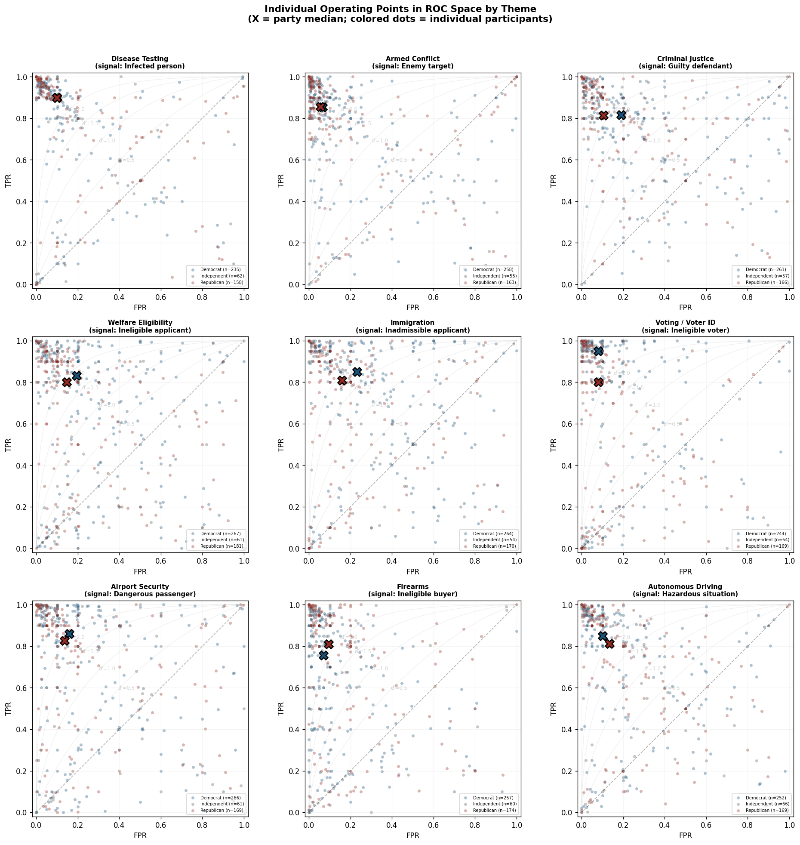

Slide 16
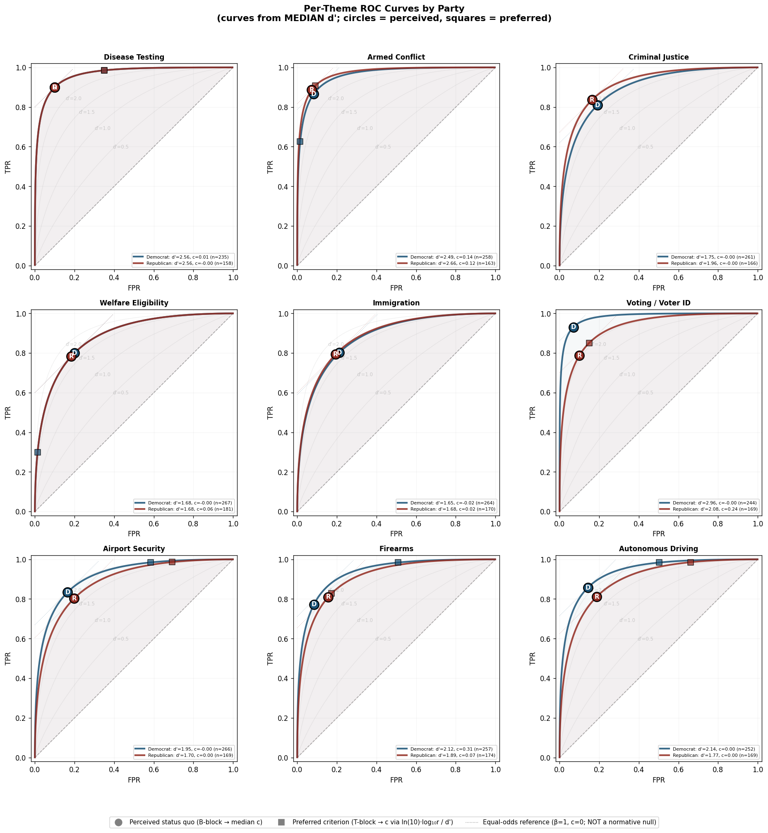

Slide 17
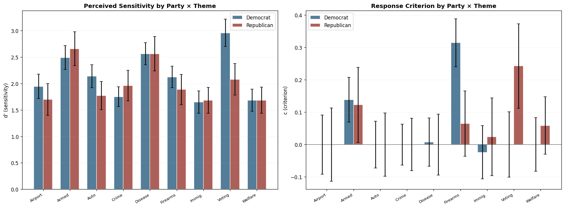

Slide 18
