Slide 1
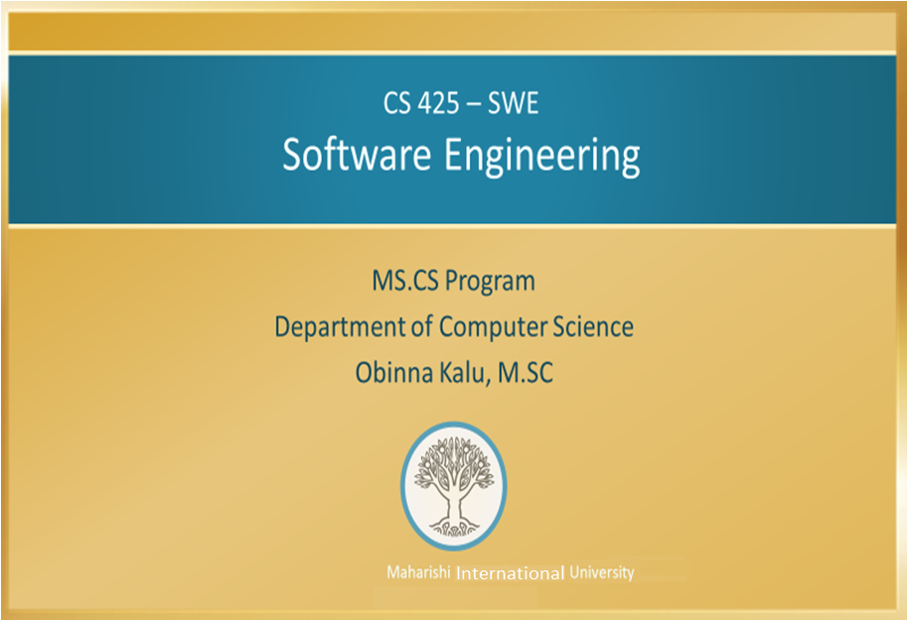

Slide 2
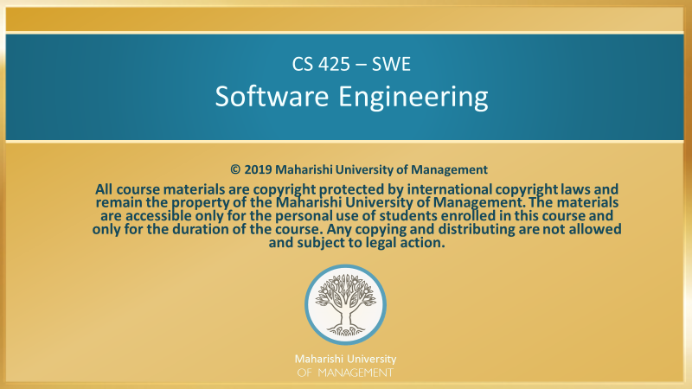

Slide 3
Lesson 1: Course Introduction
Knowledge Has Organizing Power

Slide 4
Topics: Course Introduction
Introduction to Software Engineering
Course project

Slide 5
Introduction to the Course
Course Approach:
Project Teams: 3 – 4 members
Each team will be expected to execute on their project, covering all the steps of software engineering, up to system testing and deployment
Each team will give 2 presentations:
System design presentation
Demo of the finished project
Course website: See Sakai CS425-2020-01A-01D

Slide 6
Brief History of Software Engineering
Early day: small toy programs
As programming languages and processing speed improved, more useful applications were developed
New problems arose in creating still larger applications:
Need for effective way to communicate requirements
Need for effective way to formulate and communicate design ideas; to record what has been done so far and why

Slide 7
Evolution of Solutions
Early solutions:
More emphasis on documentation and good documentation styles
Tools were developed to help visualize software design (eventually lead to, the UML)
A new design paradigm emerged – the “Object-Oriented” paradigm, which greatly facilitated the process of building larger scale applications with less cost and fewer failures

Slide 8
Software Development Processes and RUP
Emergence of Software Development Processes
As developers learned good OO techniques and documentation practices, the problem that remained: How to put all of the techniques together to produce good software?
The following questions needed addressing:

Slide 9
Software Development Processes and RUP
How long do we spend on initial requirements?
To what extent do requirements need to be fully understood before beginning design? Coding?
How do we formulate a plan for completing a project when most of the details about the project are unknown?
How do we make sure that the stakeholders for the project are satisfied with the end-result?

Slide 10
Software Development Processes and RUP
Software development processes address these concerns
RUP = Rational Unified Process has become the industry standard for providing methods of development that provide reliable answers to these questions
Agile Modeling, and agile development methods including SCRUM and eXtreme programming are widely used.
SCRUM and eXtreme are compatible with RUP.

Slide 11
Software Development Processes and RUP
Goal –> optimize and choose the best software development method based on project size, staff expertise, project goals, and other project specific characteristics.

Slide 12
Fundamental Goals of Software Engineering
Examining the aims of development methodologies, we see several fundamental goals:
A clear vision about a project that can be communicated to others (“see the tree in the seed”).
Ability to respond positively to change
Ability to minimize mistakes
Ability to fulfill a large-scale intention (get the right result on time and within budget)

Slide 13
Fundamental Goals of Software Engineering
These aims have as much to do with the quality of the developer’s awareness as they do about the development processes themselves

Slide 14
The Role of Transcendental Meditation (TM) in Software Engineering
Hundreds of studies and the experience of thousands of practitioners – including software developers – verify that the qualities needed for successful software development are developed and enhanced by TM
Clear thinking
Ability to adapt to change
Ability to achieve set goals
Ability to make fewer mistakes

Slide 15
The Role of Transcendental Meditation (TM) in Software Engineering
Science of Consciousness Principles:
Subtler Levels of the Mind Are More Powerful
Water the Root to enjoy the Fruit
Frequently, during TM or immediately after TM, solutions to problems will spontaneously arise.
The mind has had a chance to relax and transcend the level of the problem.

Slide 16
The Role of Transcendental Meditation (TM) in Software Engineering
Science of Consciousness Principle:
Release of stress and contact with Pure Consciousness supports spontaneous right action
Learn to recognize when you and your team members are being stressed
Team dynamics will start to deteriorate under stress. Stress causes spontaneous wrong action
Use TM® as a way to avoid and release stress
One person with a balanced and calm perspective can improve a whole team’s productivity

Slide 17
The Role of Transcendental Meditation (TM) in Software Engineering
“Transcending thought is infinitely more valuable than thinking”.
--Maharishi Mahesh Yogi

Slide 18
Example Course Project
MIUScheduler – design and develop software solution for managing course registration and scheduling of classes to be used by MIU Compro Students, Faculty and Staff.
The MIUScheduler system will take as input, the classes being offered in a block, the number of students for each entry, and the number of faculty, their areas of expertise and courses they teach. It will then generate a block-by-block schedule for the semester or academic year.

Slide 19
Course Project – tools and technologies
You will be expected to use various industry standard tools and technologies, some of which you will learn about in this course, to help you execute on the project. Project teams may choose to use other comparable tools/technology stacks. Here is a sample:
Github for team development
UML for design
Enterprise software dev stack - Java EE, Spring, .NET etc.
SQL and/or NoSQL Database
Unit Testing and mocking framework e.g. JUnit, Mockito
Software Dev Process model: Agile, RUP, Scrum etc.

Slide 20
Main Points
In this lesson, we are given an introduction to this Software Engineering course
The Course project will require students to work in teams of 3 to 4 members
Science of Consciousness: The benefits of TM include a clearer understanding of deeper principles of life, allowing us to more easily take the right actions to achieve a desired result.

Slide 21
CONNECTING THE PARTS OF KNOWLEDGE WITH THE WHOLENESS OF KNOWLEDGE
Introduction to Software Engineering
Software Engineering is the systematic application of a disciplined approach to the design, development, operation and maintenance of computer software.
Applying sound engineering principles, helps us to produce software that is reliable and works efficiently.
_________________________________________________
Transcendental consciousness is when our mind is in contact with the deepest underlying reality, the unified field.
Impulses within the Transcendental field: the infinite dynamism of the unified field constantly expresses itself and becomes all aspects of creation.
Wholeness moving within itself: In Unity Consciousness, one experiences that this infinite dynamism is nothing but the self.

