Slide 1
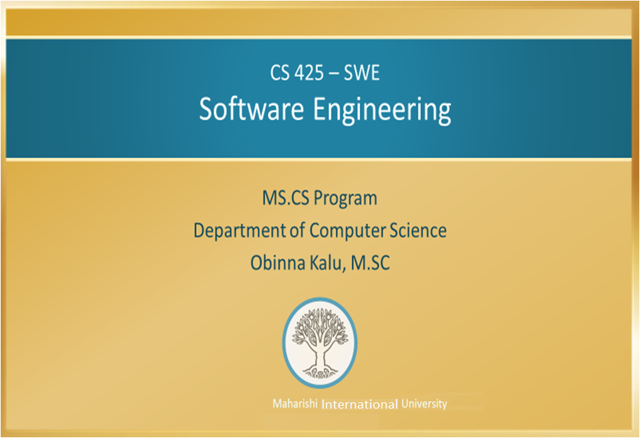

Slide 2
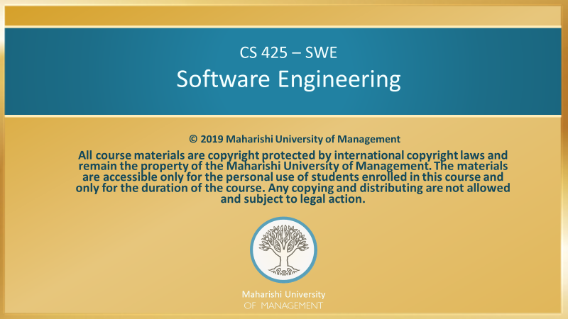

Slide 3
Main Points
We will use a course project as the focus of the activities in the course. The organizing power inherent in knowledge manifests itself in the field of action.
Software Engineering studies the principles for creating reliable and easily maintenable software, delivered on time and within budget. A month-long project will be used in the course to provide hands-on experience of some of the most important of these principles. Likewise, SCI studies the fundamental principles that underlie Life itself amd brings out effective techniques for making individual and collective life as rich and fully developed as possible. Through the practical application of SCI, using technologies of the Unified Field such as the TM and TM Sidhi programs, we gain direct experience of the powerful effect of engaging Nature’s intelligence in our individual, family, community, national and global endeavors.

Slide 4
CONNECTING THE PARTS OF KNOWLEDGE WITH THE WHOLENESS OF KNOWLEDGE
Introduction to Software Engineering
Software Engineering is a discipline that offers best practices and optimized methodologies for software development. It organizes and presents the insights and discoveries of computer scientists, researchers and engineers, acquired over several decades.
The deeper truth about the principles of good software engineering, elaborated in the Software Engineering discipline is that the principles are only valuable to the extent that they are applied. Practical application of these principles is a central ingredient in learning and benefitting from this discipline.
_________________________________________________
Transcendental consciousness provides proof of the existence of a pure field of consciousness, beyond the domains of thought, feeling and sensory experience. Experience of this field draws into the individual life, the qualities and powerful dynamics of cosmic life.
Impulses within the Transcendental field: the transcendental field of pure consciousness is awake within itself and rises in waves of self-interacting dynamics.
Wholeness moving within itself: In Unity Consciousness, the field of pure consciousness is no longer “transcendental”, but it is the intimate reality of every aspect of experience. The organizing power of this field becomes, in this state, fully lively in the impulse of one’s own thought.

