Slide 1
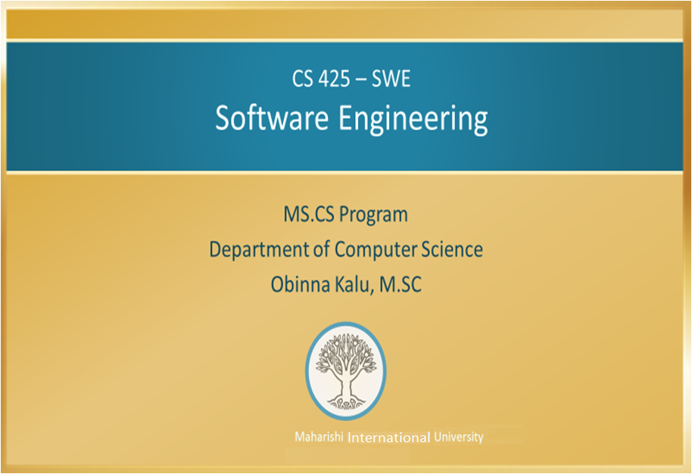

Slide 2
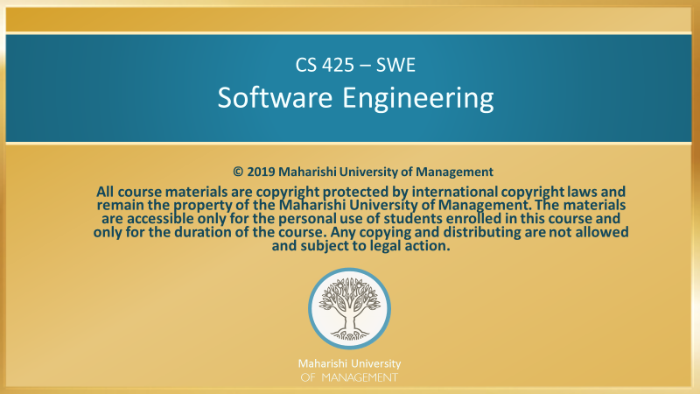

Slide 3
Main Points
Accurate and clear requirements form the basis of the entire software development process, and the first step in formulating these is by performing Systems Analysis, which makes use of a variety of techniques for discovering use needs and features. Elicitation of requirements is successfully achieved, like any action requiring skill, by application of the Maharishi Vedic Science principle that the unlimited organizing power of Nature is available at each point in creation.
To build a good software system that meets the needs of stakeholders, it is not enough to make use of best practices for design and implementation. It is also necessary to obtain a clearly formulated set of user requirements. To achieve this aim requires significant interaction with the users and other stakeholders. This fact illustrates a parallel theme in Maharishi Vedic Science: Though the universe does emerge from the dynamics of pure consciousness, these dynamics are not remote or separate from the day-to-day reality of the universe; in fact, they are fully present at every point in creation. Likewise, to be a maximally effective software developer, one must be able to apply best practices and abstract principles, but at the same time, do so in the midst of – and not divorced from – the problem domain.

Slide 4
CONNECTING THE PARTS OF KNOWLEDGE WITH THE WHOLENESS OF KNOWLEDGE
Introduction to Software Engineering
Requirements analysis starts by defining and documenting the problem, client needs and features.
There are inherent complexities in accurately eliciting client needs. It must be done carefully and systematically in order to form a solid foundation for the rest of the software development process.
_________________________________________________
Transcendental consciousness is the pure field of soultions; the field of all possibilities.
Impulses within the Transcendental field: Pure consciousness is the home of nature’s infinite creativity. Engaging this field saturates the individual mind with lively value of creative solutions.
Wholeness moving within itself: In Unity Consciousness, solutions to problems arise effortlessly and are experienced as the lively flow of pure consciousness within itself.

