Slide 1
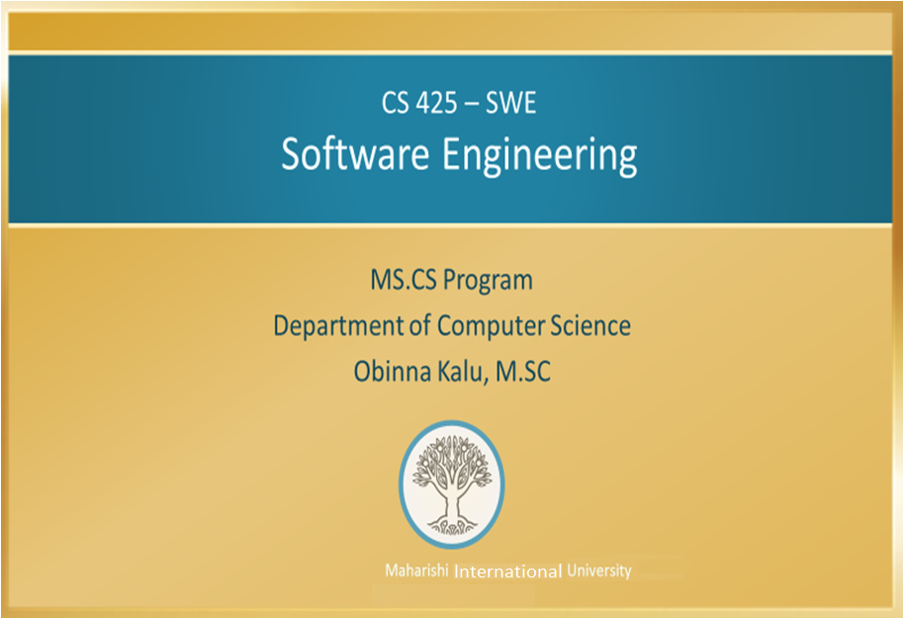

Slide 2
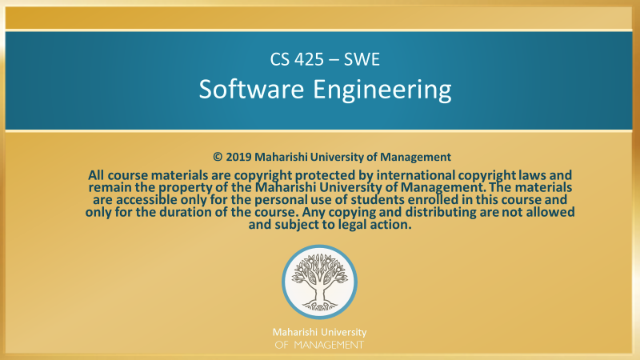

Slide 3
Main Points
Software development is an extremely complex process and procedures have evolved from industry experience to guide and coordinate all the activities and interactions. In a parallel fashion, actions arising from the level of pure consciousness will have the support of the mighty organizing power of Natural Law; such actions are destined to succeed.
All software engineering processes are designed to promote clearer thinking throughout the steps of the development lifecycle, with particular emphasis on the stages of the project. Techniques in RUP to enhance clarity of thinking include a systematic approach (via Use-cases) to getting the requirements right; a systematic approach to visualizing and elaborating the requirements via interaction and VOPC diagrams; and a step-by-step approach to building the architecture, by identifying key abstractions initially and later identifying subsystems.

Slide 4
Main Points cont’d
Alertness to these early details is further enhanced by taking an incremental and iterative approach, so that important details are not overlooked and mistakes can be corrected quickly.
A natural support for the aims of software engineering methodologies is a technique for enhancing clarity of consciousness itself. When consciousness is clear and open to the deeper laws that govern the flow of life, it is less likely that significant details in any endeavor will be overlooked. It is therefore natural to include TM as a significant component of any good software engineering methodology.

Slide 5
CONNECTING THE PARTS OF KNOWLEDGE WITH THE WHOLENESS OF KNOWLEDGE
Introduction to Software Engineering
RUP provides a detailed sequence of steps for incorporating best practices and useful artifacts, resulting in well-built and easily maintainable software.
RUP is based on clarifying the thought process behind the development of software. By paying attention to key details in the development process, RUP is able to provide the developer with just the right tools at each step in the course of the software project.
_________________________________________________
Transcendental consciousness is the field on which thoughts, perceptions and feelings arise as waves. Clarity of thought has its ground in availability of the transcendental field.
Impulses within the Transcendental field: When awareness is established in its unbounded nature, intentions and desires that arise have full support of Natural Law, since it is from this field that the Laws of Nature become to operate.
Wholeness moving within itself: In Unity Consciousness, clarity of the thinking process is never lost because the transcendental value of every object is never lost to perception.

