Slide 1
eRegistrar
Course scheduling and registration for a university department
System Requirements and Design
Ziad El Fatih · 618971 · CS425 Software Engineering · August 2026
Notes:
eRegistrar: course scheduling and registration. Covers the vision, the use-case model, the architecture, and the analysis of the significant use cases, plus what is already running.

Slide 2
The problem
Lab 1: Vision
4
100–130
8–9
~3 weeks
entries per year
students per entry
electives per block
to build one schedule
up from 3, each needing its own schedule
registering by paper form, re-keyed by staff
plus FPP and MPP courses to place
by hand, in a spreadsheet
What goes wrong today
A successful solution
Faculty preferences arrive by email and are applied inconsistently
Prerequisite and capacity violations surface after registration closes
One schedule change forces a manual re-check of every registration
Nobody can see live enrolment until the spreadsheet is reconciled
One system holding courses, faculty profiles, programs and the schedule in a single database, applying the scheduling and prerequisite rules automatically, with role-appropriate web access for administrators, faculty and students.
Notes:
The department outgrew its spreadsheet process. Four entries a year, up to 130 students each, and a three-week manual scheduling cycle. The rules exist but are enforced by people, late.

Slide 3
Features driving the design
Lab 1: Problem / Need / Feature
F1
Faculty Profile Management
F3
Schedule Generation
Faculty own their specializations, teachable courses and block availability
Draft schedule built from program requirements, qualification and availability
F4
Assignment Conflict Detection
F5
Online Student Registration
No double-booking, no unqualified assignment. Checked, not trusted.
Students register themselves and get an immediate answer
F6
Registration Rule Enforcement
F8
Role-Based Access
Prerequisites, capacity, time conflicts and course load enforced at submit
Single sign-on with Admin, Faculty and Student roles
Eight features in total; these six are the ones the architecture has to satisfy.
Notes:
The problem-need-feature table produced ten features. F3 to F6 are the heart of it: generate the schedule, and enforce the registration rules at the point of attempt.

Slide 4
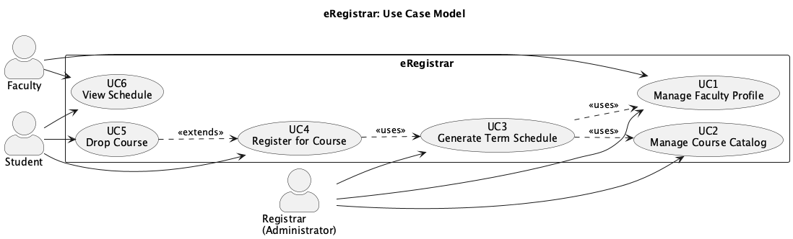
Use-case model
Lab 2: SRS
Actors
Student
Register / drop courses, view schedule
Faculty
Maintain profile, view sections and rosters
Registrar
Catalog, schedule generation, assignment, reports
Identity Provider
Single sign-on (external)
SIS
Student records, published schedule (external)
6 use cases identified. UC3 and UC4 are described in full and carried into analysis.
Notes:
Three human actors and two external systems. Eleven use cases; the four architecturally significant ones get full descriptions with flows and business rules.

Slide 5
UC4: Register for Course
Lab 2: Use-case description
Basic flow
Rules enforced (BR6–BR9)
1
Student opens registration for the term
All prerequisites completed
Section capacity never exceeded
No overlapping registration in the block
Course load within the student's category limit
No duplicate registration for the course
2
System shows the published schedule with remaining seats
3
Student selects a section and confirms
4
System validates every rule before accepting
5
Registration is created and a seat consumed, in one transaction
Every violation returns a typed failure and rolls the transaction back: no registration, no seat consumed, and the student is told exactly which rule stopped them.
Notes:
UC6 is the highest-risk use case: it is the one with contention, and the one where a wrong answer is visible to students.

Slide 6
Architectural decision
Lab 3: Architecture
Monolithic single layer
Volatile scheduling rules scattered through the page code
Rejected
Microservices
Capacity check becomes a distributed transaction; too costly for the team
Rejected
Layered web architecture
Isolates the rules, keeps registration in one local transaction, one server
Selected
Driven by: capacity must hold under concurrent registration · 150 concurrent users at peak · rules are the volatile part · one server, one database
Notes:
Microservices were considered and deferred rather than dismissed: the subsystem boundaries are drawn so services could be extracted later.

Slide 7
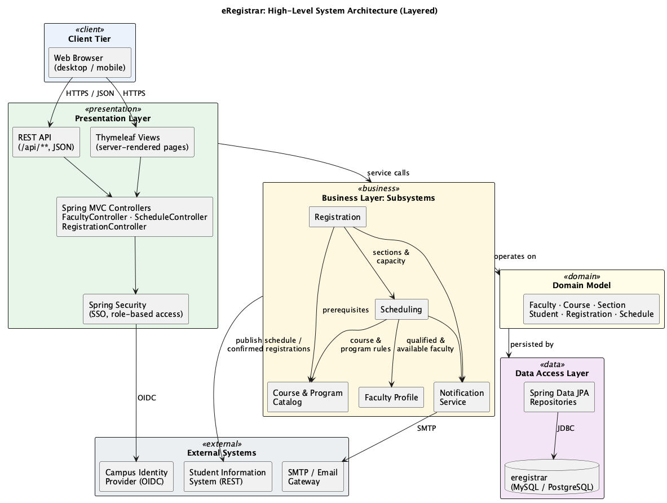
Layered architecture
Lab 3: Selected solution
Presentation
Spring MVC + Thymeleaf, security at the boundary
Business
Five subsystems; acyclic dependencies; transaction boundary
Domain model
Framework-independent, the invariants live here
Data access
Spring Data JPA; optimistic locking on Section
External
IdP, SIS and SMTP behind adapters, stubbed in development
Notes:
Dependencies point downwards only. The registration transaction stays inside one process, which is what makes the capacity guarantee affordable.

Slide 8
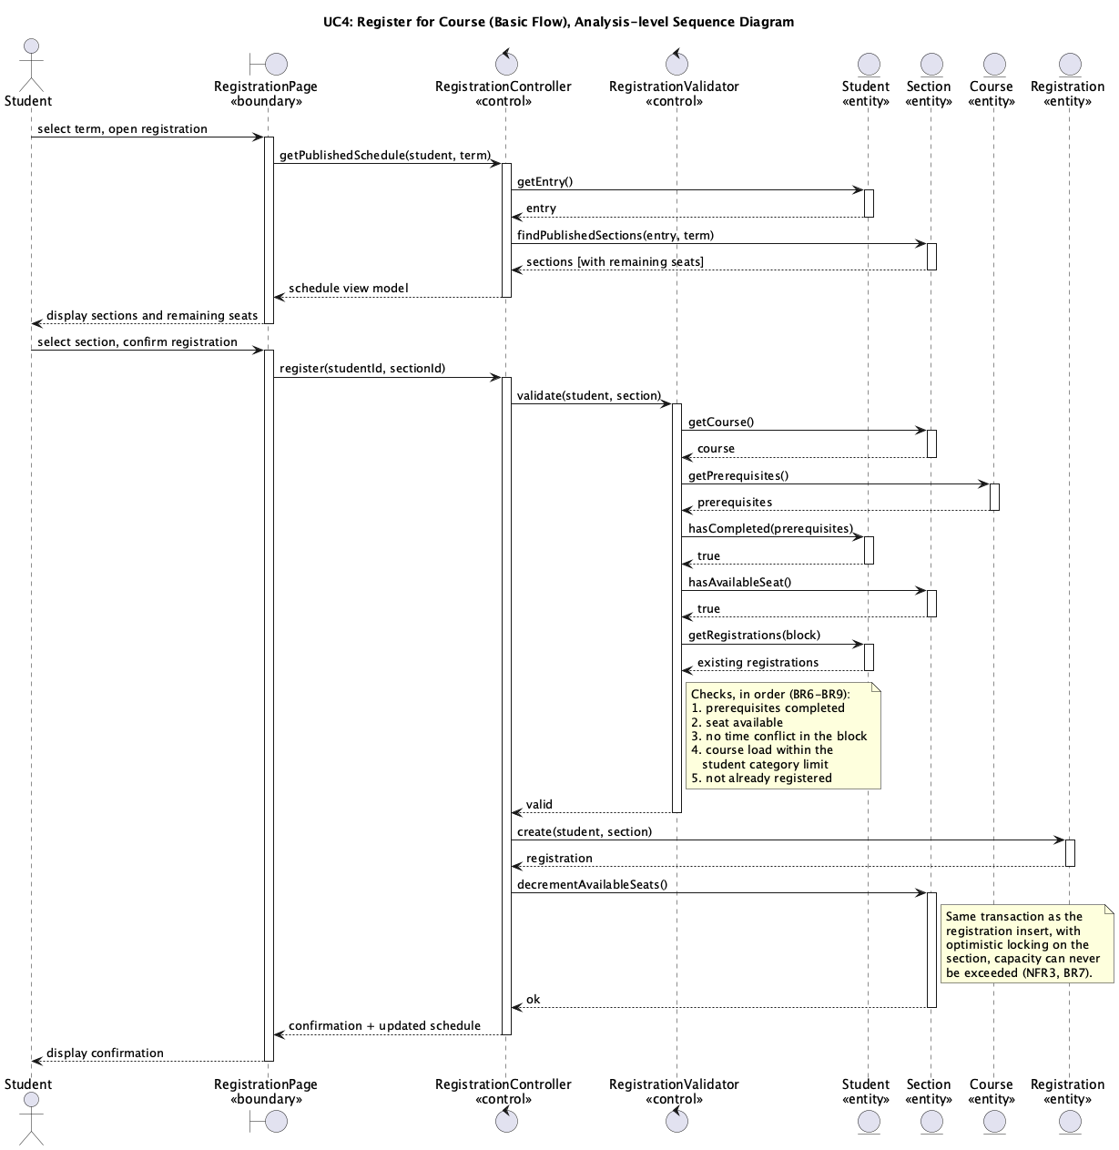
Use-case realisation: UC4
Lab 4: Sequence diagram
Analysis classes
«boundary» RegistrationPage
«control» RegistrationController
«control» RegistrationValidator
«entity» Student · Section · Course · Registration
The critical detail
The seat check and the seat decrement sit in the same transaction, with optimistic locking on Section.
A student who loses the race for the last seat gets "section full" and never an over-filled section.
Notes:
Messages flow actor to boundary to control to entity, never back up. The validator owns the rules so they cannot be bypassed by another entry point.

Slide 9
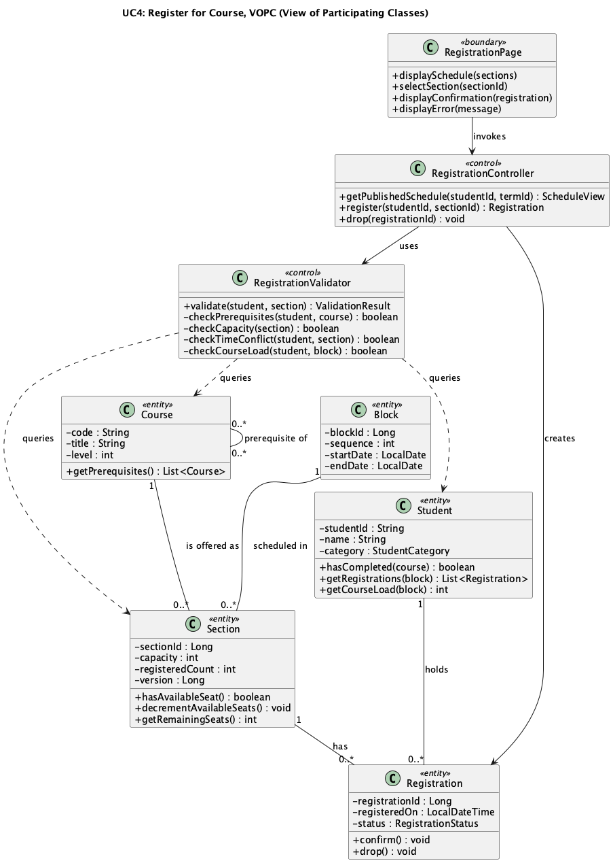
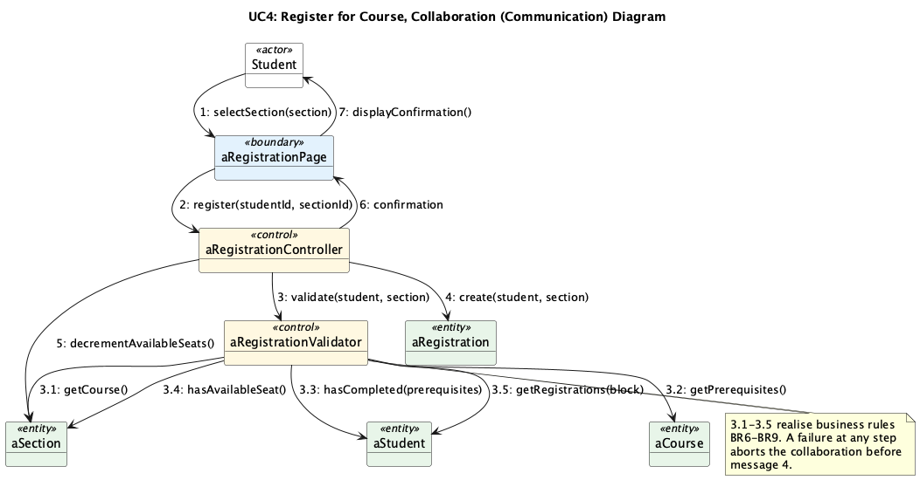
Participating classes: VOPC
Lab 5: Collaboration & VOPC
Collaboration: the same interaction by object links, numbered 1, 3.5, 7
Control classes become business-layer services · entity classes become the domain model and JPA entities · boundary classes become Spring MVC controllers and templates.
VOPC structure
Notes:
The VOPC is the bridge to class design: these classes map directly onto the subsystems in the architecture.

Slide 10
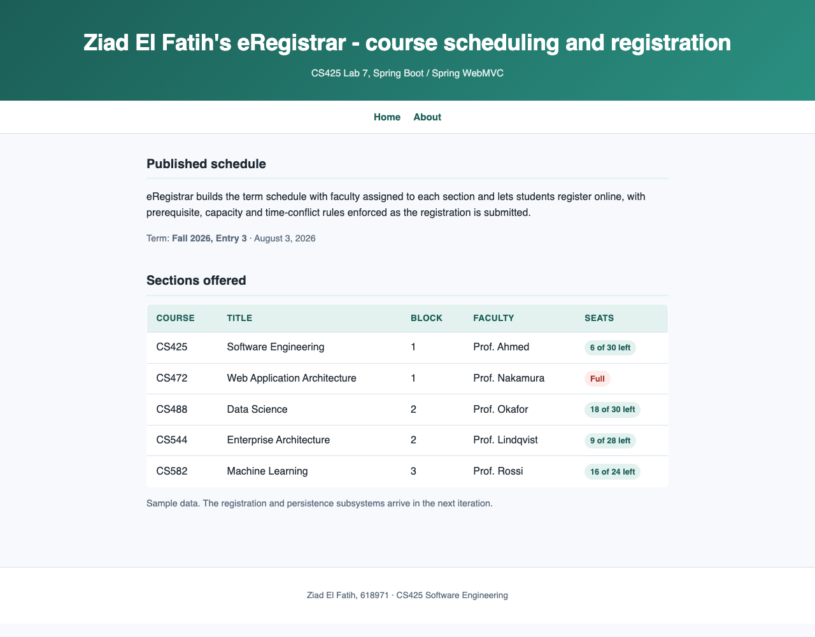
Already running
Lab 7: Implementation slice
Spring Boot 2.7 · Java 11 · Thymeleaf
Published-schedule view, the read half of UC4
Section capacity shown; full sections marked
MVC controller, Thymeleaf views, static assets
Automated tests green on every build
DevTools + LiveReload development workflow
Next iteration
JPA persistence and the registration transaction
Schedule generation with conflict detection
Single sign-on and role-based authorization
Load test the registration path against 150 users
Notes:
The homepage is the read-only half of UC6 rendered from the analysis model, so the design and the code already line up.

Slide 11
From vision to running code
1
2
3
4
5
Vision
→
SRS
→
Architecture
→
Analysis
→
Code
10 features from the problem–need–feature table
6 use cases, 2 described in full, 6 NFRs
Layered, 5 subsystems, acyclic dependencies
Sequence, collaboration and VOPC per use case
Two Spring Boot apps, tests green
Every feature traces to a use case, every significant use case to a realisation, every analysis class to a subsystem.
Ziad El Fatih · 618971 · Questions?
Notes:
Close on traceability: the chain from vision to code is unbroken, which is what makes the next iteration cheap to plan.

