Slide 1
Natural Language Processing

Slide 2
What is natural language?
What is natural language processing?

Slide 3
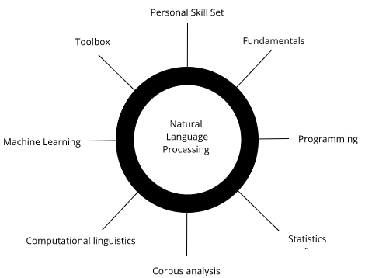

Slide 4
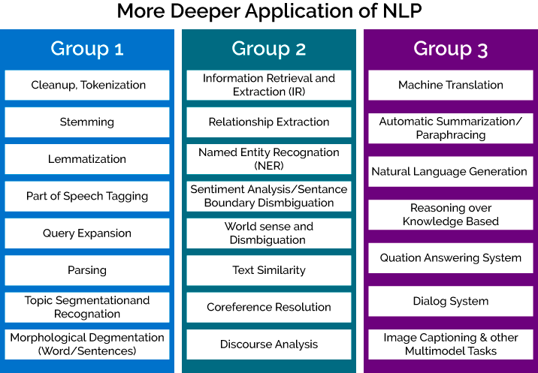

Slide 5
What is a corpus?
Why do we need a corpus?
If you have more than one corpus, it is called corpora.

Slide 6
Understanding the Structure of
a Sentences

Slide 7
Understanding the components of NLP
What is context-free grammar?
Morphological analysis
Lexical analysis
Syntactic analysis
Semantic analysis
Handling ambiguity
Discourse integration
Pragmatic analysis

Slide 8
Understanding the components of NLP
NLU
NLG
It is the process of reading and interpreting language.
It is the process of writing or generating language.

Slide 9
Defining context-free grammar
Context-free grammar is also called phrase structure grammar.
Production rules:
R1: S -> NP VP
R2: NP -> N
R3: NP -> Det N
R4: VP -> V NP
R5: VP -> V
R6: N -> Person Name | He | She | Boy | Girl | It | cricket | song | book
R7: V -> likes | reads | sings

Slide 10
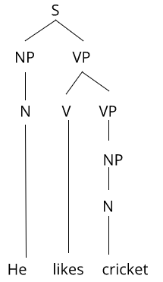
He likes cricket

Slide 11
What is morphological analysis? (morpheme-level)
What is morphology?
What are morphemes?
What is morphological analysis?

Slide 12
Types of affixes:
Prefixes, which appear before a stem, such as unhappy
Suffixes, which appear after a stem, such as happiness
Infixes, which appear inside a stem, such as bumili (this means buy in Tagalog, a language from the Philippines)
Circumfixes surround a word. It is attached to the beginning and end of the stem. For example, kabaddangan (this means help in Tuwali Ifugao, another language from the Philippines)

Slide 13
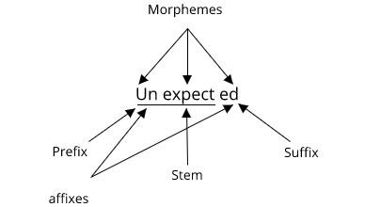

Slide 14
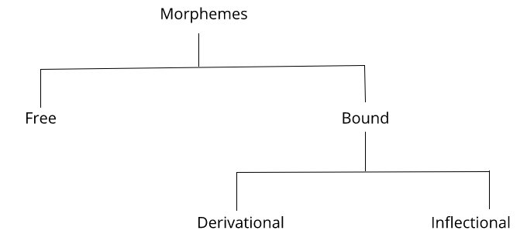
Classification of morphemes

Slide 15
Classification of morphemes
affixes
Dog, cats, town, and house
unkind happiness
dogs
expected

Slide 16
What is a stem?
The part of a word that an affix is attached to is called as stem. The word tie is root whereas
Untie is stem.
A stem is generated by using a root plus derivational morphemes

Slide 17
Lexical analysis (word-level)
What is a token?
What are part of speech tags?
Difference between stemming and lemmatization

Slide 18
Syntactic analysis (sentence-level)
In syntactic analysis, grammar rules have been used to determine which sentences are legitimate. The grammar has been applied in order to develop a parsing algorithm to produce a structure representation or a parse tree.

Slide 19
Semantic analysis (meaning of the NL)
Semantic analysis can be performed at the phrase level, sentence level, paragraph level, and sometimes at the document level as well.
Word sense disambiguation is one of the major tasks in NLP where semantic
analysis has been heavily used
The word2vec concept has emerged to handle semantic similarity.

Slide 20
Handling ambiguity
Sentence 1: Look at the stars. Here, look is a verb.
Sentence 2: The person gave him a warm look. Here, look is a noun.
Lexical ambiguity

Slide 21
Handling ambiguity
The man saw the girl with the telescope.
Syntactic ambiguity

Slide 22
Handling ambiguity
John kissed his wife, and so did Sam.
Semantic ambiguity

Slide 23
Handling ambiguity
Give it to that girl.
I have chocolate and a packet of biscuits. Give it to that girl.
Pragmatic ambiguity

Slide 24
Pragmatic analysis
Pragmatic analysis deals with outside word knowledge, which means knowledge that is external to the documents and/or queries.

