Slide 1
S.B.A Loans Prediction
Machine Learning model for bad loan detection
By Elhai Swisa
GitHub project

Slide 2
Agenda
01
Overview
What is S.B.A
Project Population
02
Objectives
The model objectives
Potential Users
03
Analysis Conclusion
Insert the Subtitle of Your Presentation
You can simply impress your audience and add a unique zing
04
Summery Results
Model performance results
Feature importance

Slide 3
Overview
S.B.A
The SBA assists small businesses in obtaining loans.
It insures a portion of the loan amount for the bank.
This enables favorable loan terms, supporting small business growth.
Population Companies from Florida that were approved for loans between 1970 and 2010,
with the SBA providing a guarantee for part of the loan to the bank.

Slide 4

Objectives
Model Objectives
Identify loans with a high probability of becoming bad debt.
Provide actionable insights to minimize financial risks.
Evaluate various loan conditions to reduce risk.
Potential Users
Banks
S.B.A Organization
Companies

Slide 5
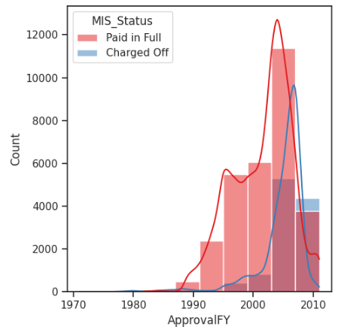
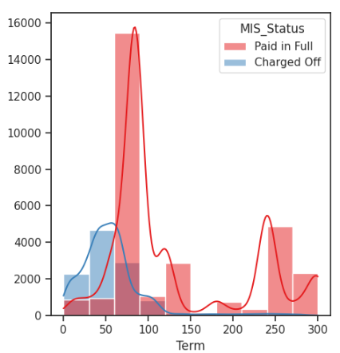
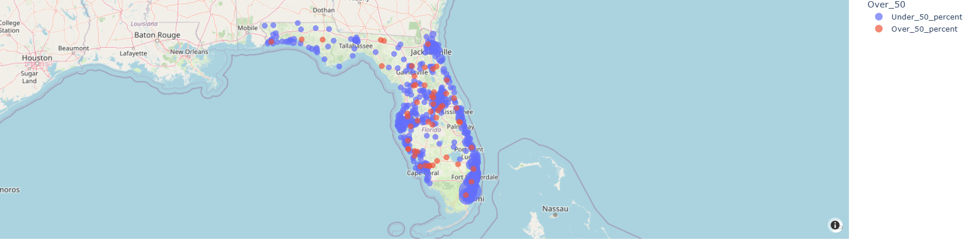
Analysis Conclusion
Distribution analysis status loans
Loan Term
Simple PowerPoint Presentation
Loan Year
Company Region

Slide 6
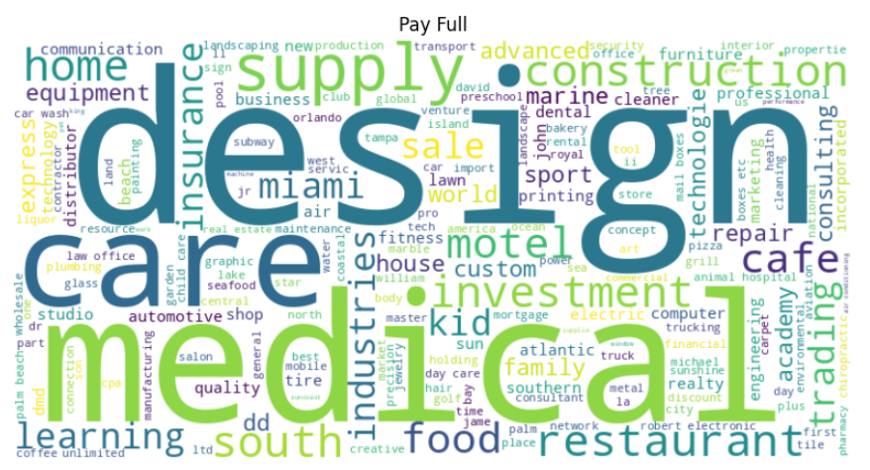
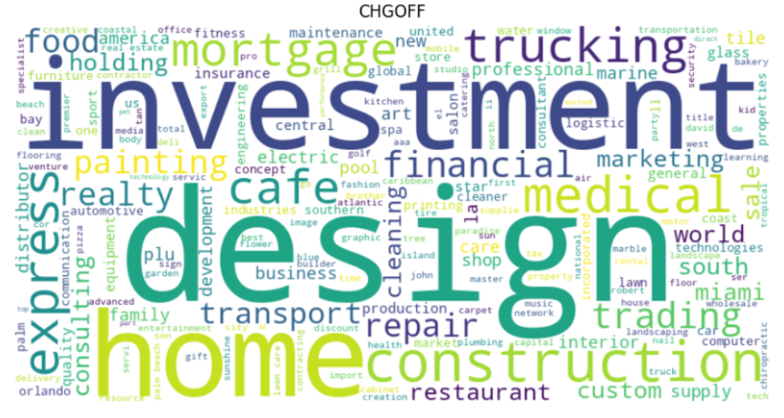
Analysis Conclusion
Distribution analysis status loans by company name
Simple PowerPoint Presentation
Common words: Design, Care, Medical
Common words: Design, Investment, Home

Slide 7
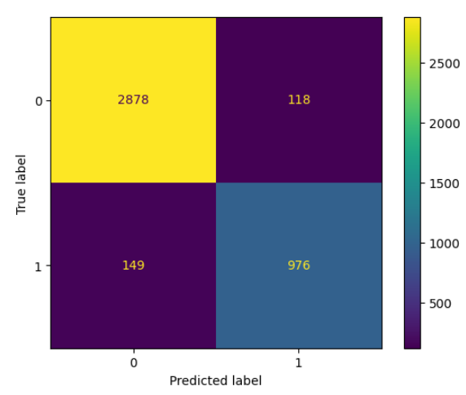
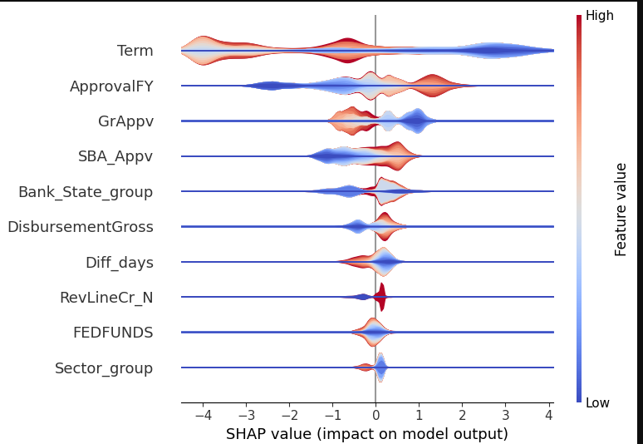
Summery Results
model's performance metrics
Feature Importance
AUC: 0.91
F1: 0.87
Accuracy: 0.93

Slide 8
AWESOME

Slide 9
THANK YOU

