Slide 1

Covid-19 Case Study
Università degli studi di Trieste
Master Degree in
Data Science and Scientific Computing
Statistical Analysis of Intensive Care in Veneto in Autumn and Winter 2020/2021
Final Project - STATISTICAL METHODS FOR DATA SCIENCE
Group A: Babaei Elham [SM3500466], De Santis Flavia [SM3500482], Doz Romina[SM3500441],
Fodor Imola[SM3500474]
Notes:
SM3500466

Slide 2
Overview
Introduction - project motivation
Explanatory analysis
About the dataset
Selecting covariates
Building model
Adding new covariates
Prediction
An extra approach

Slide 3
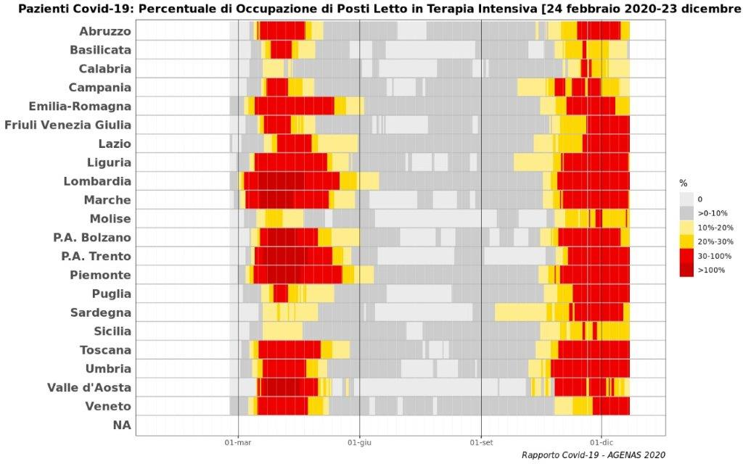
Introduction
Why studying intensive care?
Limited ICU beds to deal with covid-19 patients and those with other pathologies
Increasing ICU capacity requires more equipment (in particular ventilators) and pharmaceuticals, which might be in short supply
Increasing ICU bed numbers without increasing staff could result in increased mortality. However, doctors and nurses are not easy to find.

Slide 4
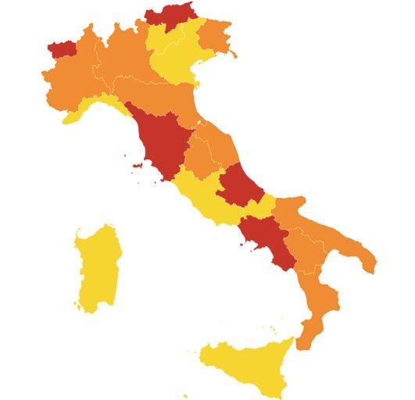
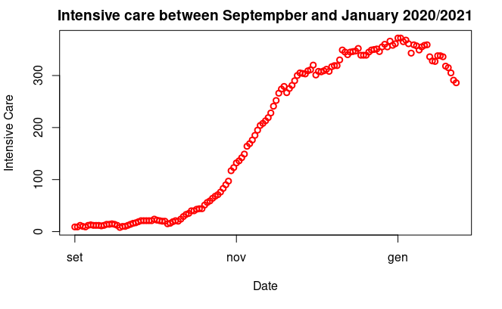
Introduction
Why a statistical analysis?
Derive low-term predictions to get an idea of how to plan/manage the hospital staff/resources in the following weeks
Understand which are the most relevant factors that determine the increasing of ICU patients
Suggest possible improvements in the management of the pandemic

Slide 5
Explanatory analysis
The dataset
terapia_intensiva | Intensive Care | Intensive_care
ricoverati_con_sintomi | Hospitalised patients with symptoms | Hos_symp
data | Date of notification | Date
totale_ospedalizzati | Total hospitalised patients | Total_Hos
isolamento_domiciliare | Home confinement | Home_con
totale_positivi | Total amount of current positive cases | Total_pos
variazione_totale_positivi | Variation of current positive cases | Variation_pos
nuovi_positivi | Variation of current cases | Variation_cases
dimessi_guariti | Recovered | Recovered
deceduti | Death | Death
totale_casi | Total amount of cases | Total_cases
tamponi | Tests performed | Test
casi_testati | Total number of people tested | People
The dataset was obtained by the official website of Protezione Civile starting from 01/09/2020 to 23/01/2021 and considering only region Veneto
Data regarding the place of the survey (latitude, longitude, exc…) have been removed
Data regarding variables no longer populated or that were only collected from a certain date onwards (as ingressi_terapia_intensiva which was collected from 03/12/2020 and so 69% are missing values in the dataset) have been removed, while notes were considered in evaluation of the dataset but not during the modeling procedure

Slide 6

Explanatory analysis
The dataset
Variable
Intensive_care
Hos_symp
Date
Total_hosp
Home_con
Total_pos
Variation_pos
Variation_cases
Recovered
Death
Total_cases
Test
People
Zone_color
Lag_zone_color
Season
Blue variables are cumulative and therefore have been replaced by the corresponding daily changes.
Red variables have been removed because they are strongly correlated to other variables:
Total_hosp = Hos_symp + Intensive_care
Total_pos = Total_cases – Recovered – Death
Variation_pos = Variation_cases - Recovered_today - Death_today
Variable
Intensive_care
Hos_symp
Date
Home_con
Variation_cases
Recovered_today
Death_today
Test_today
People_today
Zone_color
Lag_zone_color
Season
Notes:
Three new variables have been added:
zone_color is a categorical variable describing the “color” of the area in the current date (1 = yellow, 2 = orange, 3 = red)
lag_zone_color is the shifted zone (7 days before the current date)
season a categorical variable (0 = summer, 1 = autumn and winter)

Slide 7
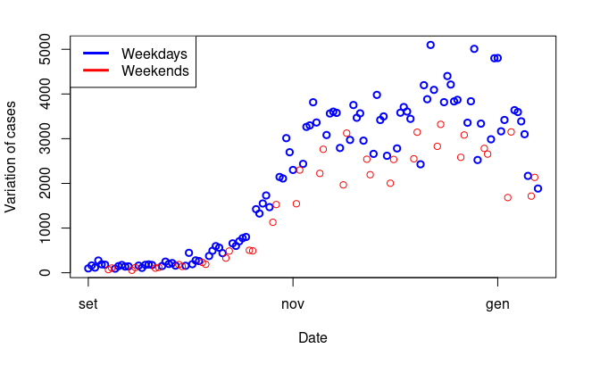
Explanatory analysis
Quality of data
Despite the fact that data was obtained by the official national source, the reliability depends on the procedures adopted to collect data. In this case, due to relatively frequent algorithm changes and new or deleted variables, data-gathering process does not guarantee the most accurate predictions possible
The dependent variable, intensive care, is not always the effective measured value because there are many temporal misalignments of the information flow, as reported in the notes of the dataset.
On the weekends or holidays, data collection slows down and is retrieved on subsequent weekdays..

Slide 8
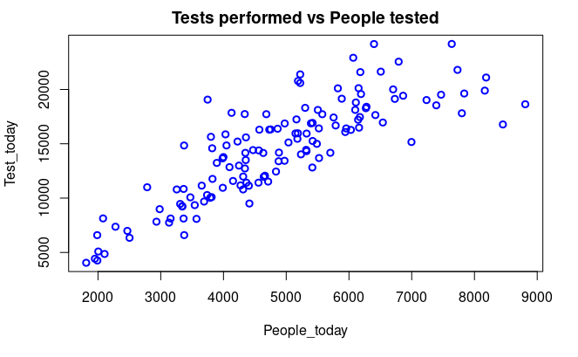
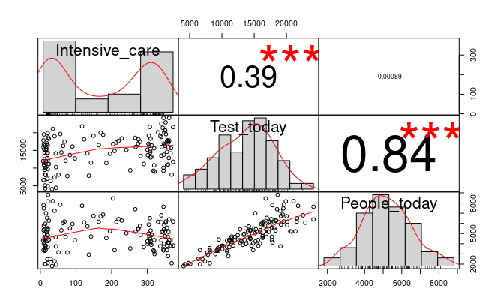
Explanatory analysis
Selecting covariates
Before starting to create a statistical model, it is convenient to analyze the variables and their relationship with the independent variable or with other covariates.
There aren’t any missing values in the chosen dataset.
There is a strong correlation between the people tested and the number of tests performed, so only one of them can be used in the model. The number of tests is chosen, being more correlated to the response variable.

Slide 9
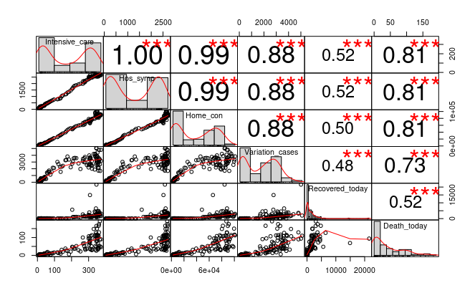
Explanatory analysis
Selecting covariates
The other possible predictors are all correlated to the variable intensive care. However, home confinement and hospitalized with symptoms are highly correlated with other covariates and so have been removed.

Slide 10
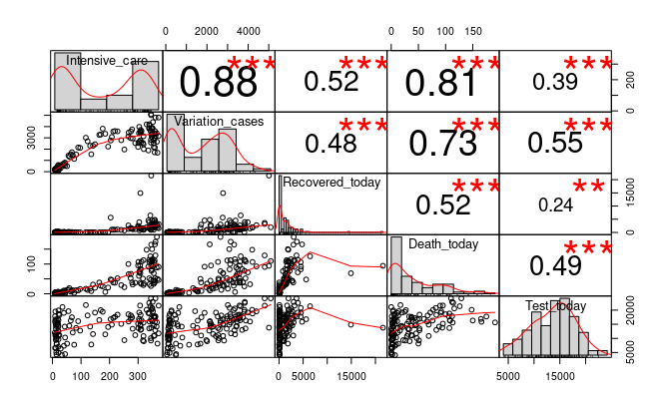
Explanatory analysis
Selecting covariates
These are possible predictors that will be considered to obtain a model for the variable intensive care.
Since there is still a degree of correlation between them (but not so strong like other cases) we will check if any of these variables can be included in the model or not during building the model.

Slide 11
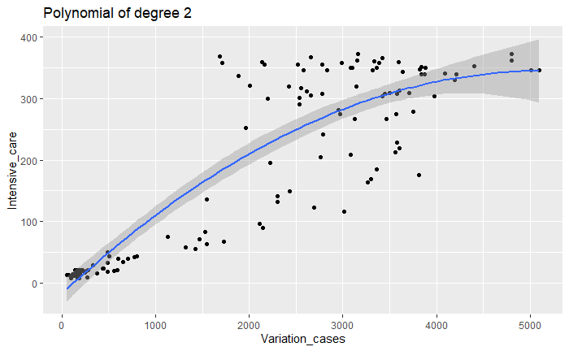
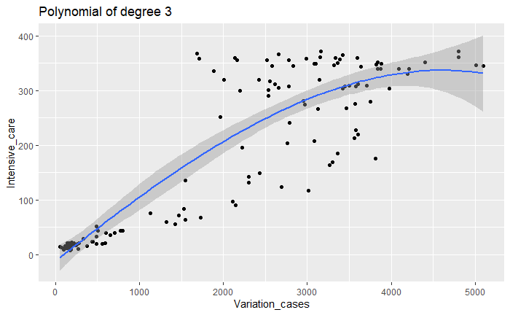
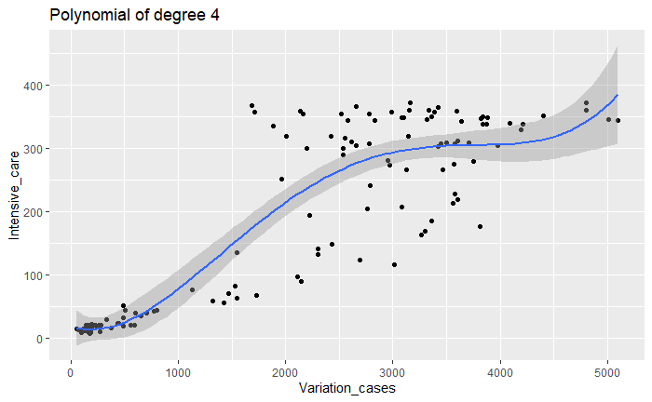
Explanatory analysis
Selecting covariates
It is possible to approximate the relationship between intensive care and variation of cases via a polynomial of degree two, three or four. As none of them can completely catch the pattern of data due to variation in the variance of data points, the simplest one will be used (degree two) to avoid overfitting.

Slide 12
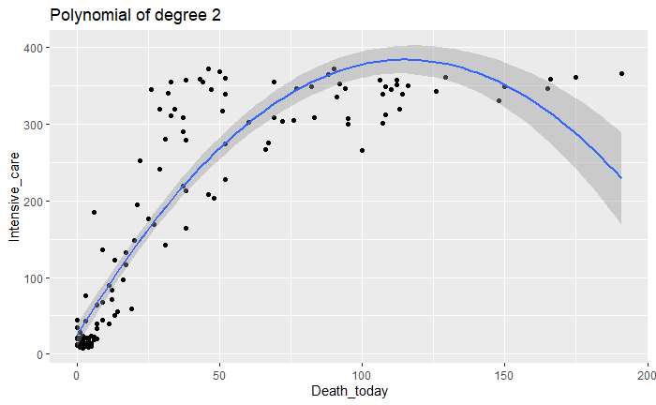
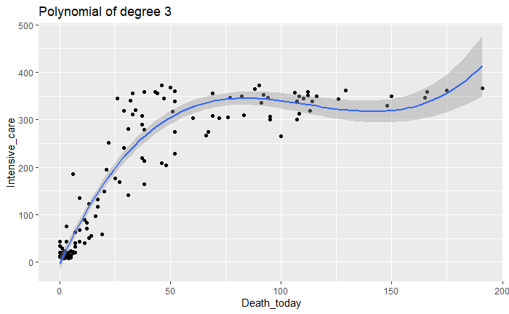
Explanatory analysis
Selecting covariates
The relationship between intensive care and number of people death can be approximated by a polynomial of degree two or three. The latter is chosen during the building of models because it can capture the curvature of data where the number of deaths is large .

Slide 13
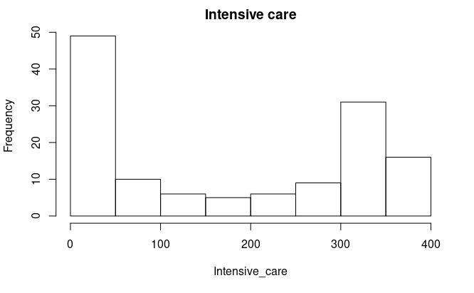
Building model Model specification
Response variable
Intensive_care
The aim is to find a model that describes a response variable (intensive care) using multiple predictors.
The response variable is not normally distributed; it is discrete and non negative. So a simple linear regression model can’t be used.
At first, only the predictors of the original dataset ( ) will be used, later other covariates ( ) will be added.
Possible Predictors
Date
Variation_cases
Recovered_today
Death_today
Test_today
Zone_color
Lag_zone_color
Season

Slide 14

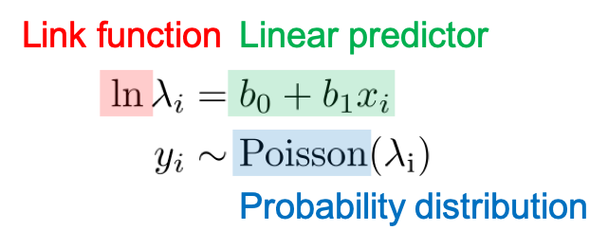
Building model Generalized Linear Model (GLM)
It is an extension of linear models, characterized by the following features:
linear predictor:
link function:
the response variable belongs to exponential dispersion family
The response variable of this problem (intensive care) is a count data and it is assumed to follow a Poisson probability distribution in which observations are independent

Slide 15
Building model Criteria
The strategy used to select the predictors is the stepwise selection, considering the following measures:
AIC: Akaike Information Criteria
BIC: Bayesian Information Criteria
F test: with the hypothesis that data follows the simpler of two nested models
VIF: Variance Inflation Factor
Occam’s razor criteria: the simplest explanation is usually the right one
The link function is chosen to be the Canonical link for Poisson regression which is log (default of Poisson family in R).

Slide 16
Building model Flow
To build the model:
First of all a baseline model is created, by using some of the more important and influential variables which are :
Date
Variation_cases
Test_today
We check whether the new variable Death_today can be added.
We check whether the new variable Recovered_today can be added.
We build the Poisson model and analyze it.
Other possible models are taken into consideration as well:
GLM
Poisson
Quasi Poisson
Negative Binomial
GAM
Random Forest

Slide 17
Building model
Baseline Poisson Model
glm0 <- glm(Intensive_care ~ Date+poly(Variation_cases,2)+Test_today,
family = poisson, data=d.train)
The P_value of F test is small so our model works better than the null model in which only intercept is included.
P_value <- pchisq(glm0$deviance,glm0$df.residual, lower.tail = F)
VIF is not greater than 10 for any variable.
AIC | BIC | Residual_Deviance | P_value
1607.79 | 1622.32 | 737.67 | 1.18e-85

Slide 18
Building model
Adding the variable Death_today
model.glm <- glm(Intensive_care ~ Date+poly(Variation_cases,2)+Test_today+
poly(Death_today,3), family = poisson, data=d.train)
The above table shows that AIC and BIC are smaller compared to baseline model.
There is no VIF value greater than 10 for all the variables.
So we add Death_today to the model.
AIC | BIC | Residual_Deviance
1469.58 | 1492.83 | 593.47

Slide 19
Building model
Adding the variable Recovered_today
model.glm <- glm(Intensive_care ~ Date+poly(Variation_cases,2)+Test_today+
poly(Death_today,3)+Recovered_today, family = poisson, data=d.train)
The above table shows there is no improvement in AIC and BIC. Thus we do not add Recovered_today.
Note: we also tried other options to check the existence of variables in the model; e.g. we added Recovered_today before adding Death_today, or we considered transformed version of variables such as log(.) etc, but we couldn't find any considerable form that works better.
Moreover, no possible interaction between variables could be added to improve the model.
AIC | BIC | Residual_Deviance
1469.66 | 1495.81 | 591.54

Slide 20
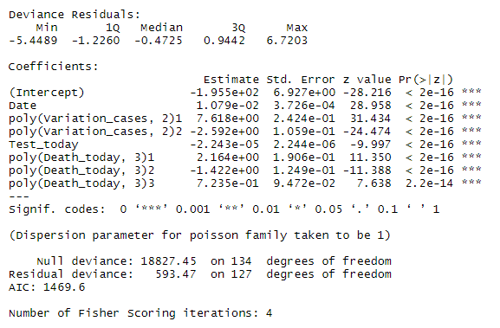
Building model
Poisson Model
model.glm <- glm(Intensive_care ~ Date+poly(Variation_cases,2)+Test_today+
poly(Death_today,3), family = poisson, data=d.train)
AIC | BIC | Residual_Deviance | P_value
1469.58 | 1492.83 | 593.47 | 2.29e-61
Predictors
Date
Var_cases
Death_today
Test_today

Slide 21
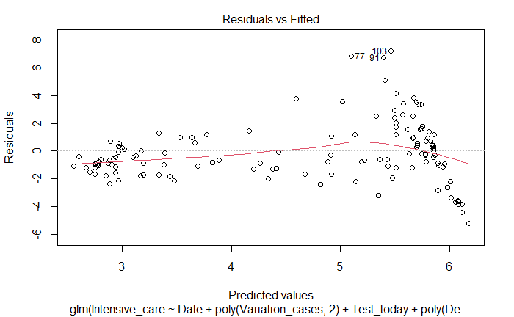
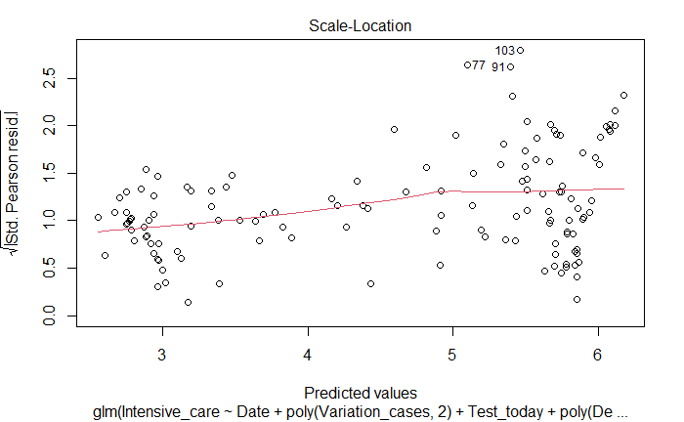
Building model
Poisson Model Plots

Slide 22
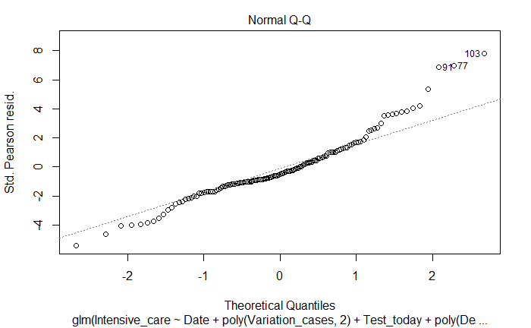
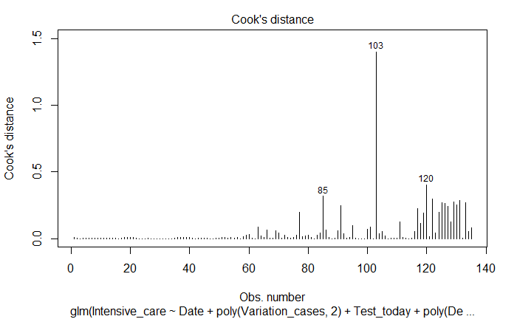
Building model
Poisson Model Plots

Slide 23
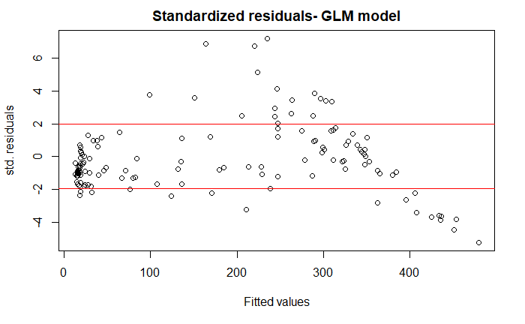
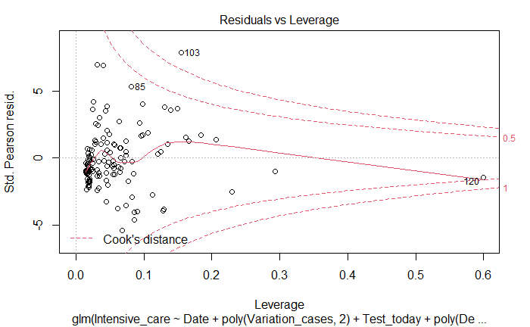
Building model
Poisson Model Plots
The standardized residual plot shows than many residuals are located outside the interval [-1.96,1.96] of standard normal distribution. It means that there is evidence of overdispersion and we try other models to cope with it such as Quasi Poisson and Negative Binomial.
Besides, the Residual vs Leverage plot reveals that the value of Cook’s distance metric is larger than 1 for an observation and there is also an observation with large Leverage. It means these observations are probable to be outliers but since the model is over-dispersed, we check them in the next models.
Besides, the Residual vs Leverage plot reveals that the value of Cook’s distance metric is larger than 1 for an observation and there is also an observation with large Leverage. It means these observations are probable to be outliers but since the model is overdispersed, we check in the

Slide 24
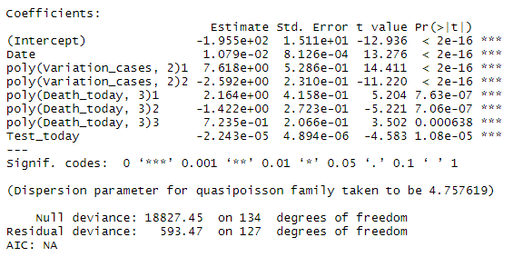
Building model
Quasi-Poisson Model
model.glm.quasi <- glm(Intensive_care ~ Date+poly(Variation_cases,2)+
poly(Death_today,3)+Test_today, family = quasipoisson, data=d.train)
The coefficients are the same as poisson.
Dispersion parameter is 4.76 > 1 .
Predictors
Date
Var_cases
Death_today
Test_today

Slide 25
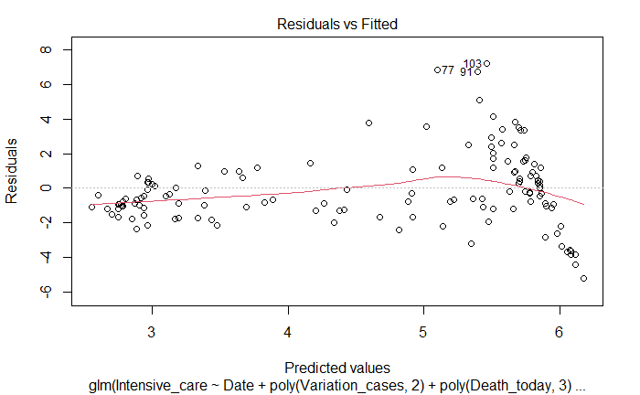
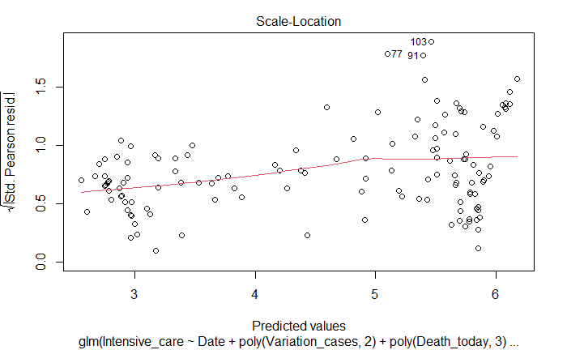
Building model
Quasi-Poisson Model Plots

Slide 26
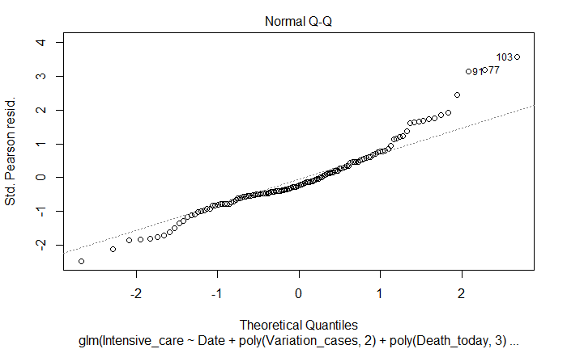
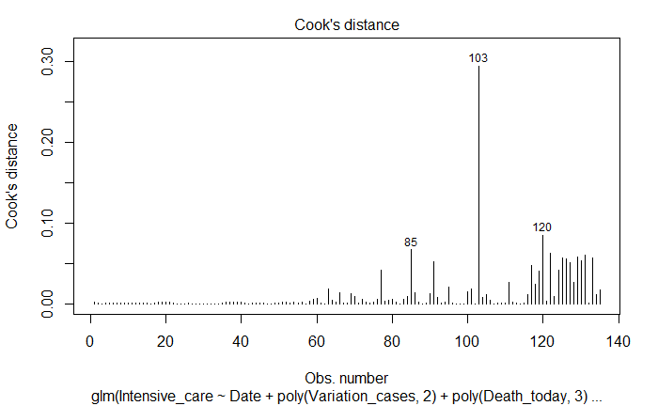
Building model
Quasi-Poisson Model Plots

Slide 27
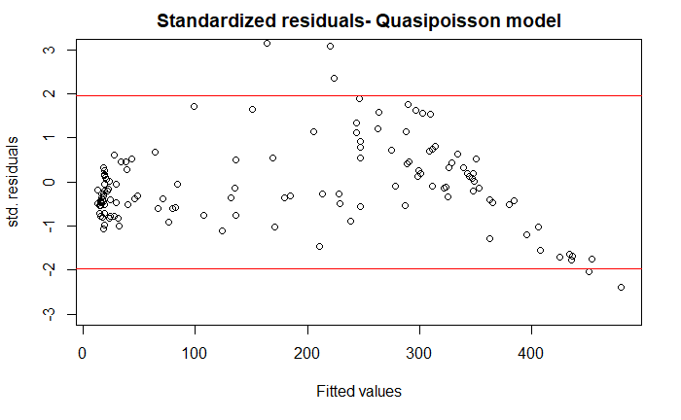
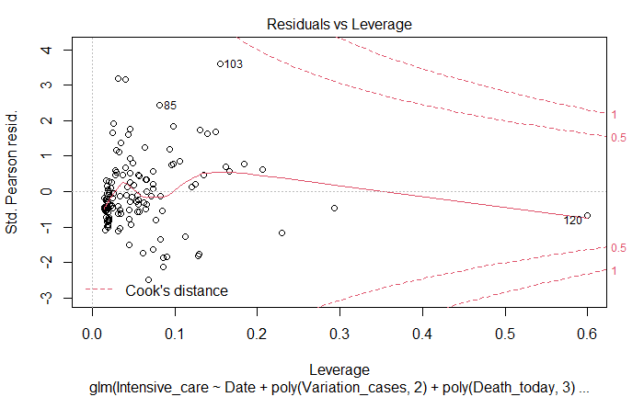
Building model
Quasi-Poisson Model Plots
The standardized residual plot shows that now many of the residuals are between [-1.96,1.96].
There is no strong outlier according to Residual vs Leverage plot anymore and also other plots. By looking at the dataset it turns out datapoint 120 which still has a larger leverage corresponds to an observation with maximum number of death from 1st Sep to 13th Jan.

Slide 28
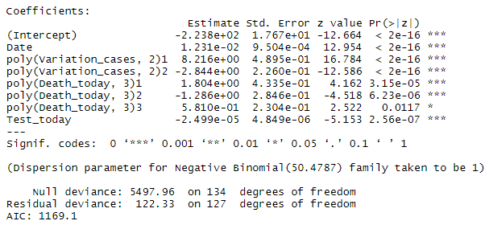
Building model
Negative Binomial Model (NB)
model.glm.nb <- glm.nb(Intensive_care ~ Date+poly(Variation_cases,2)+
poly(Death_today,3)+Test_today, data=d.train)
Predictors
Date
Var_cases
Death_today
Test_today

Slide 29
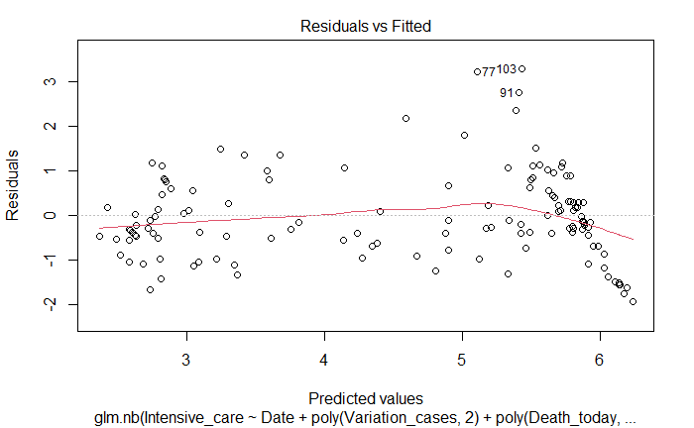
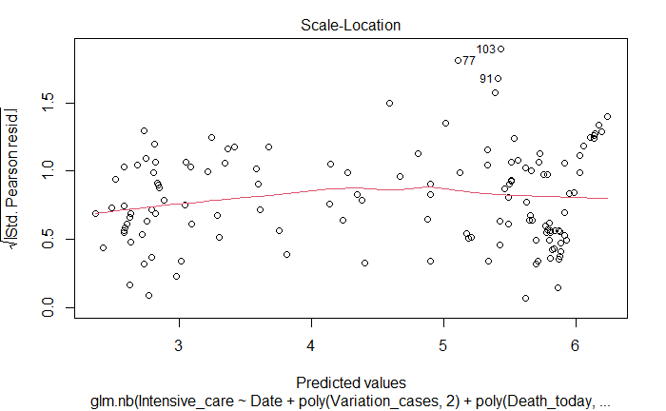
Building model
Negative Binomial Model (NB) Plots

Slide 30
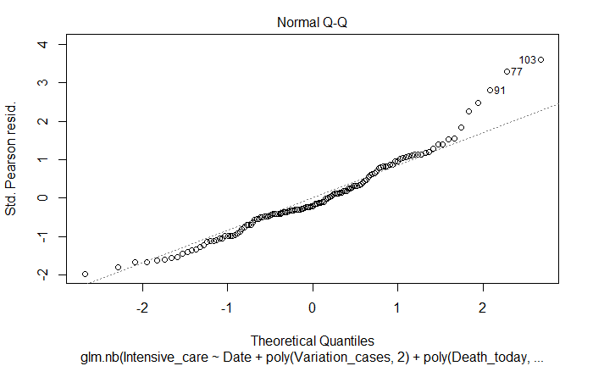
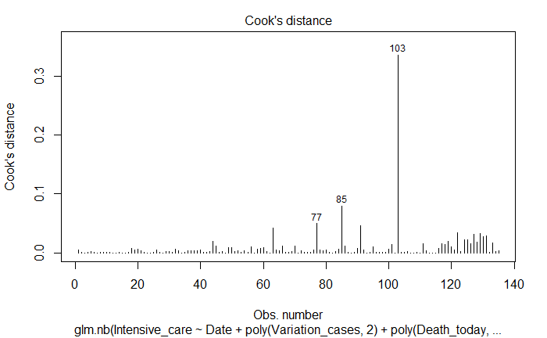
Building model
Negative Binomial Model (NB) Plots

Slide 31
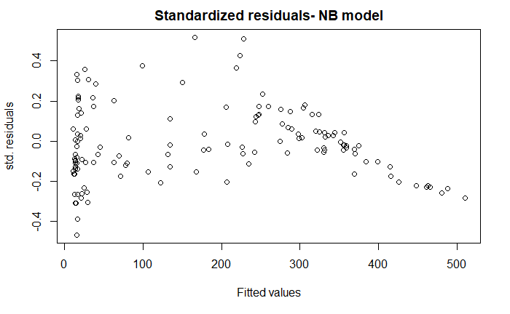
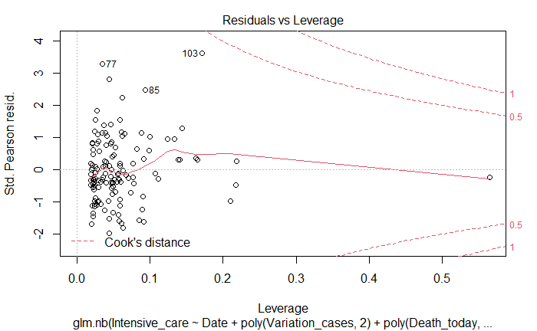
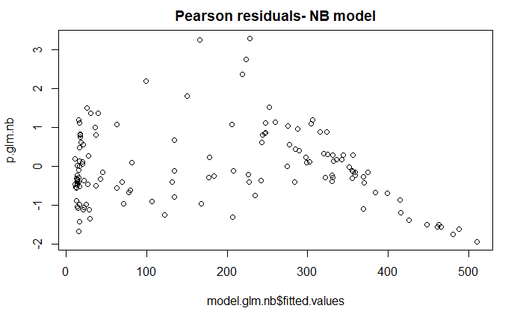
Building model
Negative Binomial Model (NB) Plots

Slide 32
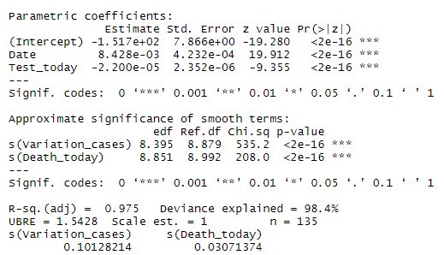
Building model
GAM Model
model.gam <- gam(Intensive_care ~ Date+s(Variation_cases)+
s(Death_today)+Test_today, family = poisson, data=d.train)
estimated degree of freedom (edf) is larger than 1 for both nonlinear parts. So it is true to consider smooth function for them
Adjusted R-square is 97% which is good. Also, the deviance in response variable explained by the model is 98%.
Predictors
Date
Var_cases
Death_today
Test_today

Slide 33
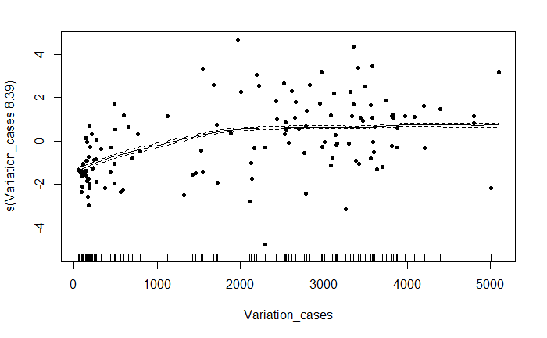
Building model
GAM Model Plots

Slide 34
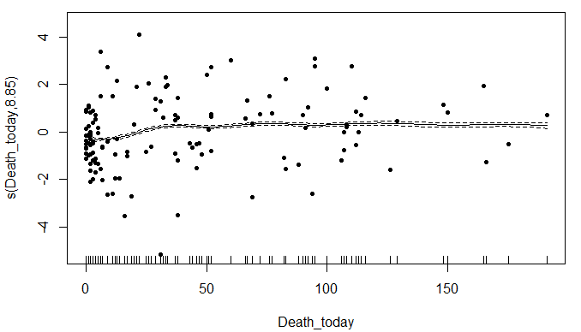
Building model
GAM Model Plots
Overfitting ?!

Slide 35
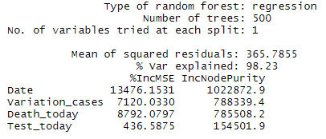
Building model
Random Forest model (RF)
Random Forest is one of the ensemble techniques that use a bag of trees instead of just one single tree to build a model. Hence, the outputs are more reliable.
The number of trees is by default 500.
The variation of response variable explained by the model is 98%.
The most important variable (ignoring the variable date) is Variation_cases with the largest amount increasing in node purity.
Predictors
Date
Var_cases
Death_today
Test_today

Slide 36
Building model
Models comparison
NB seems to be the best model as it has lower AIC and also BIC.
AIC and BIC are not available for Quasi-Poisson because it doesn't use the distribution function of the data and therefore no log-likelihood function.
Model | df | AIC | BIC
Poisson | 8 | 1469.58 | 1492.83
Quasi Poisson | 8 | NA | NA
Negative Binomial (NB) | 9 | 1169.13 | 1195.28
GAM | 20 | 1203.40 | 1262.22

Slide 37
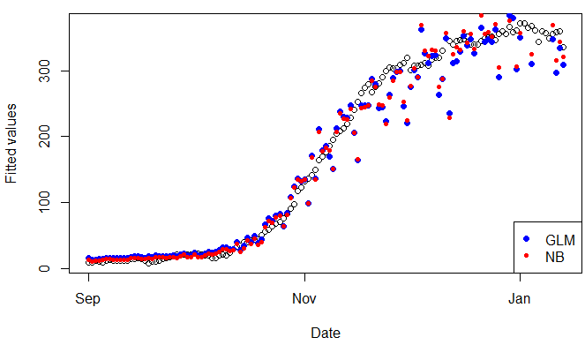
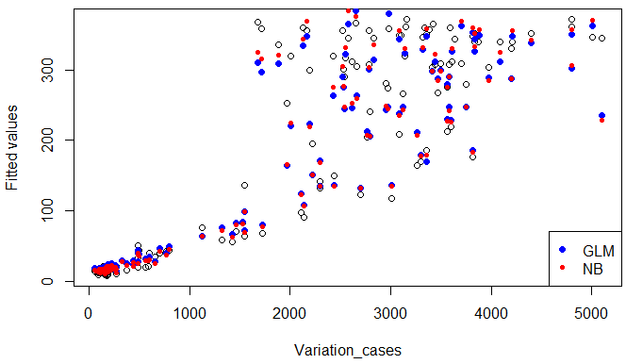
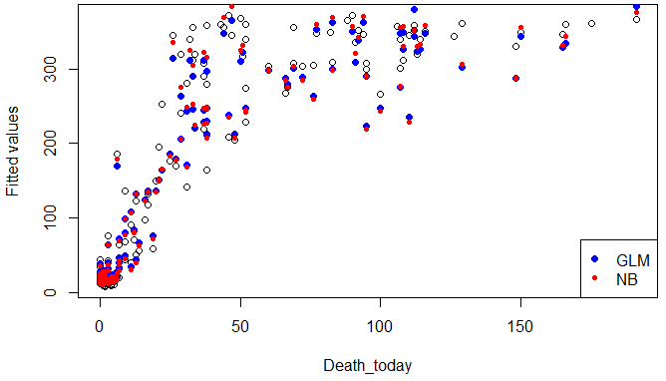
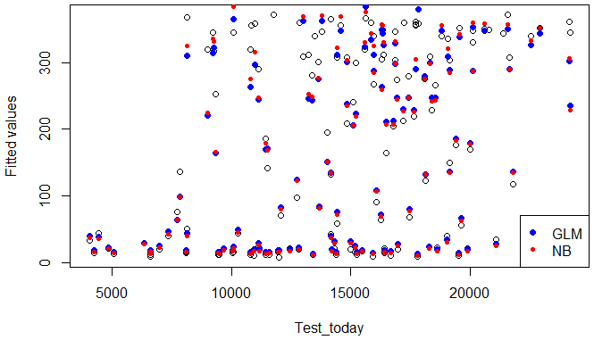
Building model
Fitted values for NB model

Slide 38
Building model
Adding new covariates
By building the models, we evaluated the inclusion of some covariates and their effect on the response variable Intensive_care.
We decided to include in the models:
The regional colors (yellow = 1, orange = 2, red = 3), to which is associated a set of laws that regulate the permitted and forbidden behaviours, defined as Zone_color;
The 7-days delay on the Zone_color variable defined as Lag_zone_color that is usually needed to see some effect on the data;
The Season categorical variable that takes into account the seasonal effect on the spreading of respiratory diseases like Covid-19.
We decided not to take into account some additional considered covariates like the region-specific laws contained in the regional edict “Decreto legge”.
It seems probably strictly correlated to Zone_color covariate that we already introduced; although surely these regional laws have had an impact on the displacement of large groups of people (for example we assisted to a larger migration in the beginning of December and a very reduced one during the holidays, when it was not allowed to exit the Municipality borders except for rare cases).

Slide 39
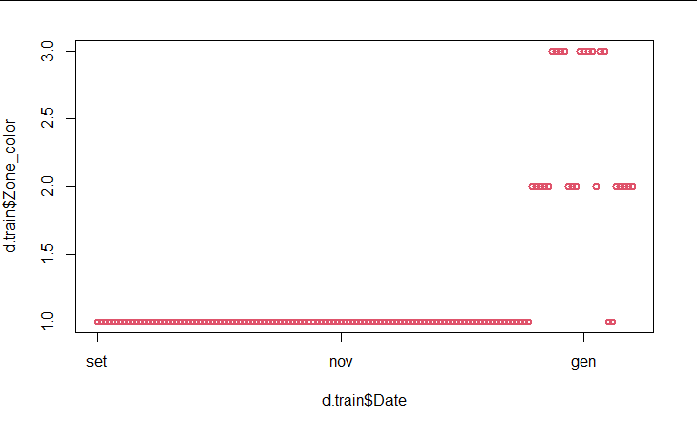
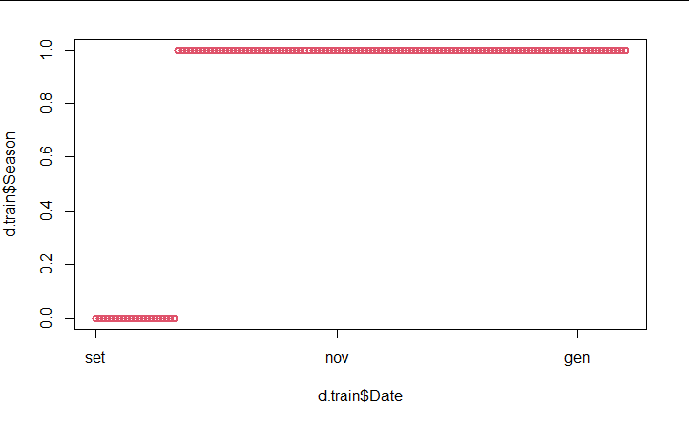
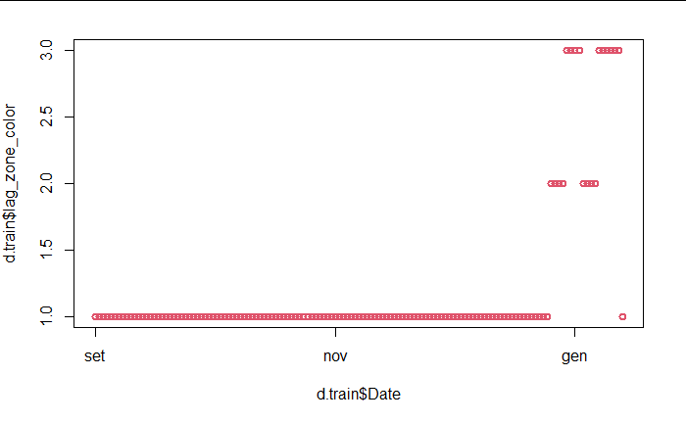
Building model
Adding new covariates
Zone_color
1 for yellow
2 for orange
3 for red
Lag_zone_color: 7 days lag
Season: categorical
0 for Summer
1 for Autumn and Winter
Zone_color
Season
Lag_zone_color

Slide 40
Building model
Adding new covariates
All the three new variables can be added to our Poisson model as they decrease AIC and BIC, also there is no any considerable collinearity between them and old variables based on VIF, and all of them are significant in the model as well.
No improvement with interaction terms.
Model | AIC | BIC | RD | VIF
Original GLM Poisson model (from slide 19) | 1469.58 | 1492.83 | 593.47
Adding Zone_color | 1428.49 | 1454.64 | 550.38 | ok
Adding Lag_zone_color | 1377.68 | 1406.73 | 497.56 | ok
Adding Season | 1351.23 | 1383.19 | 469.11 | ok

Slide 41
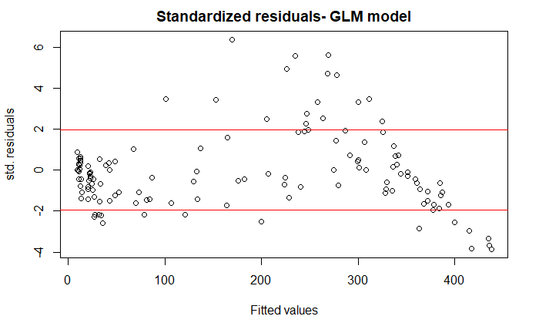
Building model
Poisson model- with new covariates
We go through all the previous steps to build our models including new variables. So we don't repeat all of them again. We just show that our new Poisson model seems to be overdispersed according to the residual plot.
The point is that comparing the two residual plots before and after adding new covariates, turns out that we managed to alleviate the tail of residual plot to some extent.
Before adding new covariates After adding new covariates

Slide 42
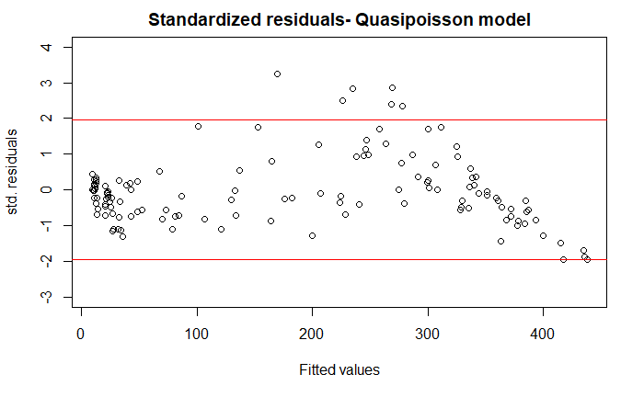

Building model
Quasi-Poisson model- with new covariates
The dispersion parameter is 3.87 >1 .

Slide 43
Model comparison
After adding new covariates
Predictors
Date
Var_cases
Death_today
Test_today
Zone_color
Lag_zone_color
Season
GLM
Poisson
Quasi Poisson
Negative Binomial
GAM
Random Forest
AIC and BIC for all the models are smaller compared to the previous ones without adding new variables. It means we also managed to improve our models by adding new variable.
The table shows NB is the best model again according to AIC.
Model | df | AIC | BIC
Poisson | 11 | 1351.23 | 1383.19
Quasi Poisson | 11 | NA | NA
Negative Binomial (NB) | 12 | 1148.19 | 1183.05
GAM | 20 | 1162.13 | 1222.06

Slide 44



Prediction
Predictive information criteria
MSE (mean-square error): measures the average squared difference between the estimated values and the actual value. It is always positive, and values closer to zero are better.
RMSE (root-mean-square error): square root of the MSE.
NRMSE (normalized-root-mean-square error): normalizing the RMSD facilitates the comparison between datasets or models with different scales.

Slide 45
Prediction
On test dataset from 14th to 23rd Jan
Model comparison without and with new covariates
Models(without) | MSE | RMSE | NRMSE
Poisson | 27883.18 | 166.98 | 0.53
Quasi Poisson | 27883.18 | 166.98 | 0.53
Negative Binomial | 29539.56 | 171.87 | 0.54
GAM | 29260.05 | 171.06 | 0.54
RF | 4055.92 | 63.69 | 0.20
Models(with) | MSE | RMSE | NRMSE
Poisson | 16466.95 | 128.32 | 0.40
Quasi Poisson | 16466.95 | 128.32 | 0.40
Negative Binomial | 20399.62 | 142.83 | 0.45
GAM | 20124.960 | 141.86 | 0.45
RF | 456.98 | 21.38 | 0.07

Slide 46
Prediction
On test dataset
After adding new variables the error rate decreases in all the models.
Random forest has the lowest error rate.
There is no considerable difference between other models; however Poisson is a bit better than NB for this test dataset.

Slide 47


Prediction
On test dataset
The first plot shows the predictions for 10 days of January, from 14th to 23rd as the test dataset, by different models without the adding of the covariates.
The second plot shows how the models change after adding all the previously introduced covariates.
Notes:
Assuming that we do not have the information of the predictor values in the test set (which is usually the case); we shift (lag) the predictors themselves x moments forward in time, and take them, together with the actual response variable for the given day, as our training set.
#Technically, in time series forecasting terminology the current time (t) and future times (t+1, t+n) are forecast times and past observations (t-1, t-n) are used to make forecasts.
#This permits not only classical X -> y prediction, but also X -> Y where both input and output can be sequences.
#Further, the shift function also works on so-called multivariate time series problems. That is where instead of having one set of observations for a time series, we have multiple (e.g. temperature and pressure). All variates in the time series can be shifted forward or backward to create multivariate input and output sequences.
#Multi-Step or Sequence Forecasting
#A different type of forecasting problem is using past observations to forecast a sequence of future observations.
#This may be called sequence forecasting or multi-step forecasting.
#We can frame a time series for sequence forecasting by specifying another argument. For example, we could frame our forecast problem with an input sequence of 14 past observations to forecast 14 future observations as follows:
# Use lagged versions of the variables in the regression model.
#This allows varying amounts of recent history to be brought into the forecast
#Lagging of independent variables is often necessary in order for the regression model to be able to predict the future--i.e., to predict what will happen in period t based on knowledge of what happened up to period t-1

Slide 48


Prediction
The fit on all the dataset
The following plots show the predictions for all the dataset (after dashed line for test dataset).
Excessive distortion in predictions from the middle of December afterwards, could be due to significant difference in data compared to the previous 3 months that play a remarkable role in building the model; and also probably due to overfitted models.

Slide 49
Extra approach
Predicting on shifted/historical data
Why this extra approach?
Not being able to say with certainty number of deaths in the span of 14 days, the idea came to use past data to predict future.
The current time (t) and future times (t+1, t+n) are forecast times and past observations (t-1, t-n) are used to make forecasts.
Sequence prediction attempts to predict elements of a sequence on the basis of the preceding elements
— Sequence Learning: From Recognition and Prediction to Sequential Decision Making, 2001.

Slide 50


Extra approach
Shifting the dataset
We could frame our forecast problem with an input sequence of 7 past observations to forecast 7 future observations and use the data as follows:
TRAIN
TEST

Slide 51

Extra approach
The added covariate percentage occupancy
Added a feature indicating the percentage from the total available ICU beds for the individual days
Did the hospitals make decisions who gets received/who stays in ICU based on this threshold? Based on this doubt, we state that the independence assumption is no longer valid, between the individual response variables.
The threshold to be around is 30% (of 1016 beds in Veneto).
NOTE This metric is one of the predictors for a custom “new” model developed for the shifted approach itself

Slide 52


Extra approach
Performance with ultimate chosen model
Well-suited Predictors
Date
Var_cases
Death_today
Test_today
Zone
Lag_zone
Season
Shifted data + proved well-suited model
Trying the approach with the covariates and models that worked best for
the original dataset shows quite good results in AIC scores, see further slides
NOTE: GAM REGULAR MISSING HERE, COMPUTATIONAL DIFFICULTIES

Slide 53


Extra approach
Performance with penultimate chosen model
Possible Predictors
Date
Var_cases
Hosp_symp
Death_today
Zone
Lag_zone
Shifted data + penultimate proved well-suited model
Trying the approach with the penultimate set of covariates, indicates a promising solution with a gam model

Slide 54

Extra approach
Performance with a new model
Chosen Predictors
Date
Moving avg Death
Moving avg Total_Hosp
Variation Total Hosp
Percentage Occupied
Shifted by 14 the data + new model
NOTE: Two methodologies for selecting predictors: backward selection & “it worked best”; here showing the version that had the best prediction when adding least correlated covariates, observing the least residual deviance + the conviction that the percentage influences decisions on accepted patients for ICU

Slide 55


Extra approach
Comparing the fit and predictions graph
AIC comparison of the models

Slide 56
Extra approach
Comparing predictions - metrics
Model comparison when using shifted/historical data from 10th to 23rd January.
AIC for the used models, together with the metrics MSE, RMSE, NRMSE proved the good
fit of the penultimate gam model.
The decreasing trend was caught for January. Predicting using historical data gives good predictions.
models | MSE | RMSE | NRMSE
Poisson EXTRA | 480.4996 | 21.92030 | 0.067
GAM Penultimate R | 234.2662 | 15.30576 | 0.047

Slide 57
Extra approach
Possible next steps
reduce days to predict
apply transformations to covariates, to improve their efficiency
Leverage the analysis from AR (Autoregressive), ARMA (Autoregressive Moving Average) and ARIMA methods (Autoregressive Integrated Moving Average) methodologies.
OR
We suggest the Recursive Multi-step Forecast technique, where the predicted values would be used as input for the successive data points.
OR
Direct Multi-step Forecast Strategy The direct method involves developing a separate model for each forecast time step.

Slide 58
Possible improvements
To further improve our analysis:
Use the newly added covariates by the “Protezione Civile”.
Use 1 month of data as training set.
Explore better the reasoning behind the peculiar relationship between certain metrics of the dataset.
Take data from e.g. Oct/Nov when new algorithms for gathering data were introduced (government rules).

Slide 59
References
Course books:
https://moodle2.units.it/pluginfile.php/340058/mod_resource/content/1/core-statistics.pdf
https://moodle2.units.it/pluginfile.php/340059/mod_resource/content/1/Data-Analysis-and-Graphics-Using-R-An-Example-Based-Approach-Cambridge-Series-in-Statistical-and-Probabilistic-Mathematics-.pdf
Resources from the internet:
Rapporto Covid-19
Intensive care management of coronavirus disease 2019 (COVID-19): challenges and recommendations
Generalized linear models. Introduction to advanced statistical… | by Yuho Kida
Terapie intensive, scopri (in tempo reale) quanti posti sono occupati - Info Data
https://www.ilmessaggero.it/salute/focus/terapia_intensiva_covid_rianimazione_ospedali_precedenza_a_chi_puo_sopravvivere_iss_ricoveri_criteri_news-5600322.html
Interpreting Generalized Linear Models
Certain terminology gotten from: 171 Responses to 4 Strategies for Multi-Step Time Series Forecasting
SMDS Course slides and labs

