Slide 1
Covid-19 case-study
Statistical Analysis of Intensive Care in Veneto in Autumn and Winter 2020/2021
Final Project - STATISTICAL METHODS FOR DATA SCIENCE
Babaei Elham, Fodor Imola, De Santis Flavia, Doz Romina

Slide 2
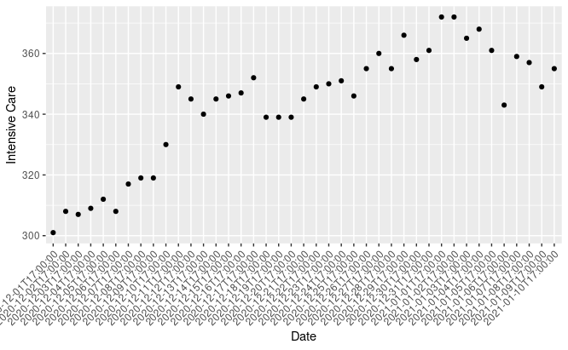
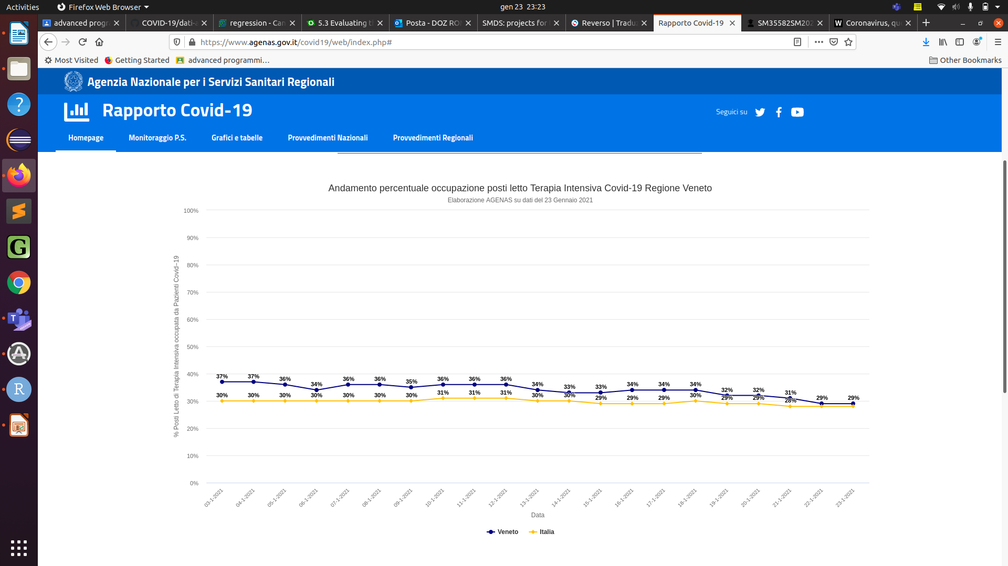
Why study intensive care
_{- Lack of staff}
- Lack of beds and breathing apparatus

Slide 3
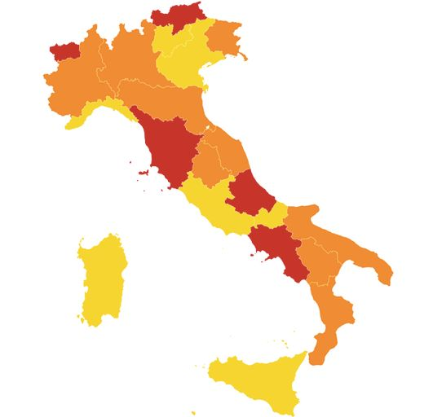
Why a statistical analysis
- Understand the factors that determine the trend
_{- Predict the future behavior}
- Suggest actions to improve the situation

Slide 4
The dataset
The dataset was obtained by the official website of Protezione Civile, starting from 1 September 2020 and considering only region Veneto.
The data regarding the place of the survey (latitude, longitude, exc...) have been removed as only an Italian region is being considered.
The data regarding variables no longer populated have been removed, while notes were considered to evaluate some data but not in the modeling project.
Field | Description
data | Date of notification
ricoverati_con_sintomi | Hospitalised patients with symptoms
terapia_intensiva | Intensive Care
totale_ospedalizzati | Total hospitalised patients
isolamento_domiciliare | Home confinement
totale_positivi | Total amount of current positive cases
variazione_totale_positivi | News amount of current positive cases
nuovi_positivi | News amount of current cases
dimessi_guariti | Recovered
deceduti | Death
totale_casi | Total amount of positive cases
tamponi | Tests performed
casi_testati | Total number of people tested

Slide 5
The dataset
The red variables have been removed because they are strongly correlated to other variables.
The blue variables are cumulative and therefore have been replaced by the corresponding daily changes.
Field | Description
data | Date of notification
ricoverati_con_sintomi | Hospitalised patients with symptoms
terapia_intensiva | Intensive Care
totale_ospedalizzati | Total hospitalised patients
isolamento_domiciliare | Home confinement
totale_positivi | Total amount of current positive cases
variazione_totale_positivi | New amount of current positive cases
nuovi_positivi | New amount of current cases
dimessi_guariti | Recovered
deceduti | Death
totale_casi | Total amount of positive cases
tamponi | Tests performed
casi_testati | Total number of people tested

Slide 6
The dataset
Two new variables have been added:
- zone is a categorical variable describing the “color” of the area in the current date
- lag_zone is a categorical variable describing the “color” of the area 7 days before the current date
Field | Description
data | Date of notification
ricoverati_con_sintomi | Hospitalised patients with symptoms
terapia_intensiva | Intensive Care
variazione_totale_positivi | News amount of current positive cases
nuovi_positivi | News amount of current cases
recovered_today | New recovered
death_today | New Death
test_today | Tests performed
people_today | Total number of people tested
zone | Color of the area
lag_zone | Previous color of the area

Slide 7
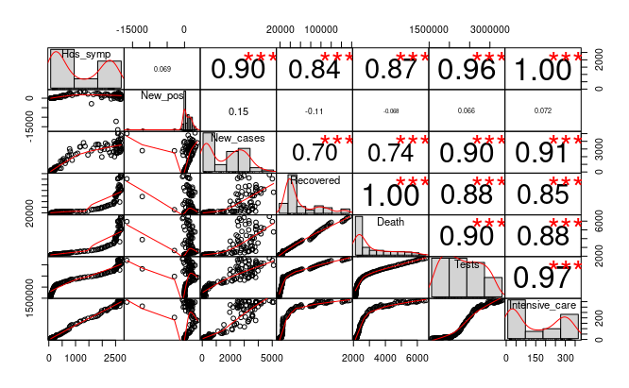
Explanatory analysis
Before starting to create a statistical model, it is convenient to analyze the variables and their relationship with the independent variable.
From the following correlation chart it can be seen that the variable new positives is not correlated to the number of intensive therapies.

Slide 8
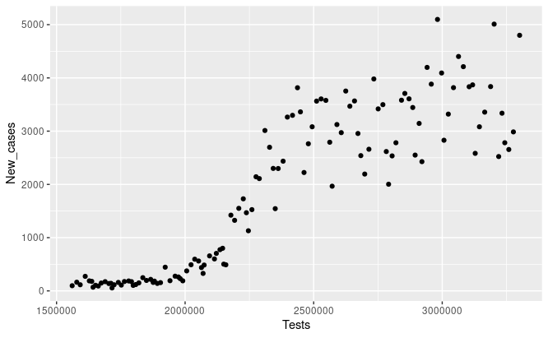
Quality of data
Despite the fact that the data was obtained from the official national source, their reliability depends on the procedures adopted to collect data. For example, deaths are likely underestimated because tests are not always performed on dead people outside hospitals. Also amount of positive cases it is definitely underestimated because it depends on the number of tests performed.
The dependent variable, intensive care, is not always the effective measured value because there are many temporal misalignments of the information flow, as reported in the notes of the dataset. Moreover, in the weekends or holidays data collection slows down and is retrieved on subsequent weekdays.
Despite this, it is possible to build a model taking into account that the forecasts will not be entirely accurate.

Slide 9
References
https://www.huffingtonpost.it/entry/oggi-il-nuovo-cambio-di-colori-le-regioni-rosse-scendono-da-8-a-5_it_5fc352efc5b6e4b1ea4bf6c6

