Slide 1

Temperature Forecasting
Prepared by: Aida Rabbani
Date : 13.02.2025

Slide 2
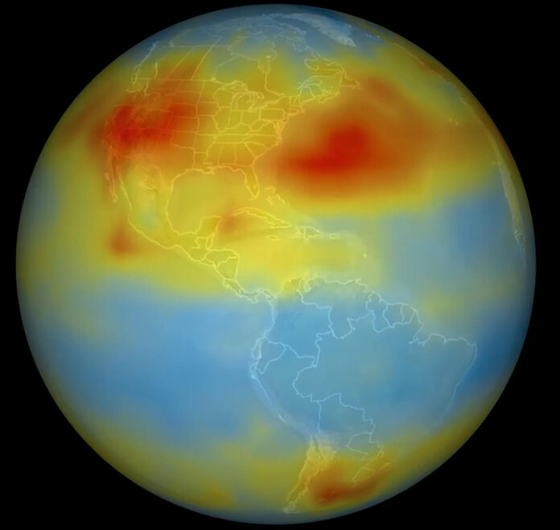
Overview
☀️ Temperature Analysis
☀️ ML Model for Temperature Prediction

Slide 3
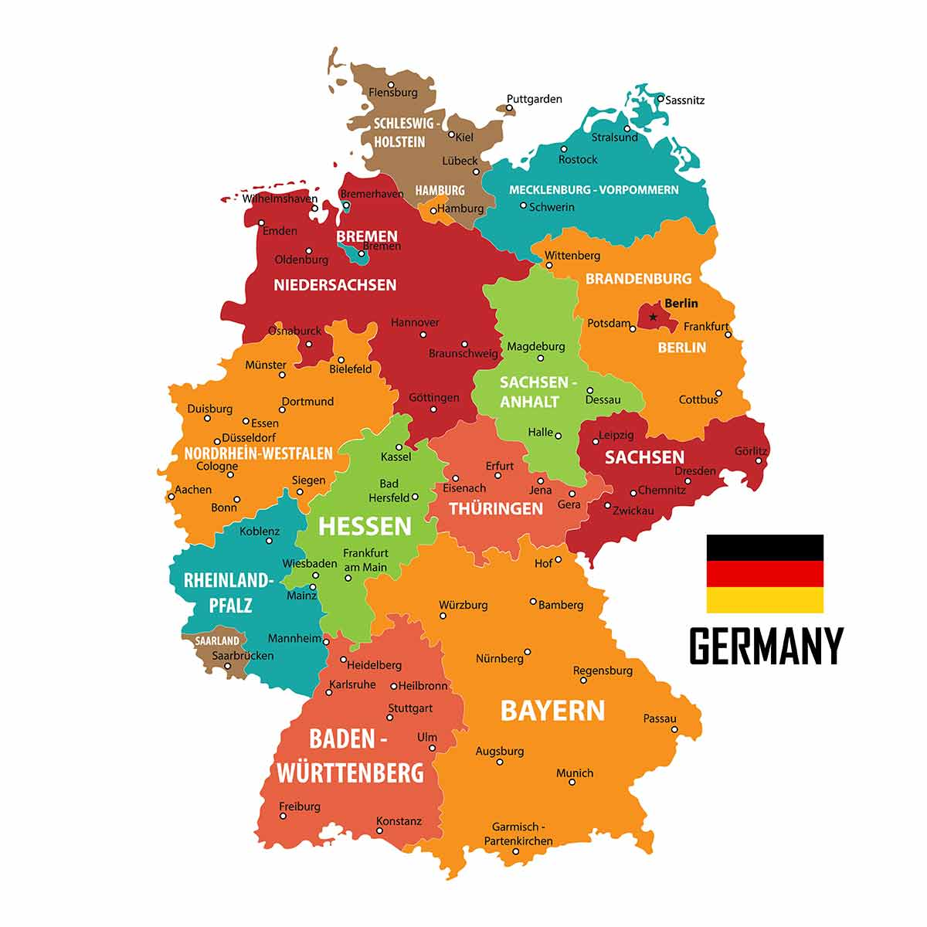
Data
Dataset: Climate indicators for Europe / Copernicus Climate Data Store (CDS)
Region | Germany
Temporal coverage | 1940-2023
Temporal resolution | Monthly
variables | Mean temperature
Source: https://cds.climate.copernicus.eu/datasets/sis-ecde-climate-indicators?tab=overview

Slide 4
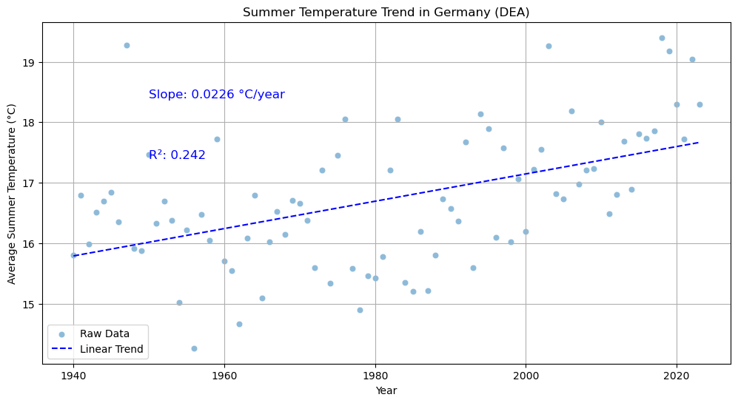
Temperature Analysis
Yearly Summer in DEA, 1940–2023 ☀️
Slope: 0.0226 °C/year → Indicates a gradual increase in summer temperatures.

Slide 5
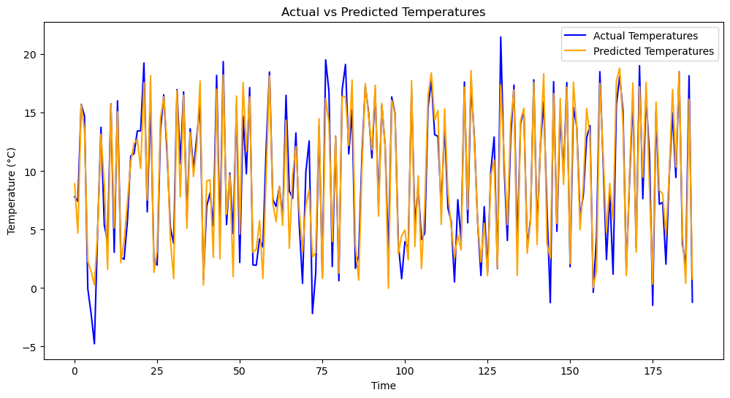
ML Model for Temperature Prediction ☀️
Monthly Temperature Predictions for DEA using the LSTM model
R²: 0.93
✅ Prediction Accuracy: 93% confirms strong alignment between past and predicted data.
✅ The model effectively captures temperature variations over time.
Notes:
This chart compares the actual (blue) with the predicted data (orange) to evaluate the model’s accuracy.
Temperature predictions from 2024 to 2030 (orange) compared with actual (blue) data. The red dashed line marks the start of predictions.
You used an "LSTM" model for monthly temperature prediction in a specific region in Germany.
The plot compares actual data with predicted data.
The high R-squared value indicates a strong alignment between past and predicted data, showing good accuracy.
The predictions closely follow actual trends.

Slide 6
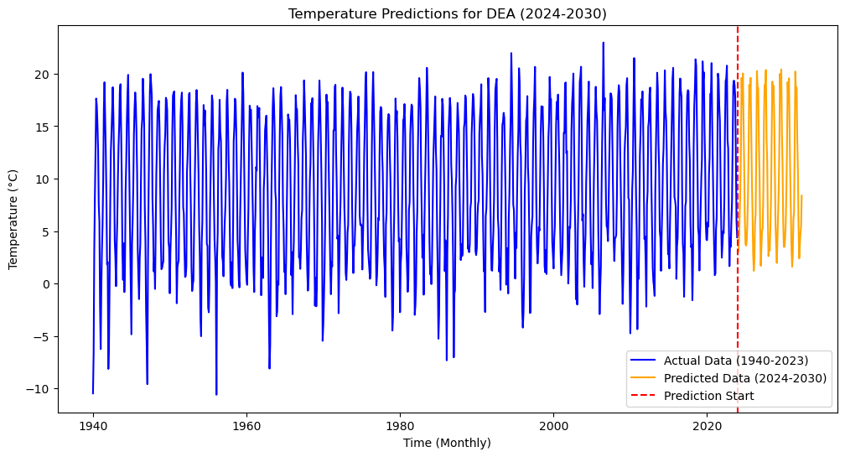
ML Model for Temperature Prediction ☀️
Monthly Temperature Predictions for DEA using the LSTM model
✅ The model has successfully preserved seasonal temperature fluctuations in its predictions.
✅ By analyzing the variation range, we can see that the model captures seasonal dynamics well.
Notes:
This chart compares the actual (blue) with the predicted data (orange) to evaluate the model’s accuracy.
Temperature predictions from 2024 to 2030 (orange) compared with actual (blue) data. The red dashed line marks the start of predictions.
You used an "LSTM" model for monthly temperature prediction in a specific region in Germany.
The plot compares actual data with predicted data.
The high R-squared value indicates a strong alignment between past and predicted data, showing good accuracy.
The predictions closely follow actual trends.

Slide 7
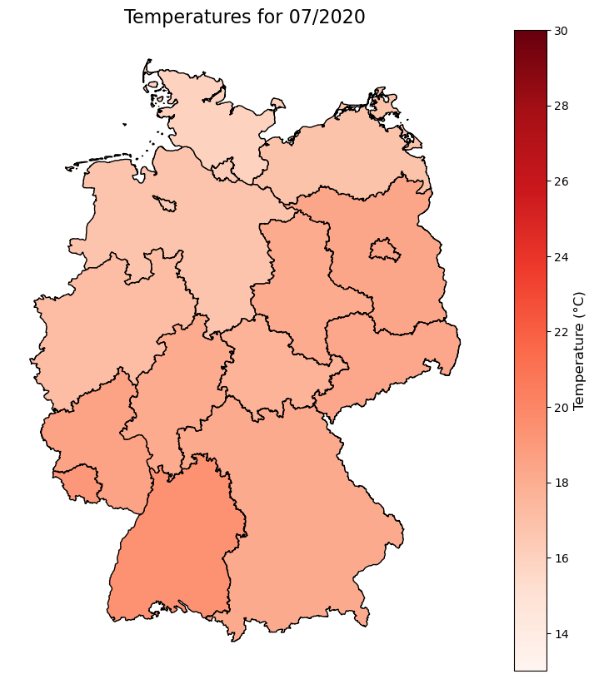
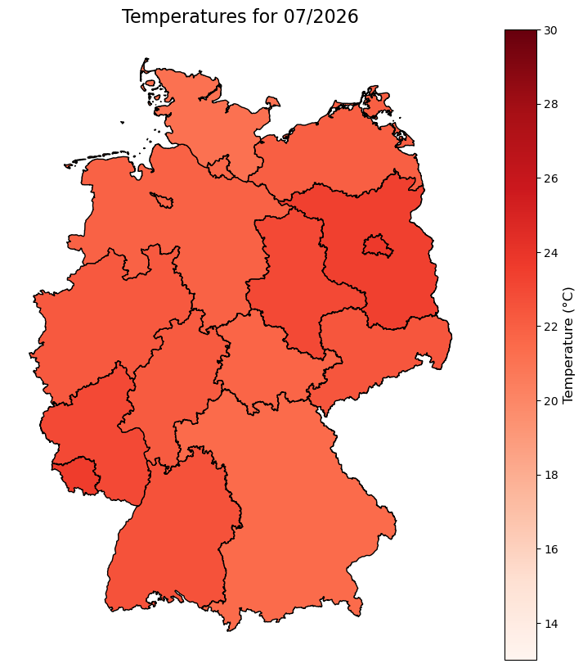
Temperature Visualization for Germany
Actual Temperatures
Predicted Temperature by LSTM
✅ Gradual temperature increase over time..
✅ Regional warming differences show that the model has learned local temperature variations.
Notes:
Visualization: Used matplotlib and geopandas

Slide 8
Results:
Temperature Analysis (1940–2023): Summer temperatures have been increasing, indicating a gradual warming trend.
Model Performance: The model demonstrated high accuracy (93%), making it effective in capturing seasonal temperature variations.
Recommendations:
Increase features
Explore advanced forecasting techniques to enhance long-term trend accuracy
Notes:
Historical & Projected Temperature Analysis:
July temperatures (1940–2025) show an increasing trend in the DEA region.
Projections indicate a continued rise under the RCP4.5 scenario.
ML Model for Temperature Prediction:
The LSTM model demonstrated strong accuracy in predicting monthly temperatures with metrics:
MAE: 1.44, MSE: 3.32, RMSE: 1.82, R²: 0.93.
Predicted temperatures align well with actual historical trends.
Temperature Visualization:
Successfully combined historical and predicted data for spatial mapping across German regions.
Geospatial visualization highlights regional variations in temperature.
Historical & Projected Precipitation Analysis:
Precipitation data shows seasonal variability without strong long-term trends in July (1940–2100).
ML Model for Precipitation Prediction:
The SARIMAX and 1D CNN models underperformed, failing to capture variability due to insufficient features.
Correlation Analysis:
Weak correlation between temperature and precipitation trends in Germany (2020–2024).
Correlation coefficients:
Pearson: 0.088 (p=0.550)
Spearman: 0.055 (p=0.710)
Suggests independence between seasonal variations in temperature and precipitation.

Slide 9

THANK YOU

