Slide 1


Slide 2

Intro To

Slide 3
M.Elyas Nawabi
2014: BCS – Kabul polytechnique university

Slide 4
Introduce yourself
Name
Occupation
Computer Science background & experience

Slide 5


About Milestone

Slide 6



Milestone Tech. Products

Slide 7
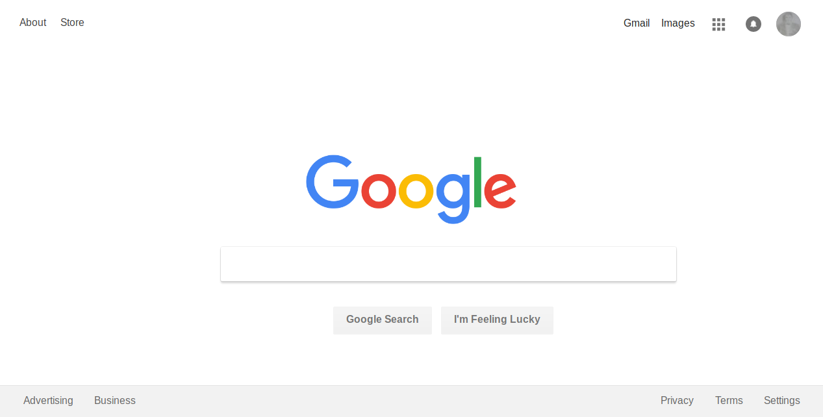
Projects

Slide 8
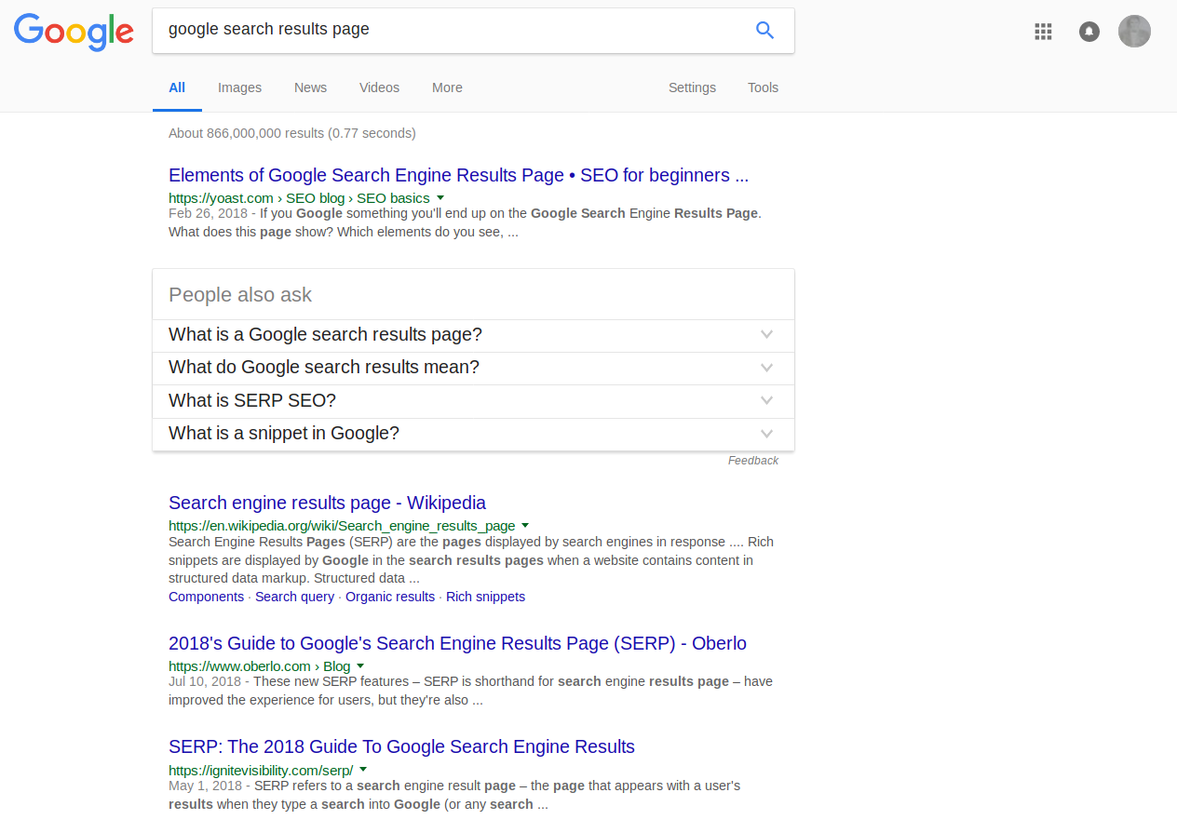

Slide 10
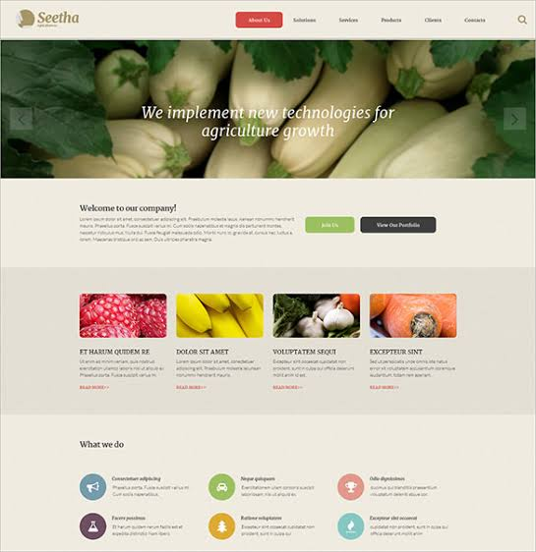
Projects Cont…
Apartment Management System
Nature Website
CV Template
Restaurant Website
Social Media Website
Travel Agency Website
Educational Website
Sport Website
Hospital, Health Website
Search Engine Page
Marketing Template
Clothing Store Website
Vegetables, Food Website

Slide 11
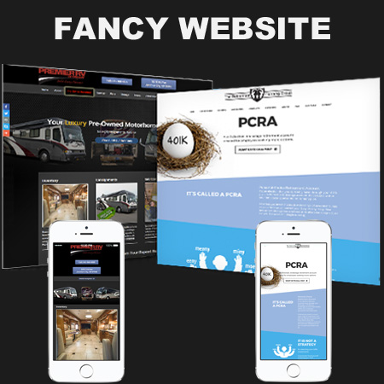
Projects Cont…
Apartment Management System
Nature Website
CV Template
Restaurant Website
Social Media Website
Travel Agency Website
Educational Website
Sport Website
Hospital, Health Website
Search Engine Page
Marketing Template
Clothing Store Website
Vegetables, Food Website

Slide 12
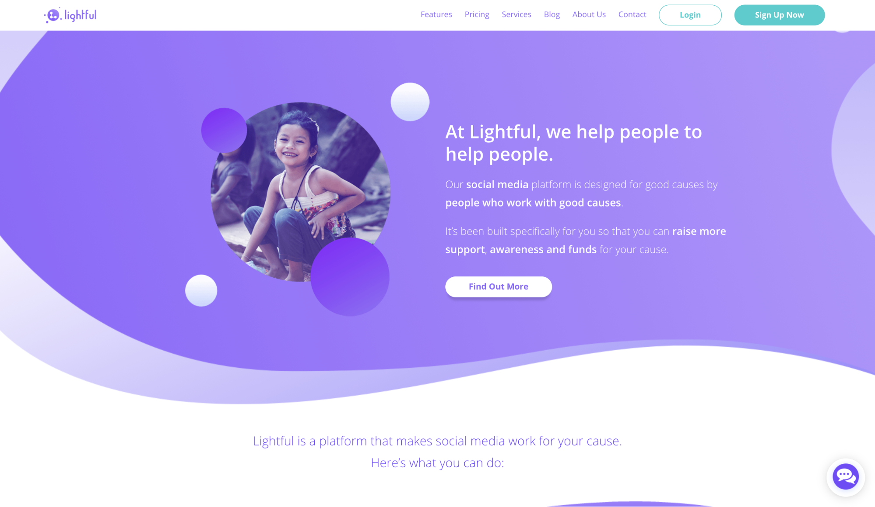
Projects Cont…
Apartment Management System
Nature Website
CV Template
Restaurant Website
Social Media Website
Travel Agency Website
Educational Website
Sport Website
Hospital, Health Website
Search Engine Page
Marketing Template
Clothing Store Website
Vegetables, Food Website

Slide 13
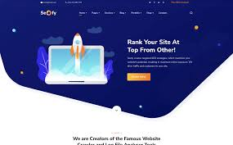
Projects Cont…
Apartment Management System
Nature Website
CV Template
Restaurant Website
Social Media Website
Travel Agency Website
Educational Website
Sport Website
Hospital, Health Website
Search Engine Page
Marketing Template
Clothing Store Website
Vegetables, Food Website

Slide 14

Projects Cont…
Apartment Management System
Nature Website
CV Template
Restaurant Website
Social Media Website
Travel Agency Website
Educational Website
Sport Website
Hospital, Health Website
Search Engine Page
Marketing Template
Clothing Store Website
Vegetables, Food Website

Slide 15
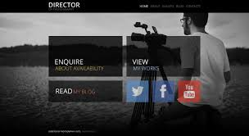

Projects Cont…
Apartment Management System
Nature Website
CV Template
Restaurant Website
Social Media Website
Travel Agency Website
Educational Website
Sport Website
Hospital, Health Website
Search Engine Page
Marketing Template
Clothing Store Website
Vegetables, Food Website

Slide 16
Web Technologies
Structure
Browsers
Webservers
Devices
How Websites are Created
How the Web Works

Slide 17
Internet!??
A large network of networks

Slide 18
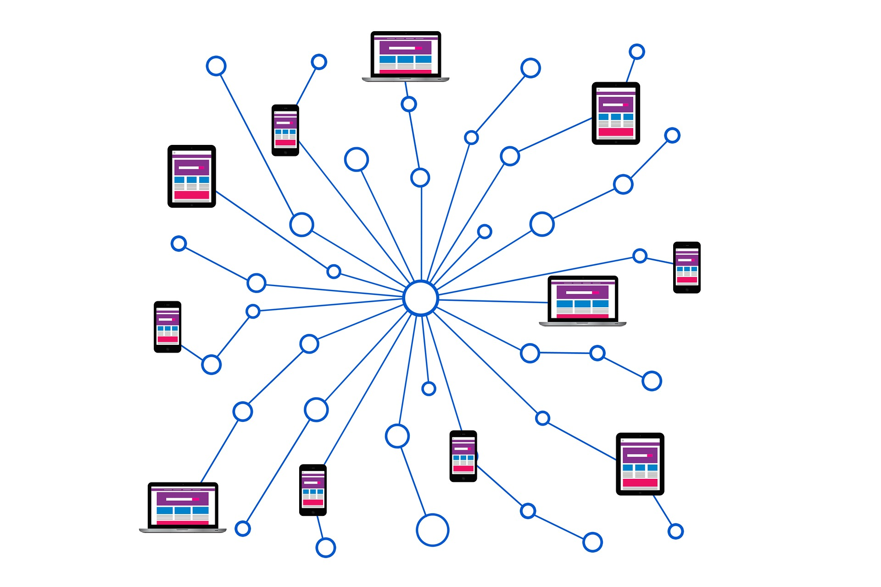
Network!??
A group of interconnected computers

Slide 19
Internet
A network of networks

Slide 20

Internet
A network of networks

Slide 21
So what is WWW (The Web)?
A system of interconnected documents

Slide 22
Why study web development?
Online presence is inevitable: demand for developer
Web apps are platform & browser independent
You can get creative
You can transition into other fields: mobile app development
Did you know? You can build mobile apps with HTML, CSS & JS
Build once compile for all

Slide 23
Why study web development? Cont.
Remote flexible hours: work at your own pace
Good salary
Ability to code is highly valuable skill
Come up with your own idea and become an entrepreneur

Slide 24
How be become a good programmer?
Programming is like sports
Don’t lose your motivation
A programmer is always learning
It’s science AND art
Surround yourself with other programmers

Slide 25
Learning Management System
Discuss in the forum
Submit assignments
Announcements

Slide 26
Syllabus Part 1
Module 0 & 1: HTML Fundamentals
Module 2 & 3: CSS Fundamentals
Module 4: Combining HTML & CSS
Module 5: Advanced CSS Topics

Slide 27
Syllabus Part 2
Module 0 : Intro to JS Language
Module 1: JS Essentials
Module 2: More JS Essentials

Slide 28
Syllabus Part 2
Module 0 : Intro to JS Language
Module 1: JS Essentials
Module 2: More JS Essentials

Slide 29
Grading Structure
Programming, coding reading, debugging assignments and + Module Projects: 25%
Reading Assignments & Module Quizzes: 25%
Final Project: 25%
Final Exam: 25%

Slide 30
Deadlines
Module Assignments Deadline is 1 Week

Slide 31
Passing Score
75%

