Slide 1

1 Unit 1

Slide 2

Contents
1 Hello everybody!
7 Then and now
2 Meeting people
8 A date to remember
3 The world of work
9 Food you like!
4 Take it easy!
10 Looking good!
5 Where do you live?
11 Life’s an adventure!
6 Can you speak English?
12 Have you ever?

Slide 3

1 Hello everybody!
Hello. My
name’s Miguel.
1

Slide 4
My name’s Miguel.
My name is Miguel.
name’s name is
1

Slide 5
What’s your name?
1

Slide 6
What’s your name?
What is your name?
what’s what is
1

Slide 7
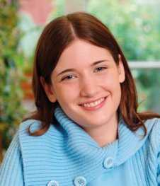

I am I’m
‘
I
a
m
My name is Emma. I’m from Canada.
1

Slide 8
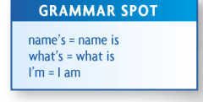
‘
Name
s
Name
s
i
i
‘
What
i
s
What
i
s
‘
I
I
a
m
a
m
1
1

Slide 9
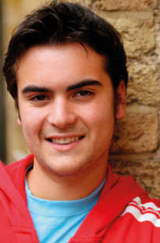

He is He’s
‘
He
i
s
He’s from Mexico.
1

Slide 10
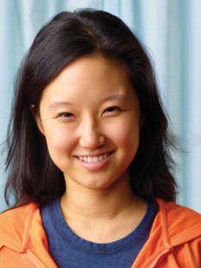

‘
She
i
s
She’s from Korea.
1

Slide 11
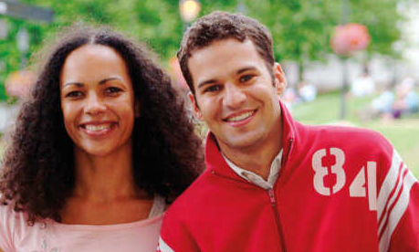

They are They’re
They’re from the U.S.
1

Slide 12
‘
He is
He
i
s
‘
She is
i
She
s
‘
They are
They
a
re
1

Slide 13
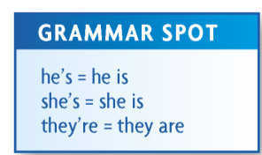
1

Slide 14
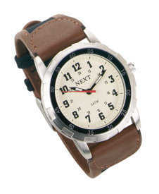

‘
It
i
s
It’s from the U.K.
1

Slide 15
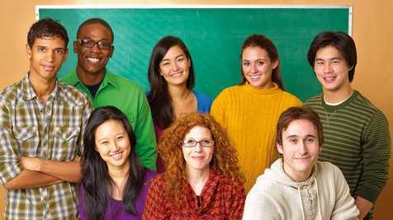
We are We’re
We’re from many different countries.
1

Slide 16
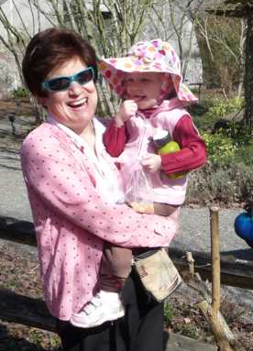
Verb: to be
I am from the United States.
am
I
He She It
We You They
1

Slide 17
Verb: to be
She is from the United States.
am
I
He She It
We You They
is
1

Slide 18
Verb: to be
We are from the United States.
am
I
He She It
We You They
is
are
1

Slide 19

Fill-in the blanks
to be
He ____ from Thailand.
They ____ from Chile.
We ____ from Canada.
I ____ from Taiwan.
It ____ from Brazil.
is
are
are
am
is
1

Slide 20
Correct or Incorrect?
1. He’s from Thailand.
correct
2. The’yre from Chile.
incorrect
2. They’re from Chile.
3. We’re from Canada.
correct
4. I’m from Taiwan.
incorrect
4. I’re from Taiwan.
5. Its’ from Brazil.
incorrect
5. It’s from Brazil.
1

Slide 21
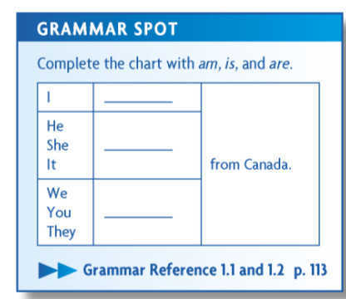
am
is
are
1

