Slide 1
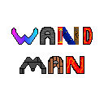
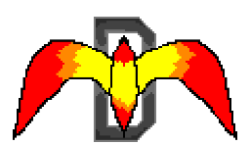
By Team MagiDev

Slide 2
Team MagiDev
Bar Ben-zvi – Design Director
Eli Miller – Technical Director
Hunter Starr –Art Director
Nelson Athow - Producer

Slide 3
Overview
Game Demo
New Features
New Audio Assets
Sound Effect Showcase
New Art Assets
Art Showcase
Beta Targets
Feature Content Target
Art Content Target
Audio Content Target

Slide 4
Game Demo

Slide 5

New Scripts, Mechanics & Features
Room Generation
New Player Spells
New Firing Patterns & Mechanics
Bosses
Bug Fixes
6. Main Menu
7. Tutorial
8. Death Menu
9. Animations / SFX

Slide 6
New Audio Assets
Player Sound Effects
Spell Attack Sound Effects
Explosion Sound Effect
Enemy Sound Effects
Hurt Sounds
Death Sounds

Slide 7
Sound Effect Showcase

Slide 8
New Art Assets
Player Assets
Walking Animations
Spell Attack Animations
Spell Textures
Map Assets
Area 1 Tiles
Area 2 Tiles
Enemy Assets
Enemy Walking Animations
Enemy Attacking Animations
Enemy Textures

Slide 9
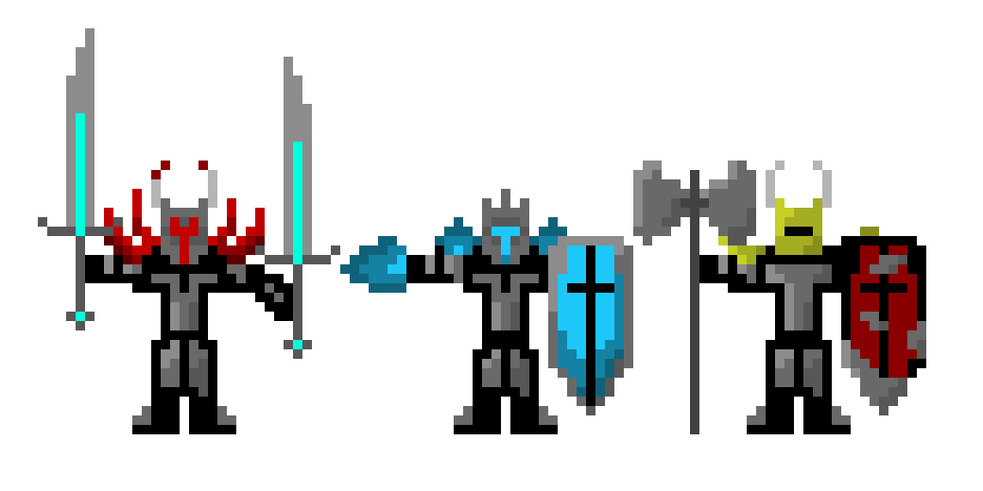
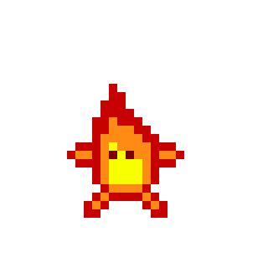
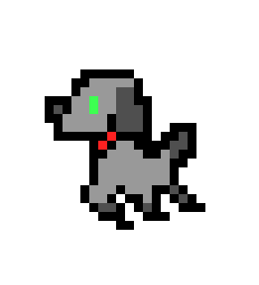

Art Showcase

Slide 10
Beta Game Content Target
Enemies:
Area 3 Enemies
Area 2 Boss
Area 3 Boss
Final Boss
Player Spells:
Arc Lightning
Acid Pool
Ring of Fire
Dragon Scale Stream
Water Stream
Rainbow Shot
Bone Shot

Slide 11
Beta Art Content Target
Enemy Attack Animations
Enemy Movement Animations
3. Player Spell Animations
4. Boss Attack Animations
5. Boss Movement Animations

Slide 12
Beta Audio Content Target
Movement And Hurt Sound Effects
Player Movement Sound Effects
Death Sound Effects
Unique Hurt Sound Effects
Attack Sound Effects
Player Spell Sound Effects
Enemy Attack Sound Effects

