Slide 1

Wand Man
By MagiDev

Slide 2
The Dream Team
Bar Ben-zvi – Design Director
Eli Miller – Technical Director
Hunter Starr –Art Director
Nelson Athow - Producer

Slide 3
Art Theme

Slide 4
Art Samples

Slide 5
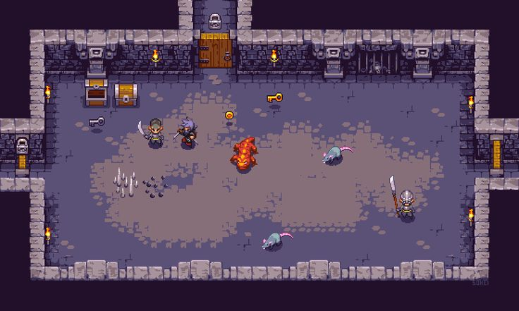
Area 1

Slide 6
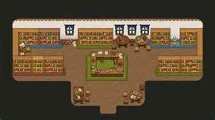
Area 2

Slide 7
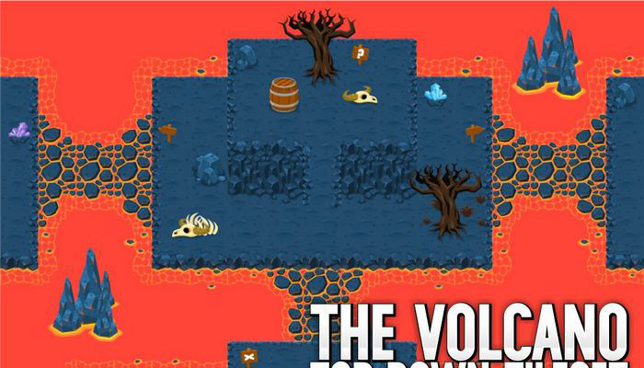
Area 3

Slide 8
Audio Theme

Slide 9
Audio Samples

Slide 10
Design Protoype

Slide 11
Core System

