Slide 1
Question: How Does Urbanization Effect Colony Growth
Theodorou, P., O. Kühn, L. M. Baltz, C. Wild, S. L. Rasti, C. R. Bucksch, E. Strohm, R. J. Paxton, and C. Kurze. 2022. Bumble bee colony health and performance vary widely across the urban ecosystem. Journal of Animal Ecology 91:2135–2148.
Aidan Perkins Will Edington, Daniel Monroe, Lane Moyer, John Henry

Slide 2
Response Variable: Prevalence of Parasite Trypanosome Predictor Variables -Colony Growth -Impervious Surfaces -Edge Density -Flowering Plant Species Richness -Flowering Plant Abundance -Green Cover

Slide 3
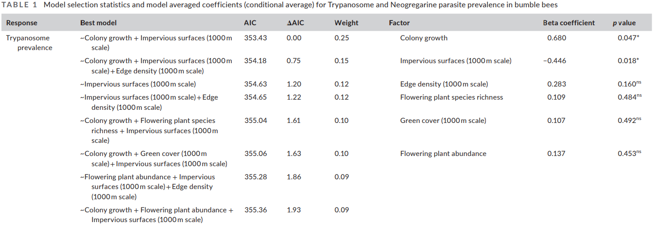

Slide 4
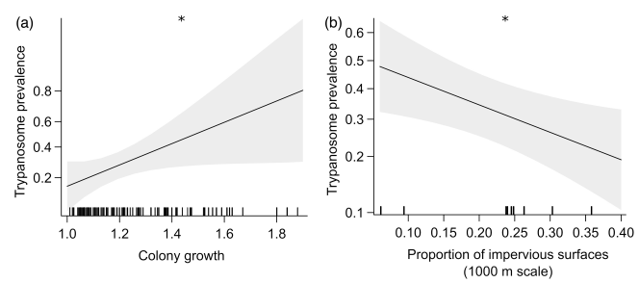
Best Model:
Colony Growth + Impervious Surfaces
All models were within 2 ΔAIC of each other

Slide 5
Concluding remarks
Impact of urbanization on bumblebees
Various factors in determining colony growth and population abundance
Parasite as an indicator species

