Slide 1
NY DEC Herpetofauna Management
By: Celebrity Wright, Aidan Perkins, Kyle Higgins, John Henry, & Will Edington

Slide 2
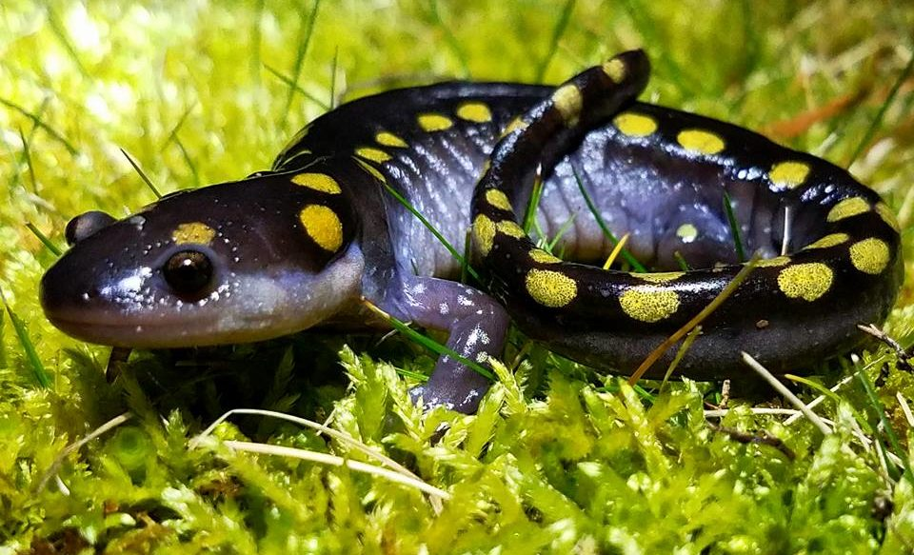
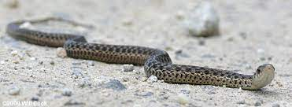
Introduction
Approximately 70 Species of Amphibians and Reptiles in NYS
19 species of Salamander
14 species of Frogs and Toads
20 species of Turtles
17 species of Snake
4 species of Lizard
9 species listed Endangered, 18 more species listed Threatened or Special Concern.
(DEC₁)

Slide 3
Background
Herp Atlas Project (1990-1999) - Species distribution around the state
New York Amphibian & Reptile Survey (NYARS) - Collaborative platform for citizen science
Submit observations of any herpetofauna species
Currently the best source of abundance and population data for herpetofauna in NY
Hunting is permitted for snapping turtles and most frogs/toads during summer hunting seasons

Slide 4
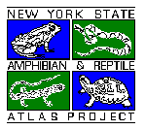
Herp Atlas Project
Data from before 1989 in addition to the Amphibian & Reptile Atlas Project used to determine location of NY herps
Amphibian & Reptile Atlas Project
Conducted over a ten-year period from 1990 to 1999
USGS 7.5 minute topographic quadrangle used as measurement
20 species or more for a quadrangle was desired
No further surveys have been done
Why hasn't there been a new atlas herpetofauna project?
Funding is the main reason there has not been another atlas project. Funding is mostly public which comes mostly from tax on ammunition. That money goes more towards management of game species and hunted species as compared to less popular species such as herps. (Gibbs 2022)
(DEC₁)

Slide 5
Hunting Regulations
Department of Environmental Conservation regulates how herps are hunted
Lizards, snakes, and salamanders cannot be owned or hunted
snapping turtles: a bow or firearm must be used with a hunting license
Frogs may be hunted using a bow or gun under a hunting license
clubs, hands, spears, or hooks require a fishing license
area, bag amount, hours, season, and size regulations exist for all game
How does hunting turtles and frogs affect their populations?
Hunting these animals has a huge impact on these species because we have no idea how many are in the population and we could potentially hunt them into endangerment. Not knowing how many individuals are in a population means we can't fix regulations and bag limits. (Gibbs 2022)
(DEC₂)

Slide 6
AM & RC Project
Amphibian Migrations and Road Crossings Project
Helps herpetofauna with their mating season migrations
Began in 2009
Uses volunteers to track amphibian migrations
How would under road crossings help these species?
Under road crossings would help increase the survivability of these species when crossing roads to get to breeding sites, over winter habitats and even just connecting their fragmented habitats. (Gibbs 2022)
Why don’t we implement these under road crossings into our road systems?
Our road systems are replaced/repaired often due to the naturally occurring cracks and movement of the roads throughout the seasons due to this fact under road crossings would be extremely expensive. (Gibbs 2022)
(DEC₃)
Notes:
During our

Slide 7
Conclusion/What Can Be Done
Mainly rely on public for funding
Leverage public on a large scale through marketing practices to inspire more volunteers & create more projects like the Atlas project and AM & RC
Can only properly regulate hunting with population dynamics
Put herpetofauna/all wildlife on the same level of importance as charismatic species
(Gibbs, 2022)

Slide 8
Literature Cited
James, G. 2022.New York State Management of Herps. SUNY ESF Syracuse, New York
DEC₁, Herp Atlas Project - NYS Dept. of Environmental Conservation. (n.d.). . https://www.dec.ny.gov/animals/7140.html.
DEC₂, N. (n.d.). Reptile and Amphibian Hunting Seasons - NYS Dept. of Environmental Conservation. https://www.dec.ny.gov/outdoor/31339.html.
DEC₃, Amphibian Migrations and Road Crossings - NYS Dept. of Environmental Conservation. (n.d.). . https://www.dec.ny.gov/lands/51925.html.

