Slide 1
EFB 390 Recitation – Tues 10/3
Announcements: - Week 5 homework due at midnight on Thurs 10/5
- Guest lecturer Thurs, readings, submit question before lecture
- No recitation next week (fall break!)
Today: - AIC presentation overview, example - Prep AIC presentation in class Thursday 10/12
Notes:
NORMAL (GAUSSIAN) (seal weight), BINOMIAL (sex), POISSON Counts (number of seals on each island)

Slide 2
AIC (Akaike Information Criterion)
Most common criterion used for model selection
Given a collection of models for data, estimates the quality of each model, relative to each of the other models
Used when we want parsimony (simplest model with the least assumptions and variables but with greatest explanatory power)
AIC can be any number
Value of AIC means absolutely nothing by itself
Comparative tool
Rules of thumb
0-2 Δ AIC = strongly competing model
4-7 Δ AIC = limited support
> 10 Δ AIC = essentially no support
Notes:
Akaike – Japanese statistician

Slide 3
AIC Presentation
In class Thursday 10/12, full group needs to present
Submit slides to Blackboard Weds 10/11 before midnight
No longer than 3 minutes
5 slides:
Title (Ecology style citation), question
Response variable and predictors
AIC Table
Important models
Concluding remarks

Slide 4
Question:
Article:
Codron, D., J. A. Lee-Thorp, M. Sponheimer, J. Codron, D. De Ruiter, and J. S. Brink. 2007. Significance of diet type and diet quality for ecological diversity of African ungulates. Journal of Animal Ecology 76:526–537.
Do morphological adaptations in African savanna ungulates reflect variations in diet type or quality?

Slide 5
Response variable and predictors:
Response variables:
Body mass (kg)
Hypsodonty (height:width ratio of molar)
Predictors:
Fecal carbon (13) isotopes represents percentage grass consumed
Fecal proxies for diet quality
%N (percent nitrogen)
NDF (neutral detergent fiber)
ADF (acid detergent fiber)
ADL (acid detergent linen)
Notes:
Response variable (X!)
- Other names? Independent variable, covariate, explanatory variable, fixed effects
Hypsodonty- high crowned teeth (ie horses) for eating abrasive materials (eg grass)
Only chose one response variable!

Slide 6
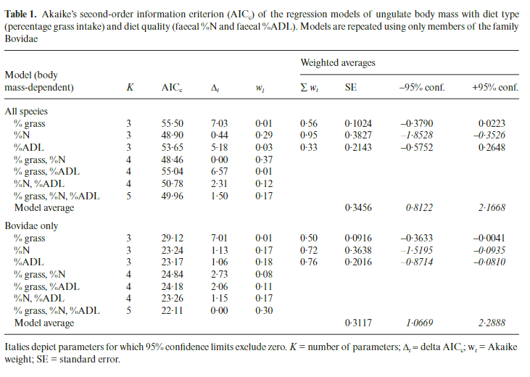
AIC Table:
Notes:
acid detergent lignin ADL (measure of fiber in diet, diet quality)

Slide 7
Important models:
Notes:
Usually models within 2 delta aic are considered supported
Body mass as a function of %grass AND %N, %ADL (diet quality measures)

Slide 8
Conclusion:
Body mass related to diet quality
Contradicts predictions that body mass related to diet type

Slide 9
Tuesday 3:30 groups:
Vincelette et al 2021 | Bernasconi et al. 2022 | Kingsolver and Srygley 2000 | Vanpe et al 2007 | Hepp et al 2005
Holly Anderson | Julianna Anglada | Mia Villanueva | Gillian Burch | Rae Burke
Thomas Fernandez | Jem Garcia | Kalani Bankston | Allison Greiner | Max Handen
Shawn Henderson | Elise Herrick | Jack Gerbe | Julia Lotempio | Nancy Mazor
Ethan McDevitt | Mila Miller | Sam Lasher | Marie Rogers | Will Schofield-broadbent
Anyka Tetu | Sarah Baker

Slide 10
Tuesday 5:00 groups:
van de Kerk et al 2020 | Noren et al 2015 | Johnson et al 2006 | Bilodeau et al. 2013
Olivia Arce | Connor Eisenbach | Nao Bellio | Sarah Brazzillo
Jasper Edwards | Mark Loveless | Victor Ferraro | Anne Gutelius
Natalie Jurgielewicz | Emily Valenti | Fritz Hopf | Adi Norris
Damien Terrell | Bruce Tangredi | Brandon Wingert | Lily Celmer

