Slide 1
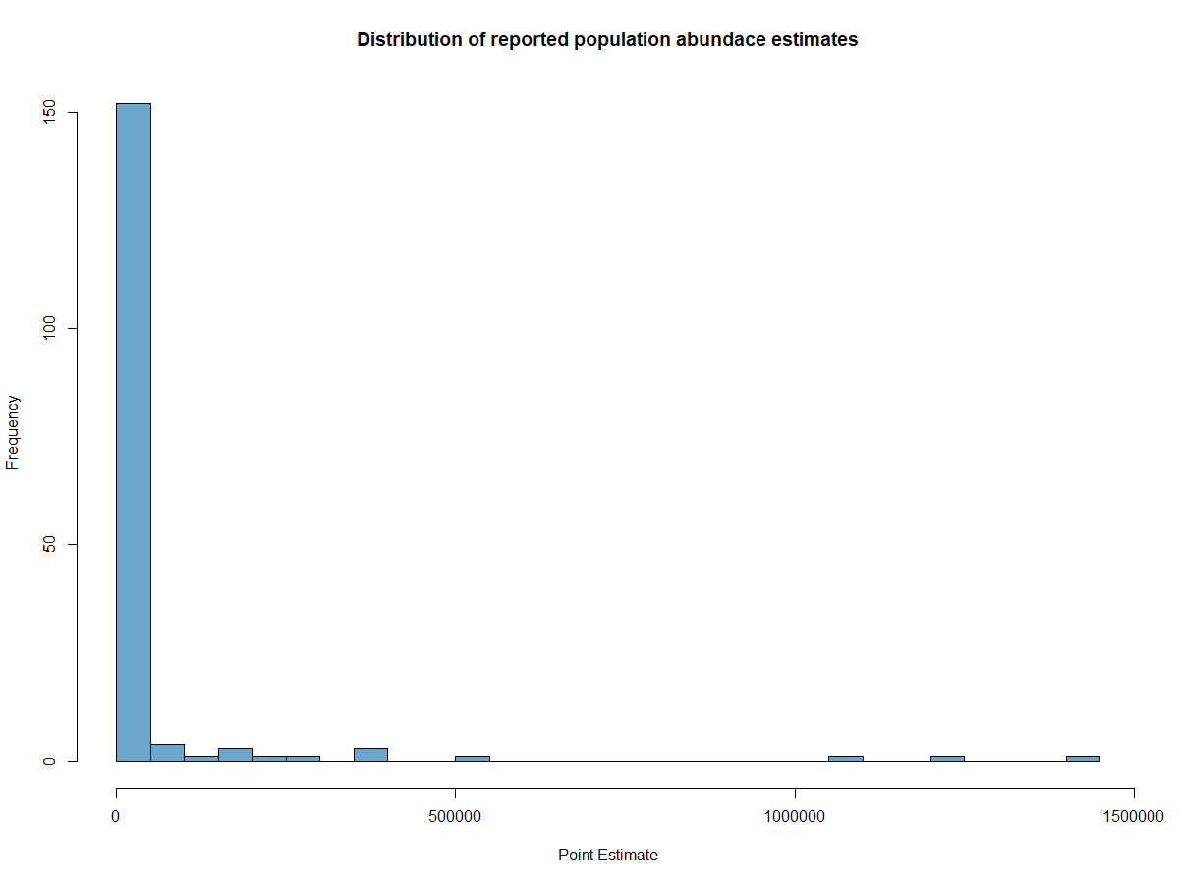
Low population:
16 [8 – 14]
Canada lynx in SW Yukon territory
Median population:
623 [561 – 741]
Mtn. Goats in Olympic Mtns
High population:
1,442,000 [976,000 – 2,132,000]
Population along Grey Kangaroo Overlap Zone in Victoria

