Slide 1
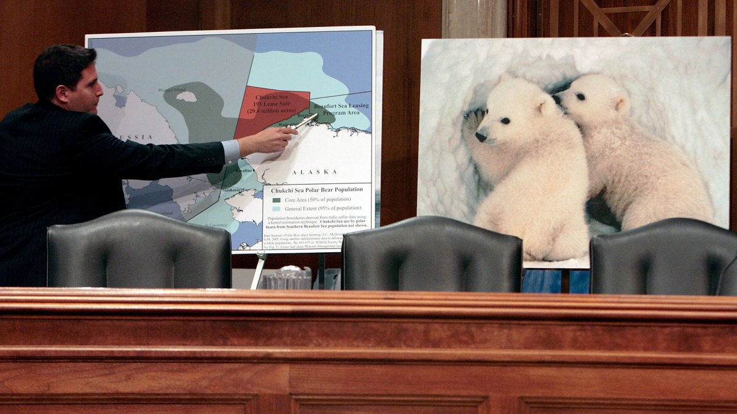
Endangered Species Due to Climate Change
Presented by Caitlin Russel, Ricky Bartlette, Manny Baker, Grace Rudolph, and Zach Mills

Slide 2
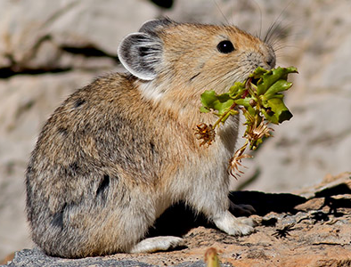
Introduction
The Endangered Species Act is a controversial law
Climate change has greatly increased the rate of species becoming endangered and therefore escalating the pressure of the ESA
Unfortunately, with many species, the effects of climate change on them is too great and it is unlikely they will be able to bounce back.
It’s often questioned if they should even be put on the ESA.
(“Summary of the Endangered Species Act” 2022)
Notes:
Polar bears

Slide 3
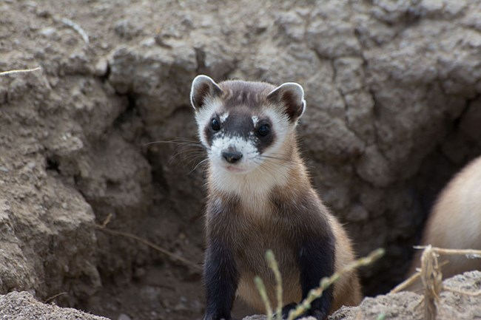
Introduction 2: Return of the Introduction
The purpose of putting species on the endangered species list is to ultimately get them off the list by getting their populations to recover
Once on the endangered species list, it is illegal to harm the species in any way as well as transporting these beings.
(“Summary of the Endangered Species Act” 2022)
Notes:
EPA. 2022. . EPA.gov.

Slide 4
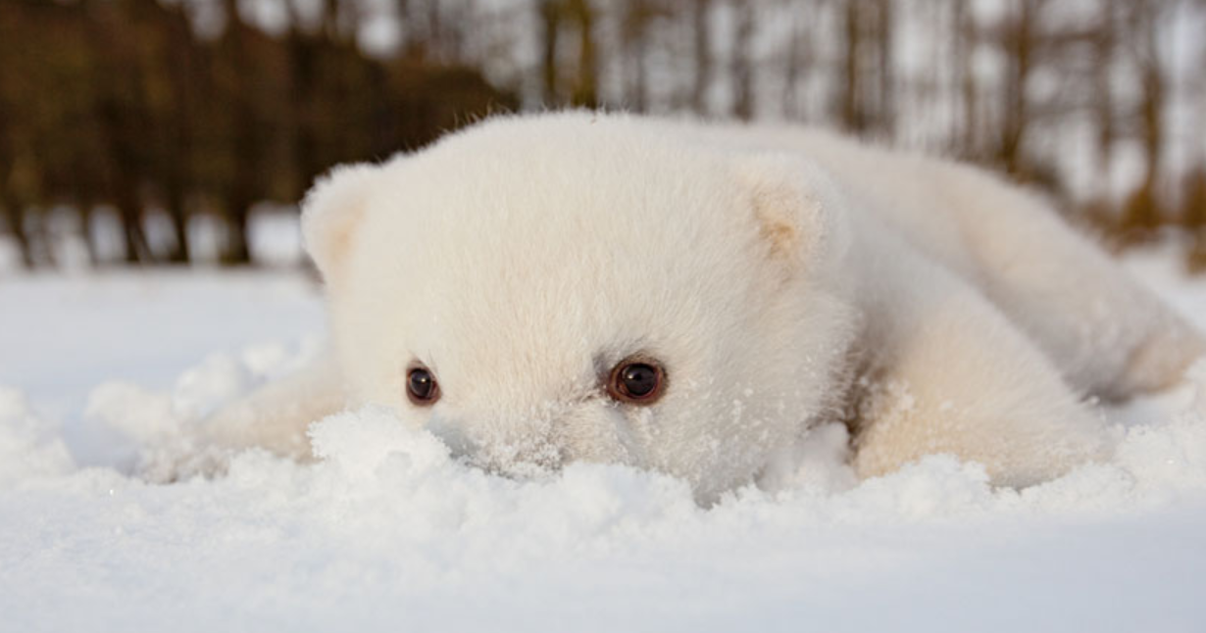
Background
ESA introduced in 1973
Modifications and exceptions
Climate change
Listing wildlife as endangered or threatened requires reparations
How would the Fish and Wildlife Service repair climate change?
Legal implications
Private vs. public
Federal, state, and municipal laws
(Henson et al. 2018)

Slide 5
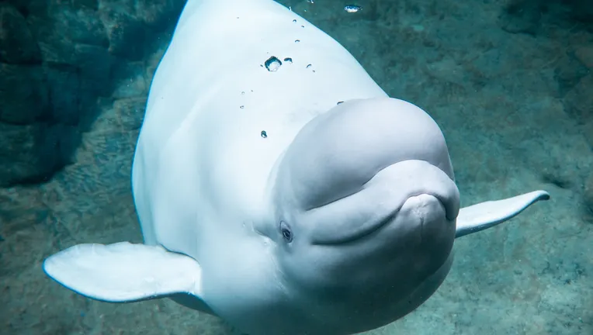
Climate change and species
There are currently over 1300 species on the ESA
Polar bears
Pikas
Monarch butterfly
Coral reefs
Sea turtles
Gray wolf
Beluga whale
(Endangered Species Act 1973, 2020)
Notes:
https://www.fisheries.noaa.gov/species-directory/threatened-endangered
https://www.fws.gov/species

Slide 6
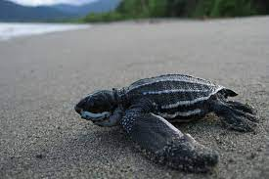
Alternative Methods
Ecosystem Restoration
Genetic intervention
Selecting what species that can be recovered
Budget
Diversity
Ecosystem structure : does the loss of the species cause a cascade?
(Foin et al. 1998; Kosch et al. 2022)

Slide 7

What can we even do?
Warnings of climate change since 1988
It’s a people problem.
Paris Agreement, 2015
(Butler 2018; Hulme, 2019; “Paris Agreement” 2015)

Slide 8
Yes, it’s still worth it!
Though difficult, potentially impossible to solve, there is value to inclusion.
Public awareness
Encourages action, such as breeding programs - potential for reintroduction.
Existential risk ≠ Total Anarchy
ESA forces allocation of resources, without it, we may delegate nothing at all.
(Butler 2018; Henson et al. 2018; Henson 2022)

Slide 9
References et al. 2022
Butler, C. D. 2018. Climate Change, Health and Existential Risks to Civilization: A Comprehensive Review (1989-2013). International Journal of Environmental Research and Public Health.
Fawzy, S., A. I. Osman, J. Doran, and Dr. W. Rooney. 2020. Strategies for mitigation of climate change: a . review. Environmental Chemistry Letters 18: 2069-2094.
Foin, T. C., S. P. D. Riley, A. L. Pawley, D. R. Ayres, T. M. Carlsen, P. J. Hodum, and P. V. Switzer. 1998. Improving Recovery Planning for Threatened and Endangered Species. BioScience 48:177–184.
1973, 2020 Endangered Species Act of 1973. Department of the Interior, US Fish and Wildlife Service,
Washington, D.C., USA.
Henson, P. November 30, 2022. Zoom interview.
Henson, P., R. White, and S. P. Thompson. 2018. Improving Implementation of the Endangered Species Act: Finding Common Ground Through Common Sense. Bioscience 68: 861-872.
https://wires.onlinelibrary.wiley.com/doi/full/10.1002/wcc.619 (11/29/2022).

Slide 10
References et al. 2022
Hulme, M. 2019. Is it too late (to stop dangerous climate change)? An editorial.
Kosch, T., A. Waddle, C. Cooper, K. Zenger, D. Garrick, L. Berger, and L. Skerratt. 2022. Genetic approaches for increasing fitness in endangered species. Trends in ecology & evolution 4:332-345.
Paris Agreement. 2015. Paris Agreement. United Nations. 54113. Secretary General of the United Nations, Paris, France.
“Summary of the Endangered Species Act. (1973). 2022. United States Environmental Protection Agency. 16 U.S.C. 1531 et seq. Environmental Protection Agency, Washington, D.C.

Slide 11
References et al. 2022
Zipkin, E. F., L. Ries, R. Reeves., J. Regetz, and K. S. Oberhauser. 2012. Tracking climate impacts on the migratory monarch butterfly. Global Change Biology 18: 3039 - 3049.

Slide 12
Questions?

