Slide 1

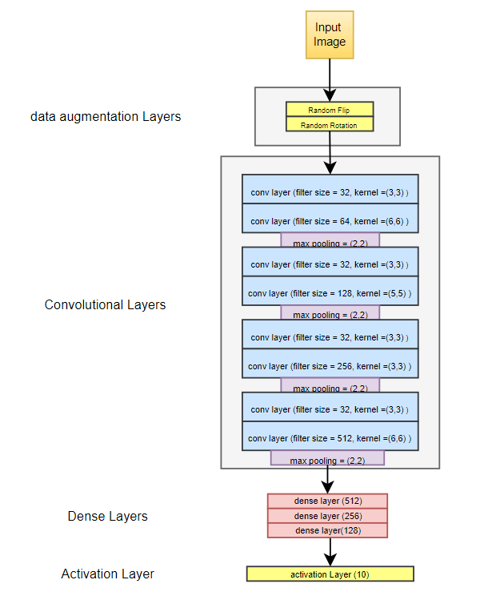
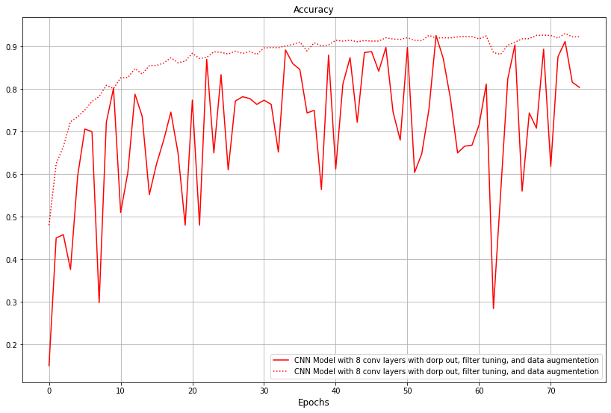
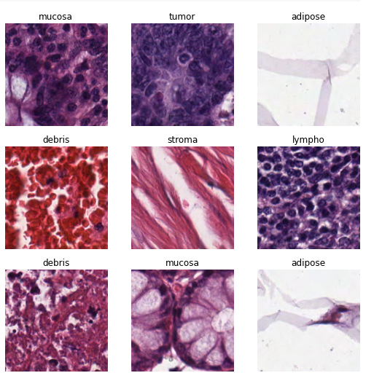
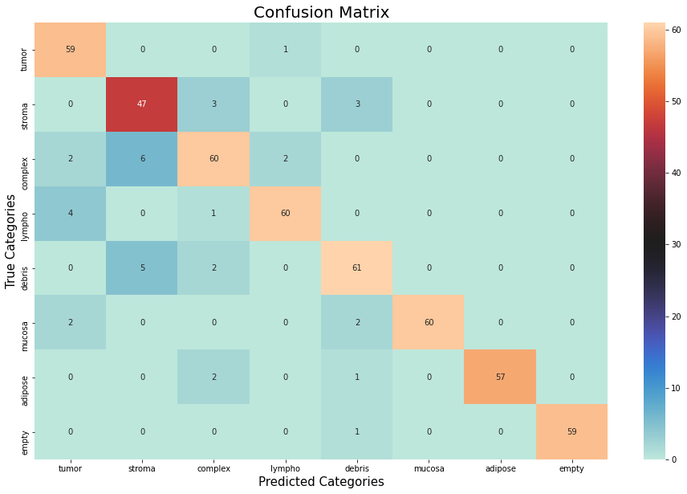
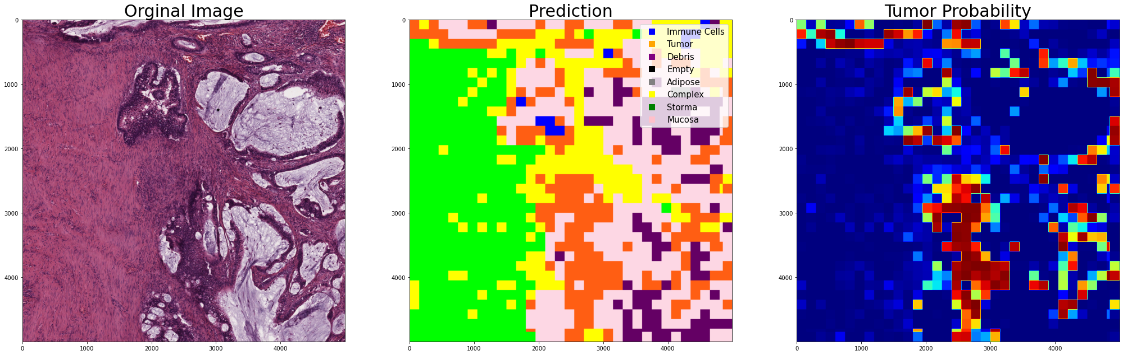
Deep Learning Course For Computer Science | CNN Model for Classification of textures of Colorectal histology Eli Guy Spring 2021 – שנה"ל תשפ"א, סמסטר ב'
Dr. Jonathan Rubin
Vs
Project Summary
The Model We Used
Work Environment: Jupyter Notebook
Programming language: Python
Project goal: Building and trying out various CNN models for detection of cancer in colorectal histology. Using best picked to display the result in various formats.
Introduction
Automated recognition of different tissue types in histological images is an essential part of digital pathology. Texture analysis is a common solution to this problem.
Our aim in this project is two-fold:
Using a CNN model to more accurately classify tumor tissue
in histological imagery.
Building a model that can not only detect
cancerous tumor tissue but also classify cancerous
tissues by their types.
Results
We were able to reach an accuracy of 92% on the test data
Most of the misclassifications were between one cancerous tissue and another, there was almost no healthy tissue classified as cancerous or vice versa.
The Training/test Dataset
For our Training and test data we used a dataset consisting of 8 different types of texture of colorectal histology
Each example was a 150x150x3 RGB image.
Predictions on Full Images
After we finished training our model we loaded a dataset containing full 5000x5000x3 histology images
We separated our prediction into two images, one color map for tissue type and the second a probability heat map that a given tissue is a cancerous tumor
Discussions
- How well will this type of CNN model perform with other types of histology
- Which additional improvements we can make to our current model even more accurate

