Slide 1
Welcome to CutiePics
Fanny. Z
Yilia. Y
Raina. Y

Slide 2


Slide 3
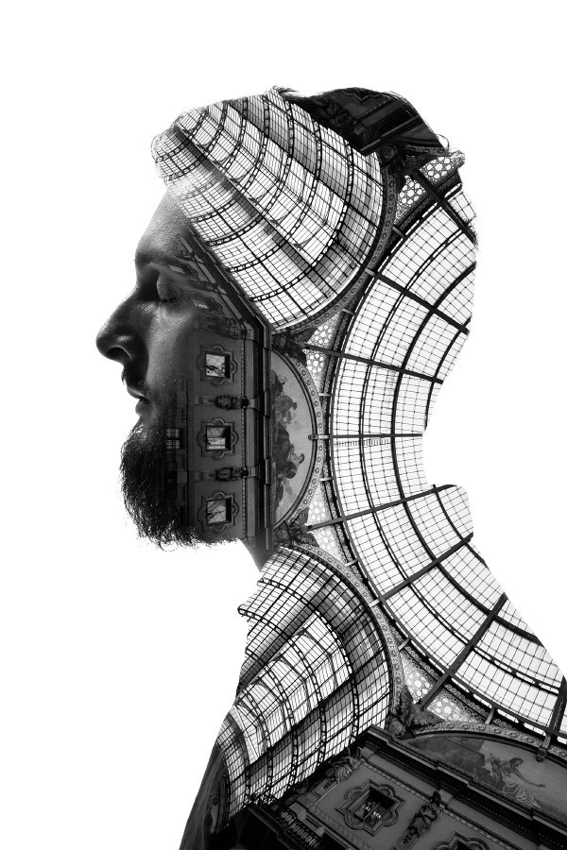

Slide 4
If you are a girl,
get it for yourself!

Slide 5
If your are a boy,
get it for your girlfriend!

Slide 6
If you don’t have a girlfriend…...
Emm……
You need a girl friend first……
Sorry Dude……

