Slide 1

seL4 Case Study
SE464 2011
Derek Rayside

Slide 2
What are the main strategies for Operating System design?

Slide 3
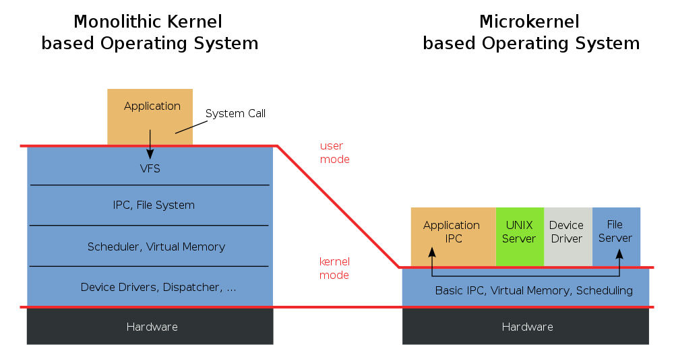
Monolithic vs Microkernel

Slide 4
What are the important criteria for an Operating System?

Slide 5
Contrasting Readings
Gerwin Klein et alia
seL4: Formal Verification of an Operating-System Kernel
SOSP'09 Best Paper
Reprinted in CACM 2010
  fitness for purpose
  performance
Think about:
  seL4 fitness for future
  seL4 interrupt during system call issue
Richard P. Gabriel
Worse is Better
  fitness for future is necessary for survival
  ITS vs Unix
  what to do when an interrupt occurs during a system call?
    ITS: handle it
    Unix: bail

Slide 6
Worse Is Better
The New Jersey Style
The MIT Approach
Simplicity
#1
impl. > interface
interface > impl.
Correctness
mostly
100%
Consistency
mostly
100%
Completeness
meh
mostly

Slide 7
3 Generations of MicroKernels
1. Mach (1985-1994)
    replace pipes with IPC (more general)
    improved stability (vs monolithic kernels)
    poor performance
2. L3 & L4 (1990-2001)
    order of magnitude improvement in IPC performance
      written in assembly
      sacrificed CPU portability
      only synchronus IPC (build async on top of sync)
    very small kernel: more functions moved to userspace
3. seL4, Coyotos, Nova (2000-2010)
    platform independence
    verification, security, multiple CPUs, etc.

Slide 8
What does a Mach kernel do?
  Asynchronus IPC
  Threads
  Scheduling
  Memory management
  Resource access permissions
  Device drivers (in some variants)
All other functions are implemented outside the kernel.
API Size: 140 functions

Slide 9
What caused Mach's performance problems?
1. Checking resource access permissions on system calls.
    Single user machines do not need to do this.
2. Cache misses.
    Critical sections were too large.
3. Asynchronus IPC
    Most calls only need synchronus IPC.
    Synchronous IPC can be faster than asynchronous.
    Asynchronous IPC can be built on top of synchronous.
4. Virtual memory
    How to prevent key processes from being paged out?

Slide 10
What does an L4 kernel do?
  Synchronous IPC
  Threads
  Scheduling
  Memory management
All other functions are implemented outside the kernel.
API Size: 7 functions (vs 140 for Mach3)

Slide 11
Jochen Liedtke's minimality principle for L4:
A concept is tolerated inside the microkernel only if moving it outside the kernel, i.e., permitting competing implementations, would prevent the implementation of the system's required functionality.
cf. Fred Books on conceptual integrity [Mythical Man Month]

Slide 12
Conceptual Integrity [F.Brooks]
Unix
Mach
L4
Everything is a file.
IPC generalizes files.
Can it be put outside the kernel?

Slide 13
seL4 MicroKernel

Slide 14
What properties do we expect from a kernel?

Slide 15
Sidebar: Invariants
A property that is true of every state*.
* at least at public method boundaries.
For example, inserting a node into a linked list may cause the list to become temporarily disconnected.
Invariants may need to be verified for every part of the system, not just the parts of the system that obviously manipulate the structure in question.

Slide 16
Desired file synchronizer properties?

Slide 17
Desired file synchronizer properties?
The synchronizer doesn't eat my files.
  partial file updates work correctly
  conflicts are handled in some sane manner
  massive deletes are not propagated without warning
I always have the latest version of my files.
  what about network latency?
    prioritize file transfers
Synchronization is idempotent.
  f(f(x)) = f(x)
  e.g., set union is idempotent

Slide 18
What properties do we expect from a kernel?

Slide 19
What properties do we expect from a kernel?
  Every system call terminates.
  No exceptions thrown.
  No arithmetic problems (e.g., overflow, divide by zero)
  No null pointer de-references.
  No ill-typed pointer de-references.
  No memory leaks.
  No buffer overflows.
  No unchecked user arguments.
  Code injection attacks are impossible.
  Well-formed data structures.
  Correct book-keeping.
  No two objects overlap in memory
  etc.

Slide 20
How to design a kernel with these properties?
Very carefully.

Slide 21
Iterative Co-design of
Kernel & Proof
Kernel Team
1. Initial prototype (Haskell)
  no interrupts
  single address space
  generic linear page table
2. Complete prototype
  add missing functionality
3. Implementation
Proof Team
1. Infrastructure
2. Abstract Spec
  prototype vs spec
3. Spec vs Implementation

Slide 22
Sidebar: What is a Prototype?
Evolutionary
  eventually becomes the real thing
  advocated by F. Brooks, R. Gabriel, agile, and others ("organic growth")
  often used in FYDP
Experimental
  used to explore an idea, then thrown away
  advocated by F. Brooks ("plan to throw one away")
  may be one of:
    Horizontal: shallow ptype of whole system
    Vertical: detailed ptype of single subsys

Slide 23
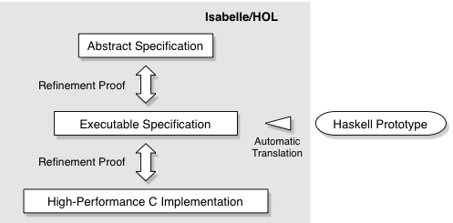

Slide 24
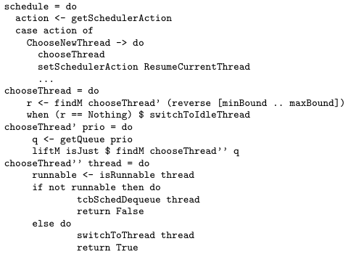
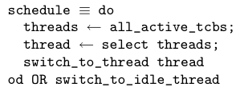
The implementation in C is much larger.
Abstract Spec
(Isabelle/HOL)
Executable Spec
(Haskell)

Slide 25
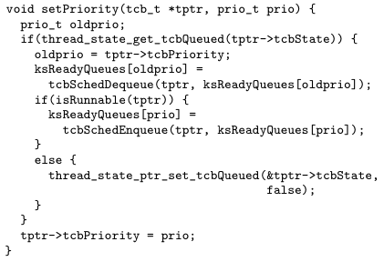
A smidgen of C from the scheduler

Slide 27
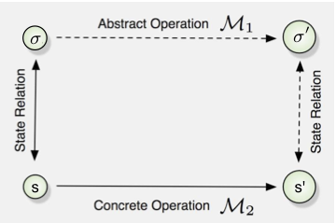
Refinement Proof by Forward Simulation

Slide 28
Effort
Implementation (including Haskell prototype):
  2.5 person years: 5,700 LOC Haskell; 8,700 LOC C
  vs 4 py estimated by the SLOCCount tool
  vs 6 py actual effort by Karlsruhe L4 team
  => evidence that Haskell prototype saved time
Proof: 20 py actual effort; 200,000 lines
  9 py infrastructure
  11 py seL4 verification
Estimate for repeat effort of kernel & proof:
  8 py estimated (cf 4py & 6py above)

Slide 29
Effort of Each Proof
Abstract Spec vs Exec Spec
  3 times more effort
  300 changes to a-spec
  200 changes to e-spec
  50% of changes due to bugs
  50% of changes for verification convenience
Exec Spec vs C-code
  easier
  160 bugs found
  16 of which were also found in testing (so testing missed 90%)
  mostly typos etc.

Slide 30
Cost of Change
Changing the proof is more expensive than changing the code. (Writing the proof was more expensive too.) Cases:
  Local, low-level change.
  Adding new, independent features.
  Adding new, large, cross-cutting features.
  Fundamental changes to existing features.
However, no bug fixes required.

Slide 31
Important Design Decisions
  Global variables & Side Effects
  Kernel Memory Management
  Concurrency & Non-Determinism
  I/O

Slide 32
Global Variables & Side Effects
Use sparingly. Expensive to verify because they require invariants, which need to be checked against all code.
Keep them modular and under control.
Haskell prototype helped with this, since side-effects in Haskell have to be made explicit.

Slide 33
Kernel Memory Management
Kernel only has mechanism.
Push policy to userspace.
  => don't need to verify policy
Invariants about the state of memory book-keeping data structures mean that certain checks can be done quickly at runtime. (This would not be safe without the proof.)

Slide 34
Concurrency & Non-Determinism
Short system calls.
Disable interrupts during system calls.
Therefore, no concurrency in the kernel.
Easy.

Slide 35
I/O
Hardware devices generate interrupts.
These are converted to IPC messages for the userspace device drivers. Hence, much complexity removed from kernel.

Slide 36
seL4 interrupt during system call?

Slide 37
seL4 fitness for future?

Slide 38
Better is Better
Less is More
Minimality ⇒ Fitness for Purpose + Future

Slide 39
Extra Slides

Slide 40
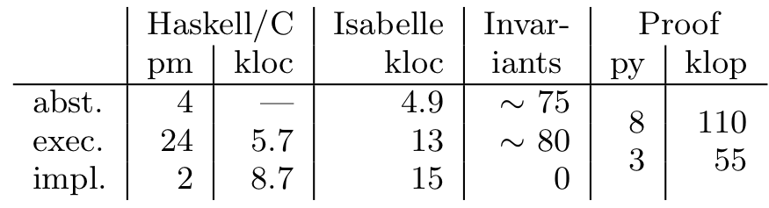

Slide 41
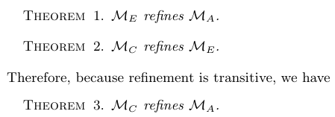
The Theorems to be Proved

Slide 42
