Slide 1



MCPS Project home temperature monitoring system & smart air distribution
Mobile and cyber-physical systems
A.Y. 2021/2022
Elia Piccoli – 621332
Domenico Tupputi - 585794
https://github.com/EliaPiccoli/MCPS-Project

Slide 2
Automatic temperature monitoring system
Future temperature prediction
Smart temperature balancing
problem Description

Slide 3
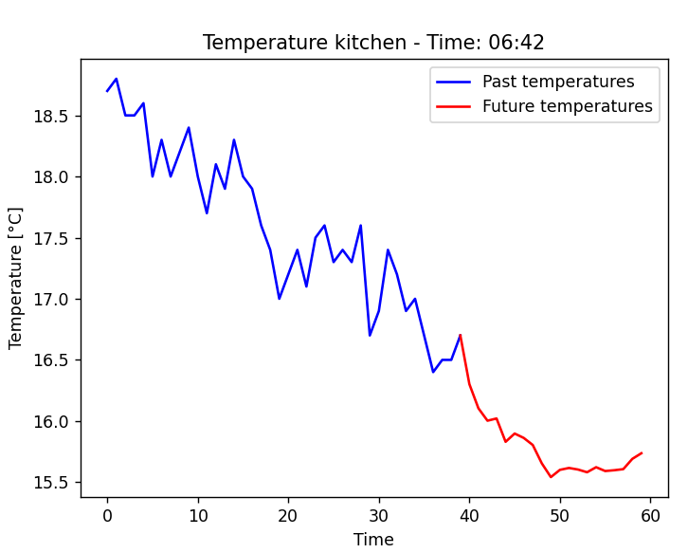
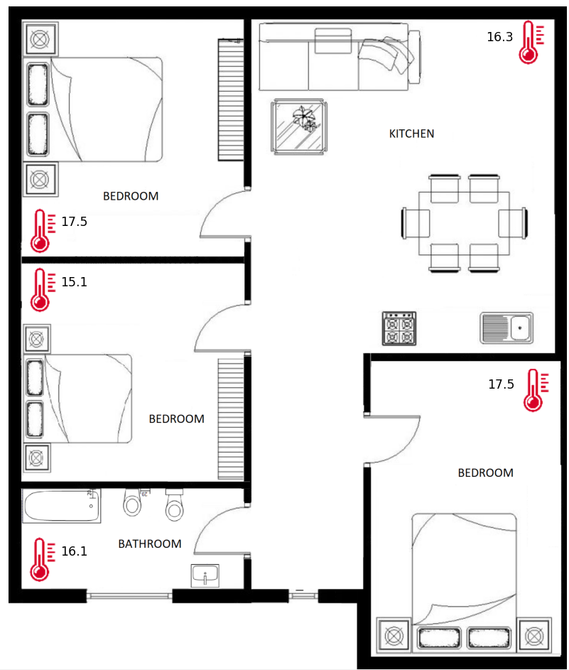
Proposed solution
Sensor in every room of the house.
Graphical interface to monitor current temperatures and to show temperatures in the near future.
System that interacts with the ventilation system of each room.

Slide 4
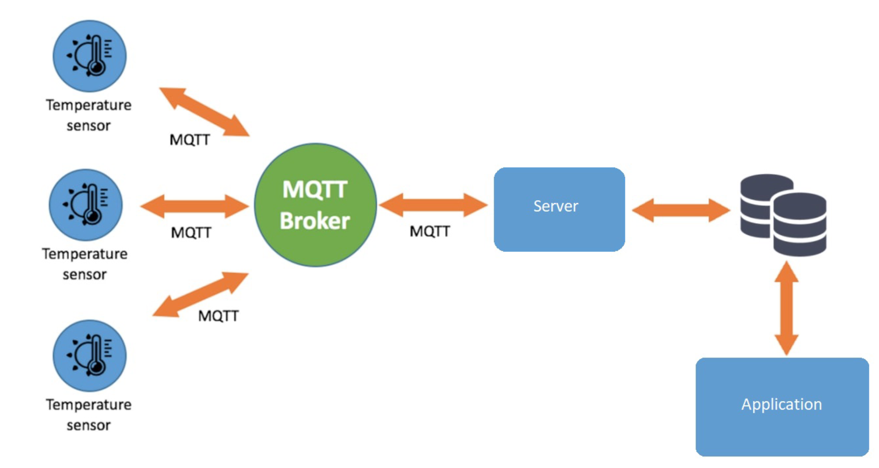
System architecture
Sensors
MQTT broker
Server
Relational database
Application

Slide 5

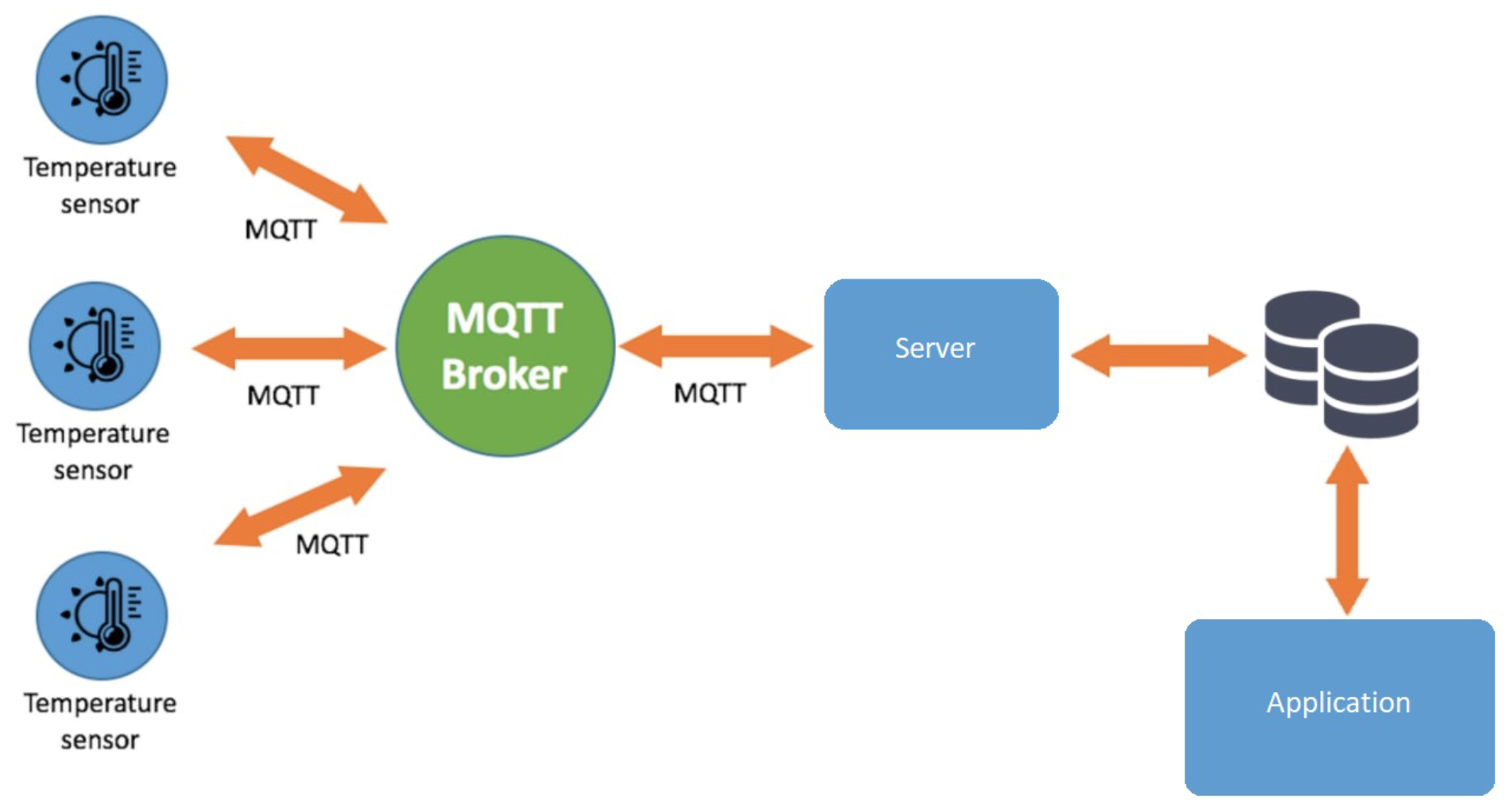





Hardware & Software

Slide 6


Slide 7
Install real sensors in a home with a built-in programmable ventilation system.
Interact with an air conditioning system: let the user set a desired temperature.
For large rooms manage more than one sensor.
Future work

