Slide 1
Moloch
Using Elasticsearch to power network forensics
http://molo.ch

Slide 2

Andy Wick
Developer
18 years at AOL, prior to that part time defense contracting
Backend developer and architect of AIM
Security group last few years

Slide 3

Eoin Miller
IDS/PCAP Centric Security Nerd
Falconer/Owl Wrangler
Anti-Malvertising Enthusiast

Slide 4

Project Logo
It is a Great Horned Owl

Slide 5
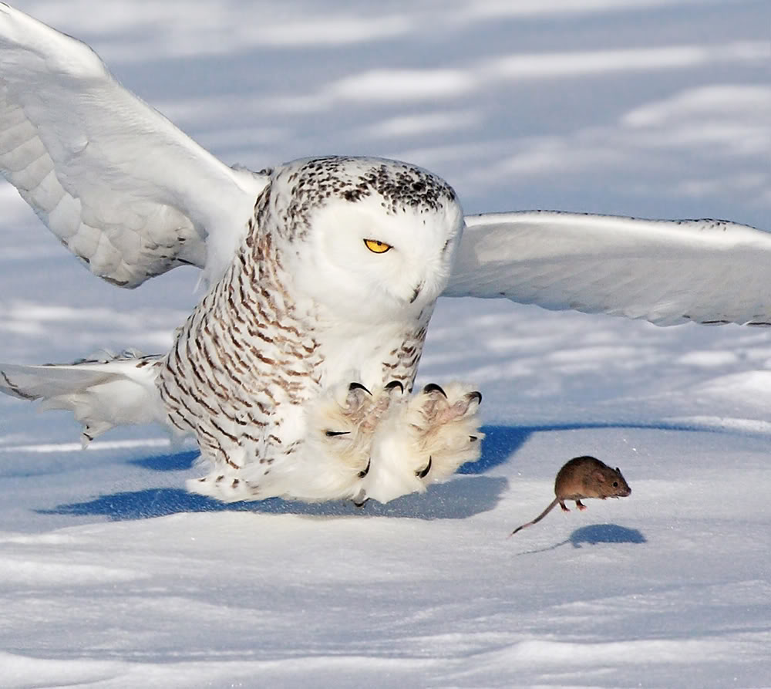
Why The Owl Logo?
Owls are silent hunters that go after RATs. We think that’s pretty cool.

Slide 6
Moloch – Overview – What Is Moloch?
Moloch is an open source, scalable IPv4 packet capturing (PCAP) indexing and database system powered by Elasticsearch
A simple web GUI is provided for browsing, searching, viewing and exporting PCAP data
Web API’s are accessible if you wish to design your own GUI or directly grab PCAP with various command line tools for further analysis or processing
Find it on AOL’s GitHub page: https://github.com/aol/moloch
It is like AOL Search for PCAP repositories!

Slide 7
Moloch – Uses
Real-time capture of network traffic for forensic and investigative purposes
Combine the power of Moloch with other indicators (intelligence feeds, alerting from IDS/anti-virus) to empower your Analysts to quickly and effectively review actions on the network to determine the validity/threat
The ability to review past network traffic for post compromise investigations
Static PCAP repository
Large collections of PCAP that is created by malware
Collections of PCAP from various CTF events
Custom tagging of data at time of import

Slide 8
Moloch – Components
Capture
A C application that sniffs the network interface, parses the traffic and creates the Session Profile Information (aka SPI-Data) and writes the packets to disk
Database
Elasticsearch is used for storing and searching through the SPI-Data generated by the capture component
Viewer
A web interface that allows for GUI and API access from remote hosts to browse/query SPI-Data and retrieve stored PCAP

Slide 9
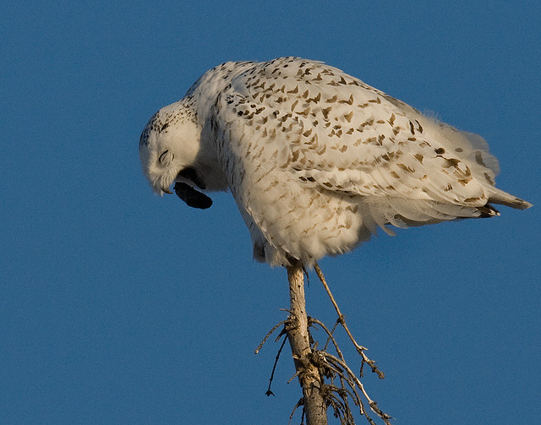
Moloch – Components – Capture
A libnids based daemon written in C
Can be used to sniff network interface for live capture to disk
Can be called from the command line to do manual import of PCAP for parsing and storage
Parses various layer 3-7 protocols, creates “session profile information” aka SPI-Data and spits them out to the elasticsearch cluster for indexing purposes
Kind of like making owl pellets!

Slide 10
Moloch – Components – Database
elasticsearch (http://www.elasticsearch.org)
Powered by Apache’s Lucene (http://lucene.apache.org)
Requests received over HTTP
Results returned in JSON
nosql
Document oriented (which is great for lots and lots of network sessions)
Automatic sharding across multiple hosts by magic elves
Fast, scalable, all that goodness

Slide 11
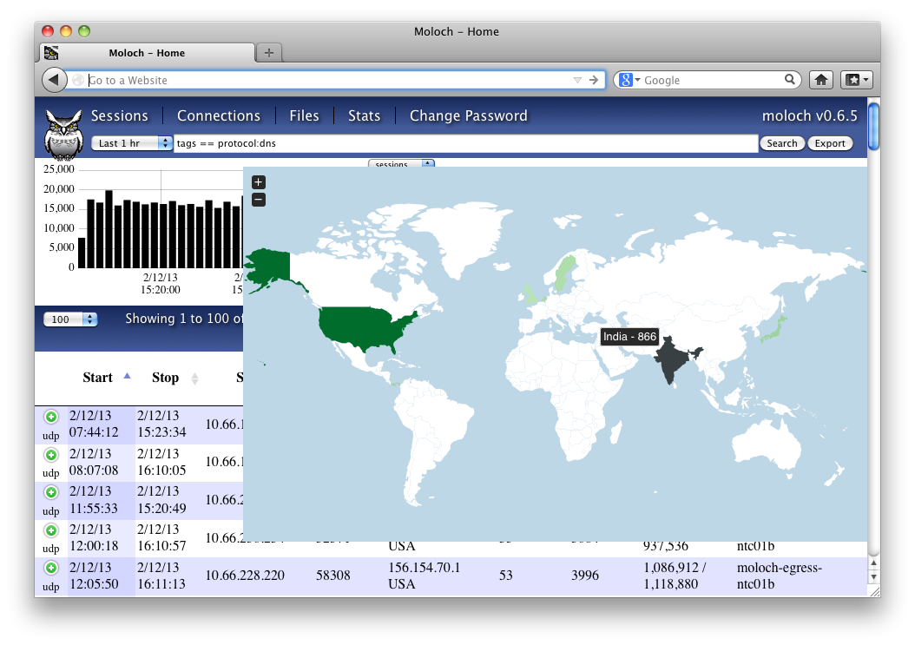
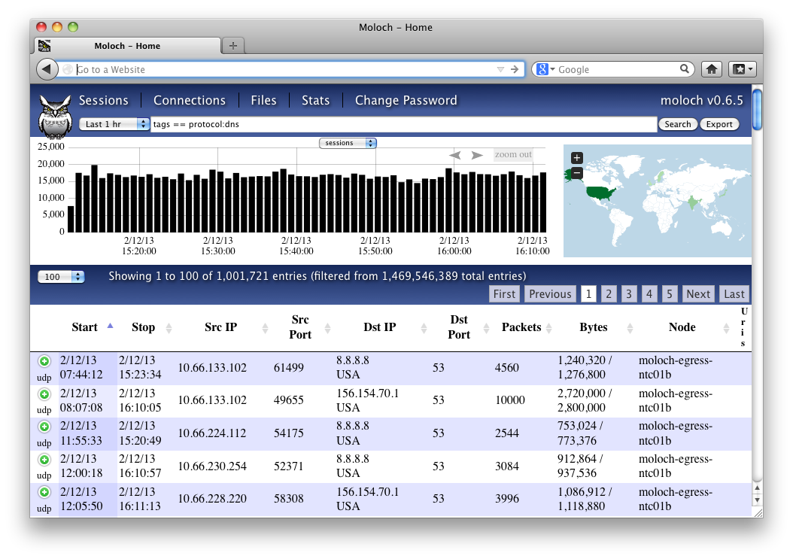
Moloch – Components – Viewer
nodejs based application
nodejs is an event driven server side JavaScript platform based on Google Chrome’s JavaScript runtime
Comes with its own HTTP and easy JSON for communication
http://nodejs.org - server side JavaScript is for the cool kids!
Provides web based GUI for browsing/searching/viewing/exporting SPI-data and PCAP
GUI/API’s calls are all done through URI’s so integration with SEIM’s, consoles and command line tools is easy for retrieving PCAP or sessions of interest

Slide 12
Moloch – Architecture
All components (Capture, Database and Viewer) can exist and operate on the same host
Capture will want lots of storage space for PCAP that has been ingested
Database will want lots of RAM for indexing and fast searching
Viewer is very small and can go anywhere really
Not recommended for large amounts of PCAP throughput
Can scale easily across multiple hosts for Capture and Database components
One or more Capture instances can run on one or more hosts and report to the Database
Database can run on one or more hosts to expand amount of RAM available for indexing
Best setup for capturing and indexing live traffic for investigations and defending your network

Slide 13
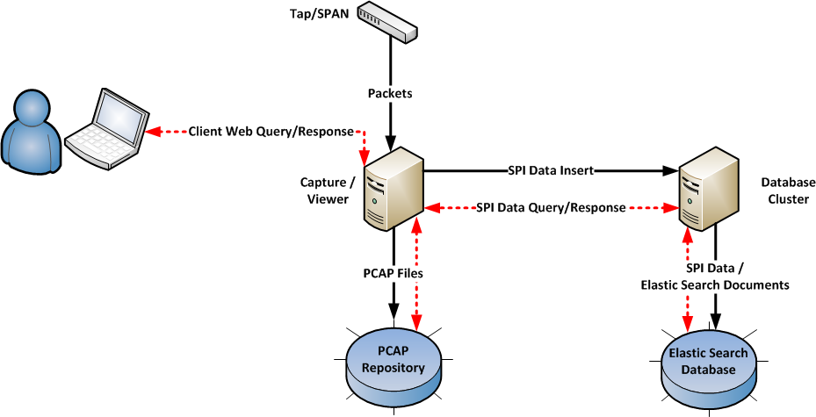
Moloch – Architecture – Overall Data Flow

Slide 14
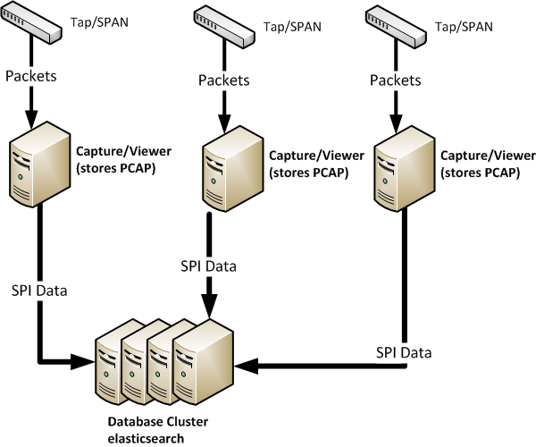
Moloch – Architecture – MultiNode w/Cluster

Slide 15
Moloch – Capture – SPI-Data Types
Moloch parses various protocols to create SPI-Data:
IP
HTTP
DNS
IP Address
Hostname
IRC
Channel Names
SSH
Client Name
Public Key
SSL/TLS
Certificate elements of various types (common names, serial, etc)
This is not an all inclusive list

Slide 16
Moloch – Capture – Creating SPI-Data
Start Time: 2/13/13 21:43:56
Stop Time : 2/13/13 21:44:04
Databytes/Bytes: 9,315/14,288
IP Protocol: 6
IP/Port: 172.128.1.1:52465 (USA) [AS1668 AOL Transit Data Network]
205.188.18.208:80 (USA) [AS1668 AOL Transit Data Network]
Tags: http:content:application/octet-stream http:method:GET
http:statuscode:200 node:egress node:moloch-egress-dtc01 protocol:http tcp
Request Headers:accept accept-encoding accept-language connection cookie host user-agent
Response Headers:accept-ranges connection content-length content-type date keep-alive server set-cookie
User Agents:'Mozilla/5.0 (Windows NT 6.1; rv:16.0) Gecko/20100101 Firefox/16.0'
Hosts:www.aol.com
URI: www.aol.com/favicon.ico?v=2
GET /favicon.ico?v=2 HTTP/1.1
Host: www.aol.com
User-Agent: Mozilla/5.0 (Windows NT 6.1; rv:16.0) Gecko/20100101
Firefox/16.0
Accept: text/html,application/xhtml+xml,application/xml;q=0.9,*/*;q=0.8
Accept-Language: en-US,en;q=0.5
Accept-Encoding: gzip, deflate
Connection: keep-alive
Cookie: <REDACTED>
HTTP/1.1 200 OK
Date: Wed, 13 Feb 2013 21:43:57 GMT
Server: Apache
Set-Cookie: RSP_CHECK_PORTAL_STARTPAGE.AOL.COM=deleted; expires=Thu Jan
01 00:17:51 1970 GMT; path=/; domain=www.aol.com
Accept-Ranges: bytes
Content-Length: 7886
Keep-Alive: timeout=5, max=71
Connection: Keep-Alive
Content-Type: image/x-icon
TCP session transcript

Slide 17
Moloch – Capture – Creating SPI-Data
Start Time: 2/13/13 21:43:56
Stop Time : 2/13/13 21:44:04
Databytes/Bytes: 9,315/14,288
IP Protocol: 6
IP/Port: 172.128.1.1:52465 (USA) [AS1668 AOL Transit Data Network]
205.188.18.208:80 (USA) [AS1668 AOL Transit Data Network]
Tags: http:content:application/octet-stream http:method:GET
http:statuscode:200 node:egress node:moloch-egress-dtc01 protocol:http tcp
Request Headers:accept accept-encoding accept-language connection cookie host user-agent
Response Headers:accept-ranges connection content-length content-type date keep-alive server set-cookie
User Agents:'Mozilla/5.0 (Windows NT 6.1; rv:16.0) Gecko/20100101 Firefox/16.0'
Hosts:www.aol.com
URI: www.aol.com/favicon.ico?v=2
GET /favicon.ico?v=2 HTTP/1.1
Host: www.aol.com
User-Agent: Mozilla/5.0 (Windows NT 6.1; rv:16.0) Gecko/20100101
Firefox/16.0
Accept: text/html,application/xhtml+xml,application/xml;q=0.9,*/*;q=0.8
Accept-Language: en-US,en;q=0.5
Accept-Encoding: gzip, deflate
Connection: keep-alive
Cookie: <REDACTED>
HTTP/1.1 200 OK
Date: Wed, 13 Feb 2013 21:43:57 GMT
Server: Apache
Set-Cookie: RSP_CHECK_PORTAL_STARTPAGE.AOL.COM=deleted; expires=Thu Jan
01 00:17:51 1970 GMT; path=/; domain=www.aol.com
Accept-Ranges: bytes
Content-Length: 7886
Keep-Alive: timeout=5, max=71
Connection: Keep-Alive
Content-Type: image/x-icon
All Session Profile Information (SPI-Data) Created

Slide 18
Moloch – Capture – Creating SPI-Data
Start Time: 2/13/13 21:43:56
Stop Time : 2/13/13 21:44:04
Databytes/Bytes: 9,315/14,288
IP Protocol: 6
IP/Port: 172.128.1.1:52465 (USA) [AS1668 AOL Transit Data Network]
205.188.18.208:80 (USA) [AS1668 AOL Transit Data Network]
Tags: http:content:application/octet-stream http:method:GET
http:statuscode:200 node:egress node:moloch-egress-dtc01 protocol:http tcp
Request Headers:accept accept-encoding accept-language connection cookie host user-agent
Response Headers:accept-ranges connection content-length content-type date keep-alive server set-cookie
User Agents:'Mozilla/5.0 (Windows NT 6.1; rv:16.0) Gecko/20100101 Firefox/16.0'
Hosts:www.aol.com
URI: www.aol.com/favicon.ico?v=2
GET /favicon.ico?v=2 HTTP/1.1
Host: www.aol.com
User-Agent: Mozilla/5.0 (Windows NT 6.1; rv:16.0) Gecko/20100101
Firefox/16.0
Accept: text/html,application/xhtml+xml,application/xml;q=0.9,*/*;q=0.8
Accept-Language: en-US,en;q=0.5
Accept-Encoding: gzip, deflate
Connection: keep-alive
Cookie: <REDACTED>
HTTP/1.1 200 OK
Date: Wed, 13 Feb 2013 21:43:57 GMT
Server: Apache
Set-Cookie: RSP_CHECK_PORTAL_STARTPAGE.AOL.COM=deleted; expires=Thu Jan
01 00:17:51 1970 GMT; path=/; domain=www.aol.com
Accept-Ranges: bytes
Content-Length: 7886
Keep-Alive: timeout=5, max=71
Connection: Keep-Alive
Content-Type: image/x-icon
Based off of the TCP session data
Session Start/End Timestamps
Databytes == total number of bytes in the payload of all packets in the session
Bytes == total number of bytes in the session, includes headers and payload
IP Protocol == Protocol number (6 == TCP)
IP address of source/destination.
Port of source/destination
Country of source/destination
ASN of source/destination IP address

Slide 19
Moloch – Capture – Creating SPI-Data
Start Time: 2/13/13 21:43:56
Stop Time : 2/13/13 21:44:04
Databytes/Bytes: 9,315/14,288
IP Protocol: 6
IP/Port: 172.128.1.1:52465 (USA) [AS1668 AOL Transit Data Network]
205.188.18.208:80 (USA) [AS1668 AOL Transit Data Network]
Tags: http:content:application/octet-stream http:method:GET
http:statuscode:200 node:egress node:moloch-egress-dtc01 protocol:http tcp
Request Headers:accept accept-encoding accept-language connection cookie host user-agent
Response Headers:accept-ranges connection content-length content-type date keep-alive server set-cookie
User Agents:'Mozilla/5.0 (Windows NT 6.1; rv:16.0) Gecko/20100101 Firefox/16.0'
Hosts:www.aol.com
URI: www.aol.com/favicon.ico?v=2
GET /favicon.ico?v=2 HTTP/1.1
Host: www.aol.com
User-Agent: Mozilla/5.0 (Windows NT 6.1; rv:16.0) Gecko/20100101
Firefox/16.0
Accept: text/html,application/xhtml+xml,application/xml;q=0.9,*/*;q=0.8
Accept-Language: en-US,en;q=0.5
Accept-Encoding: gzip, deflate
Connection: keep-alive
Cookie: <REDACTED>
HTTP/1.1 200 OK
Date: Wed, 13 Feb 2013 21:43:57 GMT
Server: Apache
Set-Cookie: RSP_CHECK_PORTAL_STARTPAGE.AOL.COM=deleted; expires=Thu Jan
01 00:17:51 1970 GMT; path=/; domain=www.aol.com
Accept-Ranges: bytes
Content-Length: 7886
Keep-Alive: timeout=5, max=71
Connection: Keep-Alive
Content-Type: image/x-icon
Custom tags applied to the session
http:content:application/octet-stream == file type fingerprint
http:method:GET == HTTP client method
http:statuscode:200 == HTTP status code returned from server
node:egress == used as a grouping to identify this and others as egress traffic
node:moloch-egress-dtc01 == node name that captured the traffic
protocol:http == session detected as http by the parsing library (port agnostic!)

Slide 20
Moloch – Capture – Creating SPI-Data
Start Time: 2/13/13 21:43:56
Stop Time : 2/13/13 21:44:04
Databytes/Bytes: 9,315/14,288
IP Protocol: 6
IP/Port: 172.128.1.1:52465 (USA) [AS1668 AOL Transit Data Network]
205.188.18.208:80 (USA) [AS1668 AOL Transit Data Network]
Tags: http:content:application/octet-stream http:method:GET
http:statuscode:200 node:egress node:moloch-egress-dtc01 protocol:http tcp
Request Headers:accept accept-encoding accept-language connection cookie host user-agent
Response Headers:accept-ranges connection content-length content-type date keep-alive server set-cookie
User Agents:'Mozilla/5.0 (Windows NT 6.1; rv:16.0) Gecko/20100101 Firefox/16.0'
Hosts:www.aol.com
URI: www.aol.com/favicon.ico?v=2
GET /favicon.ico?v=2 HTTP/1.1
Host: www.aol.com
User-Agent: Mozilla/5.0 (Windows NT 6.1; rv:16.0) Gecko/20100101
Firefox/16.0
Accept: text/html,application/xhtml+xml,application/xml;q=0.9,*/*;q=0.8
Accept-Language: en-US,en;q=0.5
Accept-Encoding: gzip, deflate
Connection: keep-alive
Cookie: <REDACTED>
HTTP/1.1 200 OK
Date: Wed, 13 Feb 2013 21:43:57 GMT
Server: Apache
Set-Cookie: RSP_CHECK_PORTAL_STARTPAGE.AOL.COM=deleted; expires=Thu Jan
01 00:17:51 1970 GMT; path=/; domain=www.aol.com
Accept-Ranges: bytes
Content-Length: 7886
Keep-Alive: timeout=5, max=71
Connection: Keep-Alive
Content-Type: image/x-icon
Request Headers == HTTP headers in the request for the session
Response Headers == HTTP headers in the response for the session

Slide 21
Moloch – Capture – Creating SPI-Data
Start Time: 2/13/13 21:43:56
Stop Time : 2/13/13 21:44:04
Databytes/Bytes: 9,315/14,288
IP Protocol: 6
IP/Port: 172.128.1.1:52465 (USA) [AS1668 AOL Transit Data Network]
205.188.18.208:80 (USA) [AS1668 AOL Transit Data Network]
Tags: http:content:application/octet-stream http:method:GET
http:statuscode:200 node:egress node:moloch-egress-dtc01 protocol:http tcp
Request Headers:accept accept-encoding accept-language connection cookie host user-agent
Response Headers:accept-ranges connection content-length content-type date keep-alive server set-cookie
User Agents:'Mozilla/5.0 (Windows NT 6.1; rv:16.0) Gecko/20100101 Firefox/16.0'
Hosts:www.aol.com
URI: www.aol.com/favicon.ico?v=2
GET /favicon.ico?v=2 HTTP/1.1
Host: www.aol.com
User-Agent: Mozilla/5.0 (Windows NT 6.1; rv:16.0) Gecko/20100101
Firefox/16.0
Accept: text/html,application/xhtml+xml,application/xml;q=0.9,*/*;q=0.8
Accept-Language: en-US,en;q=0.5
Accept-Encoding: gzip, deflate
Connection: keep-alive
Cookie: <REDACTED>
HTTP/1.1 200 OK
Date: Wed, 13 Feb 2013 21:43:57 GMT
Server: Apache
Set-Cookie: RSP_CHECK_PORTAL_STARTPAGE.AOL.COM=deleted; expires=Thu Jan
01 00:17:51 1970 GMT; path=/; domain=www.aol.com
Accept-Ranges: bytes
Content-Length: 7886
Keep-Alive: timeout=5, max=71
Connection: Keep-Alive
Content-Type: image/x-icon
User Agents == User agent string seen in the request
Hosts == hostname seen in the session
URI == the URI seen in the session

Slide 22
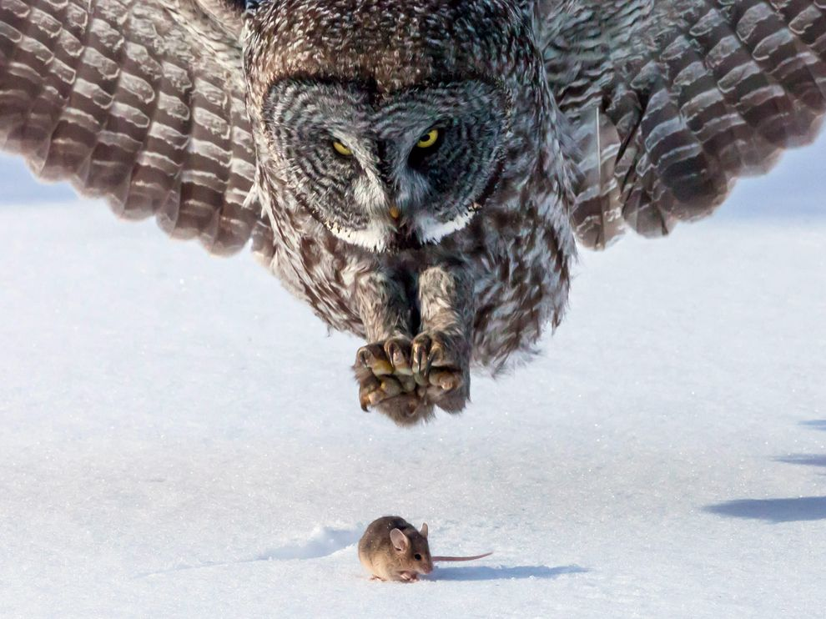
Demo

Slide 23
Moloch database requirements
Our must haves
High write rate/low read rate
Lots of search features
Billions of documents
Easy to add capacity
Easy to add hundreds of fields
Handle small and large documents - One megabyte or larger document sizes
Free
Easy to expire data
Not required
Sub second response times

Slide 24
Elasticsearch Choice
Originally used another NOSQL project
Text search was poor
Db needed to fit in memory for any kind of performance
Elasticsearch to the rescue
Elasticsearch = search + db features
The others = db + search features
Fairly memory friendly
Except for facets
Many improvements since we started 2.5 years ago
We run with 10:1 disk:memory

Slide 25
Elasticsearch – Early issues
Terminology
Have to use “search” terminology instead of "database" terminology
For example index is the name of both a container and document insertion
Faceting
Faceting high cardinality string fields caused OOMs – mostly fixed
31 bit signed integer overflow on facet counts
Missing shards - ES would randomly “delete” shards – fixed
Either had to delete entire index or create a fake shard and copy it over to create hole in data
Would still like an official way to create a “hole” in the data on machine loss
HA - more performance/search focused then DB focused
Replication didn’t fix the missing shard above
On startup data would re-replicate when it didn’t need to
Master craziness
split brain on startup – still an issue

Slide 26
Storing sessions
Like logstash and others went with time based indexes
Support hourly, daily, weekly, monthly index name creation
Wrote custom daily script to deal with expiring/optimizing
Now there is https://github.com/elasticsearch/curator
Run with one shard per node per session index
Each session also stores what files on disk and where in those files all the packets are
Increased ES refresh interval for faster bulk imports
"ps":[-129,243966,2444068,3444186]
index.routing.allocation.total_shards_per_node: 1
number_of_shards: NUMBER OF NODES
refresh_interval: 60

Slide 27
Sample Metrics
20 64G hosts each running 2 22G nodes
Easily handle 50k inserts a second
Over 7 billion documents
There are other Moloch deployments with over 30 billion documents

Slide 28
Faceting/Aggregations
With facets the more unique values and the max number of items per document, the more memory ES uses
New versions of ES and aggregations have lowered some the overhead
Moloch uses the strategy for some fields of mapping strings to numbers
not sure still required with aggregation
makes wildcard/regex searches a pain
don’t recommend
For some pages multiple queries are used since requesting multiple facets can OOM

Slide 29
Moloch Fields
Moloch allows a simple query language
Wanted it to be wireshark-ish instead of ES query DSL
For certain types of fields wanted to support searching against both analyzed and raw depending on query, without user knowing
(ip.src == 1.2.3.4 && http.user-agent == /.*firefox.*/) || ip.asn == *Google*

Slide 30
Moloch Fields v1
static mapping
shortened field names
For example eho instead of email.host
every new field required
static mapping, so es mapping update
jison (lex/yacc for js) parser change
Multiple UI and viewer changes to deal with raw vs analyzed or when multifield queries
capture changes
help changes
led to overloading tags field since easier to update
prone development to mistakes
software upgrades required running db.pl for new mapping

Slide 31
Moloch Fields v2 (1)
Now fields are defined in capture when the SPI data is created
Live in fields index - wish they could live in mapping, need _meta for mappings, issue #2857
Moloch has its own meta field "types" that let the UI know how the user can search the field
Viewer restart no longer required
"_id" : "asn.src", "_source" : {
"friendlyName": "Src ASN",
"group": "general",
"help": "GeoIP ASN string calculated from the source IP",
"type": "textfield",
"dbField": "as1",
"rawField": "rawas1"
}

Slide 32
Moloch Fields v2 (2)
heavily use dynamic mapping with named templates
template_georir: {
match_pattern: "regex",
path_match: ".*-(geo|rir|term)$",
match_mapping_type: "string",
mapping: {
omit_norms: true,
type: "string",
index: "not_analyzed"
}
},
template_string: {
match_mapping_type: "string",
mapping: {
type: "multi_field",
path: "full",
fields: {
"snow" : {"type": "string", "analyzer" : "snowball"},
"raw" : {"type": "string", "index" : "not_analyzed"}
}
}
}

Slide 33
Security
wide open elasticsearch is bad
iptables is NOT that hard, you can do it
Can add https/auth with https://github.com/sonian/elasticsearch-jetty
iptables -F
for ip in host1.example.com host2.example.com 1.2.3.0/24 do
iptables -A INPUT -i eth0 -p tcp --dport 9300 -s $ip -j ACCEPT
iptables -A INPUT -i eth0 -p tcp --dport 9301 -s $ip -j ACCEPT
iptables -A INPUT -i eth0 -p tcp --dport 9200 -s $ip -j ACCEPT
iptables -A INPUT -i eth0 -p tcp --dport 9201 -s $ip -j ACCEPT
done
iptables -A INPUT -i eth0 -p tcp --dport 9300 -j DROP
iptables -A INPUT -i eth0 -p tcp --dport 9301 -j DROP
iptables -A INPUT -i eth0 -p tcp --dport 9200 -j DROP
iptables -A INPUT -i eth0 -p tcp --dport 9201 -j DROP
/sbin/service iptables save

Slide 34
Multiple Moloch Clusters
Before tribes existed we created a multies proxy
Allows multiple ES clusters to appear as a single cluster to viewer application
Unlike tribes it merges indexes and facets with the same names
It does require that the ES nodes have unique names
Hopeful that tribes supports the feature set some day

Slide 35
Lessons Learned (1)
Stay on fairly current version, bug fix rate currently is awesome
Think hard before giving ES more then ~32G of memory
Compressed OOPs save memory and help performance
Need ~48G of memory to equal ~33G of memory
Better to run multiple instances
Don't forget about disk cache
Optimize can cause memory issues
ES is pretty good itself at determining when to optimize
Reducing the number of segments can mean more memory is used when a segment is loaded
Create your own elasticsearch.yml file outside the distribution
Saves you from any upgrade craziness
bin/elasticsearch -Des.config=<path>/elasticsearch.yml –d
use the same file for all nodes

Slide 36
Lessons Learned (2)
Use elasticsearch.yml variable substitution and set node.name to something meaningful
export ES_HOSTNAME=`hostname -s`
node.name: "${ES_HOSTNAME}"
If running multiple nodes change logging.yml to use node.name instead of cluster.name everywhere
Use as little replication as required
Replication can uses up your precious memory
Use the search primary option if memory is an issue
For time series if required only activate for previous days
file: ${path.logs}/${node.name}.log

Slide 37
Lessons Learned (3)
Fix your masters, less is more
Use either 1 or 3
Make sure most/all data nodes have “node.master: false”
We actually make our first data node the master using variables substitution in startup script
Then in elasticsearch.yml we have
export ES_MASTER=false
if [ "$(hostname -s)" == "hostes-m01" ]; then
export ES_MASTER=true
fi
export ES_HOSTNAME=`hostname -s`a
ES_HEAP_SIZE=22G bin/elasticsearch -Des.config=/srv/moloch/elasticsearch.yml –d
export ES_MASTER=false
export ES_HOSTNAME=`hostname –s`b
ES_HEAP_SIZE=22G bin/elasticsearch -Des.config=/srv/moloch/elasticsearch.yml -d
node.name: "${ES_HOSTNAME}"
node.master: "${ES_MASTER}"

Slide 38
Lessons Learned (4)
Disable bloom filter on previous indexes
Disable HeapDumpOnOutOfMemoryError in elasticsearch.in.sh
Swap is evil, turn it off
Make head plugin align shard numbers by adding to "plugins/head/_site/dist/app.css"
curl -XPUT localhost:9200/old_index/_settings?index.codec.bloom.load=false
#JAVA_OPTS="$JAVA_OPTS -XX:+HeapDumpOnOutOfMemoryError"
.uiNodesView-nullReplica {
display: none;
}

Slide 39
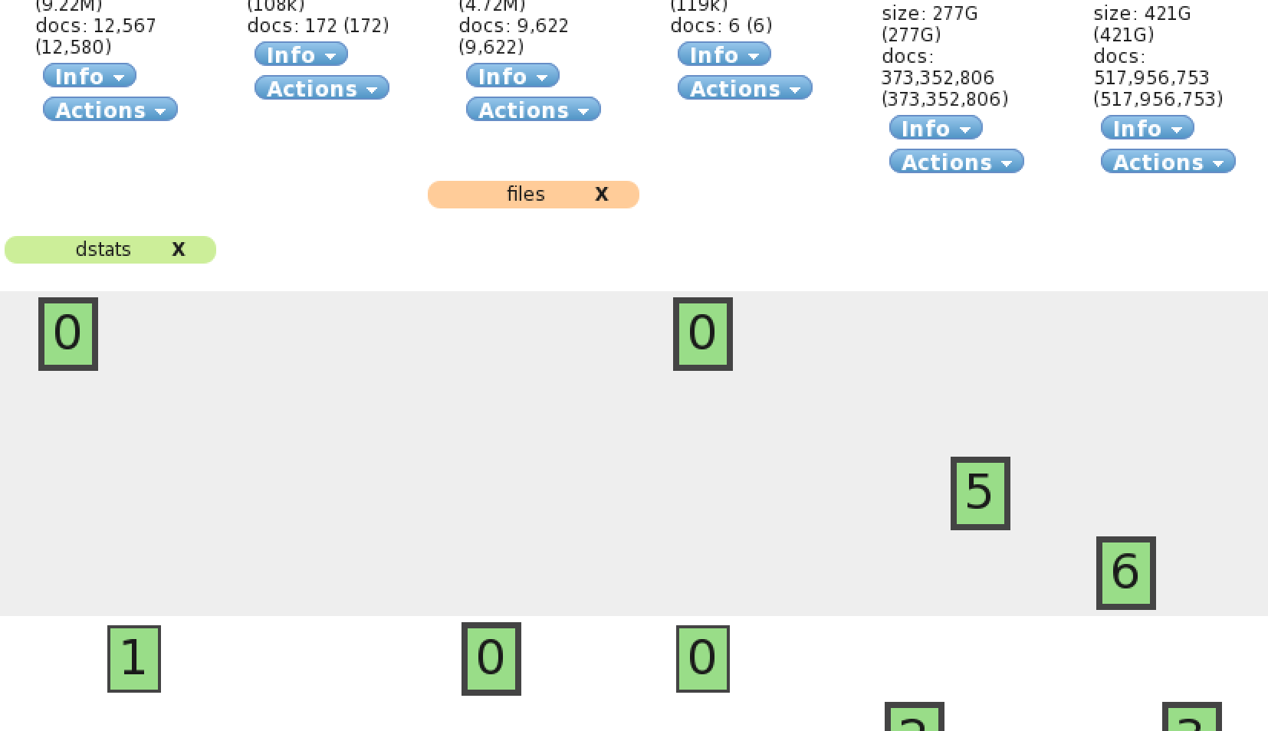
Before

Slide 40
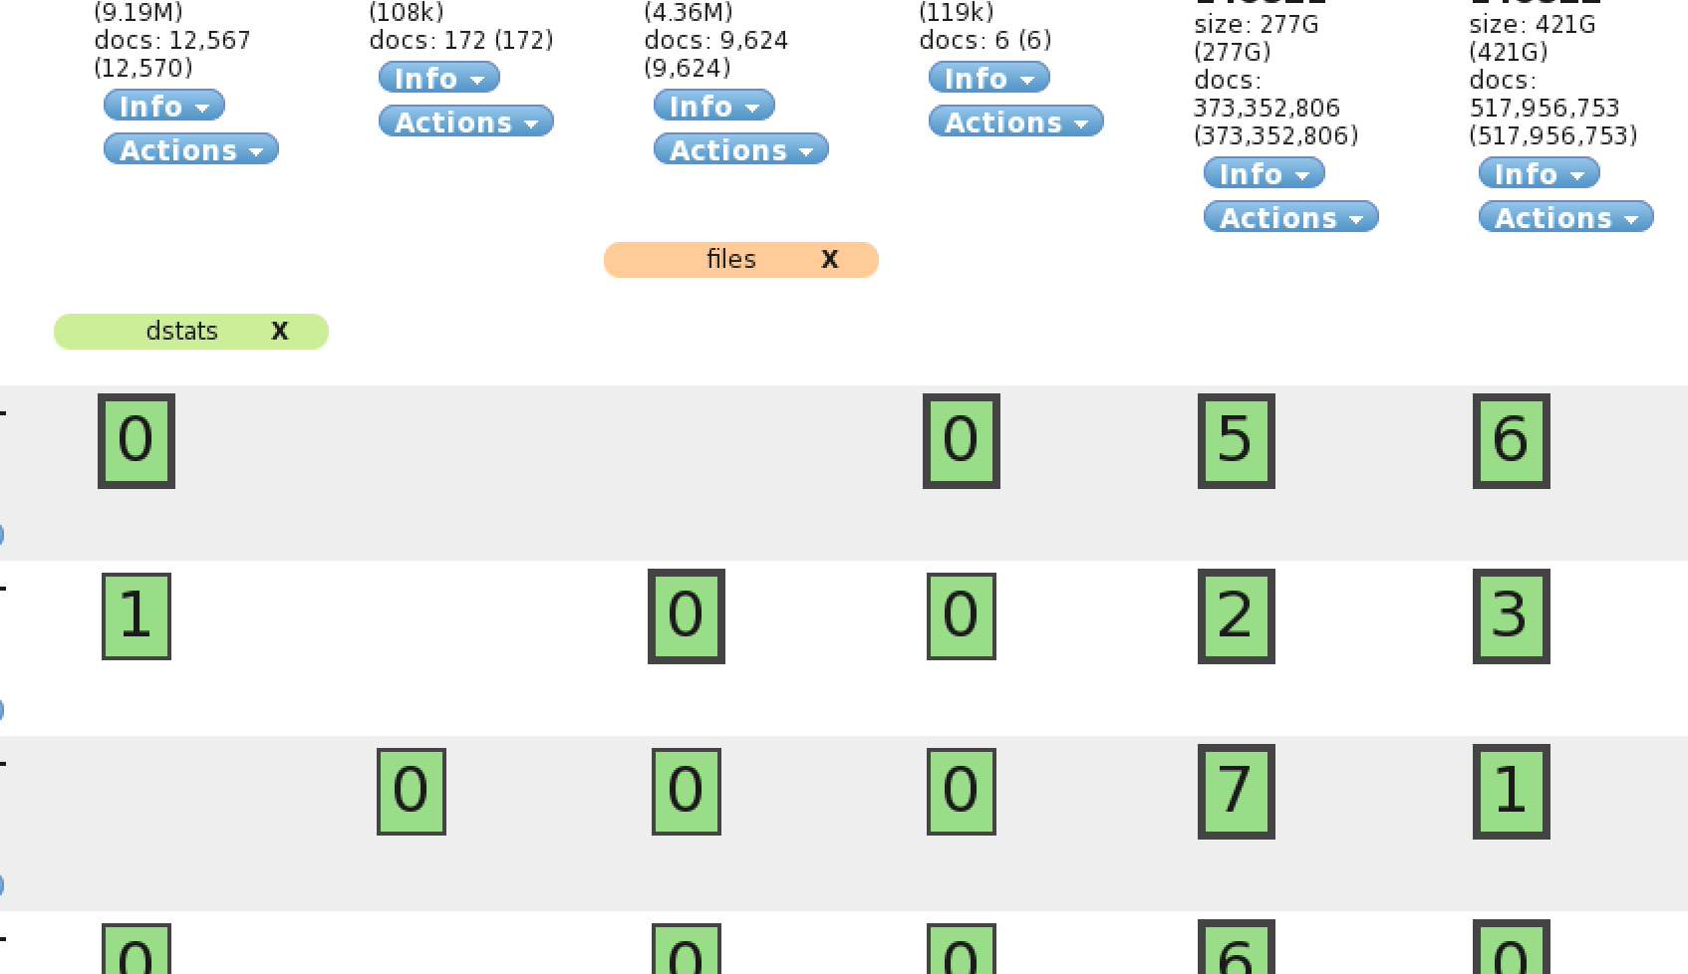
After

Slide 41
Generating Sequence Numbers
Create index
To get a sequence number just PUT the same document id
Use version number for sequence number
Clinton Gormley - http://bit.ly/1hvWC6t
curl -XPUT '127.0.0.1:9200/sequence' -d '{
"settings" : {"number_of_shards": 1, "auto_expand_replicas": "0-all"},
"mappings" : {
"sequence" : {
"_source" : { "enabled" : 0 }, "_all" : { "enabled" : 0 }, "_type" : { "index" : "no" },
"enabled" : 0}}}'
curl -XPUT '127.0.0.1:9200/sequence/sequence/fileindex?pretty=1' -d {}
{
"_index" : "sequence", "_type" : "sequence", "_id" : "fileindex",
"_version" : 3, "created" : false
}

Slide 42
Adding Nodes
Disable allocation to stop shard shuffling until ready
Increase speed of transfers
Start new nodes
Enable allocation
curl -XPUT localhost:9200/_cluster/settings -d '{"transient" : {
"cluster.routing.allocation.disable_allocation": true
}}'
curl -XPUT localhost:9200/_cluster/settings -d '{"transient":{
"indices.recovery.concurrent_streams":6,
"indices.recovery.max_bytes_per_sec":"50mb"}
}'
curl -XPUT localhost:9200/_cluster/settings -d '{"transient" : {
"cluster.routing.allocation.disable_allocation": false
}}'

Slide 43
Removing Nodes
Exclude the nodes from the cluster, this will tell ES to move things off
Increase speed of transfers
Shutdown old nodes after all shards move off
curl -XPUT localhost:9200/_cluster/settings -d '{"transient" : {
"cluster.routing.allocation.exclude._name" : ”node-05*,node-06*"
}}'
curl -XPUT localhost:9200/_cluster/settings -d '{"transient":{
"indices.recovery.concurrent_streams":6,
"indices.recovery.max_bytes_per_sec":"50mb"}
}'
curl -XPOST 'localhost:9200/_cluster/nodes/node-05*,node-m06*/_shutdown'

Slide 44
Upgrading to 1.x
"exists" changed to "found" everywhere
fields= option returns everything in arrays now, better to use _source=
GET no longer returns ok: true
/_nodes/stats changed to /_cluster/nodeStats

Slide 45
Moloch Future
IPv6 support
More parsers
Switch from facets to aggregations
Investigate using Kibana 3 to replace viewer
50+ github issues ☺

Slide 46
Elasticsearch Wishes
Add per field meta data to mapping
tribes that merge same index names
"triggers" – like percolation at insert time, but makes outgoing calls or at minimum stores _ids in separate table for later processing
https for web api and TLS for internode communication
ES version upgrades without full cluster restarts
Extend elasticsearch/curator with features we need
index globing is broken in 1.x, a glob that matches nothing matches everything
Heap dumps should be easier to disable
elasticsearch-js could be initialized with all versions supported
elasticsearch-js should hide API renames

Slide 47

Questions?

