Slide 1

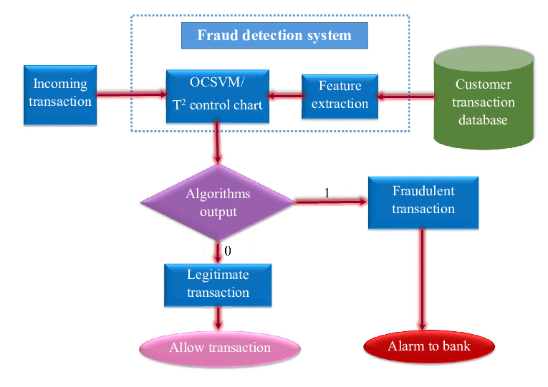
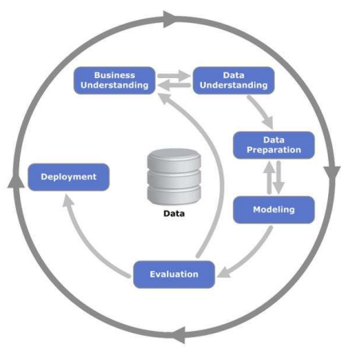
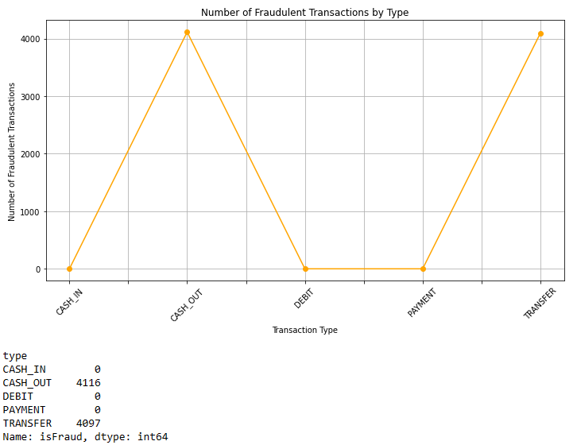
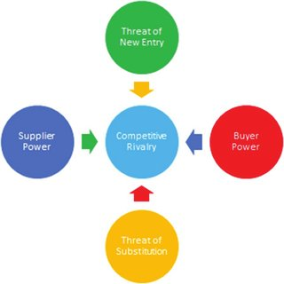


Enhancing Bank Transaction Security: An Accurate
Approach to Fraud Detection
Frank Lee
CCT College Dublin / Georgia State University (Volume 21, Issue 4, pp. 23-36), September 2023.
ABSTRACT
DATA FLOW
. To find a way to improve and control anomaly detection in Bank transactions, our fraud detection software was developed as a solution to better spot and manage unusual activities in bank transactions. Our application uses machine learning to detect anomalies in transaction data.
. We will count on tools such as: Python, with libraries like scikit-learn and TensorFlow, that offer robust machine learning for fraud detection. MySQL securely manages large transactional datasets, supporting efficient data storage and querying essential for fraud detection software development.
. "Data preparation and cleaning enhances dataset quality" Kartikay Goyle (2023) .Thinking that, our approach begins with thorough data preprocessing, which involves addressing missing values, outliers, and inconsistencies to achieve our goals.​
​
Kim Phuc TRAN (2018).
INTRODUCTION
. Safeguarding financial transactions is crucial.
Our project is dedicated to refining and managing anomaly detection within transfers. Our solution revolves around the power of machine learning techniques, as machine learning techniques are crucial to avoid transaction fraud.
. We will use open source to develop.
Opensource is free for all users, and this makes OSS classic public good (Anamika Sen, 2022, p.1), that's why we choose for open-source tools like Python and MySQL.
. By following CRISP-DM framework steps, we can effectively develop and deploy a robust fraud detection solution for bank transactions, enhancing security and customer trust. Frank Lee (2023)
FRAUD GRAPH
Eliabe Baliero de Moura (2024).
RESEARCH QUESTIONS
. Q1. How was the proposed solution developed with attention to professional ethics and legality ? (MLO1)
. Q2. What methods were used to analyze project resources, risks, and costs in the detailed report ? (MLO2)
. Q3. How were diverse computing skills applied to design and construct a prototype ? (MLO3 and MLO4)
CONCEPTUAL FRAMEWORK
Dataset link: Fraudulent Transactions Prediction(kaggle.com)
. Competitive Rivalry: Moderate: The market for fraud detection software is competitive, with several established players and new entrants constantly entering the space.
. Threat of New Entrants: Low to Moderate: Developing fraud detection software requires expertise in machine learning, data analysis, and financial security.
. Supplier Bargaining Power: Low: The necessary technologies and tools for developing fraud detection software are widely available in the market.
COCLUSION
. Q1. In developing fraud detection software for banking transactions, safeguarding customer data privacy is vital. Compliance with data protection laws like GDPR or CCPA requires robust security measures and ethical usage of data solely for fraud detection purposes.
. Q2. Estimating costs associated with project activities such as development, testing, deployment, and maintenance. Risks of potential breaches or mishandling of sensitive customer information.
. Q3. In order to build the prototype, it requires skills of some computing disciplines, the design and construction of the prototype such as: Requirement Analysis, Programming and Development, Data Analysis and Modelling.
. Buyer Bargaining Power: Moderate: Banks and financial institutions are the primary buyers of fraud detection software. ​
​. Threat of Substitution: Low due trust-building needs. While there may be other fraud detection software solutions in the market, the use of machine learning for anomaly detection provides a unique and advanced capability.​
Monique Danao (2024)
REFERENCES
. Anamika Sen. (2022, p.1) Open Source Software [Online] Available at:
https://thecommonsjournal.org/articles/10.5334/ijc.1176
[Accessed 08 March 2024].
. Kartikay Goyle. (2023, p.1) A Machine Learning Approach [Online] Available at:
2307.07119.pdf (arxiv.org)
[Accessed 10 March 2024].
. Kim Phuc Tran (2018) Real Time Data-Driven Approach [Online] Available at:
Proposed data-driven approaches for credit card fraud detection | Download Scientific
Diagram (researchgate.net)
[Accessed 25 April 2024].
. Frank Lee (2023) Using Supervised Machine Learning and CRISP-DM [Online]Available at:
EJ1403991.pdf (ed.gov)
[Accessed 29 April 2024].
. Monique Danao (2024) Porter’s Five Forces[Online]Available at:
Porter’s Five Forces: Definition & How To Use The Model – Forbes Advisor
[Accessed 24 April 2024].
WHO USE FRAUD SERVICE
. Financial Institutions and Banks:
Banks and financial institutions actively employ fraud prediction models to detect and prevent fraudulent activities related to credit card transactions, loans, and other financial services.
. Bank of America employs advanced fraud detection models to protect its customers from unauthorized transactions.
. HSBC, a multinational banking and financial services organization, focuses on fraud prevention by using predictive analytics. Their systems analyze transaction data, user profiles, and historical patterns to identify potential fraud.
Eliabe Baliero de Moura 2022474

