Slide 1
Data / Text Mining
Renaud Richardet, PhD
Brain Mind Institute
EPFL, Switzerland
renaud.richardet@epfl.ch

Slide 2
Agenda
a

Slide 3
T
a

Slide 4
T
a

Slide 5
Introduction: a few principles

Slide 6
Introduction: a few principles
move fast and break things. unless you are breaking stuff you are not moving fast enough
M. Zuckerberg

Slide 7
Introduction: a few principles
don't be evil
Google

Slide 8
Introduction: a few principles
if all else fails, you can write a program
Unknown

Slide 9
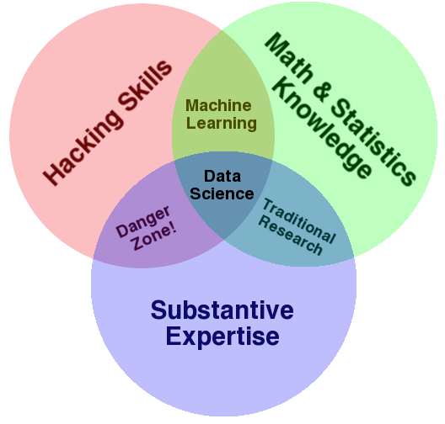
Introduction: Data Science

Slide 10
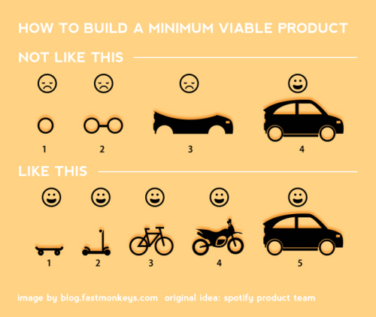
Introduction: Minimum Viable Product
mvp.jpg

Slide 11
Your usecases
Each participant will take 5 min (alone or in small groups) to present a text-mining project that is relevant to her/his work
We will then briefly discuss together potential strategies and solutions
The presentation strictly follows the following 5 simple sentences (max 600 characters):
We are [WHO IS YOUR TEAM?, WHAT ARE YOUR COMPETENCES?]
Our goal is [WHAT IS YOUR GOAL?]
So far, we [DESCRIBE CURRENT SOLUTION]
But it does not work because [WHY IS CURRENT SOL. INSUFFICIENT?]
Now, we would like to [DESCRIBE YOUR IDEA TO MAKE IT WORK]

Slide 12
Your usecases: Example
We are a team of 2 PhDs (1 neuroscientist, 1 NLP expert) and 2 CS Masters students
Our goal is to extract brain region connectivity from scientific publications
So far, we use hand-crafted PubMed searches and manually filter the relevant publication
But it does not work because it takes us too much time & we believe we miss relevant connections coming from full text
Now, we would like to create an NLP workflow that 1) finds brain regions and 2)

