Slide 1
Data / Text Mining
Renaud Richardet, PhD
Brain Mind Institute
EPFL, Switzerland
renaud.richardet@epfl.ch

Slide 2
Agenda
1) Introduction
2) Basics
a) quick start with UNIX tools
b) regular expressions
c) know your text editor
3) Data acquisition
a) strategy, considerations, copyrights
b*) crawling data from an API (PubMed)
c*) scraping data from a website
4) Data processing
a*) text processing with NLTK
b*) full-text search with Elasticsearch
c*) a sense of machine learning
d*) semantic similarity with word2vec
5) Your usecases

Slide 3
About me
PhD from EPFL's Blue Brain project
working on large scale natural language processing applications for the biomedical domain
research scientist and senior developer in Switzerland, India and in the USA
Primary fields of interests:
natural language processing (NLP)
deep learning
big data
open source software

Slide 4
About you: put your hands up if you know about:
writing a simple program in an interpreted language
creating an html page
with some Javascript
using regular expressions
programatically accessing a public API
part-of-speech tagging
stemming
inverted index
ElasticSearch
word2vec

Slide 5
Today: a broad overview
Everything there is about text mining
What we will work on today
source: http://worrydream.com/ClimateChange/

Slide 6
Introduction: a few principles

Slide 7
Introduction: a few principles
move fast and break things. unless you are breaking stuff you are not moving fast enough
M. Zuckerberg

Slide 8
Introduction: a few principles
don't be evil
Google

Slide 9
Introduction: a few principles
if all else fails, you can write a program
Unknown

Slide 10
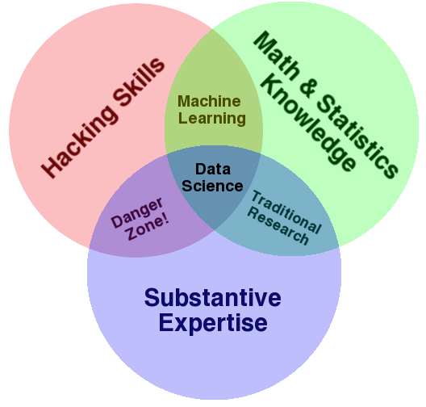
Introduction: Data Science
source: http://drewconway.com/zia/2013/3/26/the-data-science-venn-diagram

Slide 11
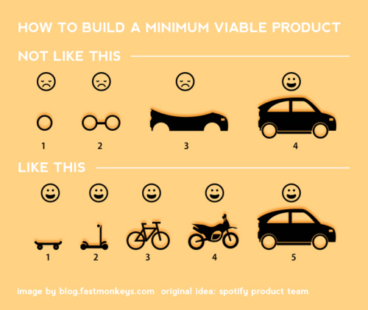
Introduction: Minimum Viable Product
mvp.jpg

