Slide 1
The Simulation of Queuing Model for Bangkok Rapid Transit Train Ticket System Using Python

Slide 2
ABSTRACT
This paper proposes the simulation model for ticket system of Bangkok rapid transit train.
The proposed analysis model is applied by using queuing theory to analyze main queuing delay problem rapid transit train ticket machines.
This analysis model has been developed by using python programming language to create software tool for analyzing the existing ticket system comparing with the desire variable condition or redesign the ticket system.
Since, proposed software tool use for analyze the effect of existing ticket system by modification to visualize the queuing, delay time, waiting time and etc.
The software tool with the simulation model can visualize the 2D animation results and graph for analyzation.
The proposed analysis model could be used to any rapid transit train ticket system for impact analysis own existing ticket system

Slide 3
Existing system Existing system Existing System
At present, mass rapid transit in Bangkok consists of three
networks, the Bangkok Mass Transit System (BTS), the Metropolitan Rapid Transit (MRT) and the Airport Rail Link (ARL).
According to the statistics in 2017, this Chaloem Ratchamongkhon (Blue) line carries more than 360,000 passengers daily.
This huge number of passengers has indeed caused negative impact on the ticketing system at each station.
At peak hours, passengers face difficulties in purchasing ticket due to inadequate ticket machines resulting long queueing delay . This causes unsatisfaction particularly among tourist travelers .
In response to this problem, reference [1] applied some basic queueing model to approximately analyze and able to roughly identify the main causes of delay

Slide 4
Disadvantages
In existing system average waiting time for a passenger is 35.78 sec. which means
More waiting time for a passengers who are arriving in peak time.
From the simulation we have analysed that existing system taking more service time for individual passenger.
Mean while existing system is more costlier and time consuming for both BTS and their passengers.

Slide 5
Proposed system
The proposed analysis model can be used to evaluate the service time of railway companies, which enables for the operators to form a proper policy and decide on different ticket system operations based on cost requirements.
The proposed simulation model has been implemented in python software tool for analyzing the effect time delay of queues or average waiting time for passengers by comparing ticket existing system and desire modification system.
Since, the proposed simulation of queuing model presents the results to show the impact of time delay in queue of passengers when ticket machines are modified by number or feature upgrading.
The proposed analysis model could potentially be used to any rapid transit train ticket system for impact evaluation on the existing ticket system.

Slide 6
Advantages
In Proposed system average waiting time for a passenger is 0.08 sec .The desired advantages of modified system includes-
Less waiting time for a passengers who are arriving in peak time.
Achieved increased service rate of ticket machine
Passengers of Bangkok Rapid Transit Train are getting more tickets in less amount of time which will gradually increase the financial growth of railway

Slide 7
Modules
Queuing Theory:
Queuing theory is the mathematical study of the congestion and delays of waiting in line. Queuing theory (or "queueing theory") examines every component of waiting in line to be served, including the arrival process, service process, number of servers, number of system places, and the number of customers—which might be people, data packets, cars, etc
.

Slide 8
Pandas: pandas is an open source, BSD-licensed library providing high-performance, easy-to-use data structures and data analysis tools for the Python programming language
Numpy: NumPy is a general-purpose array-processing package. It provides a high-performance multidimensional array object, and tools for working with these arrays. It is the fundamental package for scientific computing with Python.
MatPlotLib: matplotlib. Pyplot is a plotting library used for 2D graphics in python programming language. It can be used in python scripts, shell, web application servers and other graphical user interface toolkits
Scikit-learn: Scikit-learn is a free machine learning library for Python. It features various algorithms like support vector machine, random forests, and k-neighbors, and it also supports Python numerical and scientific libraries like NumPy and SciPy.

Slide 9
System specifications
Hardware Requirements:
RAM: 4GB and Higher
Processor: Intel i3 and above
Hard Disk: 500GB: Minimum
Software Requirements:
OS: Windows or Linux
Python IDE : python 2.7.x and above
jupyter notebook.
Language : Python Script

Slide 10
Software Requirement Specification
Software Requirements Specification (SRS) – a requirements specification for a software system – is a complete description of the behavior of a system to be developed.
It includes a set of use cases that describe all the interactions the users will have with the software.
In addition to use cases, the SRS also contains non-functional requirements. Non-functional requirements are requirements which impose constraints on the design or implementation

Slide 11
Functional Requirement
a. Software Requirements
OS : Windows
Python IDE : python 3.x and above
Jupyter Notebook,
Anaconda 3.5
Setup tools and pip to be installed for 3.6.x and above

Slide 12
b. Hardware Requirements
RAM : 4GB and Higher
Processor : Intel i3 and above
Hard Disk : 500GB: Minimum
NON Functional Requirements
Secure access of confidential data (user’s details). SSL can be used.
24 X 7 availability.
Better component design to get better performance at peak time
Flexible service based architecture will be highly desirable for future extension

Slide 13
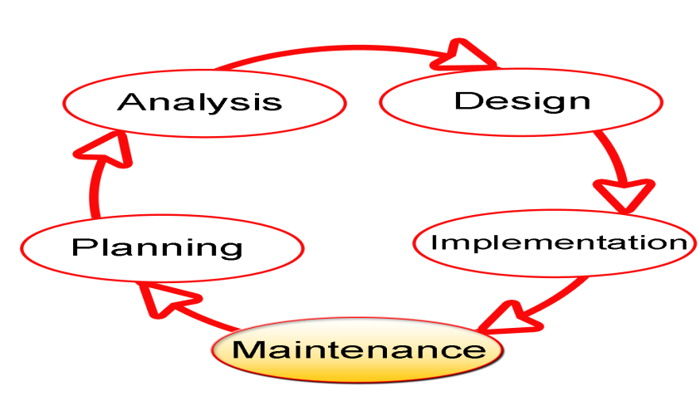
SDLC Methodologies
The Software Development Lifecycle (SDLC) for small to medium database application development efforts.
This project uses iterative development lifecycle, where components of the application are developed through a series of tight iteration.
The first iteration focus on very basic functionality, with subsequent iterations adding new functionality to the previous work and or correcting errors identified for the components in production

Slide 14
The six stages of the SDLC are designed to build on one another, taking outputs from the previous stage, adding additional effort, and producing results that leverage the previous effort and are directly traceable to the previous stages.
During each stage, additional information is gathered or developed, combined with the inputs, and used to produce the stage deliverables.
It is important to not that the additional information is restricted in scope, new ideas that would take the project in directions not anticipated by the initial set of high-level requirements or features that are out-of-scope are preserved for later consideration.

Slide 15
UML DIAGRAMS

Slide 16
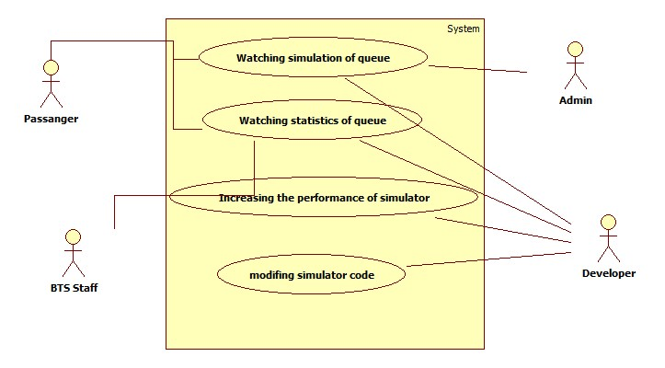
USECASE DIAGRAM

Slide 17
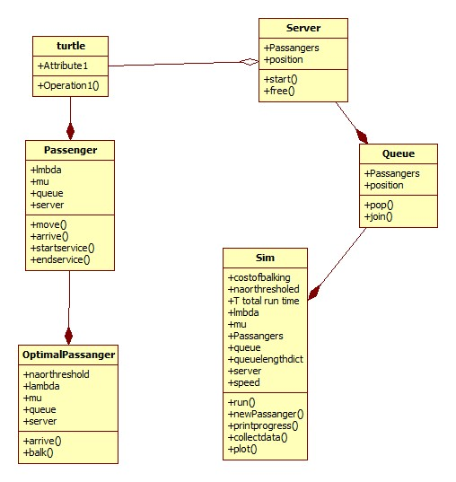
CLASS DIAGRAMS

Slide 18
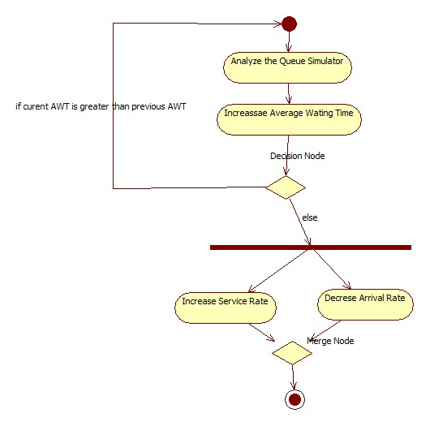
ACTIVITY DIAGRAM

Slide 19
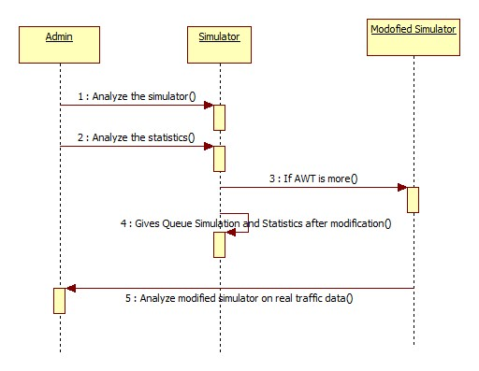
SEQUENCE DIAGRAM

Slide 20
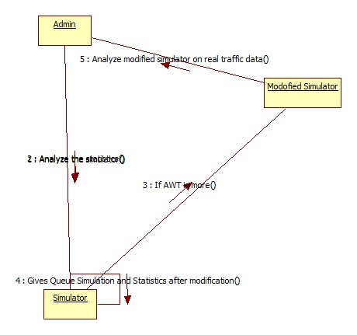
COLLABORATION DIAGRAM

Slide 21
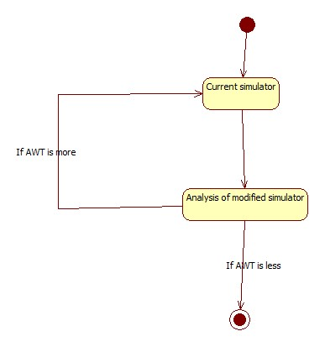
STATECHART DIAGRAM

Slide 22
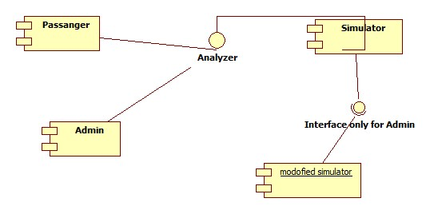
COMPONENT DIAGRAM

Slide 23
Thank You

