Slide 1
Progress Meeting
Elian van Shalkwijk
Put the data here

Slide 2
Review of last week

Slide 3
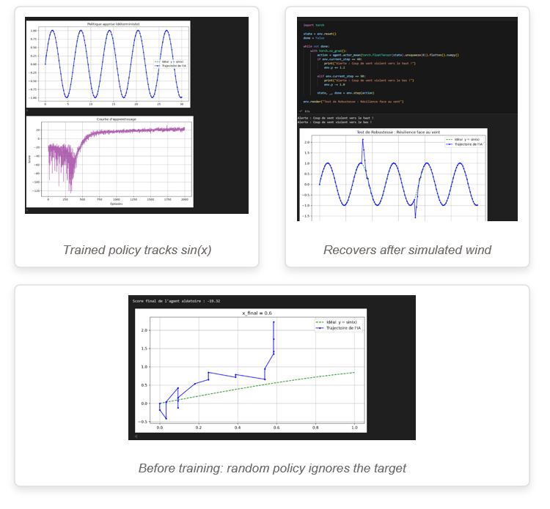
Work done this week
Agent 1 — Tracking a sin(x) trajectory
HOW IT WORKS
Custom environment: state = position + local slope of the target + tracking error; action = step (dx, dy).
Reward shaping: high reward near the curve, penalty for drifting away this pulls the agent onto sin(x).
Algorithm: PPO coded from scratch (actor + critic networks, GAE advantages).
RESULTS
Random policy scores ≈ −19 and ignores the curve.
After training: the learned policy tracks sin(x) almost perfectly.
Robustness test: injected sudden “wind gusts” → the agent recovers and returns to the curve.
Also read the papers, links and documents you gave me

Slide 4
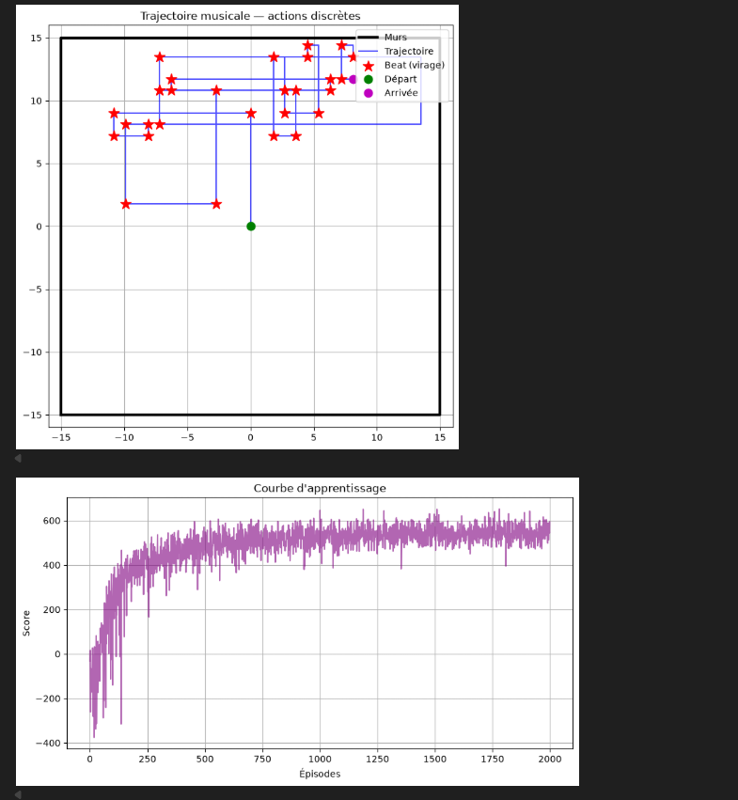
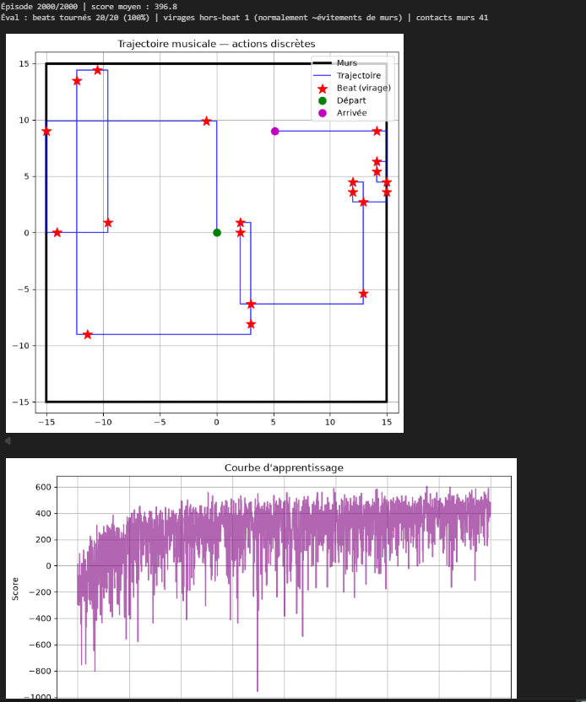
Questions to discuss
Agent 2 — Music-reactive trajectory generation
Discrete actions {go straight, turn left 90°, turn right 90°} at constant speed → clean straight lines and sharp corners.
PPO with a categorical policy; beats are random for now.
Is It a good way?
Should I make it turn other than 90°?

Slide 5
Next steps
Fix wall handling : use the beat anticipation (countdown) to avoid arena boundaries.
Add an area-coverage reward : with a visited-map in the state, so the trajectory fills the space.
From random beats → real music : drive turns from actual audio beats.
Try implementing in 3D

