Slide 1

HSLU · DENG Data Engineering · HS26
Champions League
Match Intelligence
Recording every day what was known about a match -
so a model can later predict who wins.
Elias Martinelli · Noah Rodriguez
github.com/Elias-Martinelli/deng
Notes:
Slide 1 - Title (Elias, approx. 20 s)
"We are building a data pipeline around the Champions League. It records every day what was known about a match on that day. A model can then later use it to predict who wins."

Slide 2



Who wins - and can we answer that fairly?
A fair model may only use what was known before kick-off.
Fixtures
Table & form
Weather
months ahead,
kick-off times still move
change after
every matchday
max. 16 days ahead,
then overwritten
What is not stored today is gone tomorrow. Storing it is the project.
Notes:
Slide 2 - The use case (Elias, approx. 50 s)
• "Our use case is a model that predicts the winner. Everything we build exists because of that model."
• "The question is: who wins a match? And above all: can we answer that fairly?"
• "Fair means: the model may only use things that were known before kick-off."
• "The problem: the sources only ever return today's state. Last week's weather forecast is gone."
• "If nobody stores it every day, that history does not exist. That storing is our project. The model is the purpose, but it is not part of this project."

Slide 3

End user and data product
label
features - known before kick-off
Result
Home · draw · away
Form
from earlier matches
Weather
kick-off forecast
Data scientist
trains and tests a
match-outcome model
one row per match
Secondary: a dashboard
that shows what the
model would see
Notes:
Slide 3 - User and data product (Elias, approx. 45 s)
• "Our main user is a data scientist, someone who trains a model."
• "They get tables where it is clear what one row means: one row is one match, or one team in one match."
• "The most important table is model_features. One row is one match: on the left the result, on the right everything that was known before kick-off. That is exactly what a model reads."
• "The result is called the label, the answer the model is supposed to learn. The features are form and weather."
• "For the final milestone we add one row per match per day. Then you can ask: what was known five days before the match?"
• "Next to it there is a dashboard - a web page that shows exactly this data, so a human can see what the model sees."

Slide 4

Three free sources, four ingestion steps
football-data.org
Open-Meteo
OpenStreetMap
fixtures · results · standings · crests
forecast for the kick-off hour
stadium coordinates
4 requests a day (limit 10/min)
max. 16 days ahead · no key
once per club
All documented, all free, no scraping.
Notes:
Slide 4 - Data sources (Elias, approx. 55 s)
• "Three providers, four ingestion steps. All free, all documented, no scraping - we do not scrape websites, we call official APIs."
• "football-data.org provides fixtures, results, teams and the table. Ten requests per minute are allowed; we need four per day."
• "From the same source we fetch the club crests. That is a separate step because they are images, not numbers. We fetch every crest exactly once."
• "Open-Meteo provides the weather forecast, without any key, but only 16 days ahead."
• "OpenStreetMap provides the stadium coordinates. We need them for the weather, because the football API has none."

Slide 5


Risks
Finding
Our answer
Status filter lies
select by kick-off time
API sums do not add up
compute form ourselves
Biggest risk:
data leakage
Napoli found in Novara
every stadium checked by hand
Free-tier limits
pacing and retries
A model that sees the match it predicts looks brilliant - and is worthless.
Sources overwrite history
we keep every answer
Notes:
Slide 5 - Risks (Elias, approx. 50 s)
• "We tested the API instead of guessing. Three examples:"
• "The status lies: if you ask for matches with status SCHEDULED, you get rows stored as TIMED. So we select upcoming matches by their kick-off time."
• "The sums do not add up: wins plus draws plus losses is not the number of matches played. That is why we compute form ourselves from the individual matches."
• "The stadium search was wrong: on the first attempt Napoli ended up in Novara and Roma in Turin. We checked every coordinate once by hand. The verdict is stored in the database next to the unchanged answer."
• "On top of that come the free-tier limits, for example ten requests per minute for the football data. The pipeline has to handle that."
• "The biggest risk, however, is not technical, it is data leakage. That means the model already sees information from after the match. Then it looks perfect in testing and is worthless in reality."

Slide 6
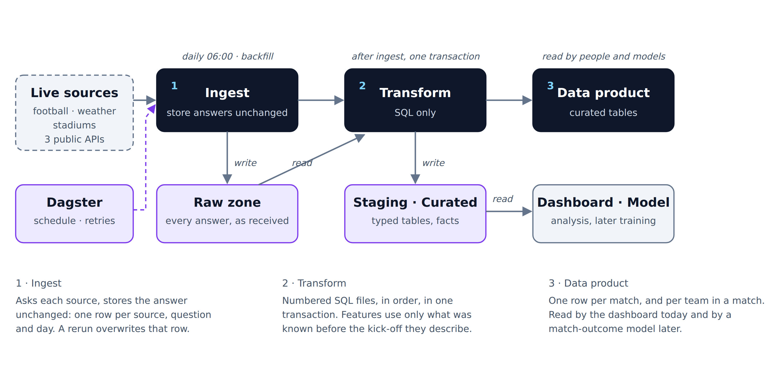
Architecture v0.1 - three stages
Rule: ingestion never reads the transformed tables - enforced by a test.
Notes:
Slide 6 - The three stages (Noah, approx. 85 s)
This is the main slide. Take the most time here.
• "This picture is the whole project. It has three stages, and each stage is a folder in the repository."
• "First, ingest: one small Python file per source, all following the same pattern. Each one answers only two questions: what should I fetch, and how do I fetch it?"
• "Second, transform: numbered SQL files that run in order. SQL is the language used to query and build tables."
• "Third, the data product: the finished tables that the dashboard reads today and a model will read later."
• "One rule holds the picture together: ingestion may only read the sources and the raw data, never the finished tables. We wrote a test for that - if someone breaks the rule, the test fails."
• "Every run is logged. The question 'did it work yesterday?' is a short query for us, not a search through log files."

Slide 7
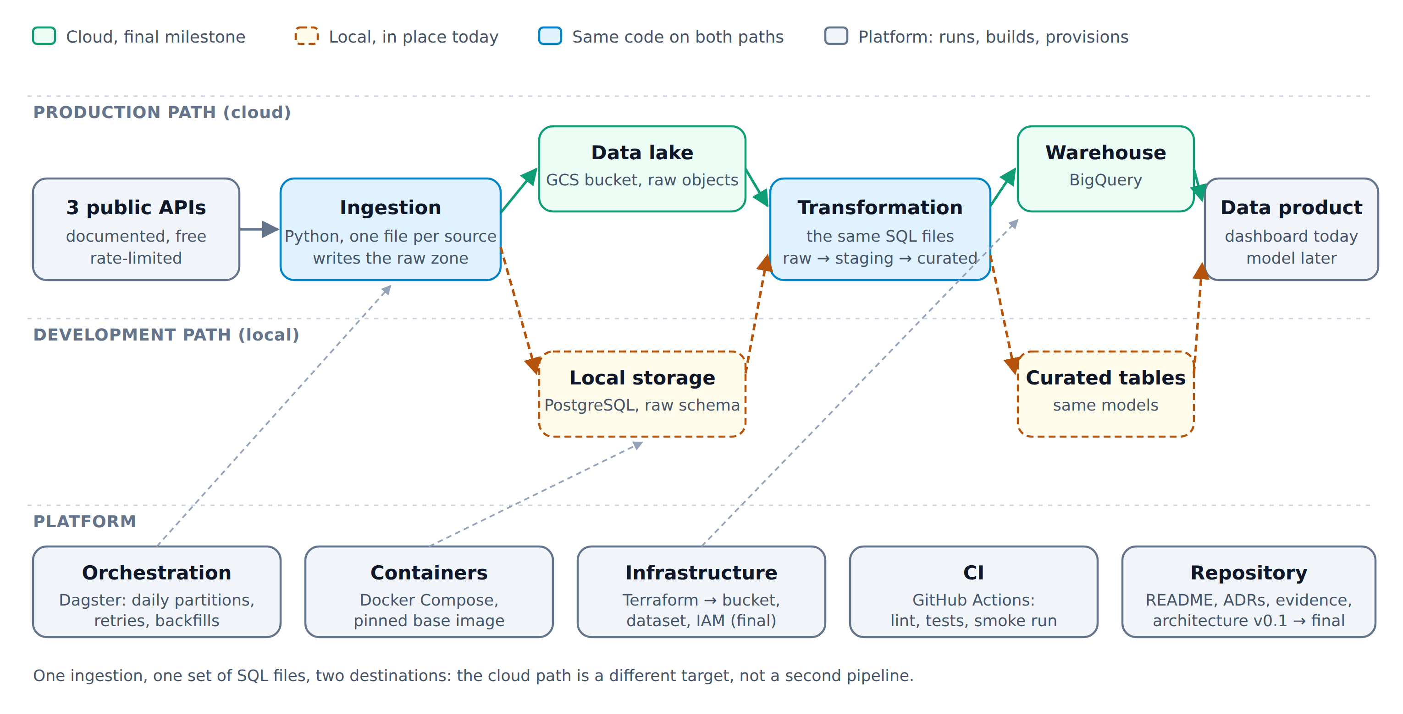
Where it goes, and who does what
Area | Owner
Football, past seasons | Both
Weather, stadiums | Elias
Transformations, model | Noah
Orchestration, Docker, CI | Noah
Dashboard, notebook | Elias
Cloud: Terraform, BigQuery | Both
Every pull request is reviewed by the other.
Midterm · 22 Oct
local pipeline
Final · 10 Dec
cloud pipeline
Notes:
Slide 7 - Target and division of responsibilities (both, approx. 50 s)
• Elias: "This is our target. In the final milestone the same code writes the raw data to Google Cloud Storage and the finished tables to BigQuery - Google's database for large-scale analysis."
• Elias: "Terraform provisions both automatically - nothing is clicked together by hand, it is described in a file."
• Elias: "Important: the sources and the SQL stay the same. Only the destination changes. The local path stays for development."
• Noah: "The work is split, but each of us has to be able to explain everything. I own weather, stadiums, the transformations, orchestration and Docker. Elias owns football, past seasons, the dashboard and the notebook. We do the cloud together."
• "The next milestone is the midterm on 22 October with the local pipeline, then the cloud by 10 December."

Slide 8

Questions?
Thank you.
github.com/Elias-Martinelli/deng
Notes:
Expected questions - and short answers
Rule of thumb for every answer: first the statement, then the reason, then the alternative we rejected. That is exactly what is assessed.
Three words you must be able to explain:
• Pipeline - a program that fetches and organises data automatically every day.
• Raw - a source's answer, stored exactly as it arrived.
• Curated - clean tables you can work with directly.
"Why do you store the raw data at all?"
Because the sources only return today's state. Forecasts are overwritten, kick-off times change. Our raw zone is the only archive we own - and the basis for recomputing everything without asking the source again.
"What happens if you run the pipeline twice on the same day?"
Nothing bad. The key is source, question and day. The second run overwrites the same row. We even report whether the answer changed at all.
"What happens if a source goes down?"
We distinguish two kinds of errors. Too many requests, server errors and network problems are retried with growing delays. Forbidden access or a missing key is reported immediately, because a second attempt changes nothing. The run is logged as failed, the existing data stays untouched.
"Why not real time?"
The use case is a prediction before kick-off. One run per day is enough, and the free tiers would not allow more anyway.
"How do you prevent data leakage?"
By construction. A team's form for a match only uses matches that were finished before that kick-off. For the weather, only a forecast fetched before kick-off counts. Both are written that way in the SQL. The dashboard additionally re-checks these rules from the tables instead of just claiming them.
"Why do you fetch past seasons - isn't the current one enough?"
No. The current league phase has 144 matches, and only a few of them have been played. A model needs examples with a known outcome. A finished season costs two requests, never changes again and brings 125 to 189 matches. Which seasons we load is a setting - change one line, done.
"Are past seasons even comparable?"
Partly. The format changed in 2024/25. That is why we store the season with every match, so a model can tell the formats apart. We throw nothing away and we do not pretend everything is the same.
"Why PostgreSQL and not the cloud straight away?"
Developing locally is faster and free, and the module requires PostgreSQL locally. The structure - raw, staging, curated - is the same as later in BigQuery. Moving is therefore a change of destination, not a rebuild.
"Why three providers and not one?"
Because the football API provides no weather and no coordinates. Each source fills exactly one gap, and each one is free.
"How much data is it?"
Less than two megabytes per day. One season is one request of about 200 kilobytes. The depth comes from history: 47 listed seasons that we could fetch once.
"What is still open?"
The table with one row per match per day, the cloud path with Terraform, and the decision how many past seasons we load in the end. That is in the backlog.
"Why do you reload everything every day instead of only the changes?"
Because the answer is small and bounded: one request, 212 kilobytes, the whole tournament. Fetching only the changes would cost an extra request just to find out what changed - and it would miss the matches the API adds, for example after the draw in December. A full load also heals itself: a missed day is made up the next day. Where incremental is right, we do load incrementally: past seasons once, crests once per URL, stadiums once per club. So the rule is not "always full", but "full as long as the answer is small and changing".
"What happens with a hundred times more data?"
Ingestion stays as it is - it is limited by the free tiers, not by our technology: ten requests per minute means a hundred seasons take about twenty minutes, once. The bottleneck moves to the transformation, because it currently rebuilds the tables completely. With a hundred times more data we would partition by season or by day and only recompute the affected partition; the raw zone already has the day as part of its key, so the structure is there. In BigQuery it would be the same idea with partitioning by date. To be honest: we have not measured this, we derived it - today it is 458 matches, which is nothing for PostgreSQL.
"Why Dagster and not Airflow?"
Because of backfills and size. Our mental model is "one run per day", and that is exactly a partition in Dagster: catching up a period is a button, not a hand-written loop. Then there is the container overhead: Dagster is two services next to our existing database, Airflow would be at least four plus a queue. Airflow is the industry standard, that is the downside of our choice - but we have to be able to explain it in ten minutes, and Dagster's assets map one to one to our tables. The comparison of four tools is in ADR-002.
"How do you know the data is correct?"
We do not claim it, we check it after every run: 24 checks whose results are stored in the database. Sixteen of them are critical and stop the run - for example if a form value uses a match that was played after kick-off. Eight are warnings and stay visible, such as a club without a stadium. We deliberately left this off the slides because Milestone 1 does not ask for it - but we can explain it.
"Are you even allowed to use this data?"
Yes, and we checked it per source: Open-Meteo is under CC BY 4.0, OpenStreetMap under ODbL - both require attribution, which is in the repository. We use the football API on the free tier for learning and evaluation, with keys that are never in the repository. We do not scrape anything and we do not republish the data.

