Slide 1
NHS login
Single Sign On – scope and processing overview
Version 1.0

Slide 2
Introduction
NHS login supports single sign on (SSO) based on an asserted token exchange between two Relying Parties (RP1 & RP2).
Asserted tokens are one time tokens (TTL 60 sec)
Partner services can control which other partner services they share SSO with
NHS login supports two parameters asserted_login_identity and prompt as part of the OIDC flow which will allows for seamless login between two Relying Parties (RP1 and RP2).

Slide 3
Technical Details - Parameter : prompt
Parameter | Req? | Value(s) | Description
prompt | Opt | <blank> “none” “login” | Requests that the NHS login Service forces the user to sign-in, or to request that the Service does not prompt the user to sign-in (SSO) <blank> - The Service will SSO the user if they still have a valid session, else the user will be requested to login none – The Service will SSO the user if they still have a valid session, otherwise an error code is returned login – The Service will request the user to login, regardless of a session already existing
Note : Please refer to NHS login Interface Specification – Federation document, for most up-to-date technical details.

Slide 4
Technical Details - Parameter : asserted_login_identity
Please refer to NHS login
Interface Specification – Federation document, for most up-to-date technical details.
Parameter | Req? | Value(s) | Description
asserted_login_identity | Opt |  | The purpose of this parameter is to support seamless login between two RPs (RP1 and RP2) where cookie-based SSO is not available. The content will be a signed jwt with payload containing “code” attribute with the value being that of the “jti” attribute from the ID Token issued to RP1. The jwt “iss” attribute MUST contain the client_id of RP1, the jwt MUST have an “exp” of no longer that 60 seconds, MUST have “jti” and “iat” attributes (as per RFC7519) and MUST be signed by RP1 using its client private key. RP1 passes the jwt to RP2 for RP2 to use in its authentication request. A non-normative example jwt payload section is as follows { code: “eeroifoteiwrudjdwusdu”, iss: “client1”, jti: “reioteotijdvorijevoihroi”, iat: 1548701645, exp: 1548701705 }
Note : Please refer to NHS login Interface Specification – Federation document, for most up-to-date technical details.

Slide 5
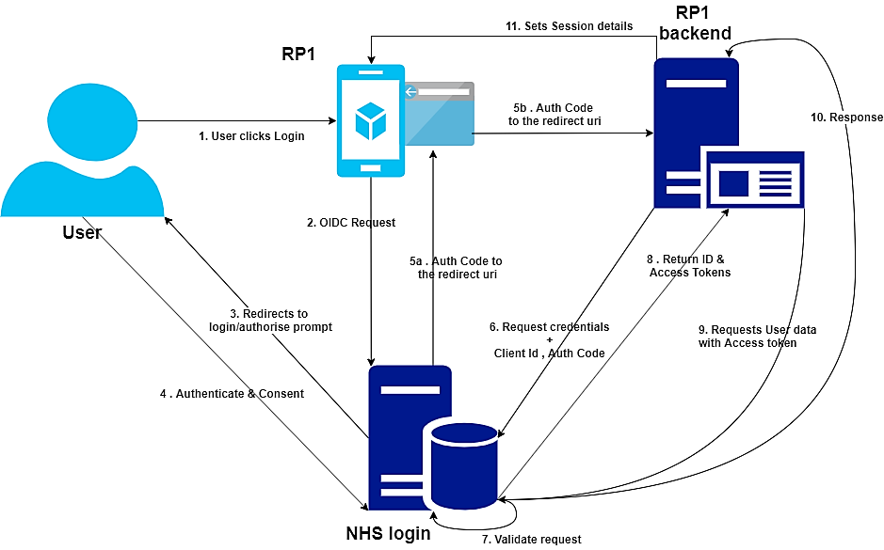
SSO Flow – Step 1 : Login to RP1
Step 1: User requests RP1 login - OIDC Flow - Authorization Code Flow

Slide 6
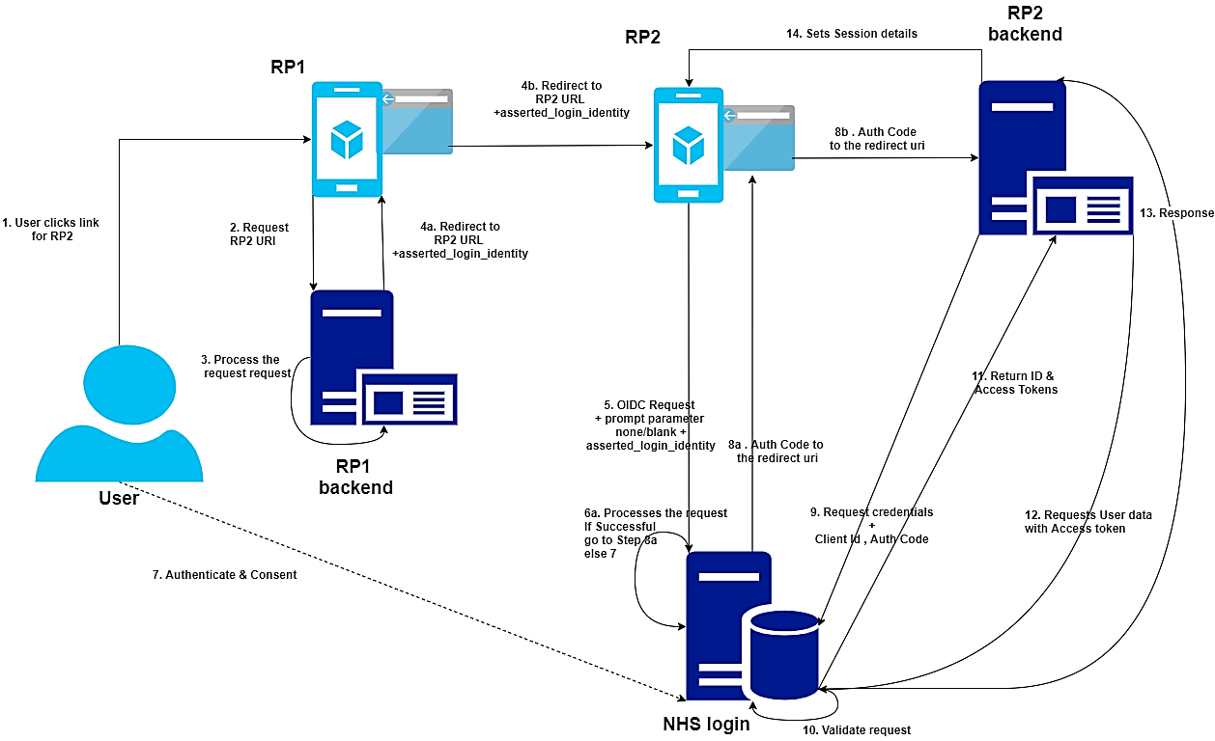
SSO Flow – Step 2 : SSO from RP1 to RP2
Step 2: User transitions from RP1 to RP2 - Single Sign On - Asserted Token Flow

Slide 7
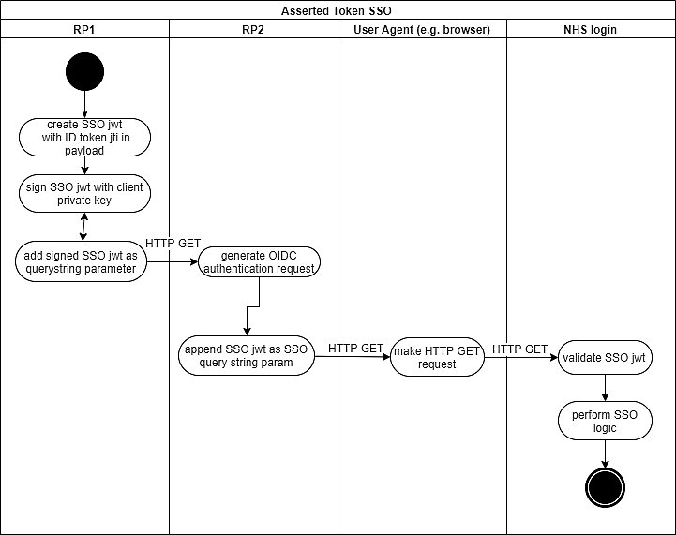
SSO – Sequence Diagram

