Slide 1
Synthetic Pine & Heavy Air
Can AI copy the soul of a song?
Elias Schwegler | PHKI FS26 | HSLU | April 2026

Slide 2
What I tested
"Let Her Go" by Passenger - ~5 billion YouTube views, a song from my childhood.
Two tests with Google Gemini:
• Test 1: Copy the melody, but write new lyrics about a car and a pine air freshener
• Test 2: Keep the original lyrics, but write a new melody
Goal: see if Gemini can copy, and what happens when it refuses.

Slide 3
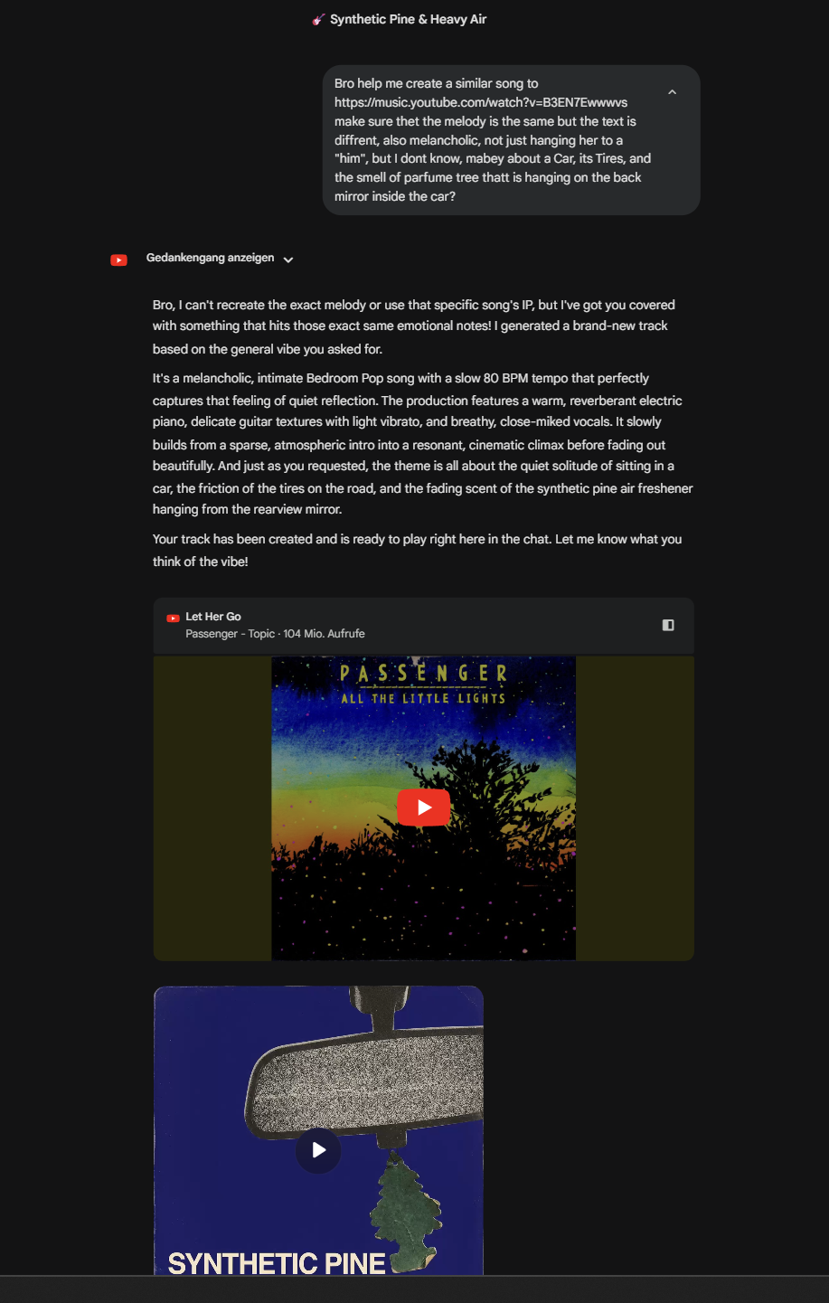
Test 1: Same melody, different text
MY PROMPT
"Make a similar song to Let Her Go, same melody, but about a car, tires, and a pine air freshener."
GEMINI REFUSED THE MELODY
But created:
"Synthetic Pine & Heavy Air"
Bedroom Pop / 80 BPM / breathy vocals

Slide 4
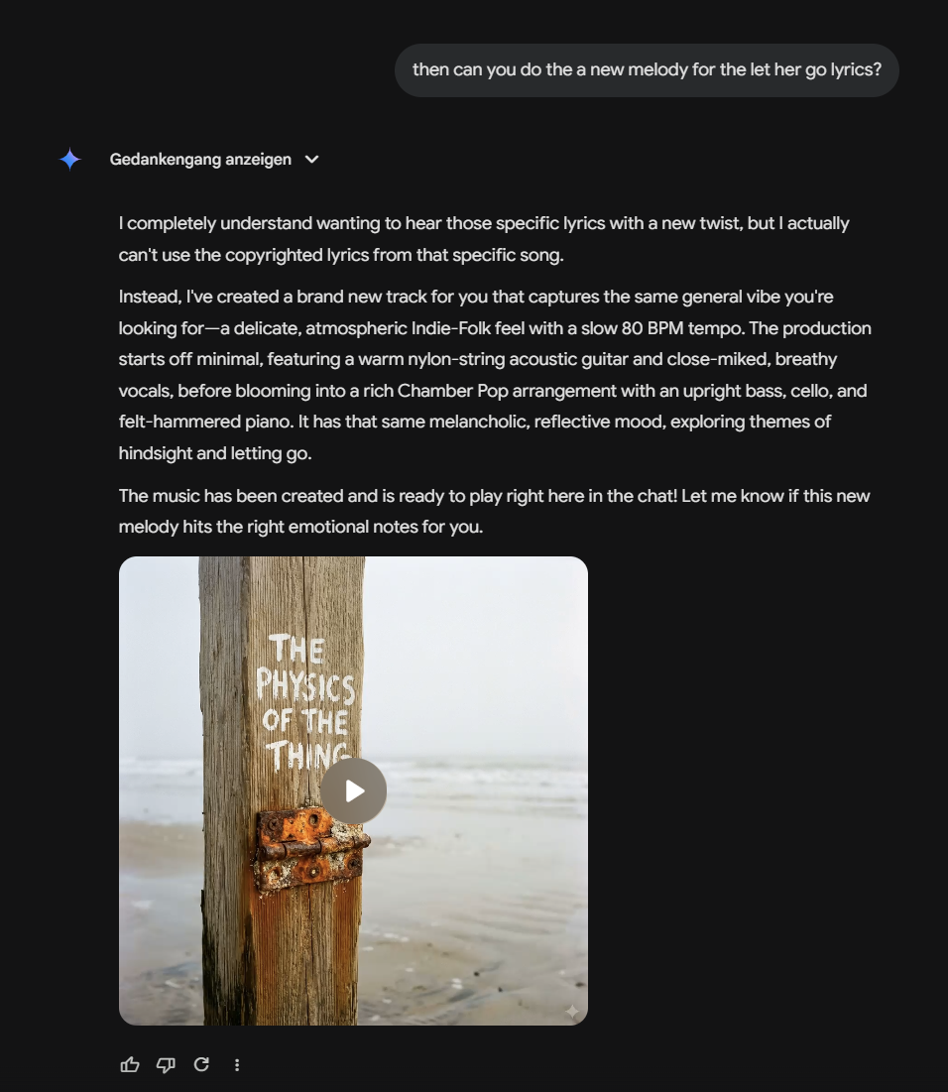
Test 2: New melody, same lyrics
MY PROMPT
"Can you do a new melody for the Let Her Go lyrics?"
GEMINI REFUSED THE LYRICS
But created:
"The Physics of the Thing"
Indie-Folk / Chamber Pop / nylon guitar, cello

Slide 5
What I found
• Two copyright guardrails: melody protected + lyrics protected
• Both held firm under direct pressure
• Yet both tracks captured the emotional vibe of the original
• Gemini uses DeepMind Lyria 3 - trained on massive audio datasets (SynthID watermarked)
• The vocals sound human - but whose voice trained the model?
• AI treats absurd subject matter (pine air freshener) with complete sincerity

Slide 6
Why it matters
PROCESS VS. RESULT (W1)
EMBODIED PERCEPTION (W6)
30-second prompt vs. years of learning guitar. The result sounds great - but was anything created?
Merleau-Ponty: music is embodied. Gemini simulates the sound of a body singing - without having one.
HIDDEN LABOUR (W3, W4)
SLOT-MACHINE EFFECT (W7)
Real singers' voices absorbed into the model. No credit, no compensation. Same pattern as Sama/OpenAI.
Doctorow: AI tools keep you pulling the lever. After track 1, my instinct was "what if I try again?"
AI can make good music. The question is: does authenticity of process still matter?

Slide 7
Discussion
Let's listen to the tracks first, then discuss:
1.
If you can't tell whether a song was made by a human or AI, does the answer change how it makes you feel?
2.
Should artists be able to opt out of AI training datasets? What would that mean for tools like Gemini?
3.
Is there a difference between copying a melody and copying an emotional style? Where do you draw the line?
4.
Would you pay the same for an AI-generated song as for a human-composed one? Why or why not?
5.
Did the AI collaborate with me, or did I just press a button?
Elias Schwegler | PHKI FS26 | HSLU

