Slide 1

Automatic Irrigation System

Slide 2
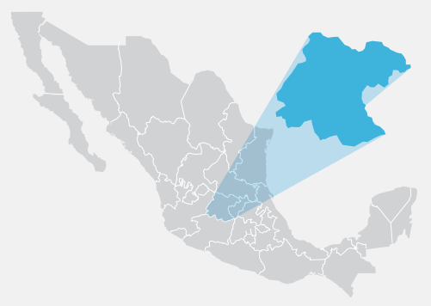
What’s the problem?
In Guanajuato, one person consumes 87 liters of water per day and around 50% of water cannot be reused.
Figure 1: México, Guanajuato.

Slide 3
What is Tech-Tuin?
Tech-Tuin is an automatic irrigation system capable of making irrigation decisions based on environmental data, saving water in the process.
Figure 2: Tech-Tuin logo.

Slide 4



Three reasons to have Tech-Tuin
Saves time
Saves water
Saves money

Slide 5
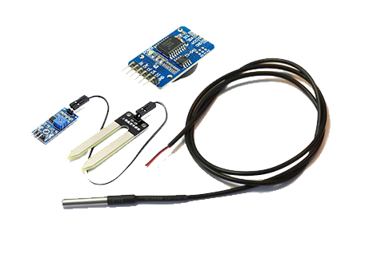
How it works
Tech-Tuin works with a set of sensors capable of detecting different aspects of the environment:
Temperature(DS18B20)
Humidity(FC28)
Real Time Clock(DS3231)
Figure 3: Sensors.

Slide 6
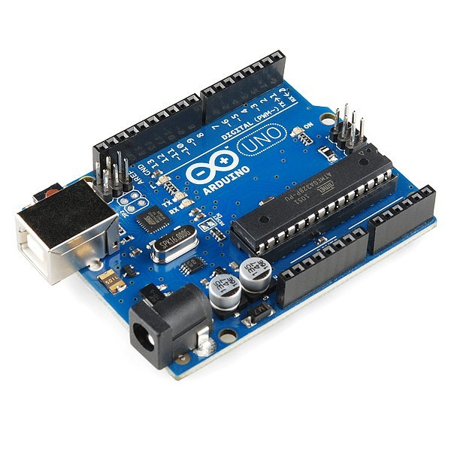
How it works
The system obtains the environmental data and makes decisions.
Figure 4: Arduino board.

Slide 7
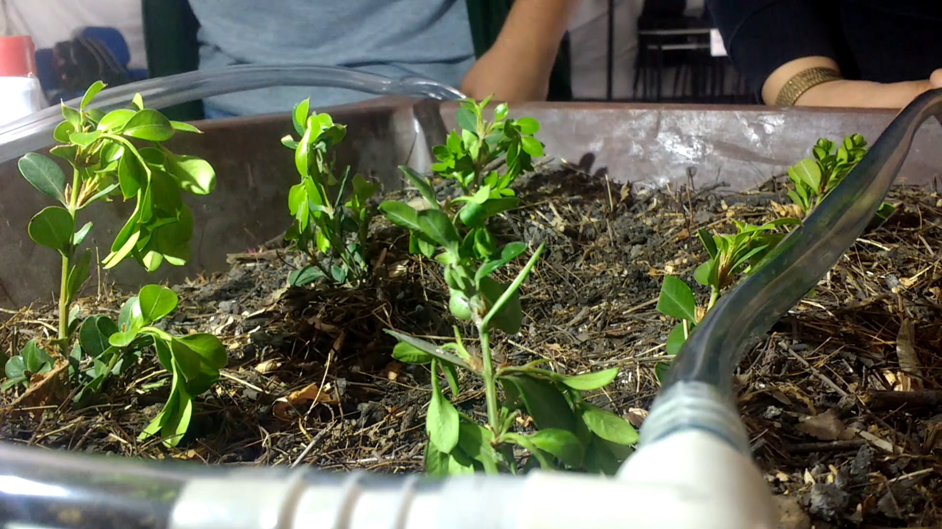
Future work
Implement more sensors to the prototype
Connect the prototype to the Internet
Make test in a larger space
Replace Arduino with PICs
Figure 5: Prototype.

