Slide 1

Project ExpoNomade
9th September 2023
Luca Del Buono, Elias Borrajo, Alexandre Martroye De Joly, Arnaud Michelet, Milena Lonfat
645-2

Slide 2
Summary
Project presentation
Demonstration
Architecture
Technologies used
Problems and solutions
Project management
Conclusion

Slide 3
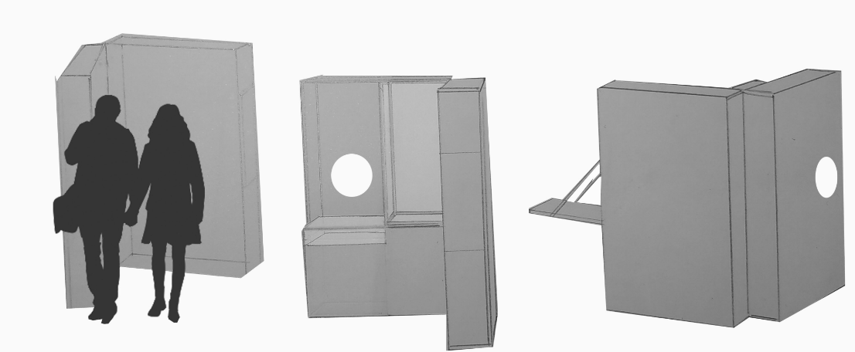
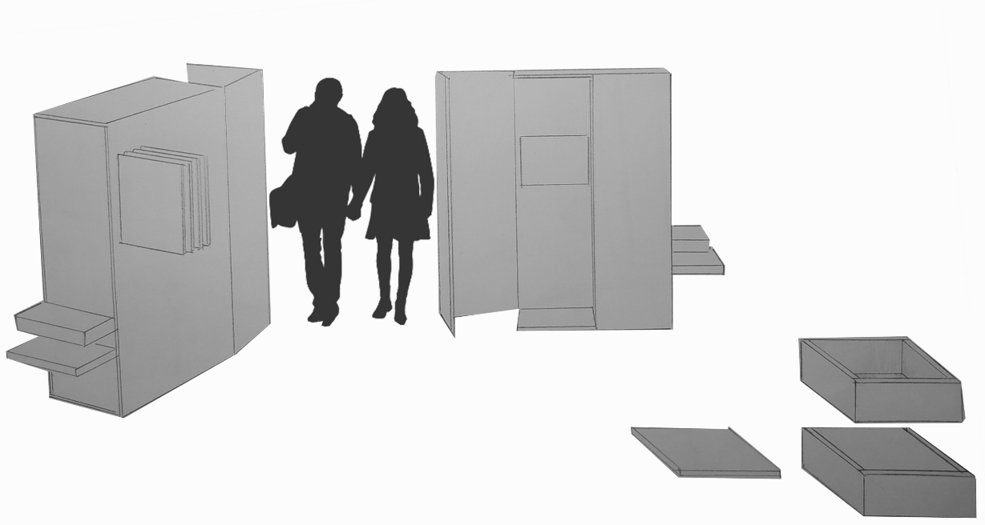
Project presentation
ExpoNomade
Association Valaisanne des Musées
Scenographic device with interactive terminal and objects from partner museums
To offer travelling exhibitions in various public places in the canton of Valant, aimed at a public unfamiliar with museums

Slide 4



Project presentation
Android application
User part
Interactive map
Museum
Museum objects
Migration zone
Quiz
Questions, multiple-choice question
Entry for player email

Slide 5



Project presentation
Administrator part
Create, read, update, delete
Museum, museum objects, migration zone, filters
Read, delete
Players informations

Slide 6
Demonstration

Slide 7



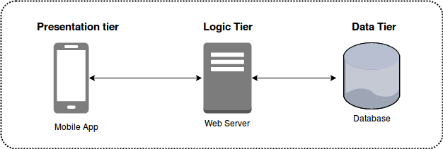
Architecture
Spaghetti
Séparations by features & N-Tier architecture
Data layer & Screens
Architectural patterns
Riverpod
Bloc
MVC
And many more
MVVM
Stacked
Clean Architecture
VIPER
MVI
MVP
FLUX
REDUX
Provider
Notes:
At the beginning :
Learning curve of Flutter was difficult
Everyone was just struggling to make theyr feature / page work
Mostly no structure, and lot of spaghetti code
Our approach :
2-tier architecture like AND features séparations
Data Layer & Screens.
DATA TIER
Firebase
Data Models
SCREENS TIER :
Map
Quizz
Admin
Architectural patterns
MVC
Riverpod
Bloc
And many more
MVVM
Stacked
Clean Architecture
VIPER
MVI
MVP
FLUX
REDUX
Provider
Sources :
https://codewithandrea.com/articles/comparison-flutter-app-architectures/#overview-of-existing-architectures
https://medium.com/@samra.sajjad0001/unleashing-creativity-exploring-architecture-patterns-in-flutter-12b7465bc927
tttt

Slide 8
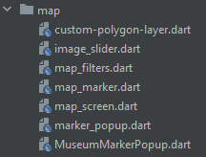
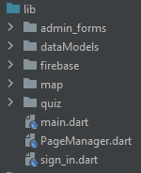
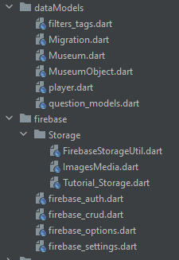
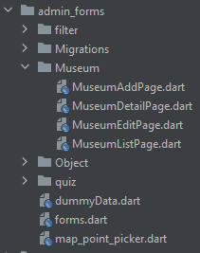

Architecture
Spaghetti
Séparations by features & 2-Tier architecture
Data layer & Screens
Architectural patterns
MVC
Riverpod
Bloc
And many more
MVVM
Stacked
Clean Architecture
VIPER
MVI
MVP
FLUX
REDUX
Provider
Notes:
At the beginning :
Learning curve of Flutter was difficult
Everyone was just struggling to make theyr feature / page work
Mostly no structure, and lot of spaghetti code
Our approach :
2-tier architecture like AND features séparations
Data Layer & Screens.
DATA TIER
Firebase
Data Models
SCREENS TIER :
Map
Quizz
Admin
Architectural patterns
MVC
Riverpod
Bloc
And many more
MVVM
Stacked
Clean Architecture
VIPER
MVI
MVP
FLUX
REDUX
Provider
Sources :
https://codewithandrea.com/articles/comparison-flutter-app-architectures/#overview-of-existing-architectures
https://medium.com/@samra.sajjad0001/unleashing-creativity-exploring-architecture-patterns-in-flutter-12b7465bc927
tttt

Slide 9
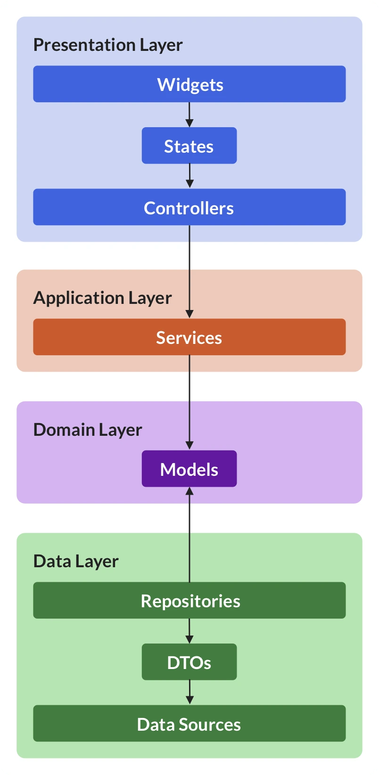
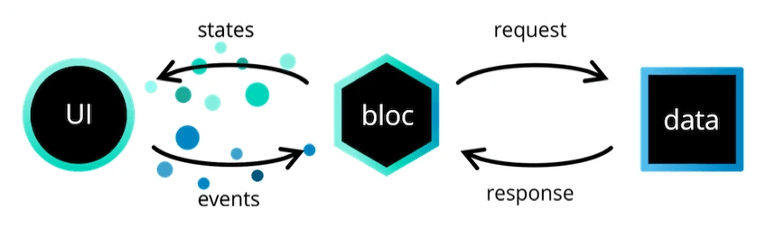
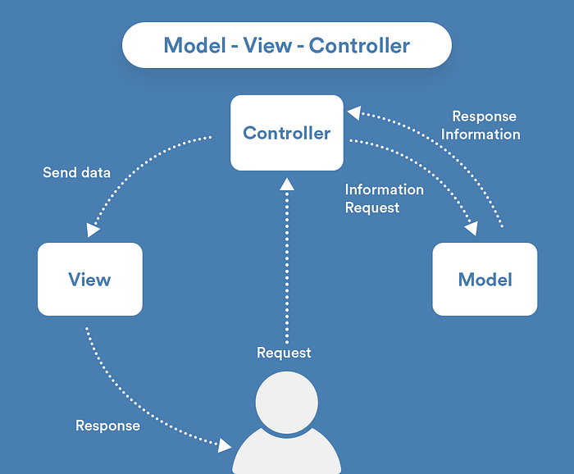
Architecture
Spaghetti
Séparations by features & 2-Tier architecture
Data layer & Screens
Architectural patterns
Riverpod
Bloc
MVC
And many more
MVVM
Stacked
Clean Architecture
VIPER
MVI
MVP
FLUX
REDUX
Provider
Notes:
At the beginning :
Learning curve of Flutter was difficult
Everyone was just struggling to make theyr feature / page work
Mostly no structure, and lot of spaghetti code
Our approach :
2-tier architecture like AND features séparations
Data Layer & Screens.
DATA TIER
Firebase
Data Models
SCREENS TIER :
Map
Quizz
Admin
Architectural patterns
MVC
Riverpod
Bloc
And many more
MVVM
Stacked
Clean Architecture
VIPER
MVI
MVP
FLUX
REDUX
Provider
Sources :
https://codewithandrea.com/articles/comparison-flutter-app-architectures/#overview-of-existing-architectures
https://medium.com/@samra.sajjad0001/unleashing-creativity-exploring-architecture-patterns-in-flutter-12b7465bc927
tttt

Slide 10




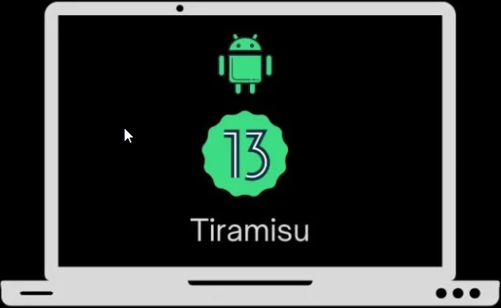
Used technologies
firebase_core - 2.15.1 firebase_auth – 4.0.8
Flutter - 3.13.2 flutter_lints – 2.0.0
google_fonts – 5.1.0 cupertino_icons – 1.0.2 carousel_slider – 4.0.0 image_picker – 1.0.4
flutter_map - 5.0.0 latlong2 - 0.9.0
Tiramisu
Notes:
Flutter:
Flutter: The core library for building user interfaces with Flutter. It is the foundation of your project and is used for creating and managing components. Flutter_lints: Package that contains a set of lints for flutter to encourage good coding practices.
Database:
Firebase_core: This is the package that allows us to interact with our Firebase Realtime Database. Firebase_auth: used for the authentication to the admin interface
Map:
Flutter_map: Library used to build the map on our flutter application
Latlong2: Library used to make latitude and longitude calculation. This library was used to put the picker of the objects and museum and draw the areas on the map.
Design:
Google_fonts: package to use the fonts from fonts.google.com -> used to improve the design of the application
Cupertino_icons: repo containing the set of icons that were used in our project carousel_slider: used to display a collection of items in a scrolling manner
Image_picker: used to select images from the image library
Virtual Device: Tiramisu: System image used to create an Android 13 virtual device for our app

Slide 11
Problems and solutions
Problems | Solutions
"Filtres" not working as intended | More time to develop the feature
 | Rethinking of the database structure
Multilingual | Redo the whole database structure
Cross Platform | Be warned earlier
List of competencies | Update the document for the current project
Difficulties to apply SCRUM because of holidays | Find a better time span to do the project

Slide 12
Project Management
SCRUM
Scrum Master -> Luca
Meetings
Daily
Reviews
Planning
Retro

Slide 13
Conclusion

