Slide 1

Project
Module 625_1

Slide 2
Contents
Demo of the application
Code Refactor - Arthur
Unit Tests - Elias
Use of Nsubstitute - Benjamin

Slide 3
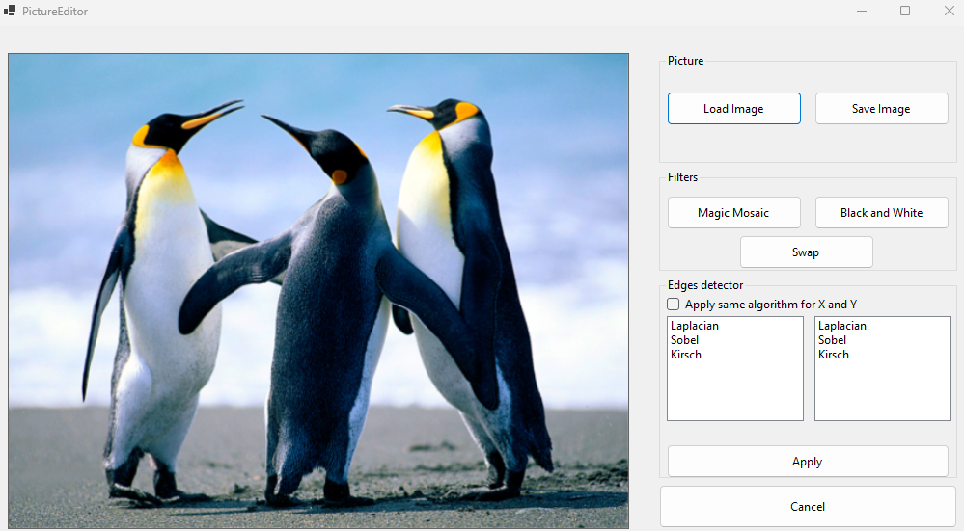
Demo of the application

Slide 4

Features Expected
Load
Load an image from the disk
Perform
Perform 0 to 3 filters and 0 to 3 edge detections
Image
Save the modified image into a file

Slide 5
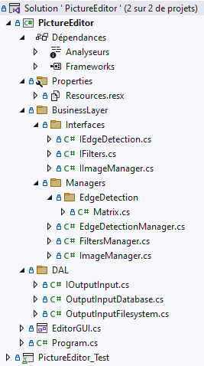
Code Refactor

Slide 6
Code Refactor

Slide 7
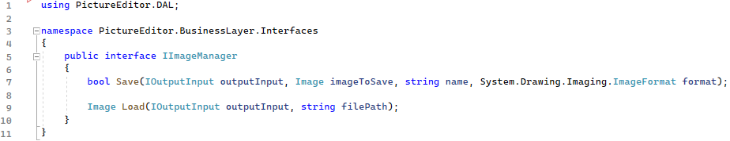
Interfaces

Slide 8
Code Refactor

Slide 9
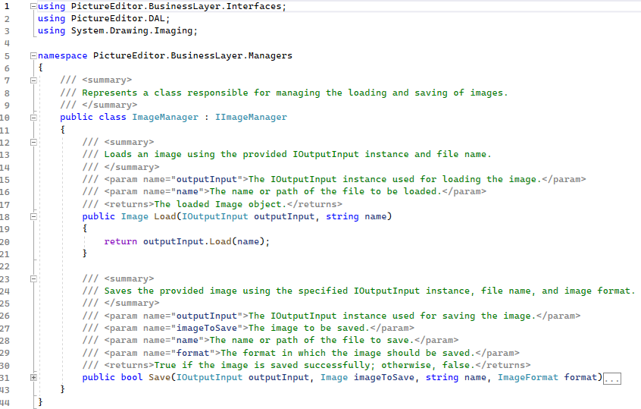
Managers

Slide 10
Code Refactor

Slide 11
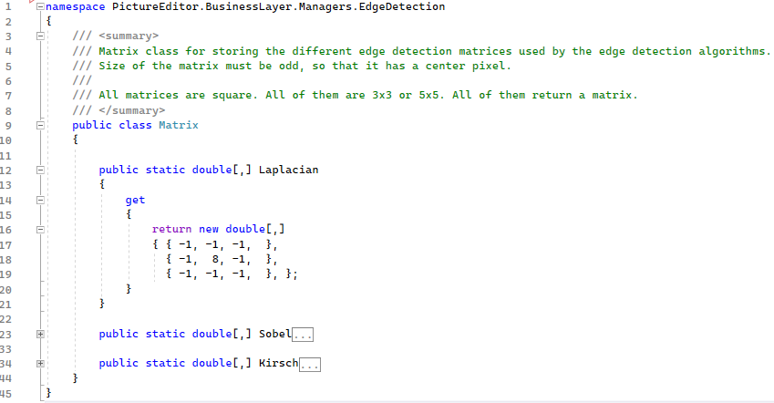
Edge Detection

Slide 12
Code Refactor

Slide 13
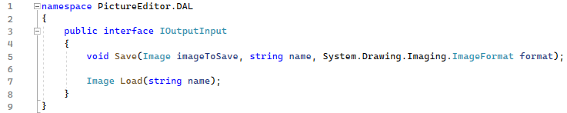
Interface

Slide 14
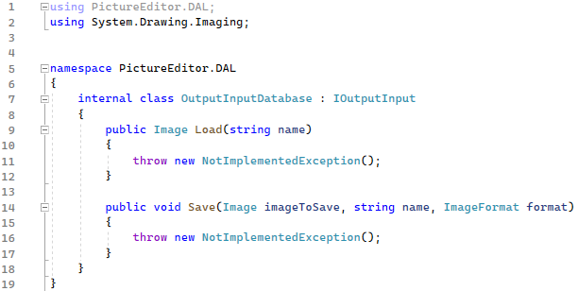
Database

Slide 15
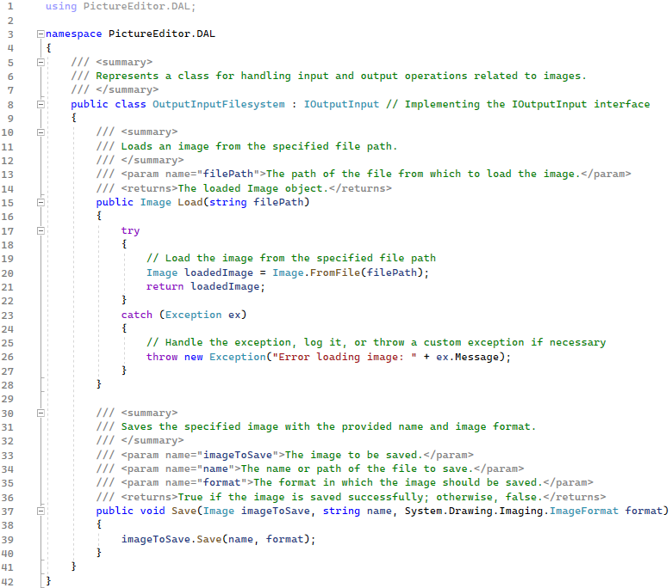
File System

Slide 16
Code Refactor

Slide 17
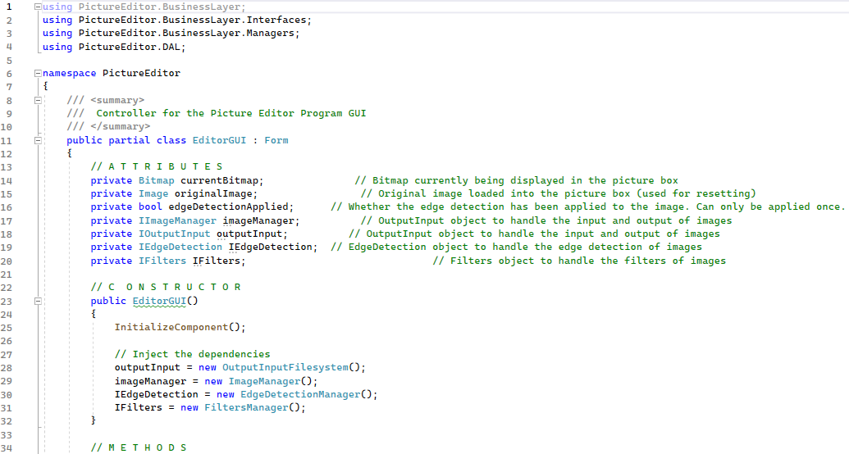
GUI et interfaces

Slide 18
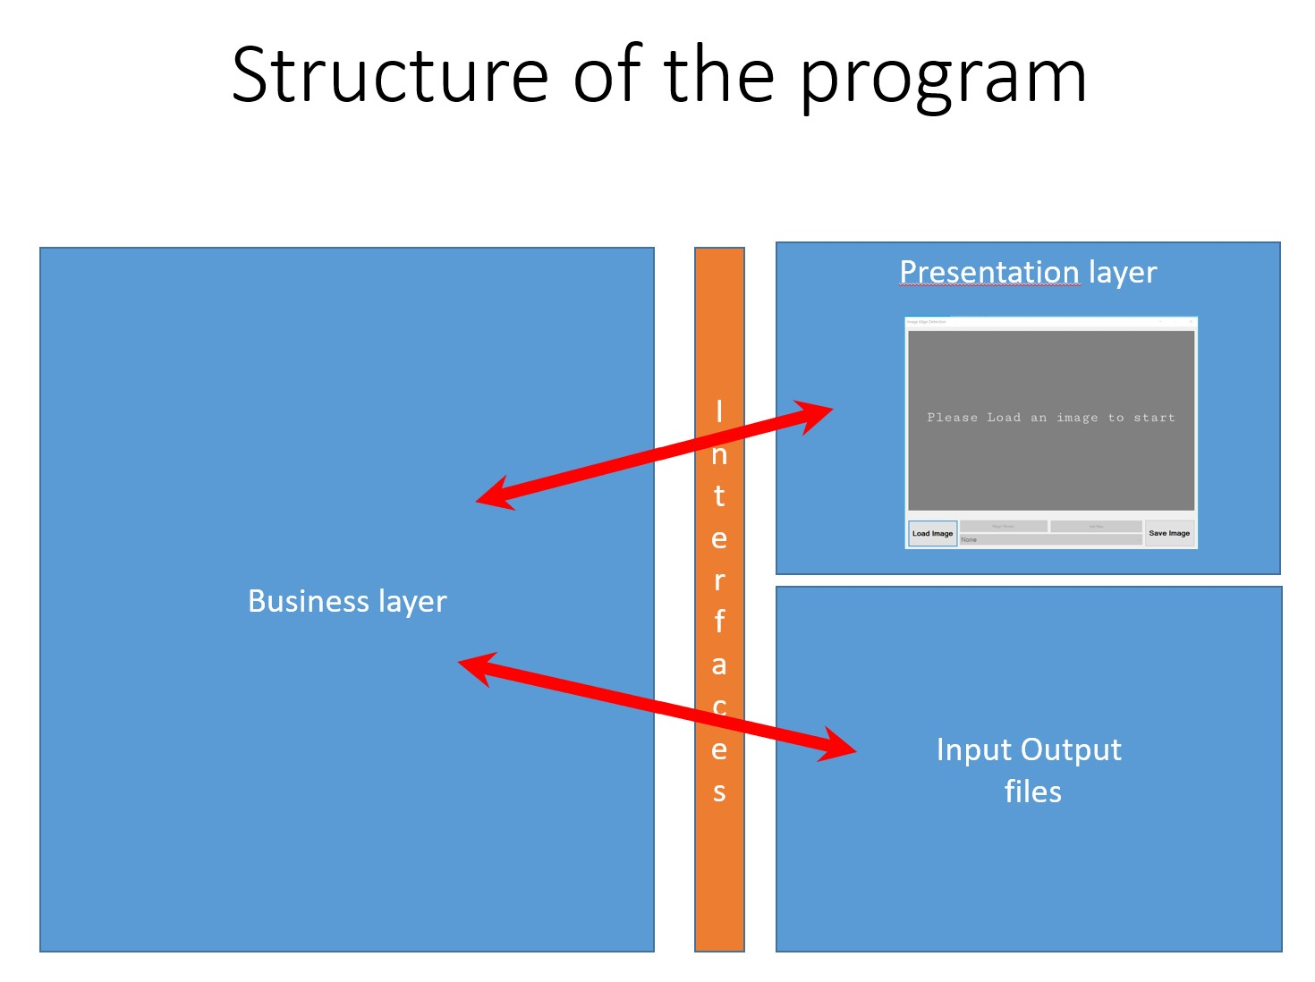

Code Refactor

Slide 19
Mandatory Structure of the Code
Use interfaces to load and save files
Use interfaces to separate the code from the presentation layer
The following elements must be seen in the code :
Exceptions
Methods that return void
Methods that return classes

Slide 20
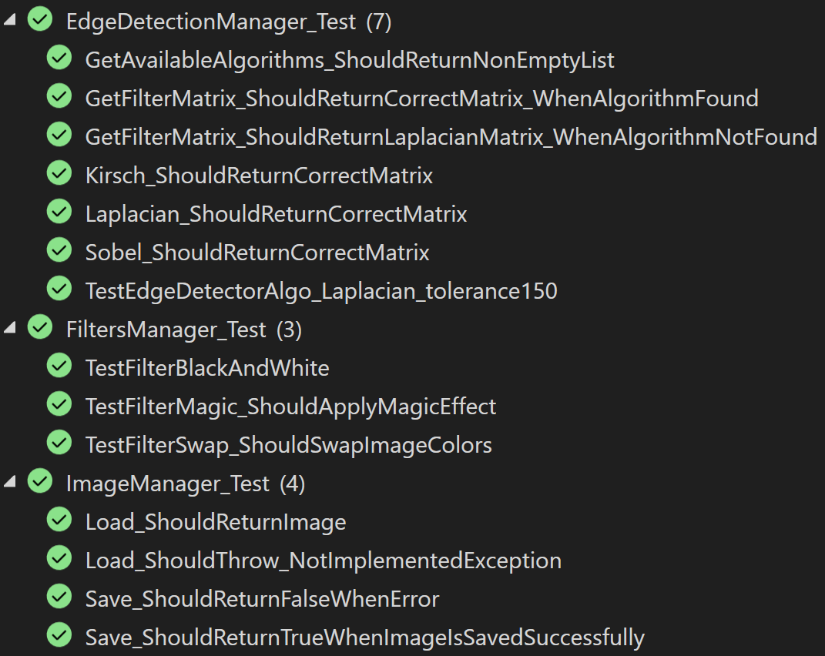
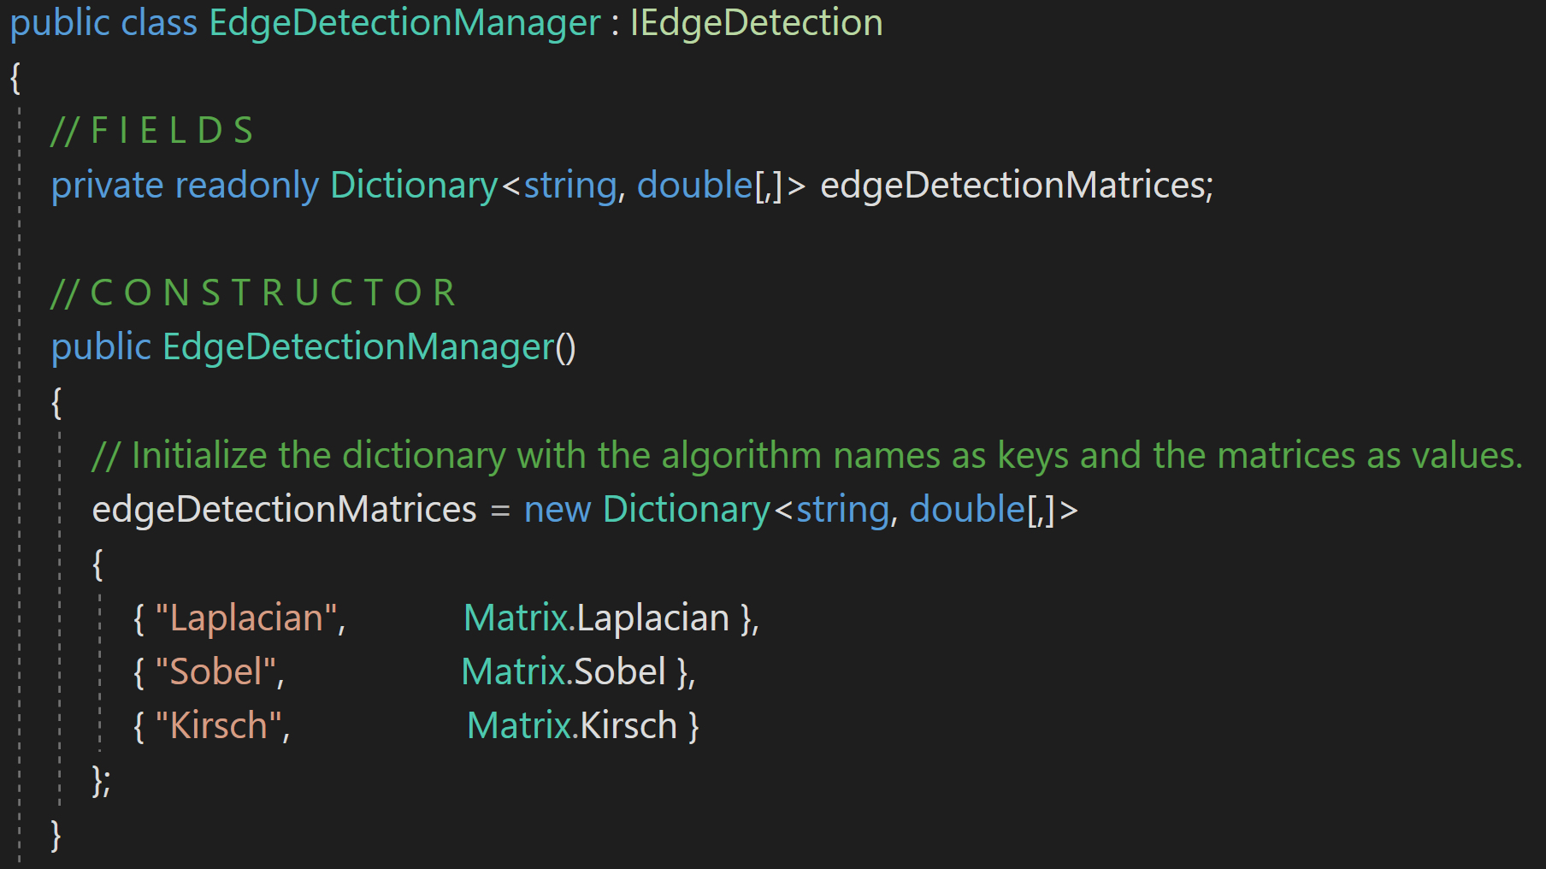
Unit Tests
{ -1, -1, -1, },
{ -1, 8, -1, },
{ -1, -1, -1, }
Compare processed image with a reference image

Slide 21
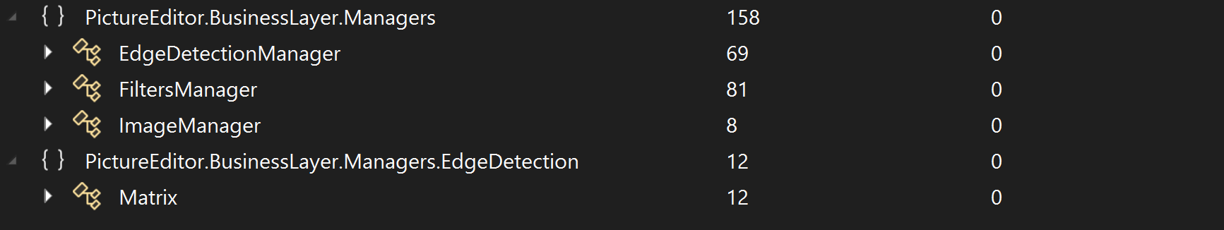
Unit Tests

Slide 22
Nsubstitute – General Context
Business Logic
Interfaces
Presentation Layer
Input Output

Slide 23
Nsubstitute – Example context
ImageManager
Interfaces
GUI
IImageManager
OutputInputFilesystem
OutputInputDatabase
IOutputInput

Slide 24
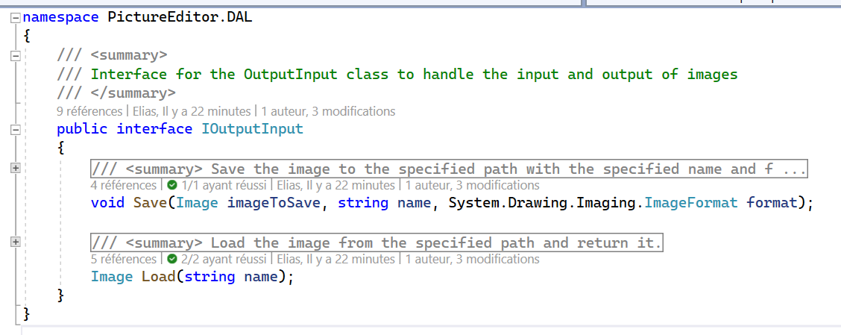
IInputOutput – The Interface

Slide 25
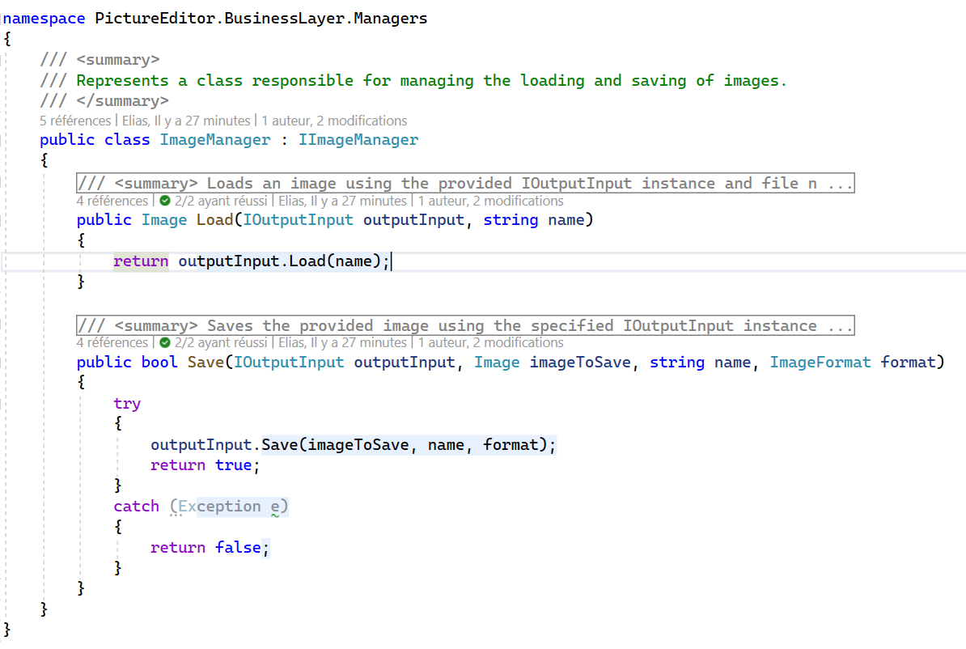
ImageManager

Slide 26
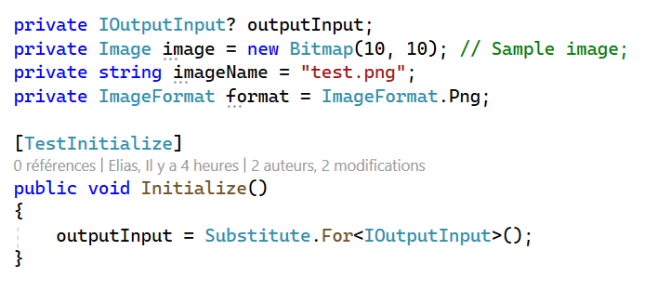
Usage of Nsubstitute – Bases for tests

Slide 27
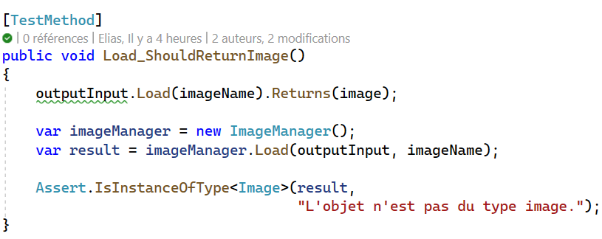
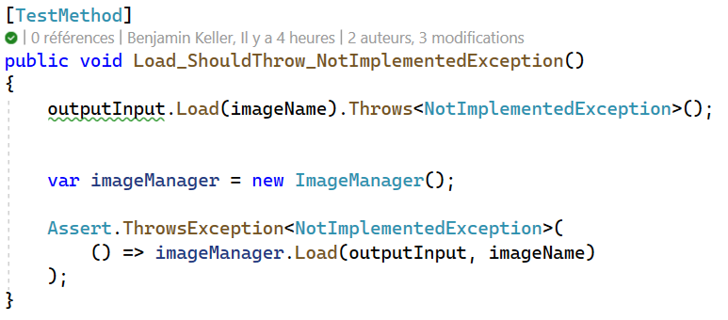
Usage of Nsubstitute – Load image
When interface returns Image
When interface throws an Exception

Slide 28
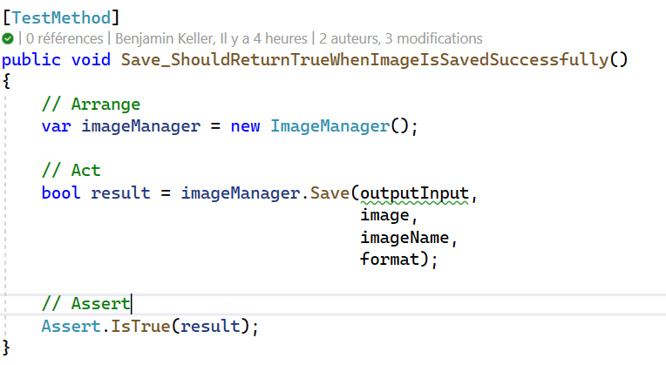
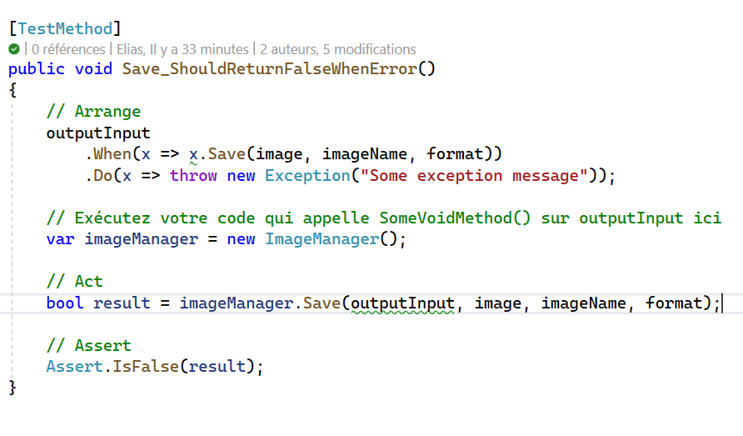
Usage of Nsubstitute – Save image
Usage with void function
Void function throwing an Exception

Slide 29
Tasks Repartition
 | Arthur | Elias | Benjamin
Refactor architecture | X | X | X
Unit Test | X | X
NSubstitute |  | X | X
User Guide | X
Clean directories |  |  | X
Documentation |  | X

Slide 30

Thanks for your attention
Do you have any questions ?

