Slide 1
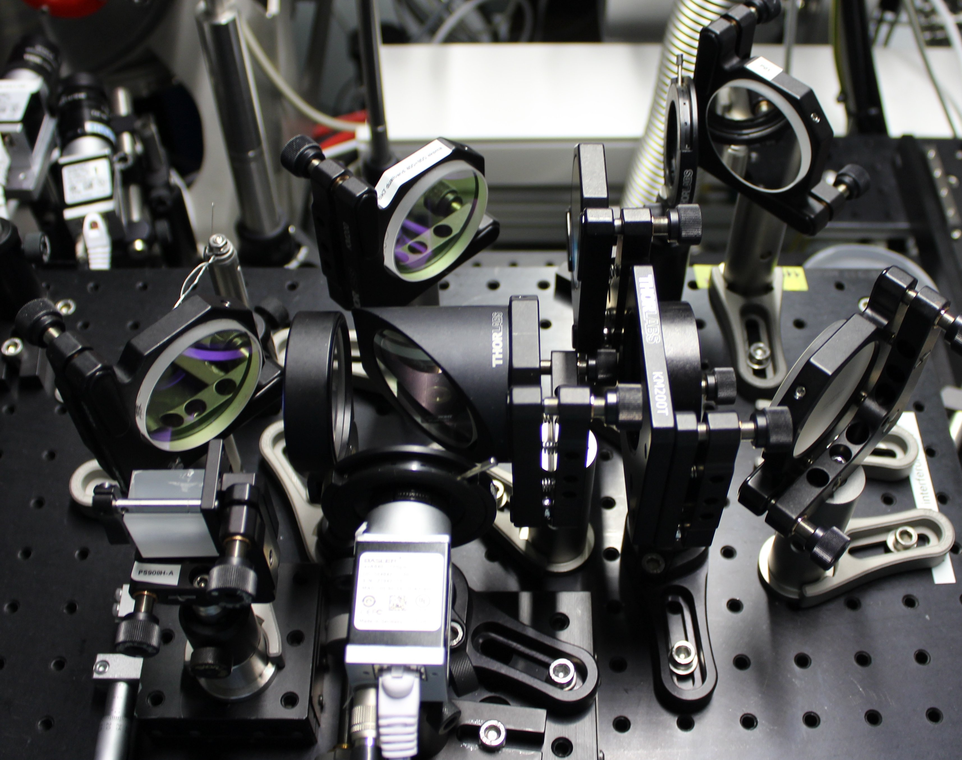

Slide 3
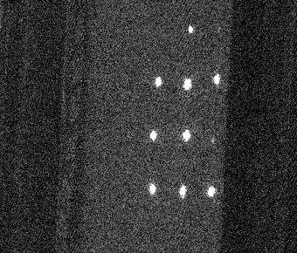
124 pxl
68 pxl

Slide 4
Prism
North
South
Cam

Slide 5
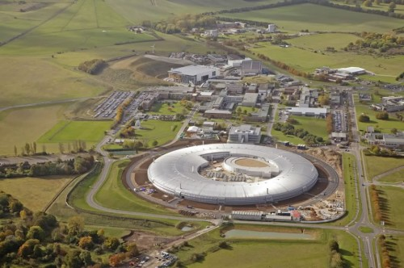
Astra Gemini

