Slide 1
PoliTricks
Faking Politicians Using Large Language Models

Slide 2
Research Interest
Faking Political Content
- How good are different LLMs at faking the positions of different political actors?
– how well do different LLMs reproduce positions of political actors?
Understanding llms
- How well do LLMs capture differences between political stances?

Slide 3

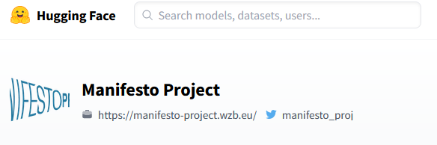

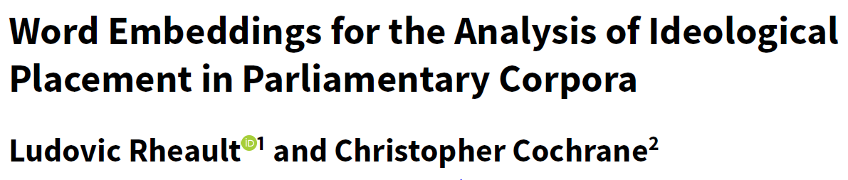
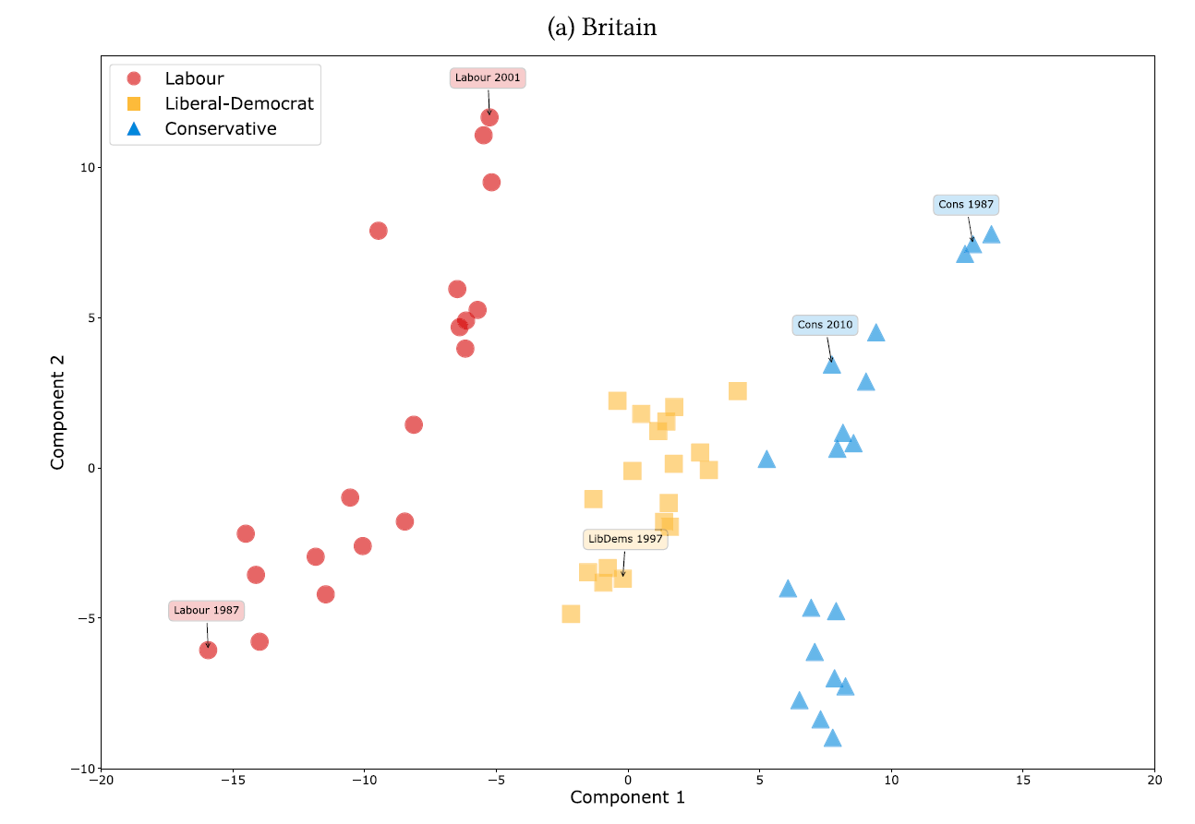

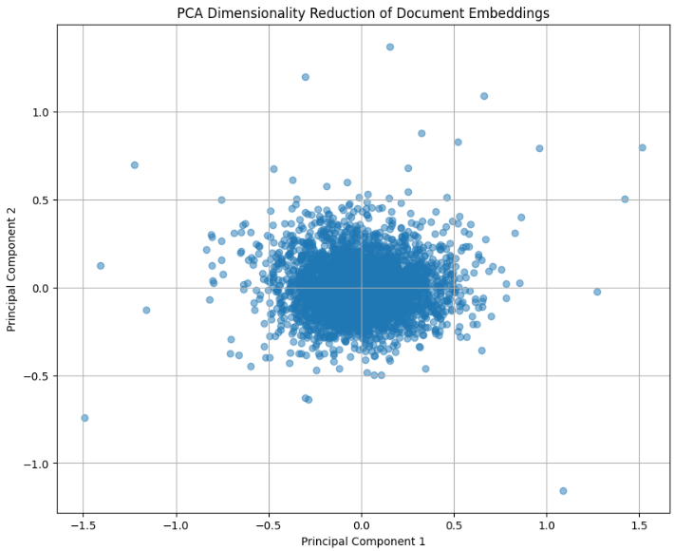
Research IDEA
Obtain ground truth from actual speeches
Content generation (speeches and articles) using LLMs
Compare document similarity
  ManifestoBerta: similarity across specific issues
  PCA of Word2Vec Embeddings: similarity across first and second PCs

Slide 4
Hypotheses
Political positions of major actors are well approximated by LLMs - less or more extreme?
LLMs are less precise with less known politicians
- Prompting LLMs to write for specific media outlets will pull the political loading of a text in the direction of the outlets political position (e.g. article of left-wing politician in right-leaning media outlet will be pulled towards the political right)

Slide 5
Challenges
Preprocessing (subsetting speeches, cleaning, stopword removal)
Prompt Engineering
Data Comparability (equal or unequal length artificial speeches, speeches and articles, etc.)
Manifestoberta as only extrinsic groundtruth

Slide 6
Open Questions
What’s the best prompting strategy to stimulate change in the LLM response (newspaper articles, interviews, politician at different party)?
Are we making too strong comparability assumptions when comparing different text types (speeches, interviews, articles)?

Slide 7
Cost Calculation
VariaBLes
Parties: 6
Politicians per Party: 3
Documents per Politician: 8
Runs: 3
Tokens: ~ 1000
Topics: 3
Model: GPT4
Parties X Politicians X Documents X Prompts X Response Tokens X Topics
= ~1.300.000 Tokens

Slide 8
Thanks
Elias Heppner
Jakob Amann
Andri Rutschmann

