Slide 1
Rectangle Calculation

Slide 2






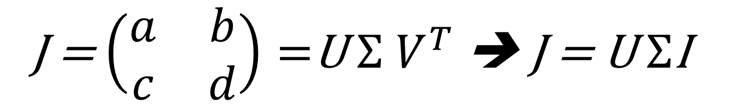
Our goal
$$b_{0}$$
$$b_{i}$$
$$c_{0}$$
$$a_{i}$$
$$c_{i}$$
$$a_{0}$$
J = $\left(\begin{matrix}a & b \\ c & d\end{matrix}\right)=$U $Σ$ $V^{T}$ ➔ J = U $Σ$I

Slide 3
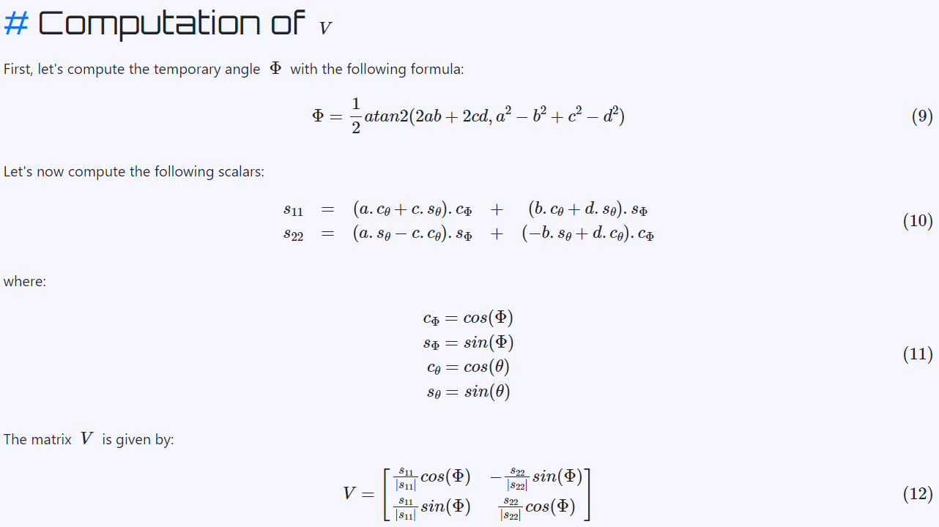
Notes:
Source link:
https://lucidar.me/en/mathematics/singular-value-decomposition-of-a-2x2-matrix/

Slide 4
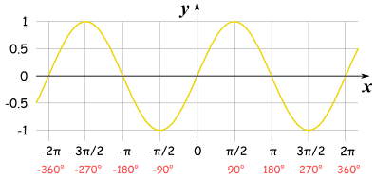
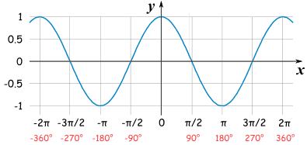
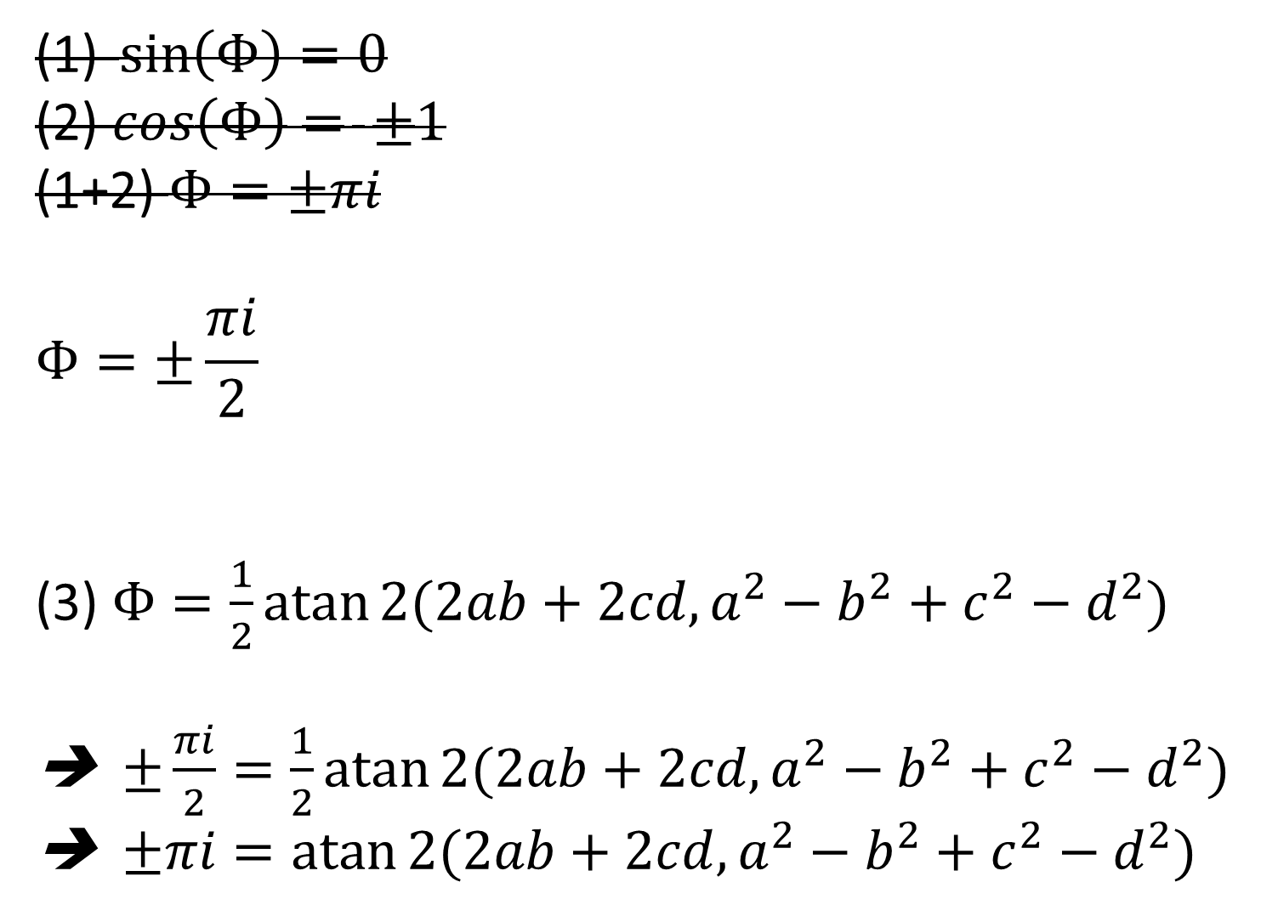
$\sin\left(Φ\right)=0$
(2) $\cos\left(Φ\right)= ±1$
(1+2) $Φ=±πi$
$$Φ=±\frac{πi}{2}$$
(3) $Φ=\frac{1}{2}\operatorname{atan}{2(2ab+2cd, a^{2}−b^{2}+c^{2}−d^{2})}$
➔$±\frac{πi}{2}=\frac{1}{2}\operatorname{atan}{2(2ab+2cd, a^{2}−b^{2}+c^{2}−d^{2})}$
➔$±πi=\operatorname{atan}{2(2ab+2cd, a^{2}−b^{2}+c^{2}−d^{2})}$

Slide 5
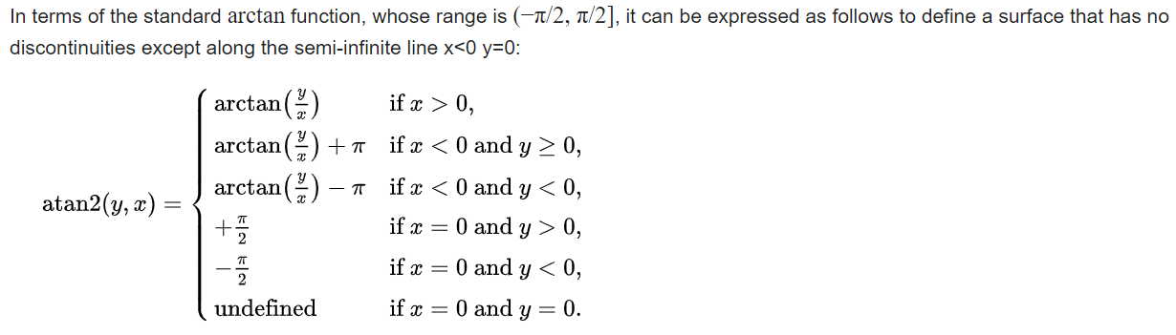

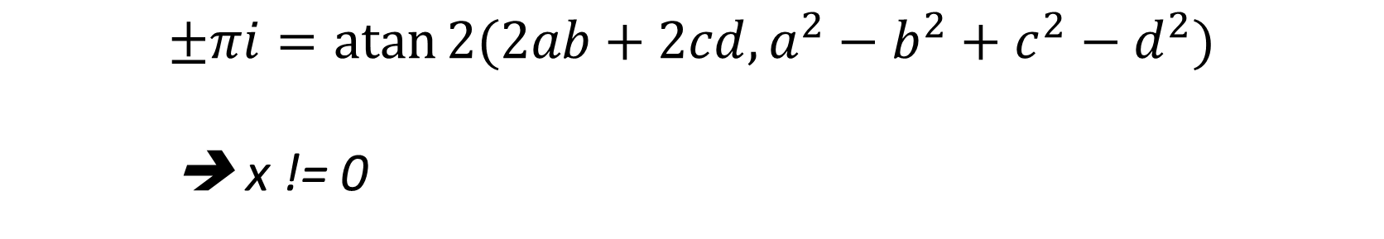




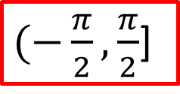

$(−\frac{π}{2},\frac{π}{2}$]
$$atan2=0$$
$(+\frac{π}{2},\frac{3π}{2}$]
$$atan2=π$$
$(−\frac{3π}{2},−\frac{π}{2}$]
$$atan2=−π$$
$atan2(.)=±$ $πi$
$$±πi=\operatorname{atan}{2(2ab+2cd, a^{2}−b^{2}+c^{2}−d^{2})}$$
➔ x != 0

Slide 6
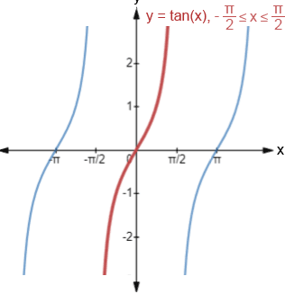
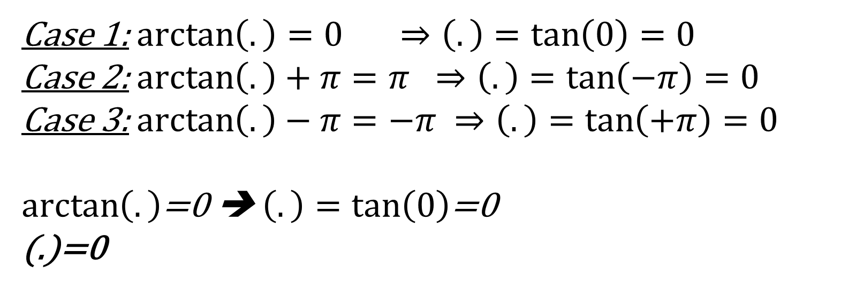
$(−\frac{π}{2},\frac{π}{2}$]
$$atan2=0$$
$(+\frac{π}{2},\frac{3π}{2}$]
$$atan2=π$$
$(−\frac{3π}{2},−\frac{π}{2}$]
$$atan2=−π$$
$atan2(.)=±$ $πi$
Case 1: $\arctan\left(.\right)=0 ⇒\left(.\right)=\tan\left(0\right)=0$
Case 2: $\arctan\left(.\right)+π=π ⇒\left(.\right)=\tan\left(−π\right)=0$
Case 3: $\arctan\left(.\right)−π=−π ⇒\left(.\right)=\tan\left(+π\right)=0$
$\arctan\left(.\right)$=0 ➔ $\left(.\right)=\tan\left(0\right)$=0
(.)=0

Slide 7
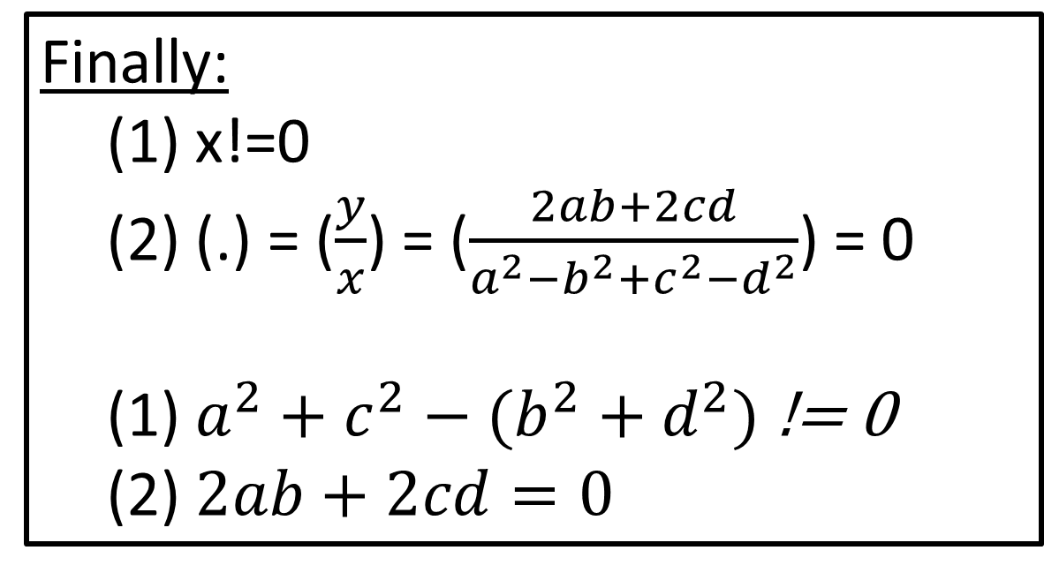
$(−\frac{π}{2},\frac{π}{2}$]
$$atan2=0$$
$(+\frac{π}{2},\frac{3π}{2}$]
$$atan2=π$$
Finally:
(1) x!=0
(2) (.) = ($\frac{y}{x}$) = ($\frac{2ab+2cd}{a^{2}−b^{2}+c^{2}−d^{2}}$) = 0
(1) $a^{2}+c^{2}−(b^{2}+d^{2})$ != 0
(2) $2ab+2cd=0$
$(−\frac{3π}{2},−\frac{π}{2}$]
$$atan2=−π$$
$atan2(.)=±$ $πi$
Case 1: $\arctan\left(.\right)=0 ⇒\left(.\right)=\tan\left(0\right)=0$
Case 2: $\arctan\left(.\right)+π=π ⇒\left(.\right)=\tan\left(−π\right)=0$
Case 3: $\arctan\left(.\right)−π=−π ⇒\left(.\right)=\tan\left(+π\right)=0$
$\arctan\left(.\right)$=0 ➔ $\left(.\right)=\tan\left(0\right)$=0
(.)=0
Notes:
J = (a b)
(c d)
Ofir weber – Bar Ilan
Add_obj ➔ Low_weght * (-Log(x))

