Slide 1
FoodExpress
Mobile Food Delivery Application
Elias Rizk & Elias Ishak
ULFG2 | Mobile Programming
Dr. Mohamad Aoude

Slide 2
Project Overview
What is FoodExpress?
Key Components
A comprehensive mobile food delivery platform enabling users to browse restaurants, order meals, and track deliveries in real-time.
Flutter Mobile App
Node.js Backend API
MongoDB Database
Delivery Dashboard
Target Audience
Customers seeking convenient food delivery, restaurants wanting online presence, and delivery personnel managing orders efficiently.

Slide 3
Technology Stack
Frontend
Backend
Framework: Flutter
Language: Dart
State Management: Provider
Cross-platform (Android/iOS)
Responsive UI Design
Real-time Cart Updates
Runtime: Node.js
Framework: Express.js
Database: MongoDB Atlas
RESTful API Architecture
Cloud-based Storage
Real-time Data Sync

Slide 4
Core Features - Mobile App
🔐 User Authentication
🍽️ Restaurant Browsing
Secure registration and login, persistent sessions, and user profile management.
Browse multiple restaurants with ratings, delivery times, and cuisine categories displayed beautifully.
🛒 Smart Shopping Cart
📦 Order Tracking
Real-time cart management with quantity adjustments, total calculations, and single-restaurant constraint.
Complete order history with status updates: Pending, Preparing, On the Way, Delivered.

Slide 5
Delivery Dashboard
Real-Time Order Management System
Web-based dashboard for delivery personnel and administrators to monitor and manage all orders with live updates every 30 seconds.
📊 Live Statistics
⏱️ Time Tracking
✅ Order Actions
Active deliveries count
Delivered today
Total orders
Auto-refresh every 30s
Time elapsed since order
Estimated delivery time
Time remaining (30 min)
Urgent order alerts
Mark as delivered
View order details
Customer contact info
Delivery address shown

Slide 6
Database Architecture
MongoDB Atlas - Cloud Database
👤 Users
🍴 Restaurants
Authentication credentials, contact info, delivery addresses
Restaurant details, ratings, delivery times, categories
🍕 Menu Items
📦 Orders
Food items with descriptions, prices, images, availability
Order details, items, status, timestamps, delivery info
🔗 Relationships
☁️ Cloud Features
References between collections using ObjectId linking
Auto-backups, scalability, 99.9% uptime guarantee

Slide 7
System Architecture
📱 Mobile App
⚙️ Backend API
🗄️ Database
Flutter
Dart
Provider
Node.js
Express
REST API
MongoDB
Atlas
Cloud
🚚 Delivery Dashboard
HTML + Tailwind CSS + JavaScript

Slide 8
Development Workflow
1
2
3
4
5
Backend Setup
Database Design
Flutter App
Dashboard
Testing
Node.js server, MongoDB connection, API endpoints
Collections schema, relationships, seed data
UI screens, state management, API integration
Web interface, real-time updates, order management
End-to-end testing, bug fixes, optimization

Slide 9
Key Achievements
✅ Full-Stack Implementation
🎨 Professional UI/UX
Complete mobile app, backend API, and admin dashboard working seamlessly together
Intuitive design with smooth navigation, responsive layouts, and modern aesthetics
⚡ Real-Time Features
☁️ Cloud Integration
Live order updates, instant cart changes, and automatic dashboard refresh
MongoDB Atlas for reliable cloud storage with automatic backups and scaling
🔄 State Management
📊 Data Integrity
Efficient Provider pattern for cart and user session persistence
Proper relationships, validation, and error handling throughout the system

Slide 10
Future Enhancements
💳 Payment Integration
Cash on delivery
🔔 Push Notifications
📊 Analytics Dashboard
Order status updates
Delivery arrival alerts
Restaurant performance metrics
User behavior analysis
Revenue tracking

Slide 11
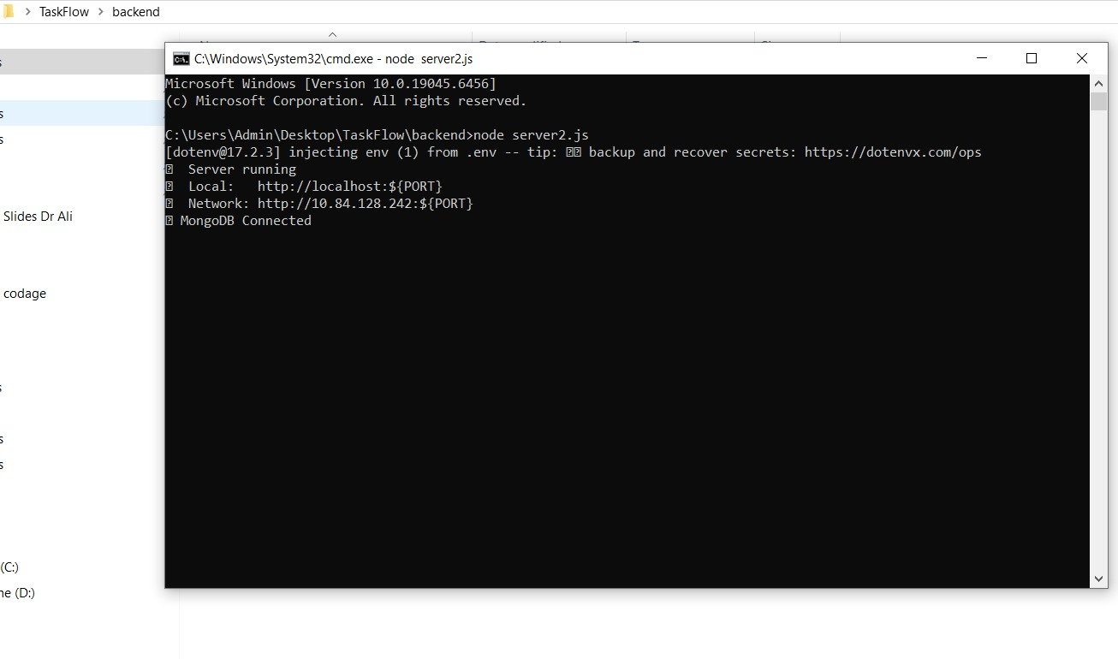
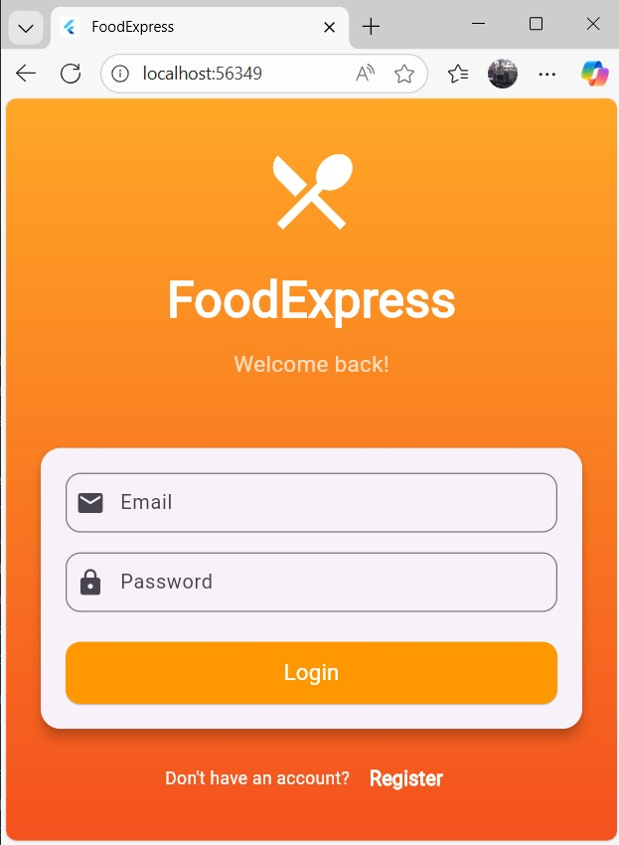
Appendix : Images
Running the server
Login screen (on pc edge browser)

Slide 12
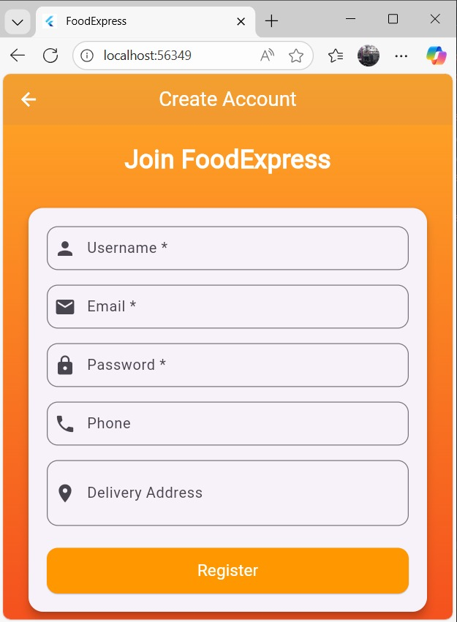
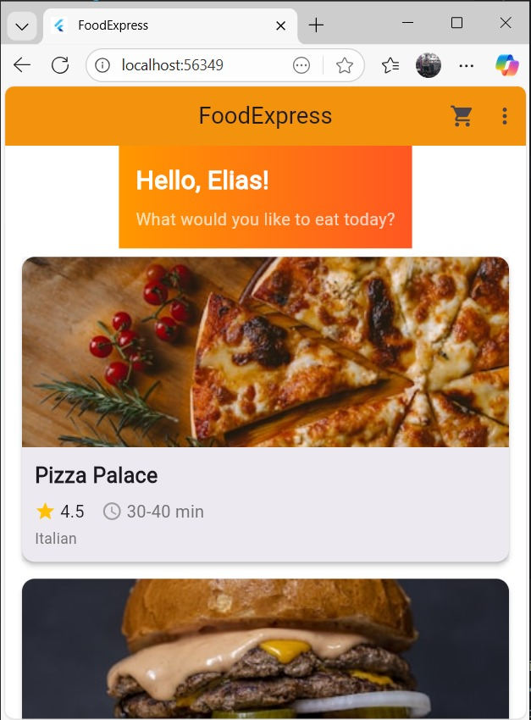
Appendix : Images
Home screen (restaurants)
Registration screen

Slide 13
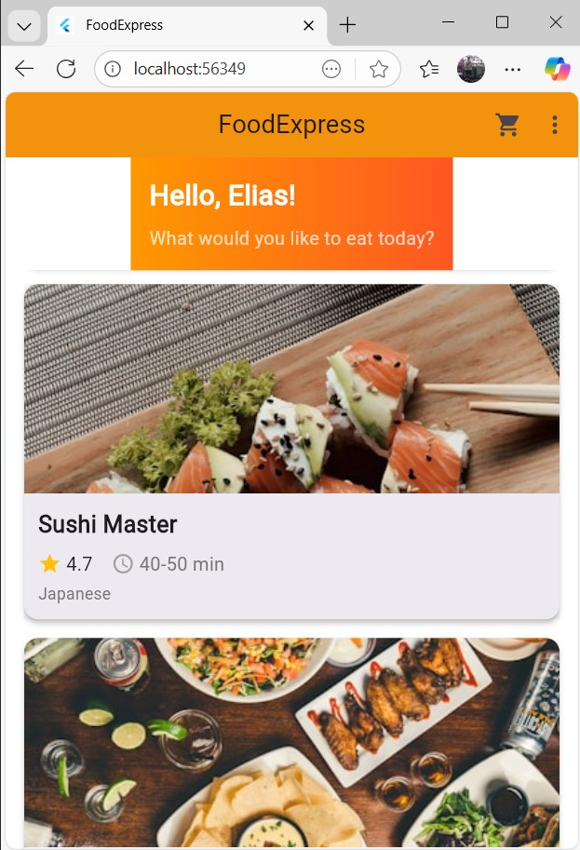
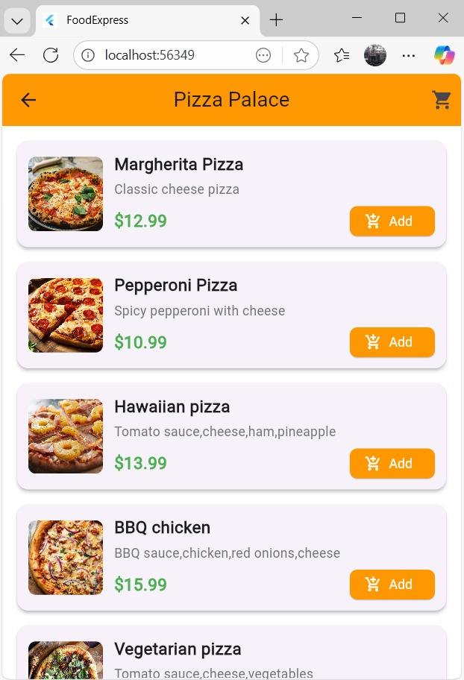
Appendix : Images
Home screen (restaurants)
Menu of the pizza palace restaurant

Slide 14
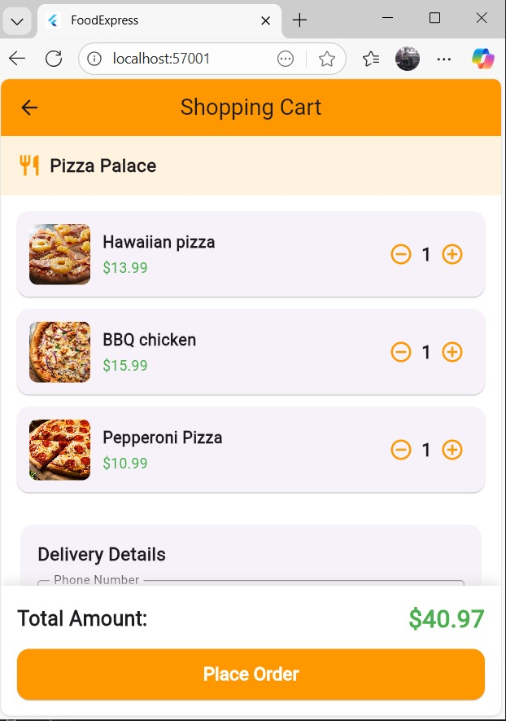
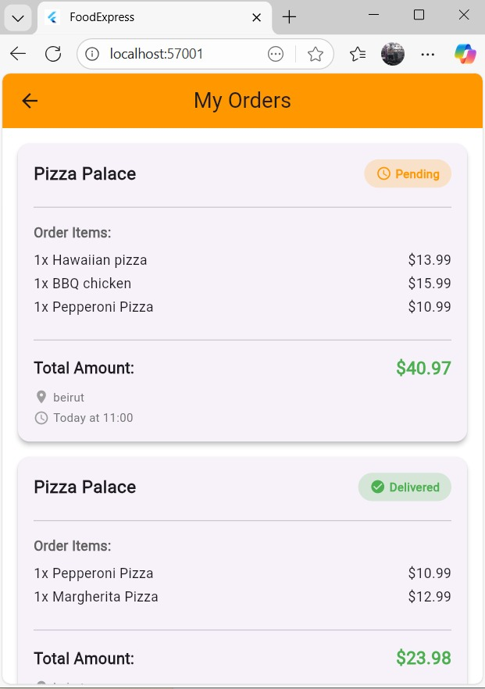
Appendix : Images
Shopping cart
My orders

Slide 15
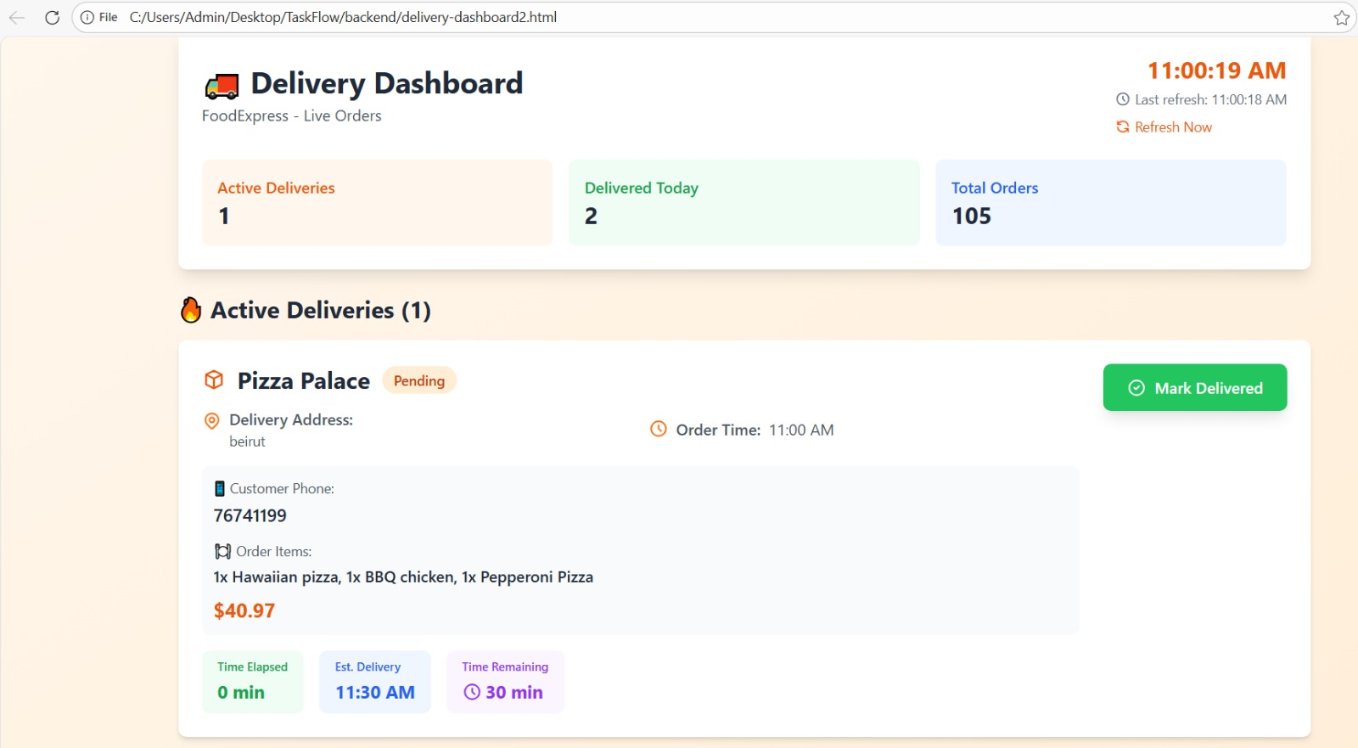
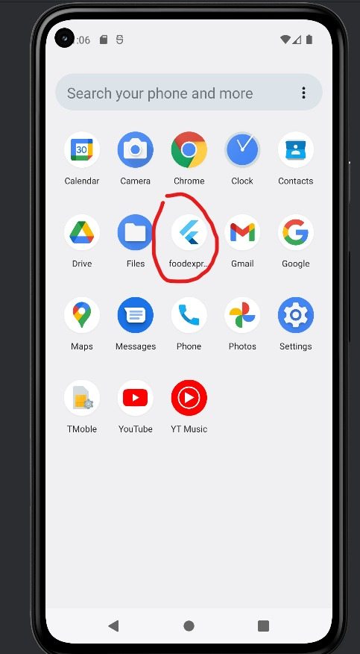
Appendix : Images
Delivery dashboard
App logo

Slide 16
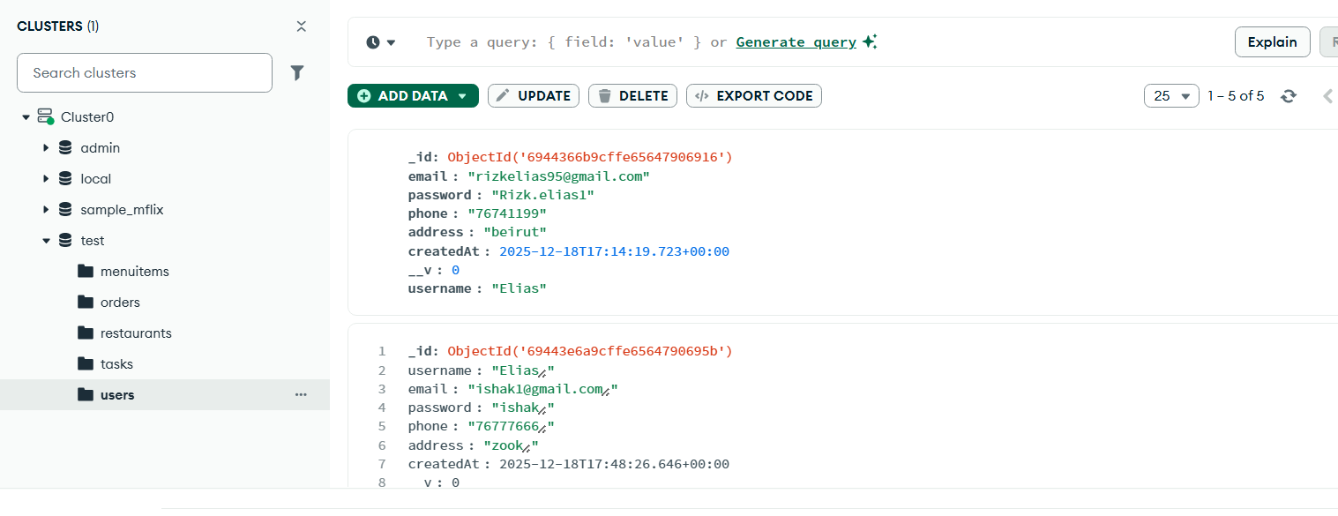
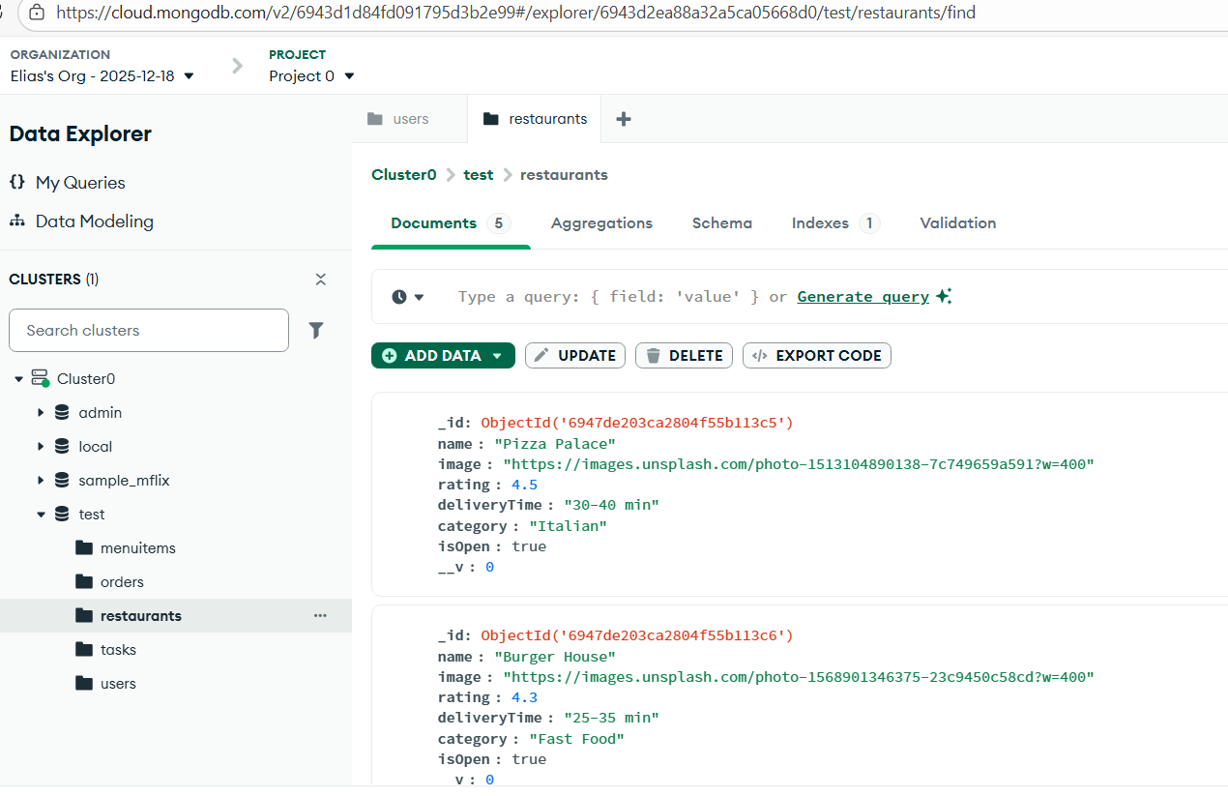
Appendix : Images
Data base (Users)
Data base (Restaurants)

Slide 17
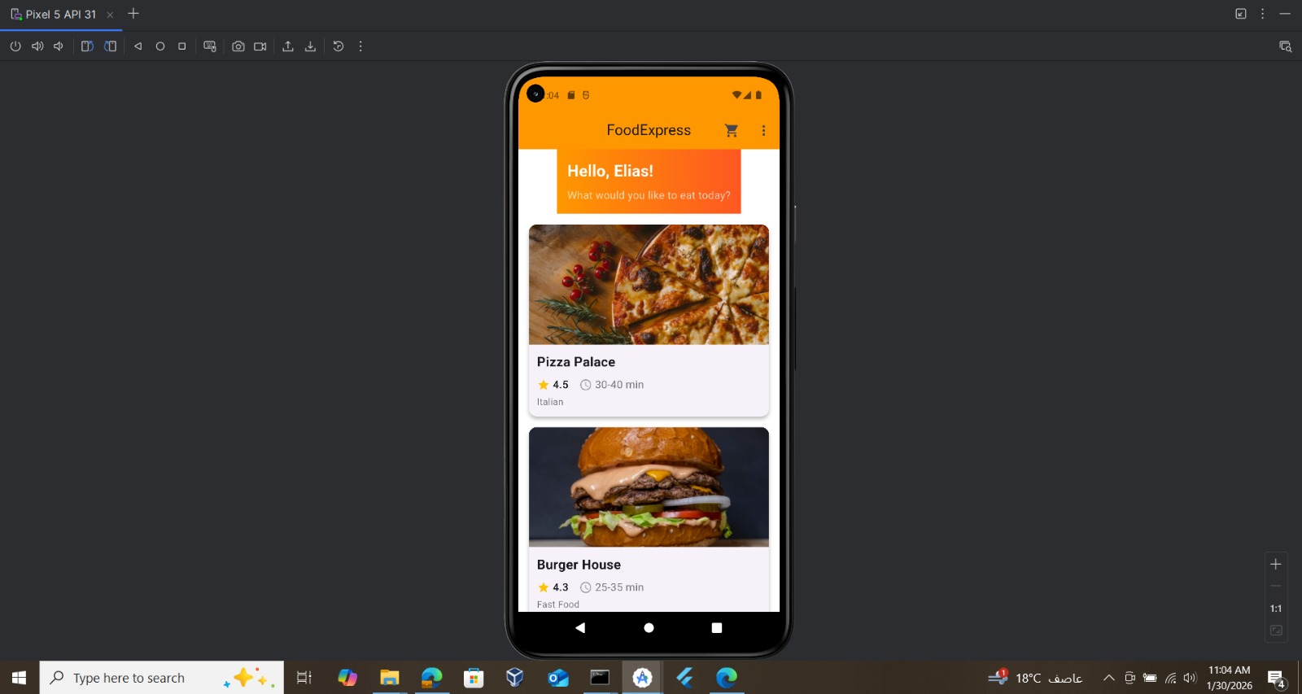
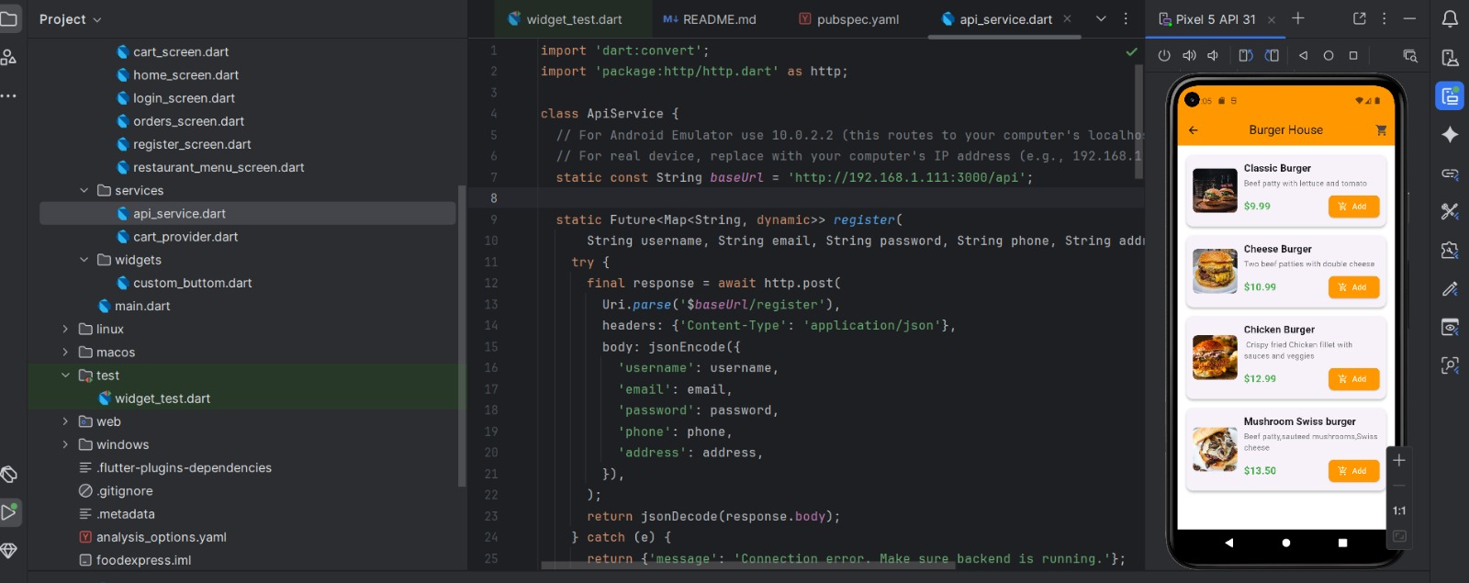
Appendix : Images
Running app on virtual phone

Slide 18
Thank You!
FoodExpress - Delivering Excellence
Please watch the video!!

