Slide 1

Kazanon
Datathon 2025
Aidyn Ubingazhibov, Omar Roumie, Elias Salameh, Charbel Chucri

Slide 2




Data Analysis-Consistency Checks
Account Profile
Account Form
Account Description
Passport
MRZ:
Correct format
Birth/Issue/Expiry/Current Date:
Reasonable timelines
Country, Country Code, Nationality Data:
Correct mappings
Consistent Name/Email/Domicile/zip
Check age/graduation/
Employment/savings/
inheritance consistency
Birth/Graduation/
Employment Date:
Reasonable Timelines
Real Estate and Property Value:
Corresponding values
Notes:
Cross-checking and consistency checking within the documents

Slide 3


Data Analysis-Account Description Parsing
LLMs
Advantages:
More Efficient
More Reliable
Cheaper
Data:
Age
Graduation Years
Inheritance
Account Description
Traditional Data Parsing and Extraction
Notes:
Cross-checking and consistency checking within the documents

Slide 4


Method
Filtered Data
Phase 1
Filtering
Phase 2
Model Training
Notes:
Cross-checking and consistency checking within the documents

Slide 5


Model Training
CatBoost
Random Forest
Ensemble
Notes:
Cross-checking and consistency checking within the documents

Slide 6
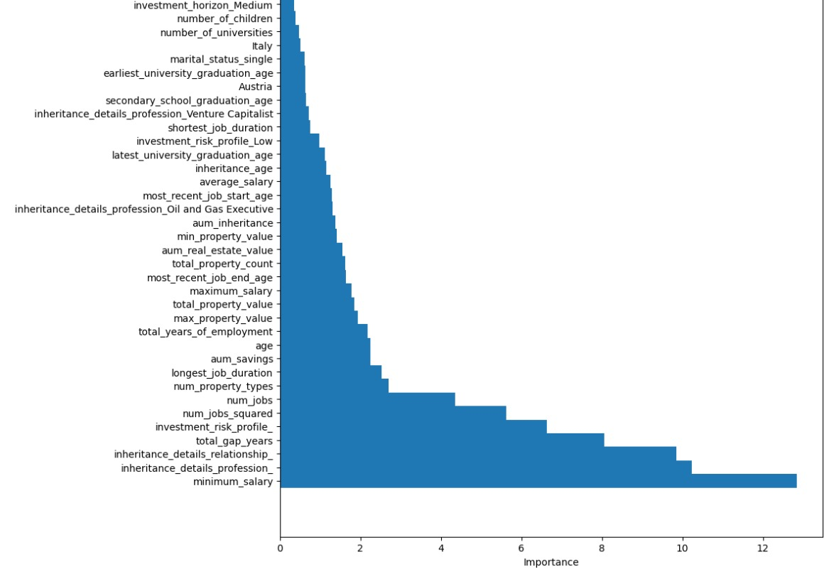
Model Training – Feature Selection
Notes:
Cross-checking and consistency checking within the documents

Slide 7
Output Metrics
Filtering phase Accuracy = 94.2%
Validation Set Accuracy = 94.3 %
Notes:
Cross-checking and consistency checking within the documents

Slide 8
Data Insights
Mismatch between combined years of experience in account profile and account description -> no effect on onboarding clients
Created a mapping between country, country code and nationality data to ensure consistency
Employment year before birth year
Notes:
Cross-checking and consistency checking within the documents

