Slide 1
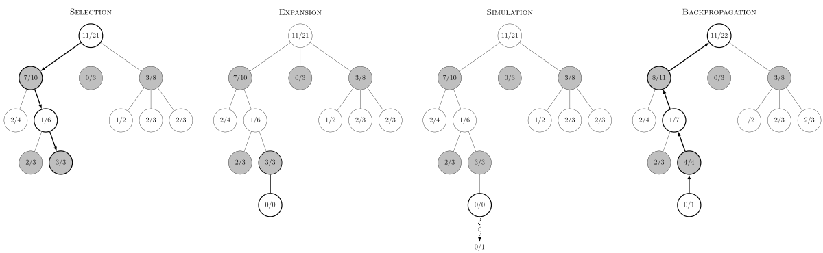
Monte Carlo tree search
Random/heuristic/net-policy/etc..
By some model of the environment

Slide 2
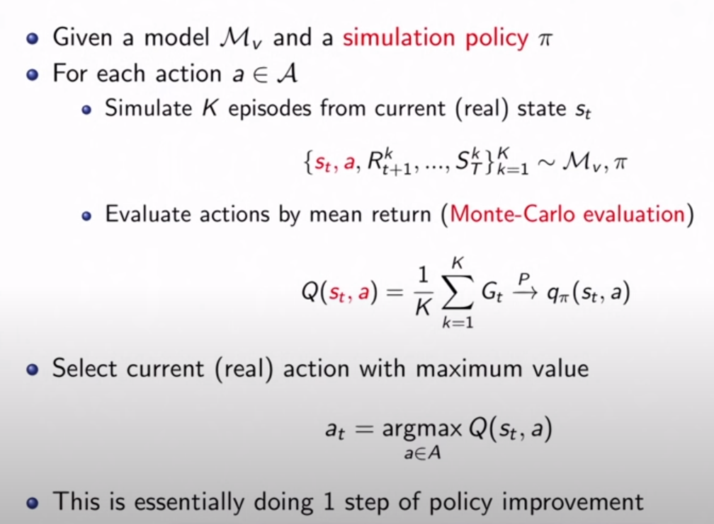

Problems in our unique case
The agents doesn’t have a model of the environment $M_{v}$.
Can be learned online
An agent doesn’t know the action space of the other agents.
We can’t grow a minimax tree
We can: treat the other-agent node as hidden node somehow?

Slide 3
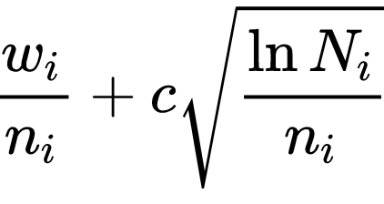
Implementing MCTS - Summary
The basic MCTS agent is planning with the following policies:
Tree policy: UCT
Roll-out policy: Random moves
Main parameters in the algorithm are:
Number of simulations
Simulations depth
Exploration constant
After implementing the algorithm, I’ve evaluated the results over the following parameter-sets:
Board size (N*N) – 5,10,15
Exploration constant: 0.5, 0.75, 1, 1.25, 1.5, 1.75, 2
*** The convergence achieved only when evaluating the MCTS agent as the zombie agent.

Slide 4
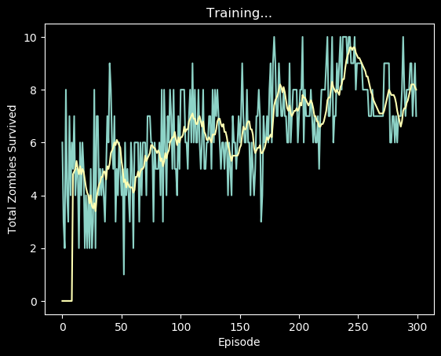
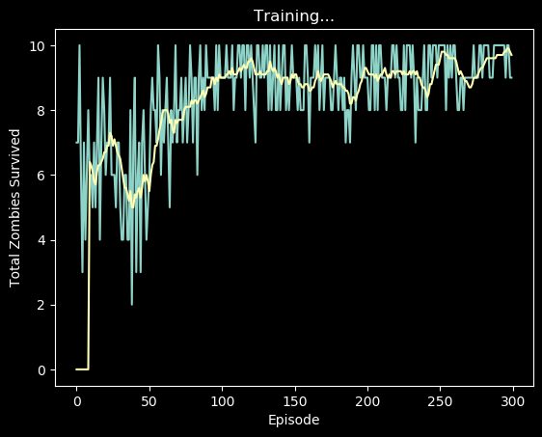
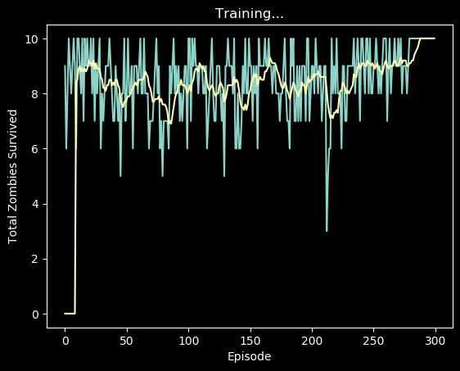
Best results over the param-sets
Board size: 5*5
Exploration rate: 1.5
Board size: 10*10
Exploration rate: 1.5
Board size: 15.*15
Exploration rate: 0.75
Shared parameters:
Light size: 3
Zombies per episode (maximum reward): 10
Number of simulations: 25
Simulation depth: 5 nir@afeka.ac.il

Slide 5
MCTS evaluation
Evaluation process of the MCTS algorithm:
Board sizes: 2x1 ; 4x2 ; 6x3 ; 8x4
Light sizes: 1 ; 2 ; 3 ; 4
Exploration rate 0 , 0.2 , 0.4 … 3.8 , 4
Best exploration rate | Light size | Board size
0.4 | 1 | 2x1
0.2 | 2 | 4x2
0.4 | 3 | 6x3
0.4 | 4 | 8x4

Slide 6
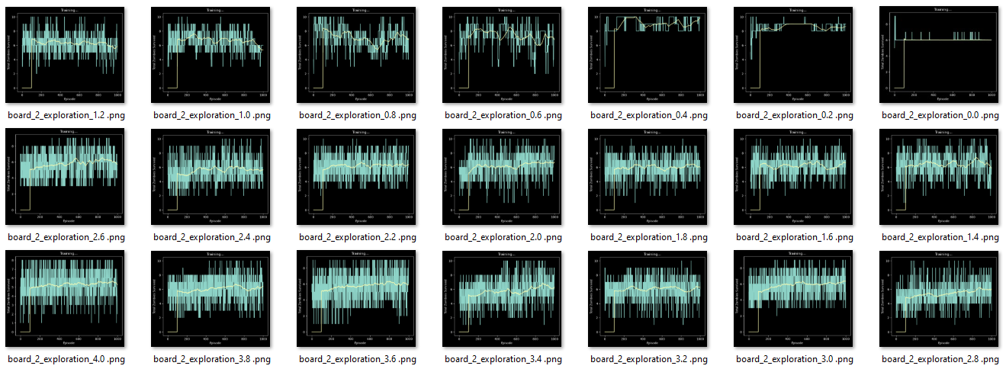
MCTS evaluation – Board size of 2x1

Slide 7
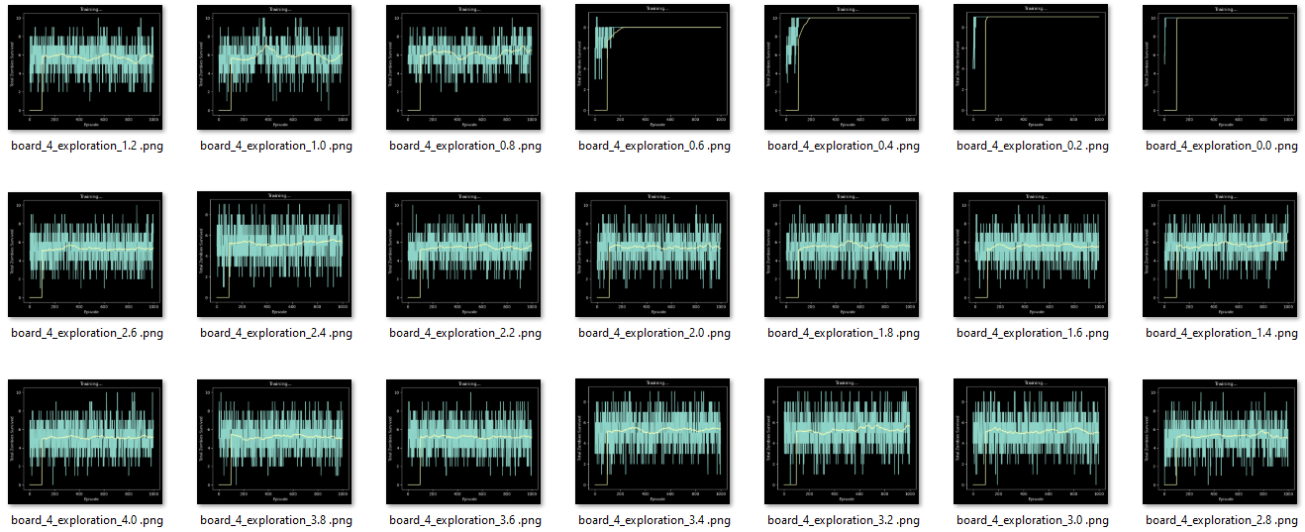
MCTS evaluation – Board size of 4x2

Slide 8
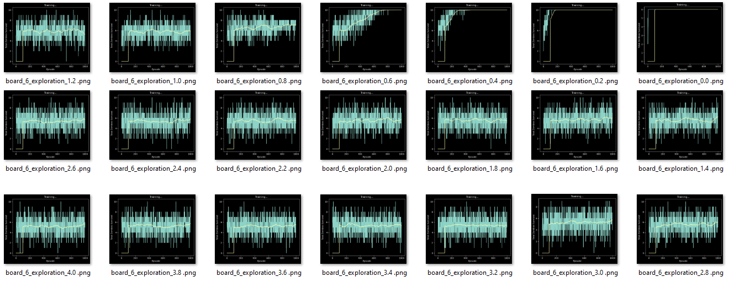
MCTS evaluation – Board size of 6x3

Slide 9
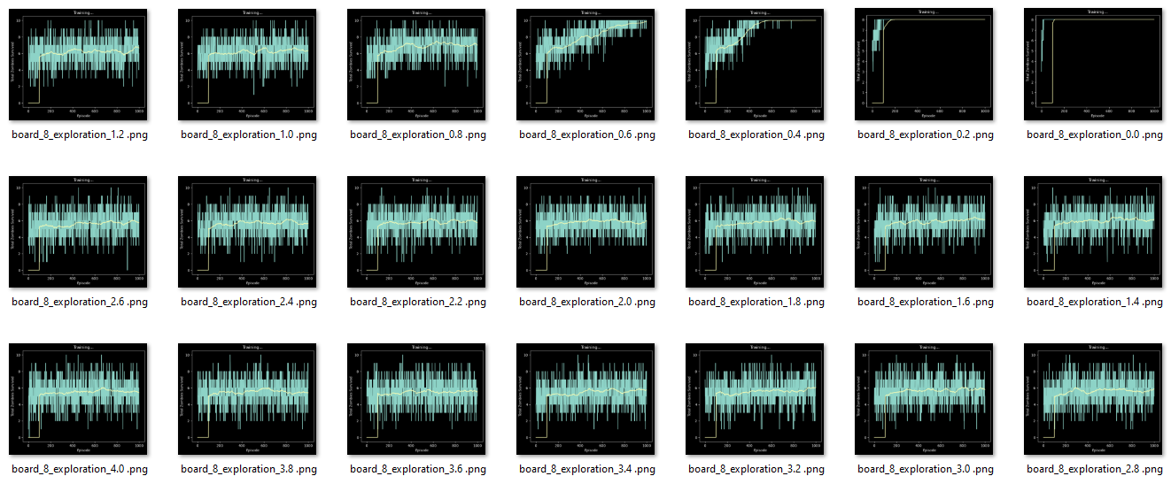
MCTS evaluation – Board size of 8x4

Slide 10
MCTS vs DDQN

Slide 11
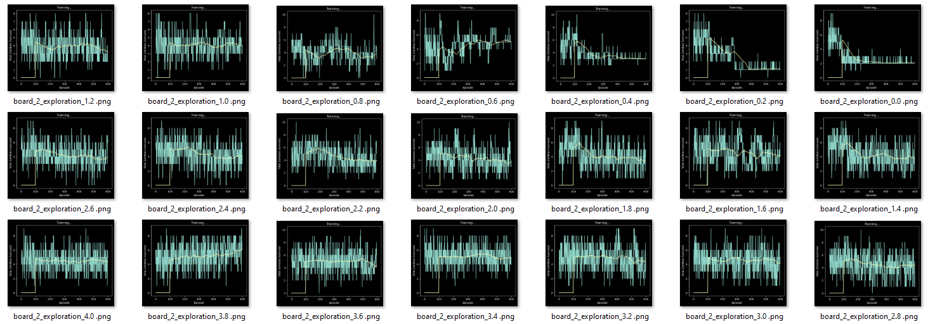
MCTS vs DDQN – Board size of 2x1

Slide 12
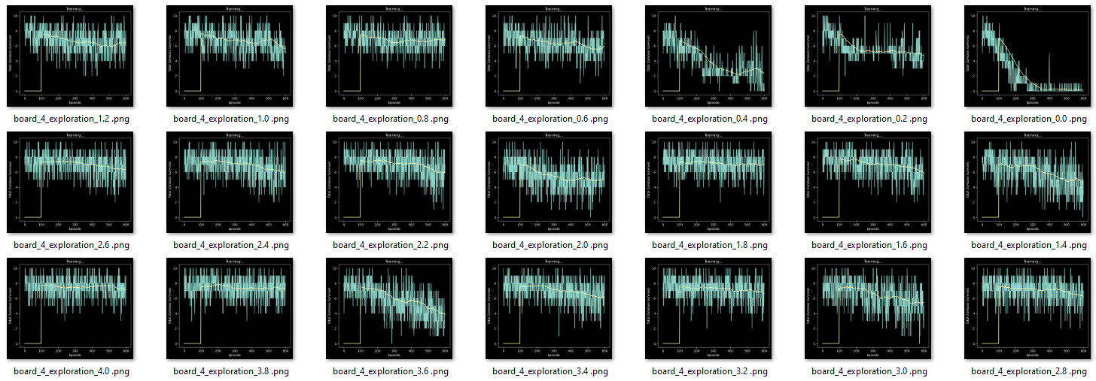
MCTS vs DDQN– Board size of 4x2

Slide 13
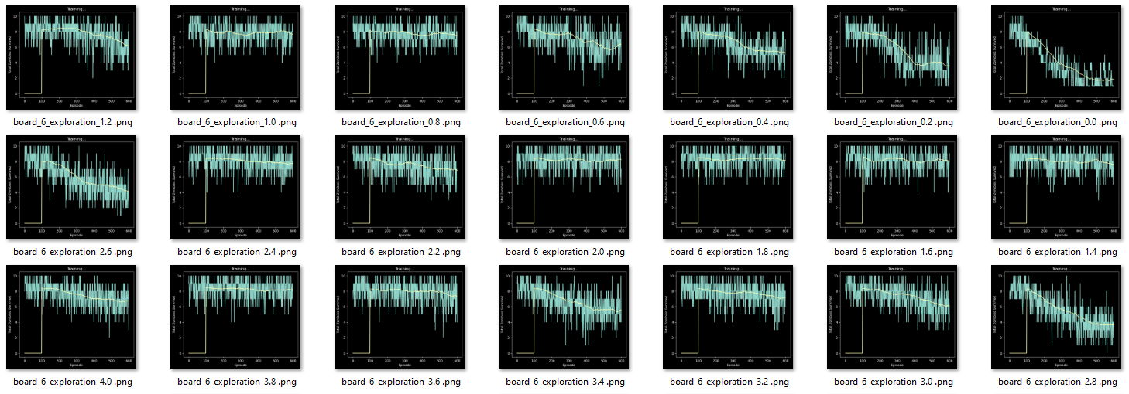
MCTS vs DDQN– Board size of 6x3

Slide 14
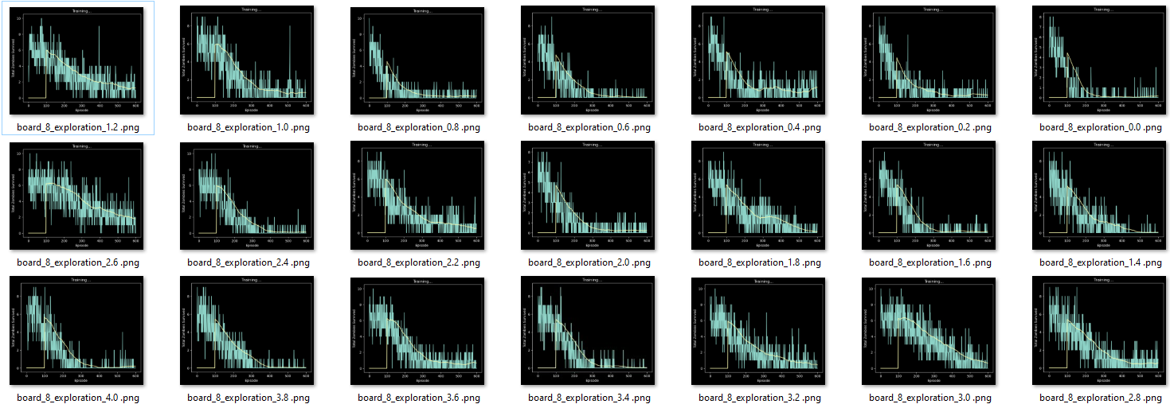
MCTS vs DDQN– Board size of 8x4

Slide 15
Focusing light action space
I’ve noticed that sometimes the light agent decides to place the light without hitting any zombies.
Although the light master knows where all the zombie at
Maybe we should constraint the light master to pick only the actions that include at least one zombie?

